Slide 1
Sortings in Python

Slide 2
Introduction to Sorting
Sorting is nothing but storage of data in sorted order, it can be in ascending or descending order.
The term Sorting comes into picture with the term Searching.
There are so many things in our real life that we need to search, like a particular record in database, roll numbers in merit list, a particular telephone number, any particular page in a book etc.
Sorting arranges data in a sequence which makes searching easier.
Every record which is going to be sorted will contain one key. Based on the key the record will be sorted.
For example, suppose we have a record of students, every such record will have the following data:
Roll No Name Age Class
Here Student roll no. can be taken as key for sorting the records in ascending or descending order.
Now suppose we have to search a Student with roll no. 15, we don't need to search the complete record we will simply search between the Students with roll no. 10 to 20.

Slide 3
Sorting Efficiency
There are many techniques for sorting. Implementation of particular sorting technique depends upon situation.
Sorting techniques mainly depends on two parameters.
First parameter is the execution time of program,(Time Complexity)
which means time taken for execution of program.
Second is the space(Space Complexity),
which means space taken by the program.

Slide 4
Types of Sorting Techniques
There are many types of Sorting techniques, differentiated by their efficiency and space requirements.
Following are some sorting techniques
Bubble Sort
Insertion Sort
Selection Sort
Quick Sort
Merge Sort
Heap Sort

Slide 5
Bubble Sort
Bubble Sort is an algorithm which is used to sort N elements that are given in a memory for a List with N number of elements.
Bubble Sort compares all the element one by one and sort them based on their values. It is called Bubble sort.
Because with each iteration the largest element in the list bubbles up towards the last place, just like a water bubble rises up to the water surface.
Sorting takes place by stepping through all the data items one-by-one in pairs and comparing adjacent data items and swapping each pair that is out of order.
In each Case it generate two parts of entire list , sorted and un sorted parts
OR
Bubble Sort is the simplest sorting algorithm that works by repeatedly swapping the adjacent elements if they are in wrong order.
Note:- it is slow sorting algorithm ,it as good as selection sort but bubble and selection sortings are slow sorting algorithms.

Slide 6
Sample Program & Tracing
Let's consider a List with values [5, 1, 6, 2]
i=0 j = 0 j=1 j=2 After 1st Pass
N -1→items
swap(5,1) No swap(5,6) swap(6,2)
i=1 j = 0 j=1 After 2nd Pass
N-2→items
No swap(1,5) swap(5,2)
i=2 j = 0 After 3nd Pass
N-3 →items
No swap(1,5) Final List
5
1
6
2
1
5
6
2
1
5
6
2
1
5
2
6
1
5
2
6
1
5
2
6
1
2
5
6
1
2
5
6
1
2
5
6

Slide 7
Tracing of the Bubble Sort
First Pass: ( 5 1 4 2 8 ) → ( 1 5 4 2 8 ), Here, algorithm compares the first two elements, and swaps since 5 > 1. ( 1 5 4 2 8 ) → ( 1 4 5 2 8 ), Swap since 5 > 4 ( 1 4 5 2 8 ) → ( 1 4 2 5 8 ), Swap since 5 > 2 ( 1 4 2 5 8 ) → ( 1 4 2 5 8 ), Now, since these elements are already in order (8 > 5), algorithm does not swap them.
Second Pass: ( 1 4 2 5 8 ) → ( 1 4 2 5 8 ) ( 1 4 2 5 8 ) → ( 1 2 4 5 8 ), Swap since 4 > 2 ( 1 2 4 5 8 ) → ( 1 2 4 5 8 ) ( 1 2 4 5 8 ) → ( 1 2 4 5 8 ) Now, the array is already sorted, but our algorithm does not know if it is completed. The algorithm needs one whole pass without any swap to know it is sorted.
Third Pass: ( 1 2 4 5 8 ) → ( 1 2 4 5 8 ) ( 1 2 4 5 8 ) → ( 1 2 4 5 8 ) ( 1 2 4 5 8 ) → ( 1 2 4 5 8 ) ( 1 2 4 5 8 ) → ( 1 2 4 5 8 )

Slide 8
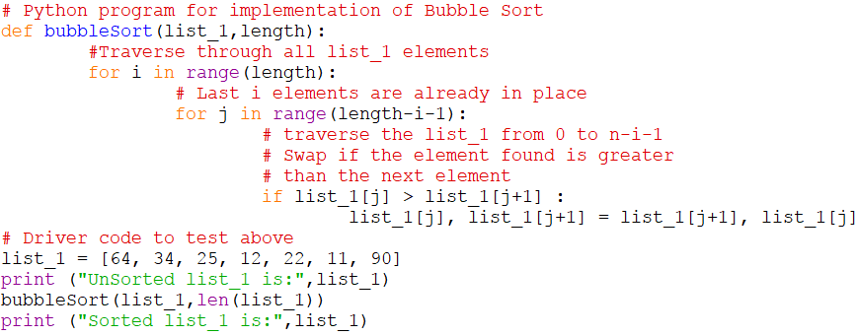
Example Program
Beside program to sort a list to using Bubble Sort.
Although the program of the logic will sort and unsorted list, still the beside program is not efficient because as per the logic of the program.
The for-loop will keep executing for five iterations even if the list gets sorted after the second iteration.

Slide 9
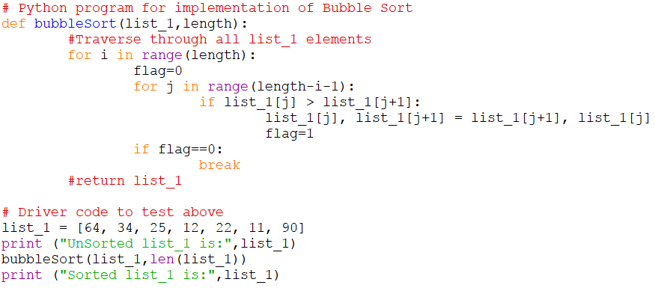
How to overcome the Redundancy of bubble sort
Hence we can insert a flag and can keep checking whether swapping of elements is taking place or not in the following iteration. If no swapping is taking place, it means the array or list is sorted and we can jump out of the for loop, instead executing all the iterations.
In the adjacent code, if in a complete single cycle of j iteration(inner for loop), if no swapping takes place, then flag will remain 0 and then we will break out of the for loops, because the array or list has already been sorted

Slide 10
Complexity Analysis of Bubble Sorting
In Bubble Sort, n-1 comparisons will be done in 1st pass, n-2 in 2nd pass, n-3 in 3rd pass and so on.
So the total number of comparisons will be (n-1)+(n-2)+(n-3)+.....+3+2+1
Sum = n(n-1)/2
i.e O(n²)
Hence the Worst and Average Case Time Complexity of Bubble Sort is O(n²).
The main advantage of Bubble Sort is the simplicity of the algorithm.
Space complexity for Bubble Sort is O(1), because only single additional memory space is required
i.e. for temp variable ,it is optional in python
Best-case Time Complexity will be O(n), it is when the list is already sorted.

Slide 11
Insertion Sort
Insertion sort is a sorting algorithm in which the elements are transferred one at a time to the right position.
Example :- Insertion sort is a simple sorting algorithm that works the way we sort playing cards in our hands.
Insertion sort is a simple Sorting algorithm which sorts the array or list by shifting elements one by one. Following are some of the important characteristics of Insertion Sort.
It has one of the simplest implementation
It is efficient for smaller data sets, but very inefficient for larger lists.
Insertion Sort is adaptive, that means it reduces its total number of steps if given a partially sorted list, hence it increases its efficiency.
It is better than Selection Sort and Bubble Sort algorithms.
Its space complexity is less. Like Bubble Sorting, insertion sort also requires a single additional memory space.
It is a Stable sorting, as it does not change the relative order of elements with equal keys

Slide 12
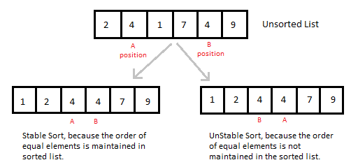
Stable sorting
It does not change the relative order of elements with equal keys

Slide 13
Sample Program & Tracing
Let's consider a List with values [5, 1, 6, 2]
5
1
6
2
Second element is the Value, therefore Value=1 is compared to 5 and inserted before 5
1
5
6
2
Value=6 is greater than 5 and 1 its still remains the same
1
5
6
2
Value=2 is less than 5, 6 and greater than 1 so its inserted after 1 and before 5
1
2
5
6
Final Sorted List

Slide 14
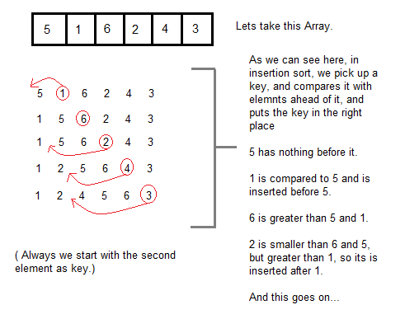
Sample Program & Tracing

Slide 15
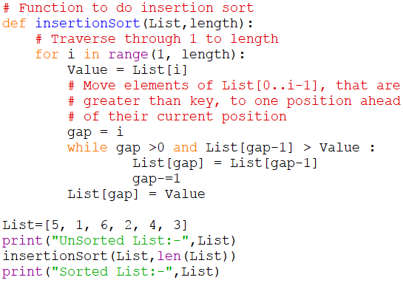
Sorting using Insertion Sort Algorithm
Now lets, understand the simple insertion sort algorithm. We took list with 6 integers. We took a variable Value, in which we put each element of the list, in each pass, starting from the second element, that is List[1].
Then using the while loop, we iterate, until j becomes equal to zero or we find an element which is greater than Value, and then we insert the key at that position.
In the above list, first we pick 1 as Value, we compare it with 5(element before 1), 1 is smaller than 5, we shift 1 before 5.
Then we pick 6, and compare it with 5 and 1, no shifting this time.
Then 2 becomes the key and is compared with, 6 and 5, and then 2 is placed after 1.
And this goes on, until complete list gets sorted.

Slide 16
Complexity Analysis of Insertion Sorting
Worst Case Time Complexity
T(n)=(c1+c3)(n-1)+{1+2+…….n-1}c2=(c1+c3)(n-1)+(n(n-1)/2)c2=a(n²)+bn+c
i.e, O(n²) when list is reverse order
Average Case Time Complexity also Big O of n² = O(n²)
Best-case Time Complexity
T(n)=(c1+c3)(n-1)=c1n+c3n-(c1+c3)=an+c=O(n)
it is when the list is already sorted.
Space complexity for Insertion Sort is O(1),
because only single additional memory space is required
Note:-
It is better than Selection Sort and Bubble Sort algorithms. Its space complexity is less.
Like Bubble Sorting, insertion sort also requires a single additional memory space.

Slide 17
Selection Sort
The selection sort algorithm sorts list by repeatedly finding the minimum element (considering ascending order) from unsorted part and putting it at the beginning. The algorithm or logic will maintains two sublists in a given list.
1) The sublist which is already sorted. 2) Remaining sublist which is unsorted.
In every iteration of selection sort, the minimum element (considering ascending order) from the unsorted subarray is picked and moved to the sorted sublist.
Selection sorting is conceptually the most simplest sorting algorithm. This algorithm first finds the smallest element in the list and exchanges it with the element in the first position, then find the second smallest element and exchange it with the element in the second position, and continues in this way until the entire list is sorted.
Note: Selection sort is an unstable sort i.e it might change the occurrence of two similar elements in the list while sorting.
But it can also be a stable sort when it is implemented using linked list data structures.

Slide 18
Sample Program & Tracing
Let's consider a List with values [3, 6, 1, 8, 4, 5]
Original List Before Sorting
the smallest element found is 1, so it is placed at the first position, then leaving the first element,
3
6
1
8
4
5
1
6
3
8
4
5
After 1st Pass next smallest element is searched from the rest of the elements. We get 3 as the smallest, so it is then placed at the second position,
1
3
6
8
4
5
After 2nd Pass Then leaving 1 and 3, we search for the next smallest element from the rest of the elements (4) and put it at third position
1
3
4
8
6
5
After 3rd Pass Then leaving 1 ,3,4 and search for next smallest 5 put it at 4th position
1
3
4
5
6
8
After 4rd Pass Then leaving 1 ,3,4 ,5and search for next smallest 6 put it at 5th position
3
6
1
8
4
5
After 5th Pass

Slide 19
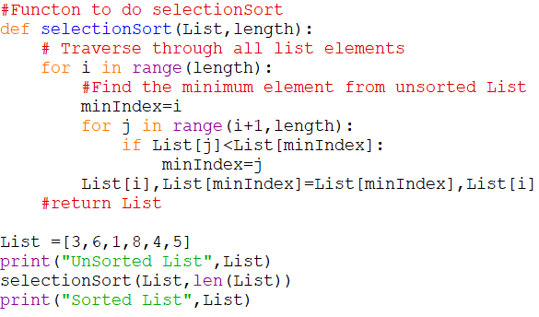
Sorting using Selection Sort Algorithm
In the first pass, the smallest element found is 1, so it is placed at the first position, then leaving the first element.
Next smallest element is searched from the rest of the elements. We get 3 as the smallest, so it is then placed at the second position.
Then leaving 1 and 3, we search for the next smallest element from the rest of the elements and put it at third position
Keep doing this until list is sorted.

Slide 20
Complexity Analysis of Selection Sorting
Worst Case Time Complexity
T(n)=c1(n-1)+(n(n-1)/2)c2+c3(n-1)=a(n²)+bn+c
i.e, O(n²) when list is reverse order
Average Case Time Complexity also Big O of n² = O(n²)
Best-case Time Complexity = = O(n²)
Note:-
It is slow sorting algorithm ,but bubble and selection sortings are slow sorting algorithms

