Slide 1
Data Formats

Slide 2

Introduction
Data: Information in raw or organized form
The internal representation must be appropriate for the type of processing to take place
Example :-
text, images, sound)
Real World
Computer
Data
Input device
Data
RGUKT NUZ
Keyboard
10110010…
Digital camera
10110010…

Slide 3
Why Standards? & Examples of Standards
Standard are “arbitrary”
They exist because they are
Convenient
Efficient
Flexible
Appropriate
Etc.
Type of Data | Standards
Alphanumeric | ASCII, EBCDIC, Unicode
Image | JPEG, GIF, PCX, TIFF
Motion picture | MPEG-2, Quick Time
Sound | Sound Blaster, WAV, AU
Outline graphics/fonts | PostScript, TrueType, PDF

Slide 4
Standard Alphanumeric Formats
Four standards for representing letters (alpha) and numbers
BCD – Binary-coded decimal (4bits )
ASCII – American standard code for information interchange (8 bits)
EBCDIC – Extended binary-coded decimal interchange code
Unicode (16bits)
Distinguishing between the number 123 (one hundred and twenty-three) and the characters “123” (one, two, three)

Slide 5
Binary-Coded Decimal (BCD)
Four bits per digit
7093₁₀ = ? (in BCD)
Digit | Bit pattern
0 | 0000
1 | 0001
2 | 0010
3 | 0011
4 | 0100
5 | 0101
6 | 0110
7 | 0111
8 | 1000
9 | 1001
Note
The following bit patterns are not used:
1010 1011 1100 1101 1110 1111
7 0 9 3
0111 0000 1001 0011

Slide 6
What is ASCII ?
ASCII is an acronym for American Standard Code for Information Interchange
Its structure is a 7 bit code (8th bit is unused ie a parity bit or an “extended” bit in some implementations)
ASCII can represent 128 symbols (2⁷ symbols) have two general types of codes:
95 are “Graphic” codes (displayable on a console)
33 are “Control” codes (control features of the console or communications channel)
It is important to be able to represent text in binary form as information is entered into a computer via a keyboard
Text may be encoded using ASCII and ASCII can represent:
Numerals
Letters in both upper and lower cases
Special “printing” symbols such as @, $, %, etc.
Commands that are used by computers to represent carriage returns, line feeds, etc

Slide 7
ASCII
It is a standard seven-bit code that was first proposed by the American National Standards Institute or ANSI in 1963, and finalized in 1968 as ANSI Standard X3.4.
The purpose of ASCII was to provide a standard to code various symbols ( visible and invisible symbols)
In the ASCII character set, each binary value between 0 and 127 represents a specific character.
Most computers extend the ASCII character set to use the full range of 256 characters available in a byte. The upper 128 characters handle special things like accented characters from common foreign languages
In general, ASCII works by assigning standard numeric values to letters, numbers, punctuation marks and other characters such as control codes.
An uppercase "A," for example, is represented by the decimal number 65."

Slide 8
Bytes: ASCII
By looking at the ASCII table, you can clearly see a one-to-one correspondence between each character and the ASCII code used.
For example, 32 is the ASCII code for a space.
We could expand these decimal numbers out to binary numbers (so 32 = 00100000), if we wanted to be technically correct -- that is how the computer really deals with things.
Computers store text documents, both on disk and in memory, using these ASCII codes.
For example, if you use Notepad in Windows XP/2000 to create a text file containing the words, "Four score and seven years ago," Notepad would use 1 byte of memory per character (including 1 byte for each space character between the words -- ASCII character 32).
When Notepad stores the sentence in a file on disk, the file will also contain 1 byte per character and per space.
Binary number is usually displayed as Hexadecimal to save display space.

Slide 9
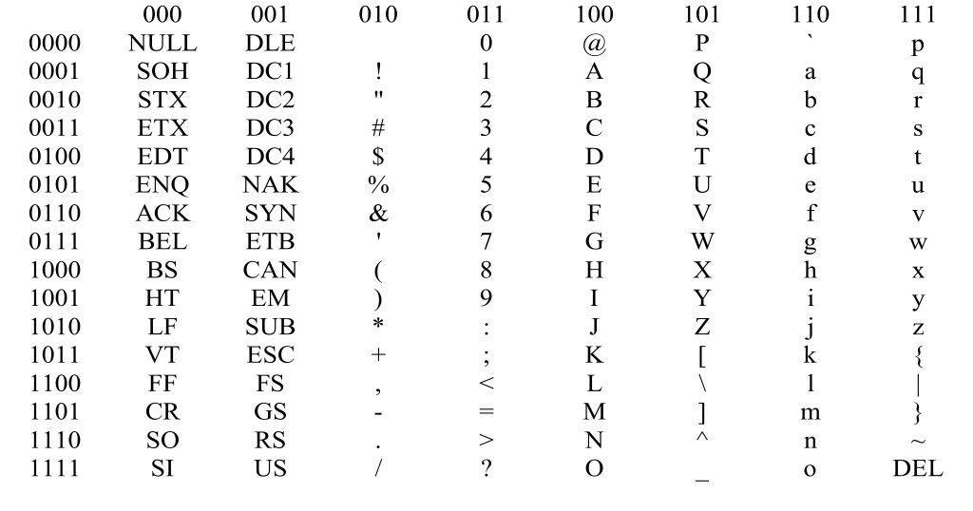
ASCII Chart in Binary Format
0 1 2 3 4 5 6 7
0
1
2
3
4
5
6
7
8
9
10
11
12
13
14
15

Slide 10
ASCII Chart in Binary Format
e.g., ‘a’ = 1100001
Most significant bit
Least significant bit

Slide 11
95 Graphic Codes in ASCII

Slide 12
33 Control Codes in ASCII

Slide 13
ASCII - Alphabetic & Numeric Codes

Slide 14
ASCII - Punctuation, etc Codes

Slide 15
Hello World Example
H
e
l
l
o
,
w
o
r
l
d
=
=
=
=
=
=
=
=
=
=
=
=
Binary
01001000
01100101
01101100
01101100
01101111
00101100
00100000
01110111
01100111
01110010
01101100
01100100
=
=
=
=
=
=
=
=
=
=
=
=
Hexadecimal
48
65
6C
6C
6F
2C
20
77
67
72
6C
64
=
=
=
=
=
=
=
=
=
=
=
=
Decimal
72
101
108
108
111
44
32
119
103
114
108
100

Slide 16
Common Control Codes
CR 0D carriage return
LF 0A line feed
HT 09 horizontal tab
DEL 7F delete
NULL 00 null
Hexadecimal code

Slide 17
ASCII - Hexadecimal Codes

Slide 18
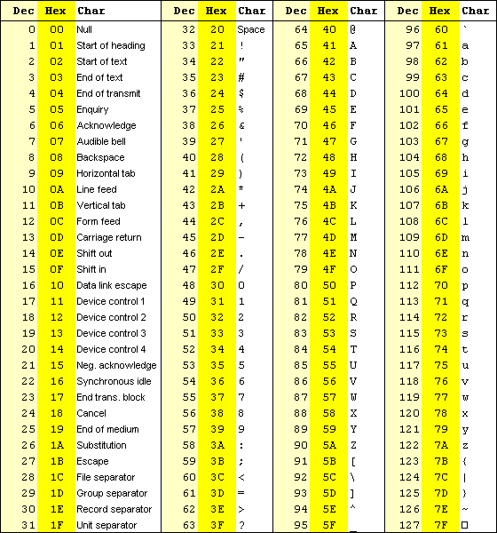
ASCII Chart in Decimal and Hex
This ASCII chart illustrates Decimal and Hex representation of numbers, text and special characters
Hex can be easily converted to binary
Upper case D is 44₁₆
4₁₆ is 01002
Upper case D is then 0100 0100 in binary

Slide 19
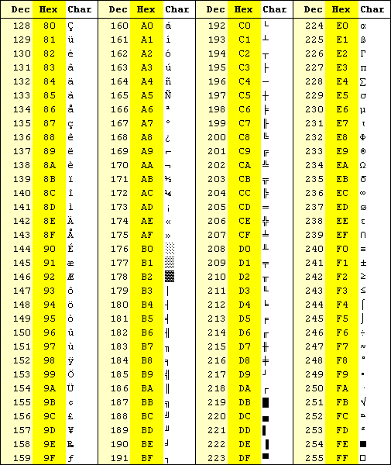
Extended ASCII Chart in Decimal and Hex
Another example:
You want to represent the Yen sign (¥)
From the table: 9D
9₁₆ = 9₁₀ = 10012
D₁₆ = 13₁₀ = 11012
The ¥ sign in binary is: 1001 1101

Slide 20
ASCII conversion example
Let us convert You & I, to decimal, hex and binary using the ASCII code table :
Y: 89₁₀ 59₁₆ 1011001₂
o: 111₁₀ 6F₁₆ 1101111₂
u: 117₁₀ 75₁₆ 1110101₂
Space: 32₁₀ 20₁₆ 0100000₂
&: 38₁₀ 26₁₆ 0100110₂
Space: 32₁₀ 20₁₆ 0100000₂
I: 73₁₀ 49₁₆ 1001001₂
,: 44₁₀ 2C₁₆ 0101100₂
You & I, in Hex:
59 6F 75 20 26 20 49 2C
You & I, in decimal:
89 111 117 32 38 32 73 44
You & I, in binary:
1011001 1101111 1110101 0100000 0100110 0100000 1001001 0101100

Slide 21
revisit “char” data type
In C, single characters are represented using the data type char, which is one of the most important scalar data types.
char achar;
achar=‘A’;
achar=65;
A character and an integer (actually a small integer spanning only 8 bits) are actually indistinguishable on their own.
If you want to use it as a char, it will be a char, if you want to use it as an integer, it will be an integer, as long as you know how to use proper C++ statements to express your intentions.
Finally in Python we don’t worry about data type it will automatically assign itself and choose ASCII Codes based on the assignment.
Example :- ch=‘H’ here H is character in python based on single quotation mark

Slide 22


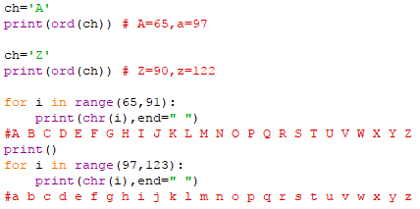
The ord() function returns ASCII code of the character.
The chr() function returns character represented by a ASCII number.
Write a program to print Alphabet using ASCII Numbers ?

Slide 23
Comparing Strings
Python allows you to compare strings using relational(or comparison) operator such as >, <, < =, < =,etc.
== if two strings are equal ,it returns True → ‘Abc’ ==‘Abc’ →True
!= or <> if two strings are not equal, it returns True → ‘AbC’ != ‘ABC’ →True
> if first string is greater than the second ,it returns True → “abc”>”Abc” →True
< if second string is greater than the first ,it returns True → “abC”<”abc” →True
>= if first string is greater than or equal to the second ,it returns True → “aBC”>=”ABC”→True
<= if second string is greater than or equal to the first ,it returns True → “ABc”<=”ABc”→True
Note:
These operators compare the strings by using the lexicographical order i.e using ASCII values of the characters.
The ASCII values of A-Z is 65 -90 and ASCII code for a-z is 97-122 .

