Slide 1

Healthcare Analytics for Doctor Visits_TIRTC
Durga Prasad Pampana
Adikavi Nannaya University College of Engineering

Slide 2

PROBLEM STATEMENT
To analyze doctor visit patterns and identify how factors such as age, gender, income, illness, health status, healthcare access, and chronic conditions influence healthcare utilization.
Goal: Generate data-driven insights to understand which patient groups have higher doctor visits and support better healthcare planning.

Slide 3
Project Description
This project uses Python, Pandas and data visualization to analyze visit patterns. It explores how illness, health status, age groups, and chronic conditions are associated with healthcare utilization. The insights help hospital management understand patient needs and identify opportunities to improve healthcare services.

Slide 4

WHO ARE THE END USERS?
Doctors & Healthcare Professionals – Understand patient visit patterns.
Hospitals & Clinics – Improve resource and staff planning.
Healthcare Administrators – Monitor healthcare utilization.
Government & Public Health Organizations – Identify healthcare needs across different groups.
Researchers & Data Analysts – Study healthcare trends and patterns.

Slide 5

Technology Used
Python – Data analysis and processing
Pandas – Data cleaning, manipulation, and analysis
NumPy – Numerical computations
Matplotlib – Data visualization and charts
Seaborn – Statistical visualization and correlation analysis
Google Colab– Development and analysis environment
Excel/CSV – Dataset storage and input

Slide 6
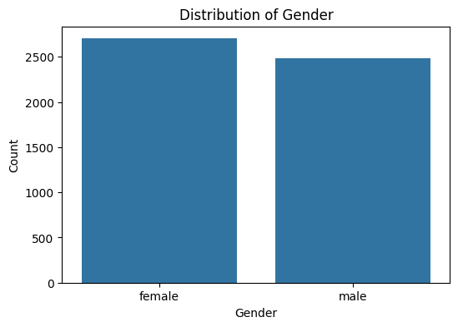
RESULTS
Demo Link

Slide 7
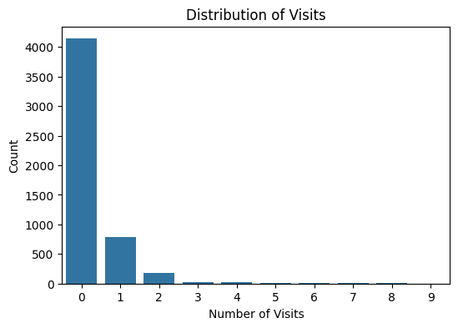
RESULTS
Demo Link

Slide 8
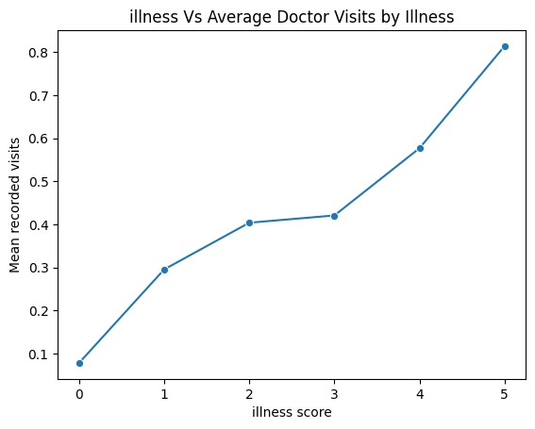
RESULTS
Demo Link

Slide 9
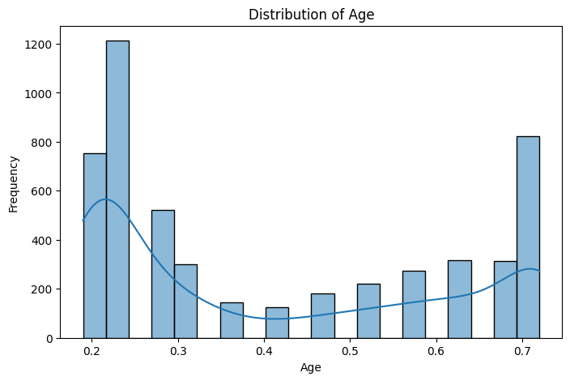
RESULTS
Demo Link

Slide 10
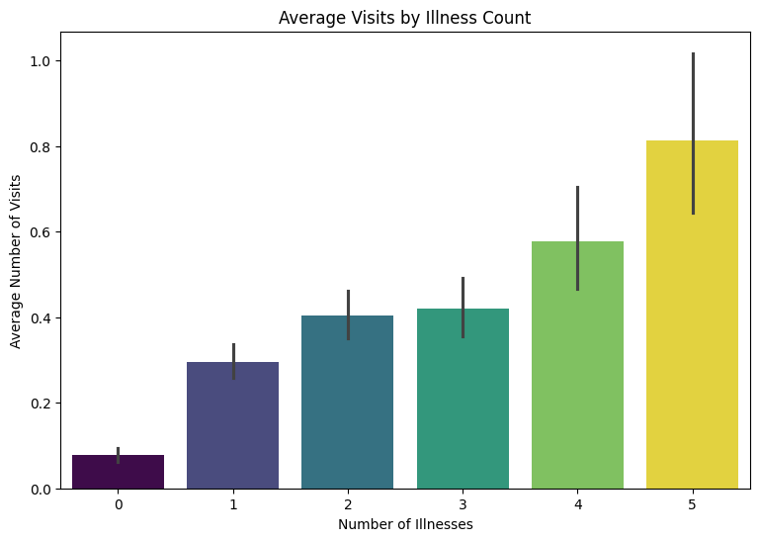
RESULTS
Demo Link

Slide 11
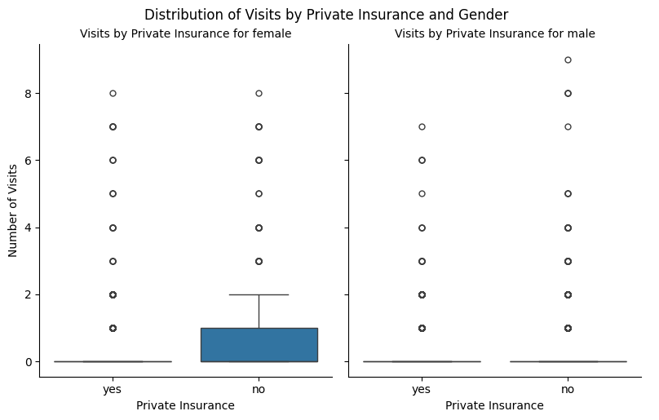
RESULTS
Demo Link

Slide 12
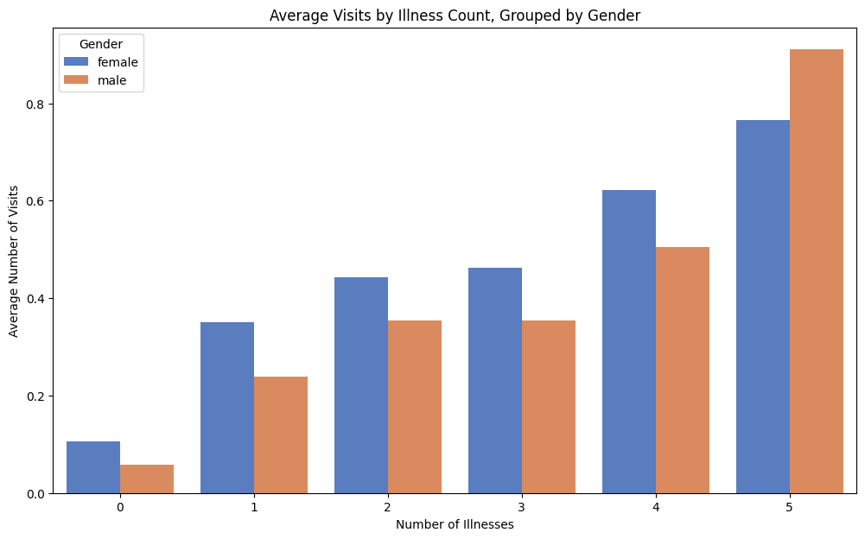
RESULTS
Demo Link

Slide 13
Thank you
.
.

