Slide 1

BANKING ANALYTICS
GROUP 3
Pooja
Prasad
Sowmya
Supriya
Dushyant

Slide 2
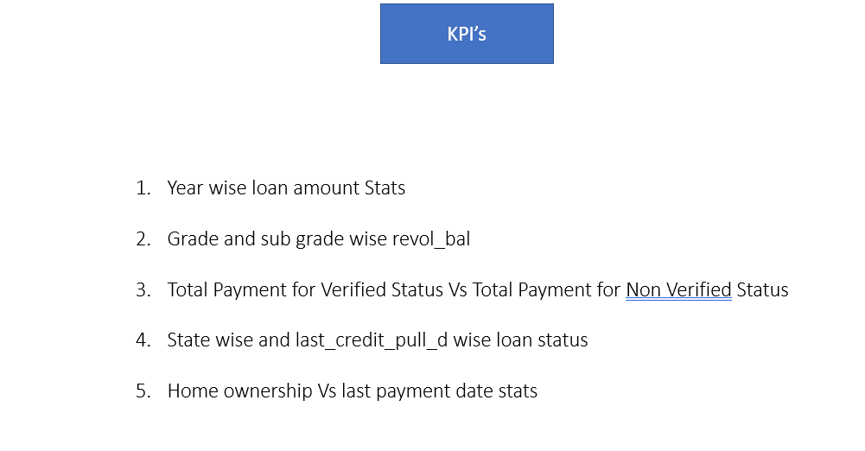

Slide 3
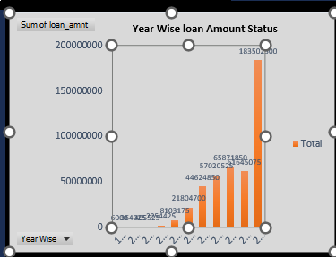
Year wise loan amount Stats
The bar chart showing the year-wise loan amounts from 1900 to 2016. Here are some observations from the data:
Significant Growth in Recent Years:
  There is a noticeable increase in loan amounts from 2010 onwards.
Gradual Increase:
  The loan amounts show a steady increase from 2007 to 2016, indicating a trend of growing loan amounts over the years.
Low Amounts in Early Years:
  The loan amounts before 2007 are significantly lower, with only 6,000 in 1900 and modest increases in 2007, 2008, and 2009.
Year 2016 Peak:
  The peak in loan amounts in 2016 suggests that there was either a significant increase in demand for loans or a policy change that led to higher loan disbursements.

Slide 4
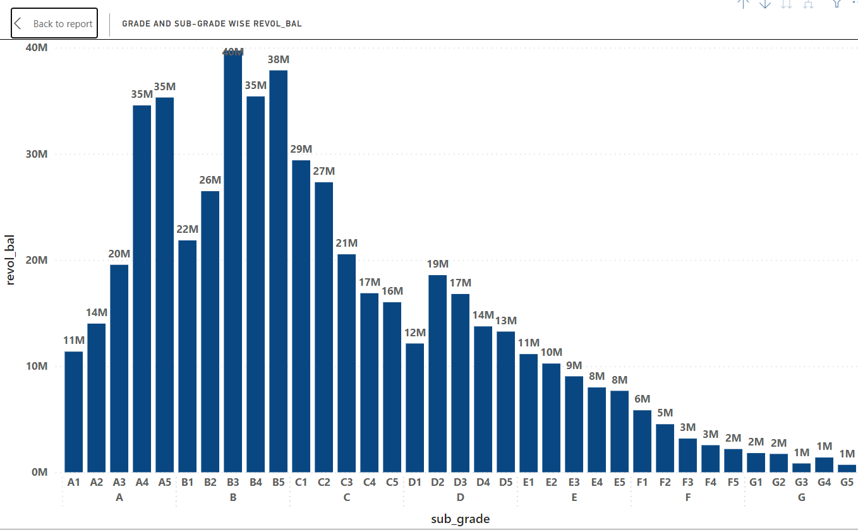
Grade and sub grade wise revol_bal
"Grade and sub-grade wise revol_bal" shows the distribution of revolving balances (revol_bal) across different credit risk categories, with grades indicating broad risk levels (A to G) and sub-grades offering finer segmentation (A1, A2, etc.).
This bar chart displays the revolving balance (revol_bal) by grade and sub-grade. Key observations:
Peak at B3: The highest revol_bal is in sub-grade B3 at 40M.
Descending Trend: revol_bal generally decreases from sub-grade B3 through to G5.Clustered Peaks: Significant peaks are observed in sub-grades A5, B3, and C1.
Lowest Balances: Sub-grades F5, G1 to G5 show the lowest revol_bal values, all around 1M.

Slide 5
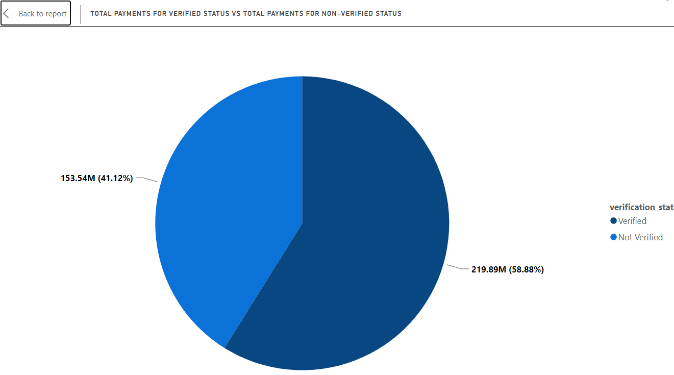
Total Payment for Verified Status Vs Total Payment for Non-Verified Status
The pie chart shows the total payments categorized by verification status. Here are the key points to highlight in your presentation:
The chart compares payments for "Verified" and "Not Verified" statuses.
Verified payments total 219.89 million, which represents 58.88% of the total payments.
Not Verified payments total 153.54 million, which represents 41.12% of the total payments.
The majority of payments are for verified statuses.
This information could be useful for understanding the distribution of payments based on verification status, indicating a preference or trend towards verified payments.

Slide 6
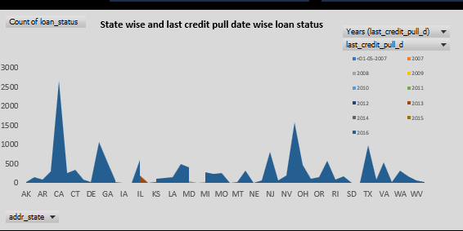
State wise and last_credit_pull_d wise loan status
State-wise Distribution:
  Each state (e.g., CA, NY, TX) has different counts of loans, indicating varying levels of loan activity across the states.
  For example, California (CA) has higher counts in multiple years compared to other states.
Year-wise Distribution:
  The columns represent the number of loans pulled in specific years, from 2001 to 2015.
  Notable peaks are observed in certain years, indicating higher loan activities during those periods.
Grand Total:
  The grand total of loan counts across all states and years is 39,778.
Summary: This data provides insight into: Geographical distribution of loan activities across states. Temporal trends in loan activities over the years. Helps identify regions and periods with higher loan demands. This information can be used for strategic decision-making, resource allocation, and identifying market trends in the loan industry.

Slide 7
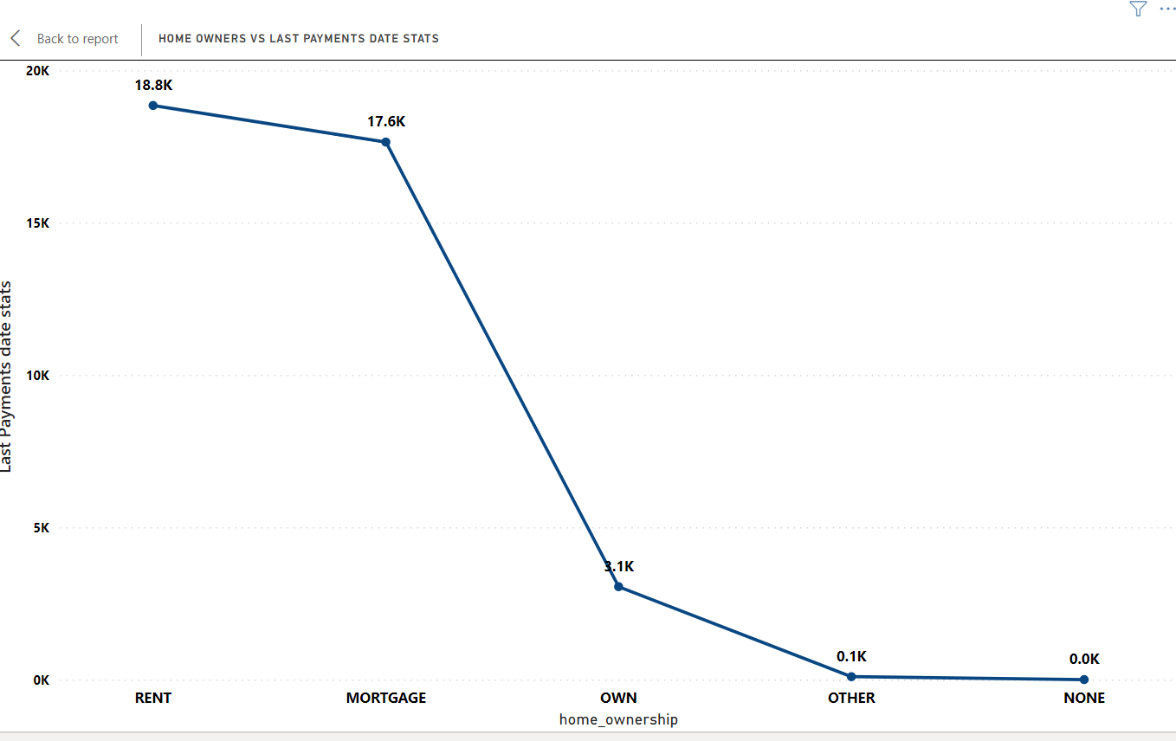
Home ownership Vs last payment date stats
Home Ownership vs. Last Payment Date Stats
Rent: 18.8K last payments, indicating high payment activity among renters.
Mortgage: 17.6K last payments, showing significant activity among mortgage holders.
Own: 3.1K last payments, reflecting less frequent transactions for fully owned homes.
Other: 0.1K last payments, minimal impact from this category.
None: 0.0K last payments, no reported payment activity.
Key Insight: The data reveals a high payment frequency for renters and mortgage holders, with a sharp decline for fully owned homes. Minimal activity in "Other" and "None" categories.

