Slide 1

Enhanced Marks Management System
This project develops a user-friendly desktop app for managing student marks. It targets teachers, school admins, and staff.
Palla Durga Prasad - AP22110011422
Merugu Jagan Venkat - AP22110011396
Gorripati Hemanth - AP22110011383
Yerukala Shashi Kanth - AP22110011380
Gnana Manjari Munuswamy – AP22110011473

Slide 2
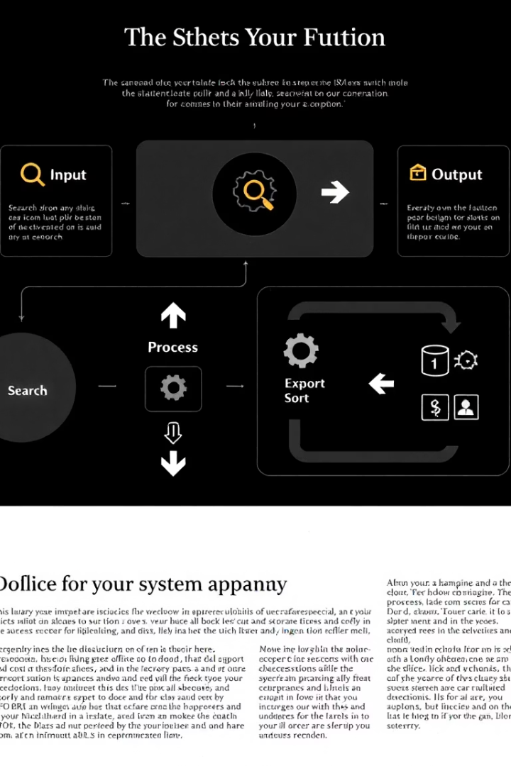
Project Overview
Core Features
Target Users
Search, add, update, delete student records
Teachers
School Administrators
Export results to CSV files
Academic Staff
Sort and rank students by total marks
Technology Stack
Java with Swing for UI
Oracle Database backend
JDBC connectivity

Slide 3

System Design
Frontend
Backend
Interaction
Architecture Pattern
Java Swing GUI using JFrame, JTabbedPane, JTable components
Oracle Database stores student and marks data securely
JDBC enables robust communication between UI and database
MVC pattern: Model (StudentRecord), View (GUI), Controller (Events)

Slide 4
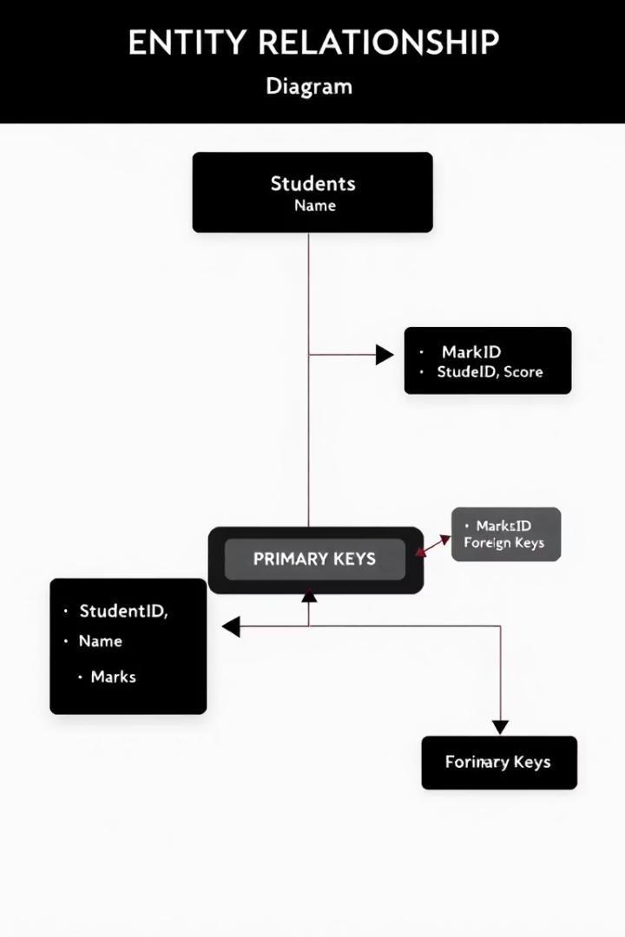
Database Structure
Table
Fields
Students
student_id (PK), roll_number, name, class_name
Marks
mark_id (PK), student_id (FK), subject, marks_obtained
Auto-increment sequences handle IDs. One student has multiple subject marks.

Slide 5
GUI Design
Tab 1: Search & View
Tab 2: Add/Edit Student
Features
Contains search fields and JTable showing results
Form layout for entering student details and marks
Responsive design using GridBagLayout and GridLayout
Status bar for real-time feedback to users
Nimbus look and feel for modern UI

Slide 6
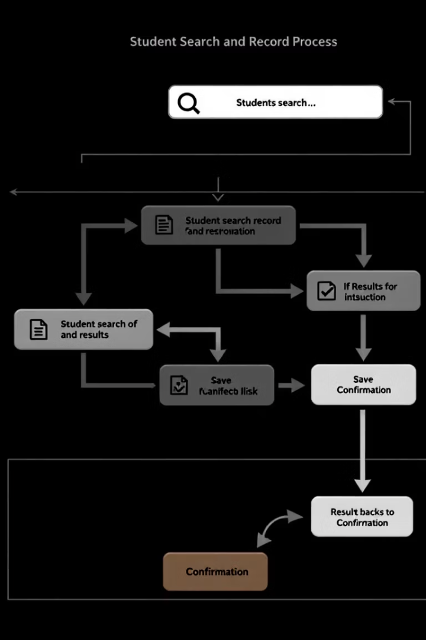
Key Features
Search
Filter by roll number, name, class, subject, or marks
Add/Edit
Insert or update student details plus marks
Delete & Sort
Remove records; rank students by total marks
Export & Validation
Save filtered results as CSV; validate inputs (0–100 marks)

Slide 7

Code Highlights
1
Database Operations
2
Event Handling
ActionListeners for buttons, ListSelectionListener for table rows
JDBC with PreparedStatement for secure SQL execution
3
Data Processing
StudentRecord class encapsulates data and sorting logic

Slide 8
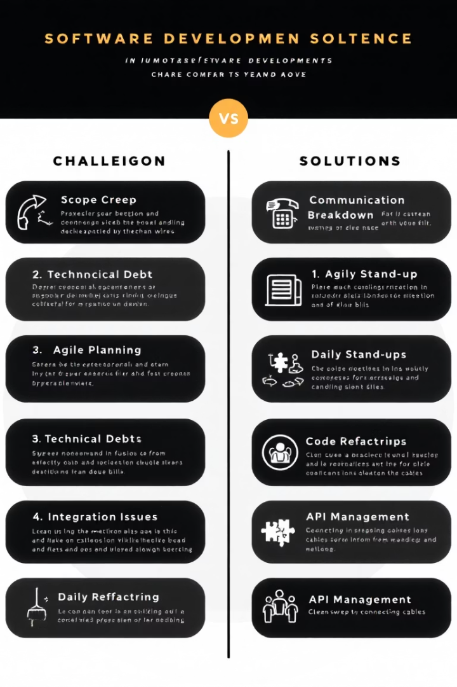
Development Challenges
Challenge
Solution
Flexible SQL query building
Use StringBuilder with parameterized queries
Database transaction management
Implement commit control with setAutoCommit(false)
Ranking with tied scores
Custom ranking algorithm in processResults()
Responsive UI layout
Leverage GridBagLayout for flexible component arrangements

Slide 9






Potential Improvements
Multiple Academic Sessions
Support marks management across different school years
User Authentication
Role-based access to secure data and features
Graphical Reports
Interactive charts for marks distribution and analysis
Bulk CSV Import
Efficient student data import from external files
Web Application
Move to Java Spring for web-based access
Email Notifications
Automatic alerts on result updates and deadlines

Slide 10
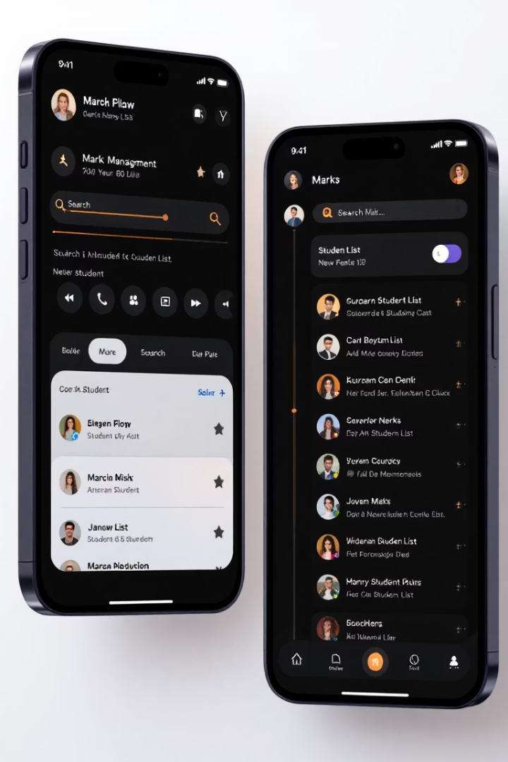
Summary and Demo
Project Recap
User-friendly tool managing student marks with powerful features
Key Learnings
Java Swing UI development
JDBC database connectivity
SQL query optimization
Demo Highlights
Showcase search, add, edit, and export functionalities

