Slide 1
Seasonal Agriculture
Performance Analysis
VOIS AICTE Batch 1 | Major Project 2026–2027
Yield • Profitability • Resource Efficiency • Environmental Conditions
4,000
28
3
8
8
Farm records
Variables
Seasons
Crops
States
Student Name: SUMANT PRASHANT GHANTEWAR
College Name: Central University of Andhra Pradesh
AICTE STU ID: STU69e4ae330f40d1776594483
1

Slide 2
Problem Statement
Why this analysis matters
• Agricultural performance changes with season, weather, farm practices, resource availability, and market conditions.
• Raw data alone does not clearly reveal how Kharif, Rabi, and Zaid differ in yield, efficiency, risk, and profitability.
• The project analyzes seasonal patterns, relationships, variations, and unusual observations in the supplied agricultural dataset.
Core Question
How does agricultural performance vary across Kharif, Rabi, and Zaid?
2

Slide 3
Project Description
Scope, objectives, and analytical approach
Dataset Scope
Project Objectives
• 4,000 farm records × 28 original variables
• 3 seasons: Kharif, Rabi, Zaid
• 8 crops and 8 states
• Environmental, soil, irrigation, input, production, and financial variables
• Clean and validate the data
• Compare seasonal performance
• Analyze crop × season combinations
• Study irrigation and resource-use patterns
• Test seasonal differences statistically
• Convert evidence into practical recommendations
Analysis Dimensions
• Yield & production
• Profitability
• Water efficiency
• Disease/pest risk
Method: EDA → group comparisons → correlation → Kruskal–Wallis testing
3

Slide 4
Who Are the End Users?
Farmers
Agricultural Planners
Extension Officers
Season and crop planning
Evidence-based seasonal decisions
Field advisory support
Government / Policy Makers
Researchers
Agri-business / Analysts
Program and resource planning
Pattern and risk investigation
Market and performance insights
These are potential users of the analytical insights; the supplied dataset does not describe an already-deployed system.
4

Slide 5
Technology Used
Python
Jupyter Notebook
Pandas
NumPy
Core analysis
Reproducible workflow
Cleaning & aggregation
Numerical operations
Matplotlib
SciPy
GitHub
PowerPoint
Visualizations
Statistical testing
Code repository
Final presentation
Complete workflow: Data → Cleaning → Exploration → Statistical Analysis → Insights → Presentation
5

Slide 6
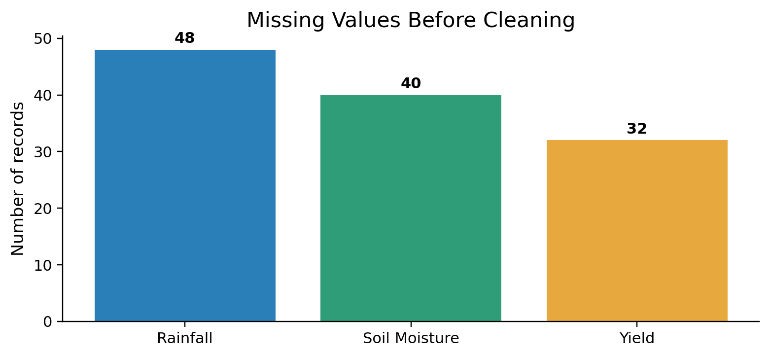
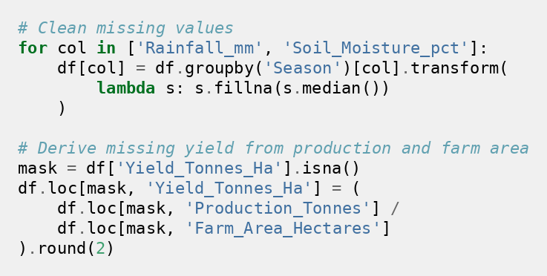
Data Preparation & Quality Checks
4,000
28
0
120
Records
Variables
Duplicates
Missing cells
Cleaning: season-median imputation for rainfall/soil moisture; missing yield reconstructed from Production ÷ Farm Area. Final missing values = 0.
6

Slide 7
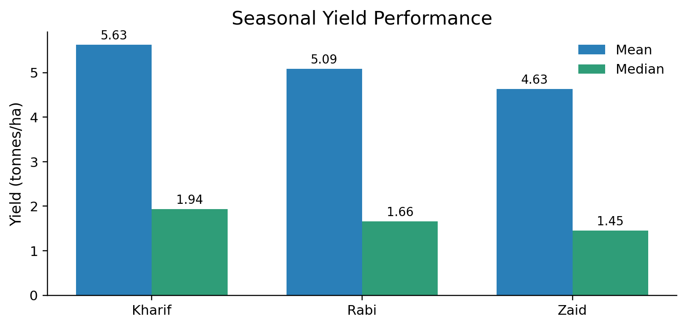
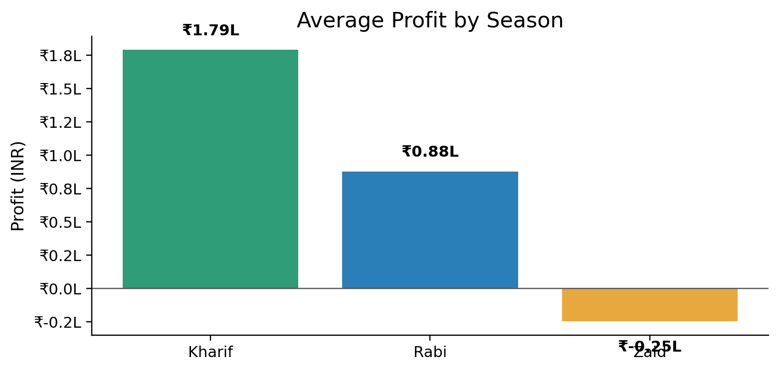
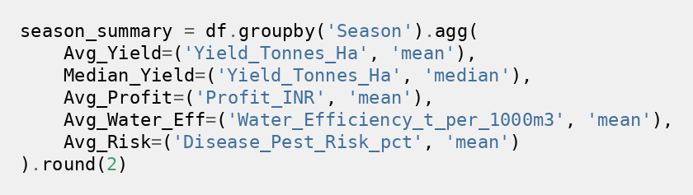
Results — Seasonal Performance
Kharif 5.63 t/ha
Kharif ₹1.79L
Zaid –₹24.8K avg.
Highest average yield
Highest avg. profit
Weakest economics
Key takeaway: Kharif leads both yield and profitability; Zaid is negative on average in this dataset.
7

Slide 8
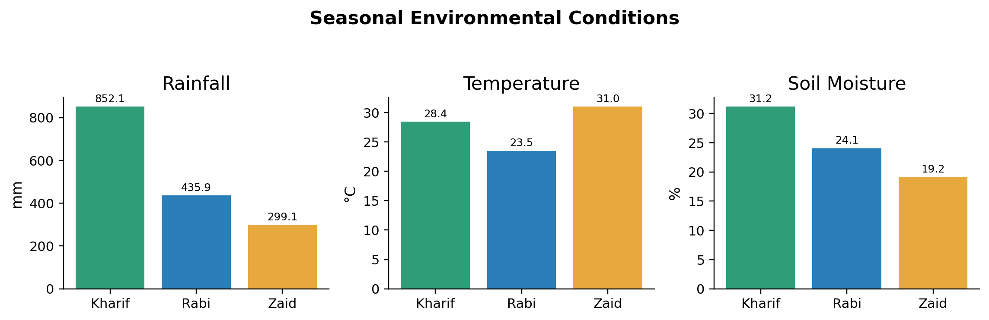
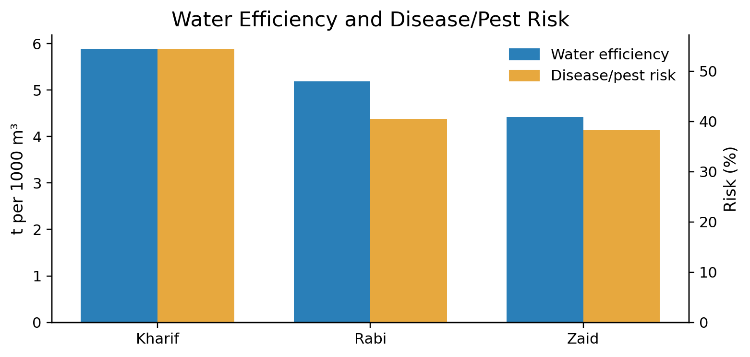
Results — Environment & Resource Efficiency
Seasonal profile
• Kharif: 852 mm rain, 31.2% soil moisture, 54.5% risk
• Zaid: hottest (31.0°C), driest, lowest water efficiency
• Fertilizer/pesticide use is comparatively stable across seasons
8

Slide 9
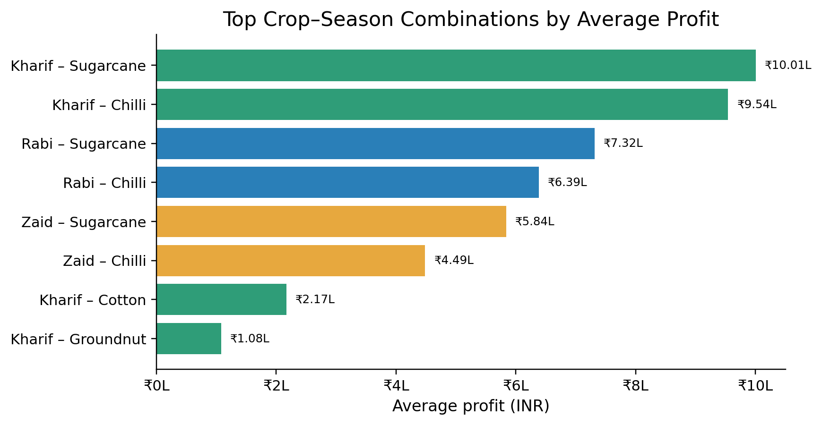
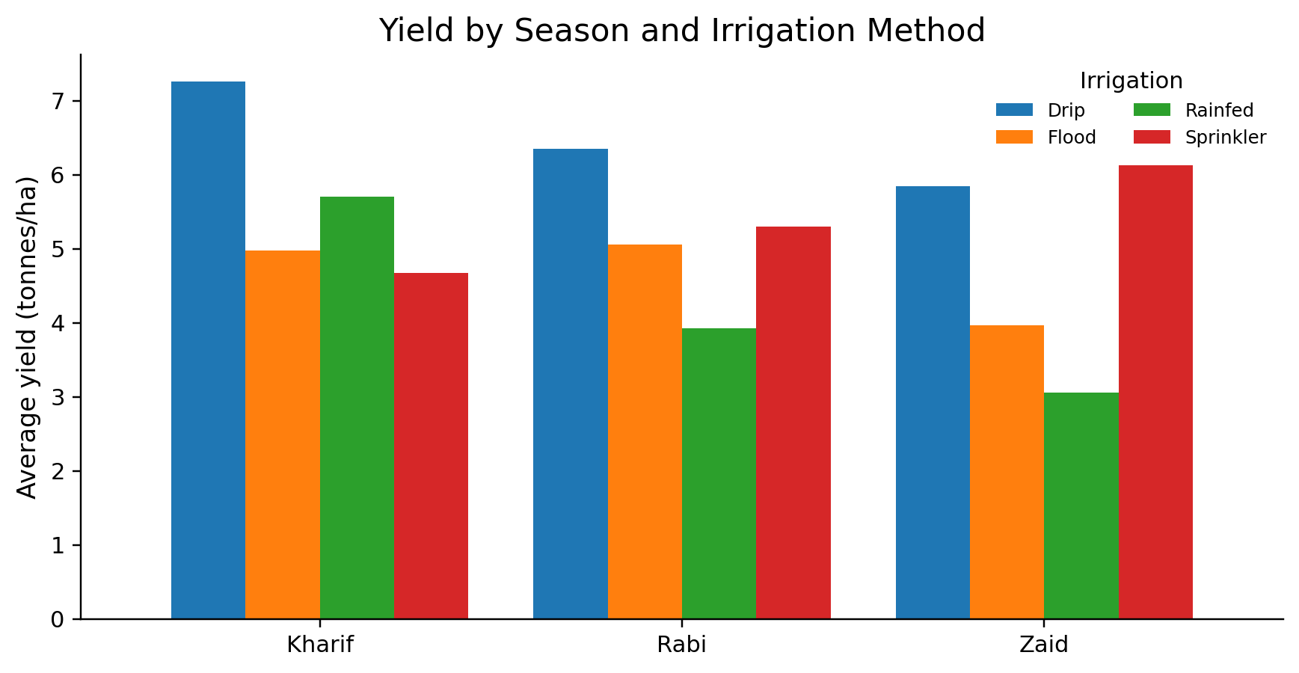
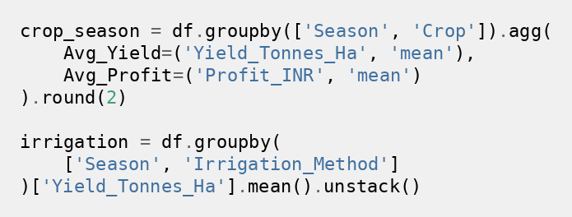
Results — Crop × Season & Irrigation
Kharif Sugarcane: 53.46 t/ha and ~₹10.01L average profit. Drip leads yield/profit in Kharif & Rabi; Sprinkler leads these metrics in Zaid.
Market value matters: Chilli is highly profitable despite much lower physical yield.
9

Slide 10
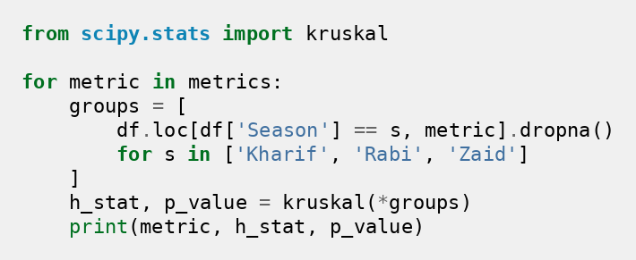
Results — Statistical Evidence & Key Insights
Kruskal–Wallis Seasonal Tests
Relationships & Interpretation
Metric
H
p-value
• Yield ↔ Water efficiency: r = 0.916
• Yield ↔ Profit: r = 0.490
• Yield ↔ Rainfall overall: r = 0.027
• Seasonal averages are influenced by crop mix; use crop-level context
• Correlation indicates association, not causation
Yield
70.59
<0.001
Profit
101.93
<0.001
Water efficiency
56.81
<0.001
Disease/pest risk
1430.91
<0.001
All four seasonal differences are statistically significant at α = 0.05.
Planning implication
Balance yield + profitability + water efficiency + pest/disease risk rather than optimizing yield alone.
10

Slide 11
Future Scope
Multi-year data
Weather + satellite data
Separate one-season effects from long-term climate and market trends.
Add real-time rainfall, temperature, vegetation, and soil indicators.
Predictive models
Regional recommendations
Forecast yield, profit, water demand, and pest/disease risk.
Build state/district/crop-specific planning guidance.
Interactive dashboard
Scenario analysis
Enable decision-makers to filter season, crop, region, and irrigation.
Test changes in market price, input cost, rainfall, and climate conditions.
11

Slide 12
GitHub Repository
Add your repository URL here after uploading the project
prasadgh400-cmyk/Seasonal-Agriculture-Performance-Analysis
12

Slide 13

VOIS Course Completion Certificate
Course: Data Visualization
INSERT CERTIFICATE HERE
13

Slide 14
Thank You
Seasonal Agriculture Performance Analysis
Final takeaway
Better seasonal planning balances yield, profitability, water efficiency, and agricultural risk.
Sumant Prashant Ghantewar | Central University of Andhra Pradesh | AICTE STU ID: STU69e4ae330f40d1776594483
14

