Slide 1


Department of Computer Science and Engineering
SMART PARKING SYSTEM INTEGRATING IOT SENSORS
Supervisor
Dr.K.Anandhajothi, M.E.,Ph.D,
Professor
Batch ID - B21A2425C34
PRASADH C - 210701191
KARTHICK RAJA K - 210701505

Slide 2
Problem Statement and Motivation
Traditional parking systems face challenges such as inefficient space utilization, manual processes, long wait times, and limited monitoring capabilities, leading to user frustration and operational inefficiencies. With increasing urbanization and vehicle usage, the demand for smarter solutions has grown. The motivation for developing the Smart Parking System lies in leveraging advancements in technology, such as ANPR, IoT sensors, and digital payments, to address these issues. This system aims to reduce time spent searching for parking, enhance user convenience, minimize environmental impact through lower emissions, and optimize revenue for parking lot owners. By providing real-time monitoring, automated processes, and seamless payment options, it supports the vision of modern, scalable, and efficient urban infrastructure.

Slide 3
Objectives
The main objectives of the Smart Parking System project are to automate parking space management using ANPR technology for vehicle license plate recognition, allocate parking slots based on real-time availability through IoT sensors, and provide vehicle owners with SMS notifications containing parking details and payment links. The system aims to offer commercial vehicles a QR code for easy slot selection and payment, ensure the automated exit process by verifying payments before opening the gate, and provide a web-based dashboard for administrators to monitor slot usage, track payments, and analyze system performance, ultimately optimizing parking space usage and improving overall efficiency.

Slide 4
Abstract
Parking management in city and commercial areas is terribly inefficient and prompt largely by difficulty in space usage, bulky manual processes, and inconvenience to its end users. This project proposes a Smart Parking System that incorporates state-of-the-art technologies such as ANPR, IoT sensors, and SMS messages to overcome those difficulties. The entry of the vehicle is automated using ANPR license plate scanning and based on the real-time availability from IoT sensors provides dynamic allocation of slots. It sends the details of the slot and the payment link to the users' SMS. For commercial vehicles, a QR code facilitates slot selection and payment. A web-based dashboard empowers parking operators to track slot occupancy, monitor payments, and oversee system performance.

Slide 5
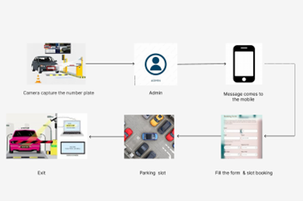
System Architecture

Slide 6
List of Modules
ANPR (Automatic Number Plate Recognition)
ModuleParking Slot Allocation Module
Web-Based Dashboard Module
Database Module

Slide 7
Explanation of Modules
The ANPR (Automatic Number Plate Recognition) Module is responsible for scanning and recognizing vehicle license plates at the entry and exit points of the parking facility. Using high-resolution cameras and specialized software, it captures the vehicle’s number plate and processes it through optical character recognition (OCR) to extract the alphanumeric characters. The system then matches the recognized plate with available parking slots in the database, records the entry time, and grants access to the vehicle.

Slide 8
Explanation of Modules
2. The Parking Slot Allocation Module is responsible for dynamically managing and assigning parking spaces to vehicles based on availability. This module uses data from IoT sensors embedded in each parking spot to monitor real-time occupancy. When a vehicle enters the parking area, the system checks for available slots and automatically allocates an empty space. The slot allocation is communicated to the ANPR system, which updates the vehicle's details in the database, including the assigned slot.

Slide 9
Explanation of Modules
3. The Web-Based Dashboard Module provides a centralized platform for system administrators to monitor and manage the entire smart parking system. This module displays real-time data on parking slot availability, vehicle entry and exit logs, payment status, and system performance metrics. The dashboard allows administrators to track which parking spots are occupied, view detailed information about vehicles (e.g., license plate, slot number), and oversee payment transactions.

Slide 10
Explanation of Modules
4. The Database Module serves as the backbone for storing and managing all data related to the Smart Parking System. It handles the storage of essential information such as vehicle details (license plates, vehicle numbers), parking slot availability, transaction records, payment status, and system logs. The database ensures seamless integration between various modules, such as the ANPR system, parking slot allocation, and payment processing.

Slide 11
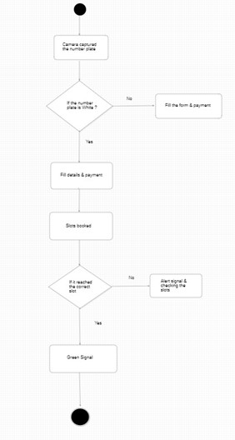
Activity Diagram

Slide 12
Conclusion & Work for Phase II
The Smart Parking System, as designed and implemented in Phase I, successfully integrates Automatic Number Plate Recognition (ANPR), IoT sensors, and SMS notifications to provide an efficient and automated solution for parking space management. The system enhances user convenience by automating entry, slot allocation, and exit processes while optimizing parking space usage. Real-time monitoring through IoT sensors and a web-based dashboard ensures effective management of parking resources.
Smart Parking System will focus on enhancing system functionality by integrating advanced features such as support for commercial vehicles with QR code-based slot selection and payment, incorporating multiple payment methods including credit cards and mobile wallets, and integrating AI to predict parking availability based on data patterns. Additionally, a mobile app will be developed for users to reserve and pay for parking via their smartphones, and security will be strengthened through encryption and secure access controls. Scalability and performance optimization will be prioritized to ensure the system can handle larger parking areas and higher traffic efficiently, making the solution more robust and user-friendly for real-world applications.

Slide 13
References
Z. Huang et al., "Convolutional Neural Network Based on Complex Networks for Brain Tumor Image Classification With a Modified Activation Function," in IEEE Access
R. Agarwal, S. D. Pande, S. N. Mohanty and S. K. Panda, "A Novel Hybrid System of Detecting Brain Tumors in MRI," in IEEE Access.
M. S. Majib, M. M. Rahman, T. M. S. Sazzad, N. I. Khan and S. K. Dey, "VGG-SCNet: A VGG Net-Based Deep Learning Framework for Brain Tumor Detection on MRI Pictures," in IEEE Access.
A. A. Asiri, T. A. Soomro, A. A. Shah, G. Pogrebna, M. Irfan and S. Alqahtani, "Optimized Brain Tumor Detection: A Dual-Module Approach for MRI Image Enhancement and Tumor Classification," in IEEE Access
M. F. Almufareh, M. Imran, A. Khan, M. Humayun and M. Asim, "Automated Brain Tumor Segmentation and Classification in MRI Using YOLO-Based Deep Learning," in IEEE Access,

Slide 14
Paper Publication Status
Preparing the paper for the conference submission, awaiting acceptance.

Slide 15
Thank You

