Slide 1

Machine Learning – Term 3
- Seshathri S

Slide 2
Problem statement
The problem statement of this project is to determine the price of the house using the data set provided.
The dataset contains multiple factors that contributes to the increase/decrease of the house price.
In this project, we will be exploring the dataset and build models using machine learning algorithms to predict the price of the house

Slide 3

Given dataset
1460 records
81 columns (one target and 80 independent variable)
Contains both categorical and continuous variables

Slide 4
Pre processing data
Removed columns that have less than 1000 records
Replaced missing categorical value with mode value
Replaced missing continuous value with mean value
Encoded the categorical values

Slide 5
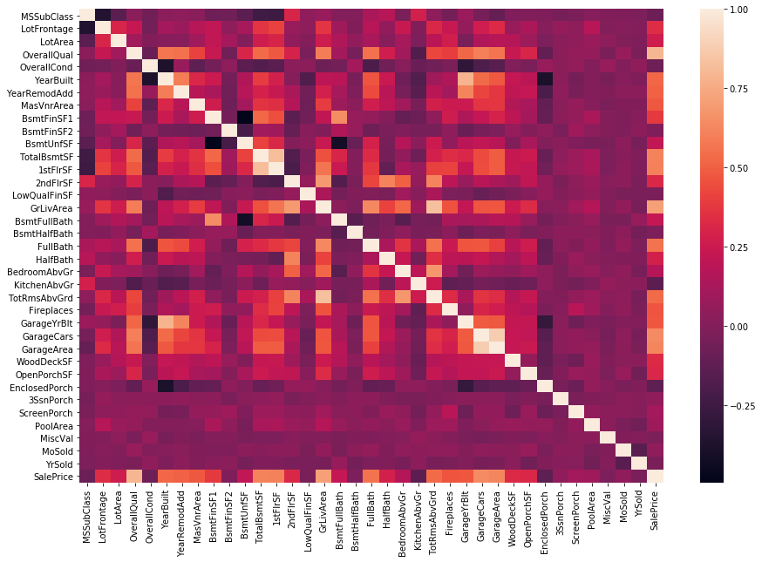
Heat map on continuous data

Slide 6
Training models
Decision tree and Random forest algorithms are used
Multiple parameters like the test size, scaled data, Grid Search, Randomized Search
Multiple test sizes are used (0.15, 0.2, 0.25, 0.3, 0.35, 0.4)

Slide 7
Results
48 models were generated
Results were compared with MAE, MSE, RMSE, MSLE and R-squared values
Time taken for each model to train and test were also calculated

Slide 8
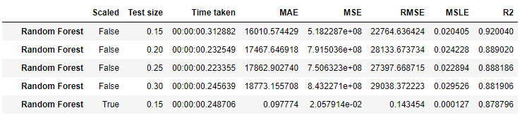
Conclusion
The random forest model with the test size of 0.15 has the highest accuracy score of 92%
The same model has an accuracy score of 88% for other test sizes (0.2, 0.25, 0.3)
Top 5 accurate models

Slide 9
Thank you!!!!

