Slide 1

Capstone Project – Movie Rental Analysis

Slide 2
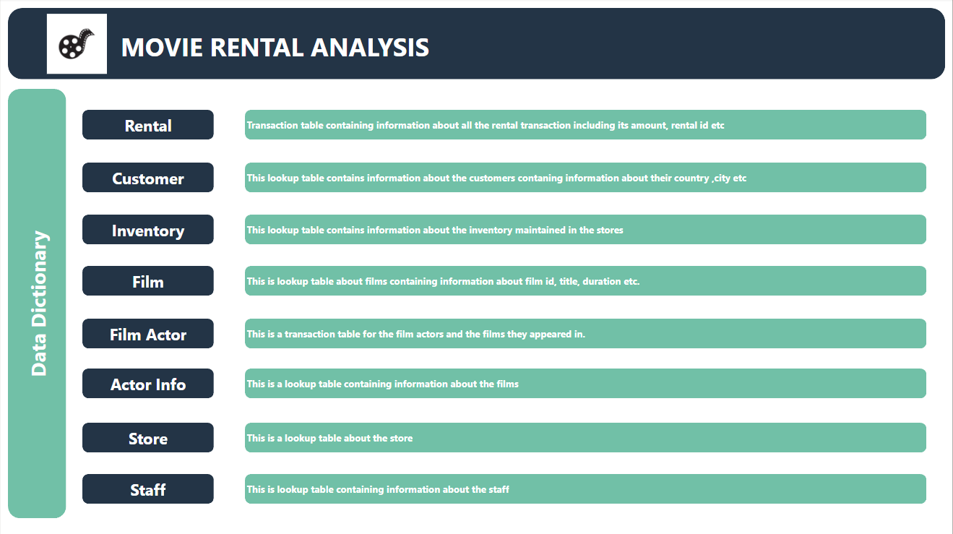

Slide 3

Exploring Movie Rental Analysis
Movie Rental Analysis would guide the business to analyze the business trends and guide to determine the further strategy.
Performance across different countries
Historical Trends
Limitations and better utilization of resources

Slide 4
Project Objective
The purpose of the project is to uncover patterns, trends, and factors that impact the sales and volume of the movie rental business.
By gaining valuable insights from the analysis, strategies can be developed to enhance sales and volume while reducing operational costs for the business.

Slide 5
Approach:
- Source and Clean Movie Rental Data
- Explore Patterns Through Visualization
- Analyse Factors Impacting Business
- Address Limitations and Biases

Slide 6
Key Findings and Insights:
- Correlation Between Factors and Sales, Rentals
- Strategies to Mitigate Biases
- Enhancing Decision-Making in growing business

Slide 7
The project will involve the following tasks:
Performing a comprehensive analysis of movie rental analysis, including variations across systems,
key factors influencing sales, historical trends, and the impact of limitations and biases on rentals and sales.
Deriving meaningful conclusions and recommendations for improving business growth.
Compiling analysis results, conclusions, and recommendations for stakeholders.
The success of the project will be measured by the following metrics:
The quality of the analysis
The relevance of the insights
The impact of the recommendations
This project is significant because it has the potential to improve the sales of the business and help it grow worldwide.

Slide 8
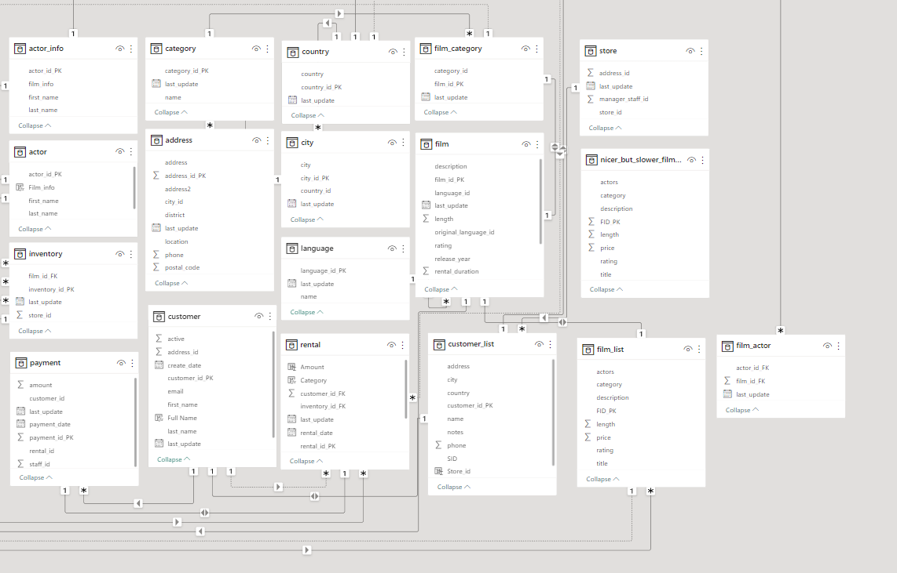
ER Diagram

Slide 9
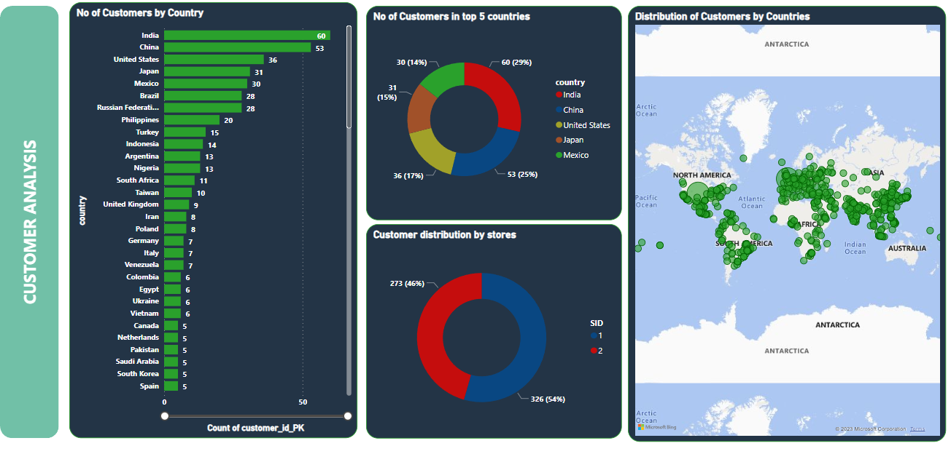

Slide 10
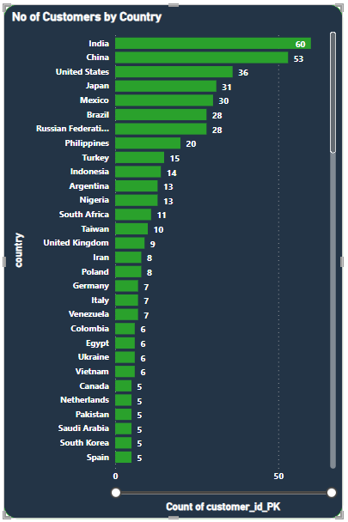
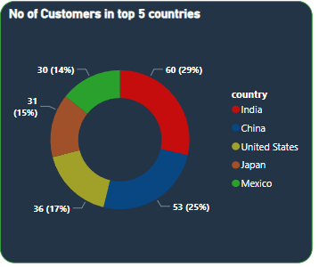
How may customers are there in each country?
Going by the visual, It can be understood that customer distribution is
Uneven.
India, China,US,Japan and Mexico are the top 5 countries with highest
Number of customers present.

Slide 11
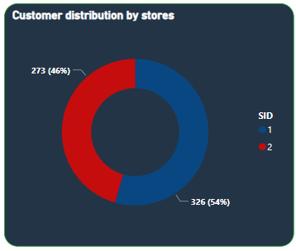
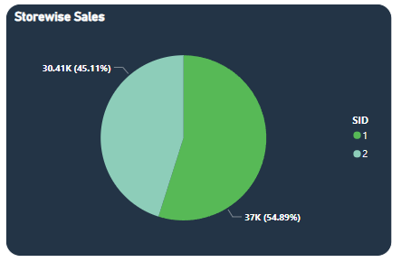
What is the distribution of the customers store wise?
The visual depicts that Store 1 has 54 % of the total customers whereas store 2 has 46 % of the total customers.
What is the sales distribution store wise?
As can be seen from the visual store 1 does the 55 % of the total sales whereas store 2 does 45 % of the total sales

Slide 12
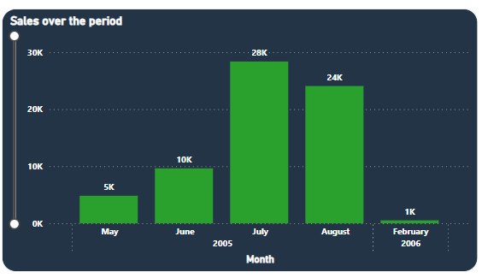
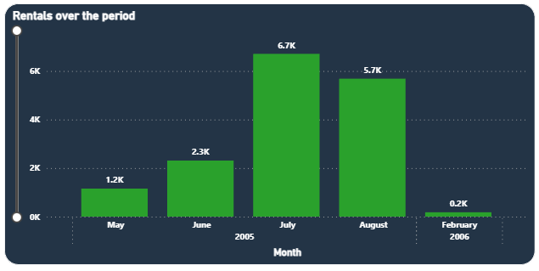
How do the sales and no of rental orders vary month wise?
As can be understood from the visual , sales starts to increase from the May month. It peaks in July and starts to decrease.
Similar trend is observed in rental orders.

Slide 13
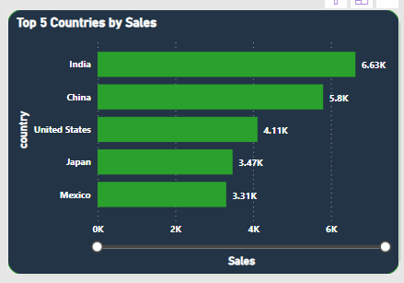
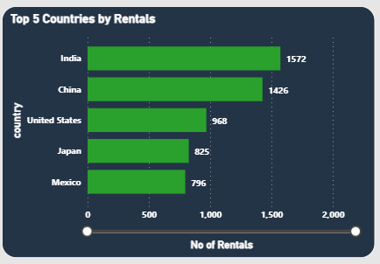
Which are top 5 countries by sales and no of rentals orders?
India, China, US , Japan and Mexico are the top 5 countries in terms of the sales generated.
These same 5 countries with the same order are also top 5 countries in terms of the number of rental orders.

Slide 14
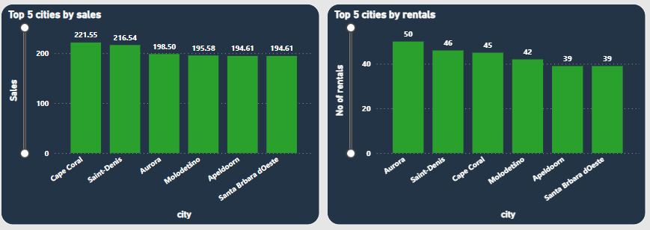
Which are top 5 cities in terms on sales and number of rental orders?

Slide 15
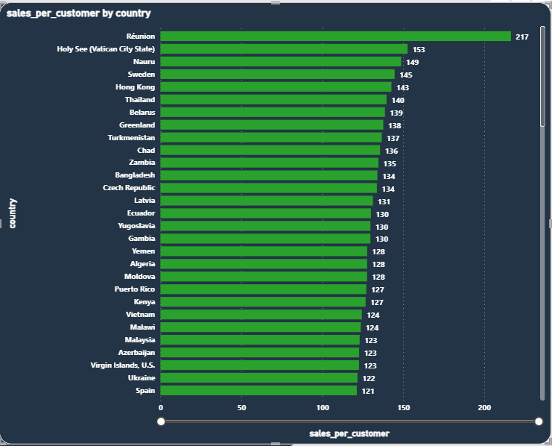
What is sales per customer country wise?
Sales per customer in the country= (total sales generated in the country)/(Total number of customers in the country)
As can be seen Reunion has the highest sales per customer that is 217.

Slide 16
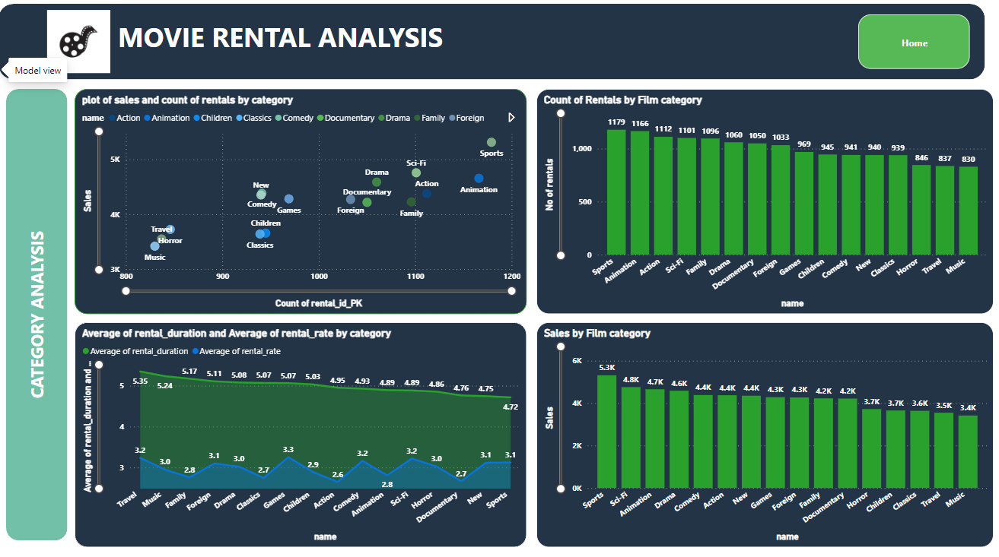

Slide 17
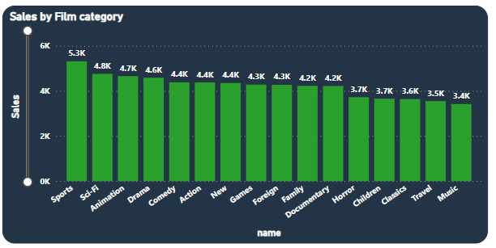
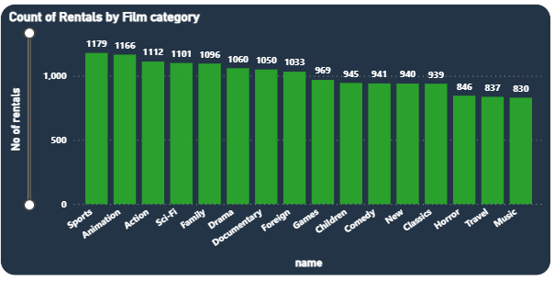
What is the sales distribution by the films category ?
As can be seen from the visual sports category has the maximum sales and no of rental orders.
Sci-fi, Animation, drama and comedy are other top 4 categories.
What is the rental order distribution by film category
As can be seen from the visual, Sports category has the maximum no of rentals orders. Followed by Animation, Action, Sci-fi and family.

Slide 18
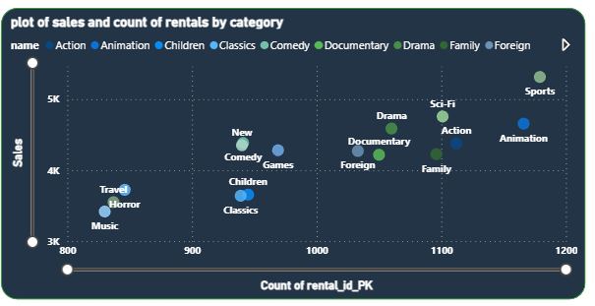
How each film category performs in terms of sales and no of rentals?
The scatter plot shows the sales on Y axis and count of rental orders on X axis for each film category.
Sports is the category which dominates both in orders and sales.

Slide 19
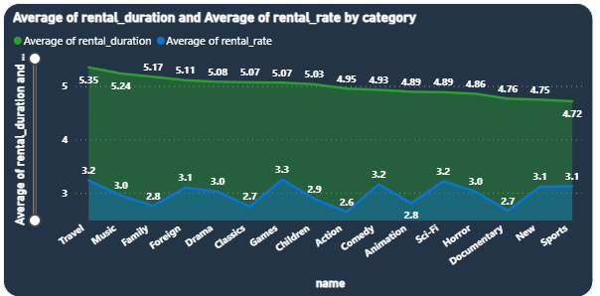
What is distribution of Average rental rate and average rental duration across film category?
As can be seen from the visual, Travel category films has the maximum Average rental duration whereas Sports category films have the lowest average rental duration despite being the highest sales film category.

Slide 20
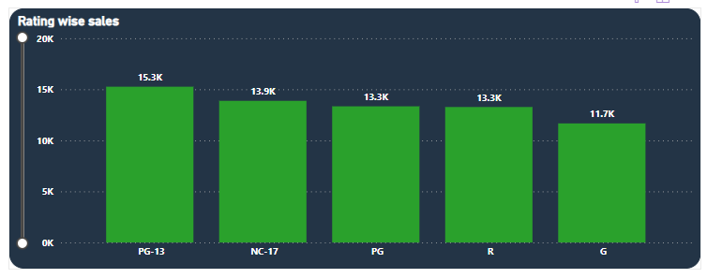
What is rating wise sales generated?
PG-13 rated films generate the highest sales.
G- rates films generate the lowest sales.

Slide 21
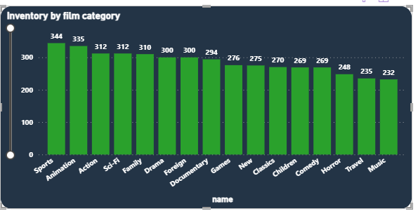
What is inventory for each category?
Sports category films have the most inventory.
Interestingly sports category films generate highest sales among all the categories.
Music films have the lowest inventory.

Slide 22
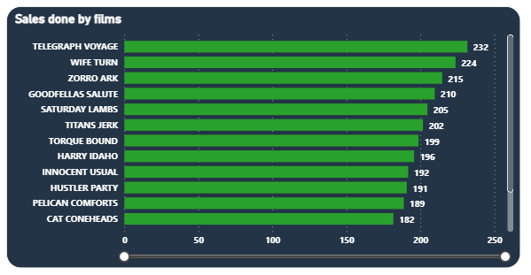
What is sales done by each film?
As can be seen from the visual Telegraph voyage is the highest sales generating film.

