Slide 1


Prasad Khandake
July 2024
Category review: Chips
Retail Analytics
1
Classification: Confidential

Slide 2
Our 17 year history assures best practice in privacy, security and the ethical use of data
We all have a responsibility to use data for good
Privacy
Security
Ethical use of data
Applies to all facets of our work, from the initiatives we take on, the information we use and how our solutions impact individuals, organisations and society.
We have built our business based on privacy by design principles for the past 17 years
Quantium has strict protocols around the receipt and storage of personal information
All information is de-identified using an irreversible tokenisation process with no ability to
re-identify individuals.
We are ISO27001 certified - internationally recognised for our ability to uphold best practice standards across information security
We use ‘bank grade’ security
to store and process our data
Comply with 200+ security requirements from NAB, Woolworths and other data partners
All partner data is held in
separate restricted environments
All access to partner data is limited to essential staff only
Security environment and processes regularly audited by our data partners.
Quantium believes in using data for progress, with great
care and responsibility.
As such please respect the commercial in confidence nature
of this document.
2
Classification: Confidential

Slide 3
Executive summary
01
Customer Analytics
The three highest contributing segments to total sales are: 1. Budget older families, 2. Mainstream young singles/couples, 3. Mainstream retirees.
Factors driving sales: older families have largest avg no of packets purchased per customer, while the
mainstream young singles/couples have the largest population
To target in the store strategy: mainstream young singles/couple are more likely to purchase Tyrells chips than other segments.
02
Trial Store Analysis
A trial of changing the store layout was implemented in three stores.
A control store was constructed to reflect the prior performance of the selected trial store.
The trial saw a significant increase the total sales and number of customers with a new store layout.

Slide 4
01
Customer Analytics

Slide 5
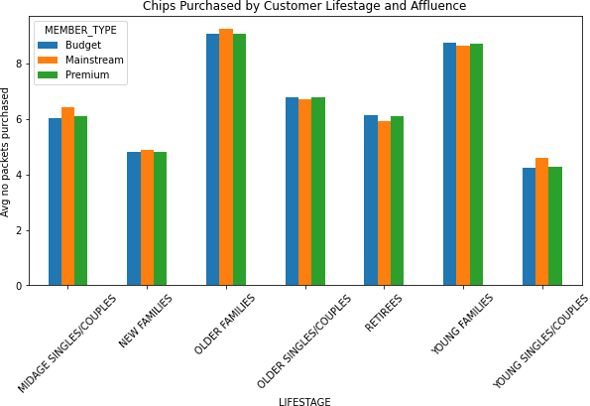
Older and young families purchase more chips on average than the other groups with affluence not affecting quantities of chips purchased.

Slide 6
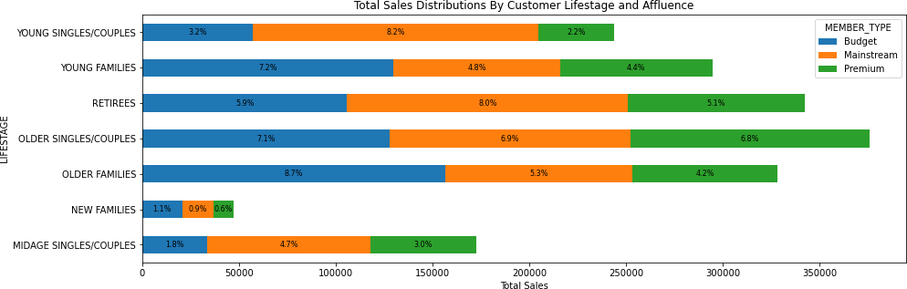
Instead, sales are coming mostly from budget older families, followed by mainstream young singles/couples.

Slide 7
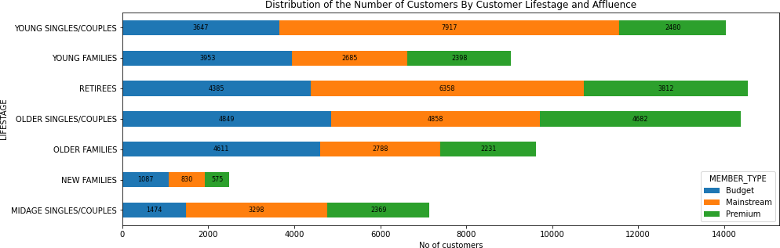
Mainstream young singles/couples have the largest population, driving their sales.

Slide 8
A deeper dive in the mainstream young singles/couples segment:
While Kettles chips are the most purchased brand across most segments, mainstream young singles/couples are 28% more likely to purchase Tyrells chips
They are also 32% more likely to purchase 175g packets – only Twisties has this size
Product placement strategy – put Kettles and Twisties where this segment is more likely to see them

Slide 9
02
Trial store performance

Slide 10
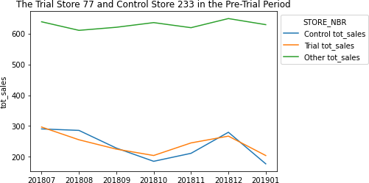
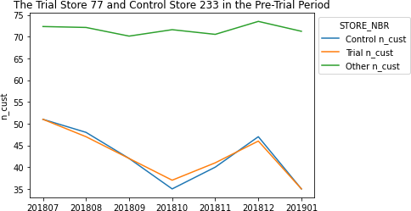
The control store is constructed to reflect performance of the trial store rather than the average of other stores. See e.g. stores 77 and 233:

Slide 11
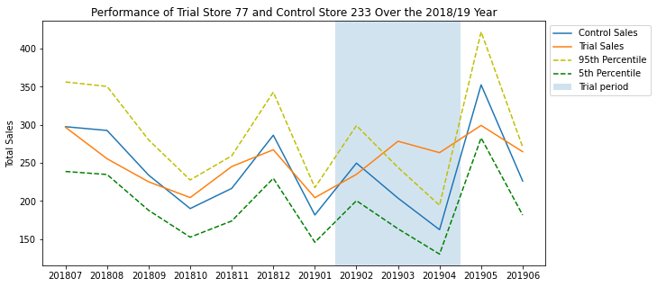
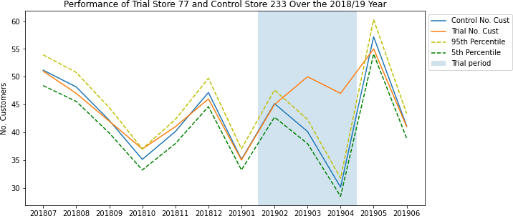
Trial store 77 and control store 233: trial success, with increases in sales and customer numbers.

Slide 12
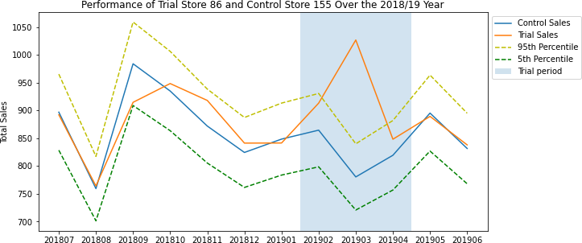
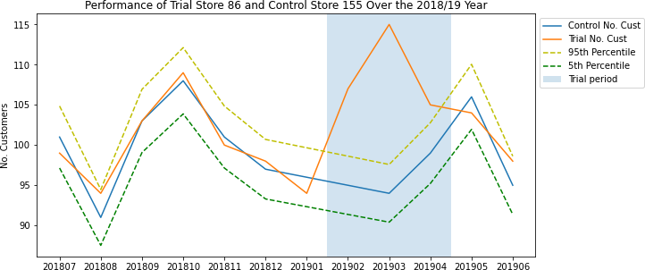
Trial store 86 and control store 155: trial success, greater increase in customer numbers than sales – check the trial implementation.

Slide 13
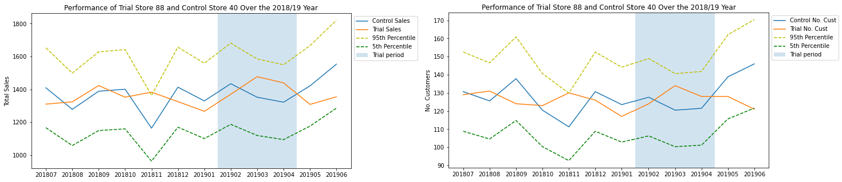
Trial store 88 and control store 40: no significant difference in performance.

Slide 14
Recommendation :
Transaction increase before cristmas on December. So, it is a good opportunity to increase total sales or promotion at this moment and also stocks should be high in December before the Christmas.
Chips brand Kettle, Smiths, Doritos, and Pringles should be kept in stocks as they are the most sold Mainstream young singles/couples, retirees are the account for a great share of chips sale so they need much attention
Despite Older Families not having the highest population, they have the highest frequency of purchase, which contributes to their high total sales.so, We can give promotions that encourage them to buy more quantity of chips per purchase. and increase the average unit purchase price per customer
Control stores 233, 155, 237 for trial stores 77, 86, and 88 respectively would be a good choice.

Slide 15
Disclaimer: This document comprises, and is the subject of intellectual property (including copyright) and confidentiality rights of one or multiple owners, including The Quantium Group Pty Limited and its affiliates (Quantium) and where applicable, its third-party data owners (Data Providers), together (IP Owners). The information contained in this document may have been prepared using raw data owned by the Data Providers. The Data Providers have not been involved in the analysis of the raw data, the preparation of, or the information contained in the document. The IP Owners do not make any representation (express or implied), nor give any guarantee or warranty in relation to the accuracy, completeness or appropriateness of the raw data, nor the analysis contained in this document. None of the IP Owners will have any liability for any use or disclosure by the recipient of any information contained in, or derived from this document. To the maximum extent permitted by law, the IP Owners expressly disclaim, take no responsibility for and have no liability for the preparation, contents, accuracy or completeness of this document, nor the analysis on which it is based. This document is provided in confidence, may only be used for the purpose provided, and may not be copied, reproduced, distributed, disclosed or made available to a third party in any way except strictly in accordance with the applicable
14
written terms and conditions between you and Quantium, or otherwise with Quantium’s prior written permission

