Slide 1
welcome
Project Name: Pharmacy Management
System

Slide 2
Intorduction
‘This project concerned about developing a Pharmacy Management System that will be used for retail and wholesale pharmacies. The purpose of this project is to manage all data derived for a pharmacy to maintain their business through the system rather than recording their data manually which is more risk to the business to maintain and to avoid loss. According to my'.

Slide 3
Scope
The user of this system is being able to manage all necessary activities of the pharmacy shop. The information management that provided by the system is a great advantage to reduce records errors associated with pharmacy shops.

Slide 4
Software Requirement
Operating system: Windows
Web-technology: PHP
Front-end: HTML, CSS, JAVASCRIPT.
Back-end: MYSQL
Web Sever: WAMP Sever

Slide 5
Existing System
Lack of security of data.
More man power.
Time consuming.
Consumes large volume of pare work.
Needs manual calculations.
No direct role for the higher officials.

Slide 6
Proposed system
As far as the project is developed the functionality is simple, the objective of the proposal is to strengthen the functioning of Audit Status Monitoring and make them effective and better. The entire scope has been classified into five streams knows as Coordinator Level, management Level, Auditor Level, User Level and State Web Coordinator Level.

Slide 7
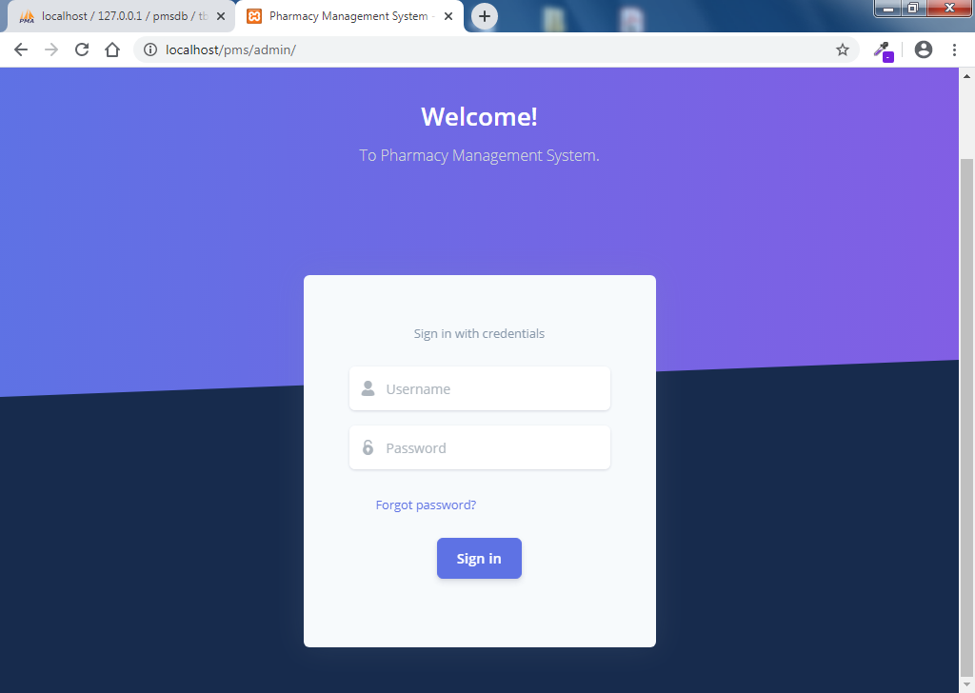
snapshots

Slide 8
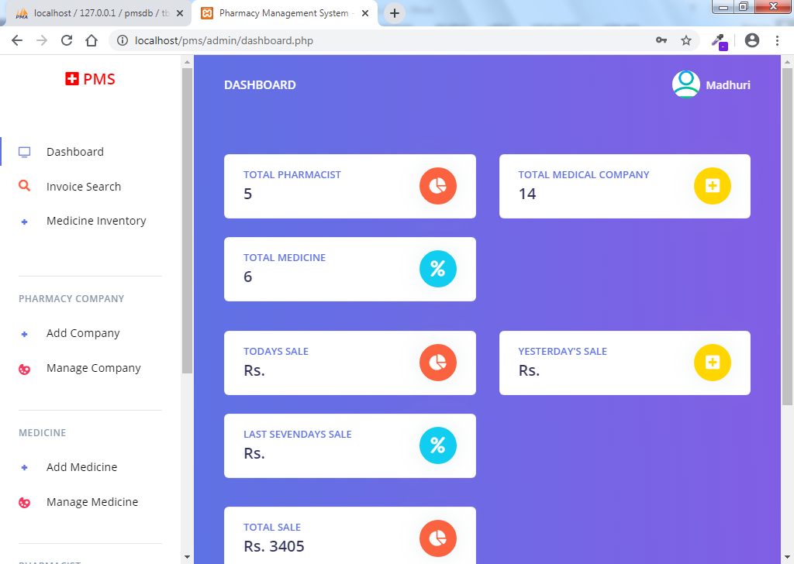
Admin Home Page

Slide 9
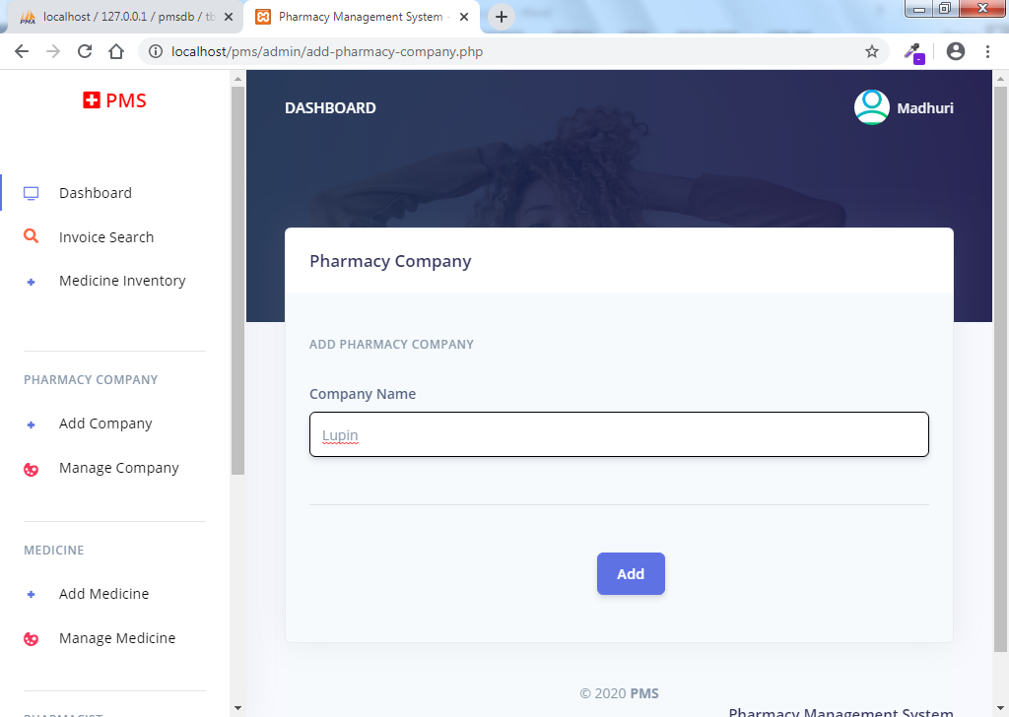
Compny Add

Slide 10
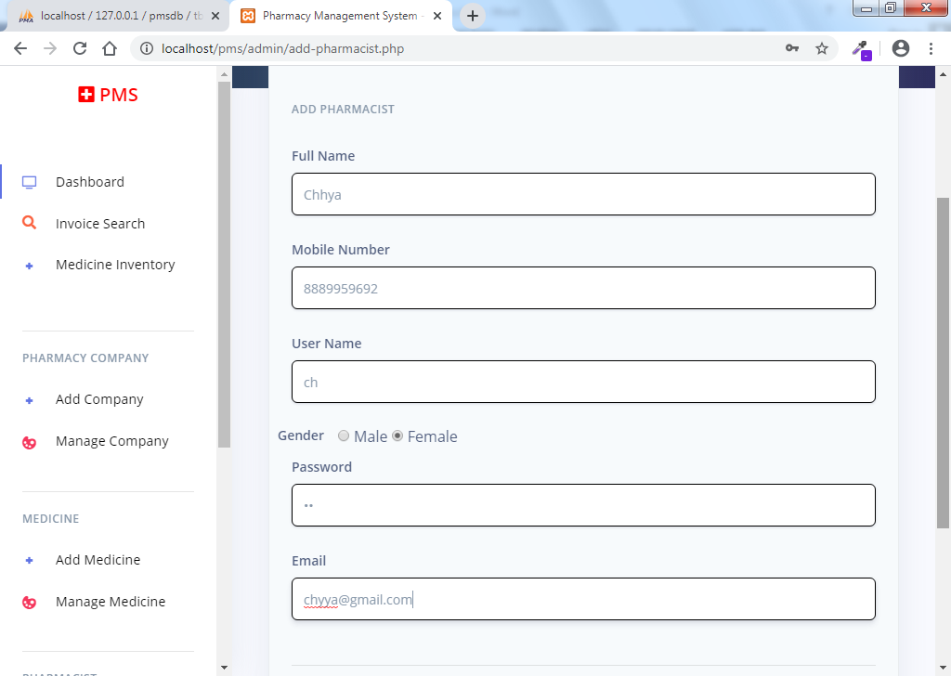
Add Pharmcist

Slide 11
Thank you

