Slide 1

NETWORK DESIGN AND ALGORITHMS PROJECT
Comparison of delay variation for different network resiliency models
Submitted By: Prasad P. Netalkar : N15310512
Sneheil Raz : N18411738

Slide 2
Introduction
Resiliency is the ability of a network to provide and maintain an acceptable level of service in the time of failure.
We have two restoration design models - Link Path and Demand Flow, which are well established in an autonomous system (AS).
We compared two restoration models with respect to their Flow Allocation, Link Load and Congestion Delay.
Our formulated model aims at minimizing the congestion delay in the network in the event of failure and also in normal state.
Also we verified the working of CISCO routers running OSPF in case of normal operation as well as in case of link failure.
Keywords: Resiliency, Failure, AMPL, Link Capacity.

Slide 3
Link Path re-establishment
Link re- establishment assumes single, total failures of individual links.
Restores the entire (or part of) capacity of the failed link on one or several paths between the two end nodes of the link.
In link re -establishment the spare capacity is shared among different links.
Our model minimizes total congestion in the network at the time of failure.
We are assuming link to have a fixed given bounded capacity .

Slide 4
Link Path re-establishment FORMULATION
LP: DR/CF/BR/CC/LIN/LR+BR Design with Link Restoration+ Minimize Congestion Delay
Indices
d = 1, 2, ..., D Demands
p = 1, 2, ..., Pd Candidate paths for demand d
e,l = 1,2,...,E Links
q = 1, 2, ..., Qe Candidate restoration paths for link e
Constants
δedp = 1 if link e belongs to path p realizing demand d; 0, otherwise
hd Volume of demand d
βleq = 1 if link l belongs to path q restoring link e; 0, otherwise
ce Capacity of each link, Bounded Capacity.
Variables
xdp0 (non-negative) normal flow allocated to path p of demand d
ye (non-negative) normal capacity of link e
zeq (non-negative) flow restoring normal capacity of link e on restoration path q (non-negative) spare, protection capacity of link e (not used in the
ye’ (non-negative) spare, protection capacity of link e (not used in the normal network operating state)
re (non-negative) Average delay in each link

Slide 5

Link Path re-establishment FORMULATION (CONT)
Objective
Minimize $\sum_{e}{re}$
Constraints
$\sum_{p}{Xdp0=hd}$ d :1, 2, ..., D
$\sum_{d}{\sum_{p}{ðedpXdp0}}$ < = ye e: 1,2 , ...,E
$\sum_{q}{zeq=ye}$ e: 1,2,...,E
$\sum_{p}{βleqZeq<=yl′}$ l: 1,2,...,E e:1,2,...,E
$ce≥ye+yl^{′} l: 1,2,...,E e:1,2,...E$
$re≥ye+yl′ e:1,2…E$
$re≥3(ye+yl^{′})−\frac{2}{3}ce e:1,2…E$
$re≥10(ye+yl^{′})−\frac{16}{3}ce e:1,2…E$
$re≥70(ye+yl^{′})−\frac{178}{3}ce e:1,2…E$
$re≥500(ye+yl^{′})−\frac{1468}{3}ce e:1,2…E$
$re≥5000(ye+yl^{′})−\frac{16318}{3}ce e:1,2…E$

Slide 6
DEMAND FLOW re-establishment
The demand flow re-establishment also called Path Re-establishment (PR) mechanisms deal directly with demand flows.
Contrary to link re-establishment, the PR mechanisms restore individual flows rather than link capacities.
Also, the PR schemes use not only shared spare capacity, but are also able to reuse the capacity released by the failed flows on those links of the broken paths, which survive the failure.
Our model minimizes total congestion in the network.
Even here we are assuming link to have a fixed given bounded capacity

Slide 7
Demand Flow re-establishment FORMULATION
LP: DR/CF/BR/CC/LIN/PR+UR {DR-U} PR with Unrestricted Reconfiguration + Minimize Congestion Delay
Indices
d = 1, 2, ..., D Demands
p = 1, 2, ..., Pd Candidate paths for demand d
e = 1,2,...,E Links
s = 0, 1, ..., S Failure situations
Constants
δedp = 1 if link e belongs to path p realizing demand d; 0, otherwise
hd volume of demand d
χds demand coefficient of demand d in state s, hds=Xds*hd
ce Fixed Capacity of each link, Bounded Capacity.
αes Fractional availability coefficient of link e in state s (0 ≤ αes ≤ 1).
Variables
Xdps flow allocated to path p of demand d in state s
ye (non-negative) normal capacity of link e
re (non-negative) Average delay in each link
We have considered Xds= 1 for total restoration and αes={0,1}

Slide 8

Demand flow re-establishment FORMULATION (CONT)
Objective
Minimize $\sum_{e}{re}$
Constraints
$\sum_{p}{Xdps=hd}$ d = 1, 2, ..., D s = 0, 1, ..., S
$\sum_{d}{\sum_{p}{ðedpXdps}}$ < = αes*ye e = 1,2,...,E s = 0, 1, ..., S
$ce≥ye l: 1,2,...,E e:1,2,...E$
$re≥ye e:1,2…E$
$re≥3(ye)−\frac{2}{3}ce e:1,2…E$
$re≥10(ye)−\frac{16}{3}ce e:1,2…E$
$re≥70(ye)−\frac{178}{3}ce e:1,2…E$
$re≥500(ye)−\frac{1468}{3}ce e:1,2…E$
$re≥5000(ye)−\frac{16318}{3}ce e:1,2…E$

Slide 9
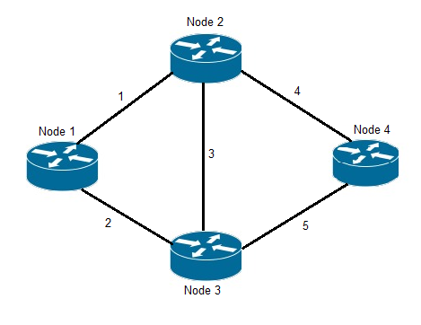
TOPOLOGY OVERVIEW
Candidate Demand Path:
Topology 1- Simple Four Node Scenario
Demand | Volume | Path
Node 2 – Node 3 | 6 | (3) (1 2) (4 5)
Node 2 – Node 4 | 4 | (4) (3 5) (1 2 5)
Node 1 – Node 3 | 4 | (2) (1 3) (1 4 5)
Link | Restoration Path
1 | (2 3) (2 5 4)
2 | (1 3) (1 4 5)
3 | (1 2) (4 5)
4 | (3 5) (1 2 5)
5 | (3 4) (2 1 4)
Link Restoration Path:
For Link Re-establishment
Models.

Slide 10
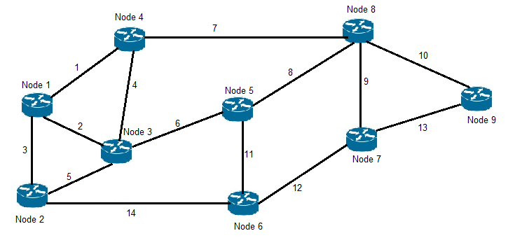
Topology 2- Complex Real Network Scenario
Link Restoration Path:
For Link Re-establishment Model.
Link | Restoration Path (Link no)
1 | (2 4) 2. (3 5 4)
2 | 1. (1 4) 2. (3 5)
3 | 1. (2 5) 2. (1 4 5)
4 | 1. (2 1) 2. (1 3 5)
5 | (3 2) (6 11 14)
6 | (4 7 8) (5 14 11)
7 | (4 6 8) (1 2 6 8)
8 | 1. (7 4 6) 2. (11 12 9)
9 | 1. (8 11 12) 2. (10 13)
10 | 1. (9 12) 2. (8 11 12 13)
11 | 1. (6 5 14) 2. (8 9 12)
12 | 1. (11 8 9) 2. (14 5 6 8 9)
13 | 1. (9 10) 2. (12 11 8 10)
14 | 1. (5 6 11) 2. (3 1 7 8 11)
Demand | Volume | Path
Node 1 – Node 5 | 6 | (2 6) (1 7 8) (3 14 11)
Node 1 – Node 9 | 3 | (1 7 10) (3 14 12 13) (2 6 8 10)
Node 4 – Node 6 | 4 | (4 6 11) (1 2 5 14) (7 8 11)
Node 8 – Node 2 | 4 | (8 6 5) (9 12 14) (7 1 3)
Candidate
Demand
Path:

Slide 11
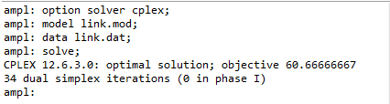
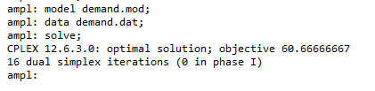
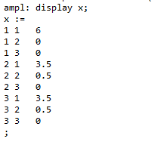
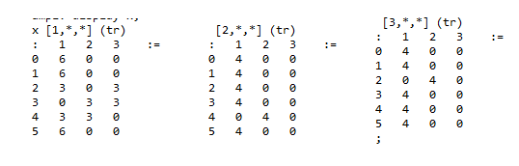
SIMULATION AND RESULTS
Topology 1: 4 Node Scenarios
Flow Allocation (x):
Link Path Restoration:
Demand Flow Restoration:
Xdps

Slide 12
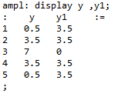
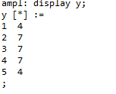
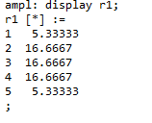
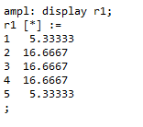
Link Load (y):
Link Path Restoration:
Demand Flow Restoration:
Both the models
exhibit same link load.
Congestion Delay: (r)
Link Path Restoration: Demand Flow Restoration:
Both the models
have same congestion delay.

Slide 13

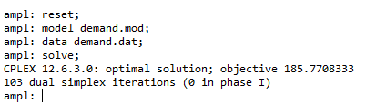
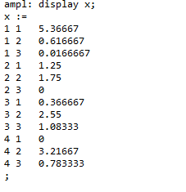
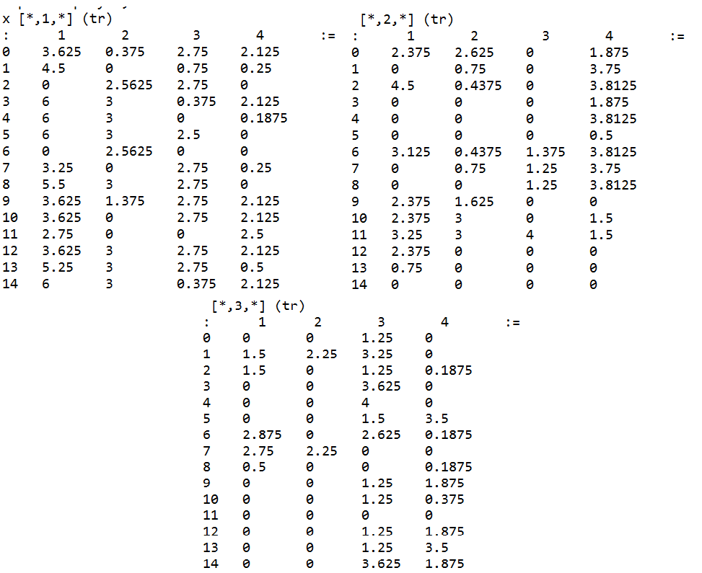
Topology 2: Complex Real Network Scenario
Flow Allocation (x)
Link Path Restoration:
Demand Flow Restoration:
Xdps

Slide 14
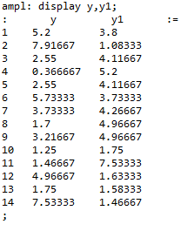
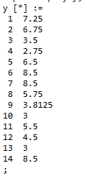
Link Load (y)
Link Path Restoration: Demand Flow Restoration:
Lower link load allocated
in the case of demand
flow restoration.

Slide 15
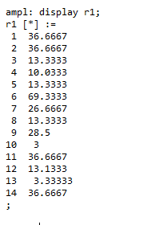
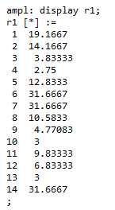
Congestion Delay
Link Path Restoration:
Demand Flow Restoration:
Lower congestion delay is
observed in the case of demand
flow restoration as we have
more choice for re-routing.

Slide 16
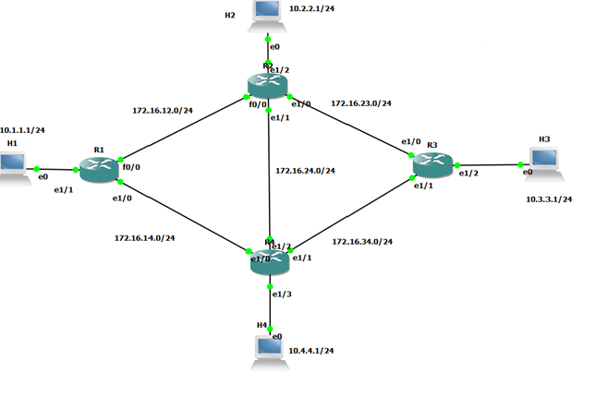
Network Resiliency using CISCO routers
GNS 3 topology
Routers are running OSPF. Links are numbered as follows:
C1: Link 1: R1 --- R2, Capacity: 100mbps
C2: Link 2: R1 --- R4, Capacity: 10mbps
C3: Link 3: R2 --- R4, Capacity: 10mbps
C4: Link 4: R2 --- R3, Capacity: 10mbps
C5: Link 5: R4 --- R3, Capacity: 10mbps

Slide 17
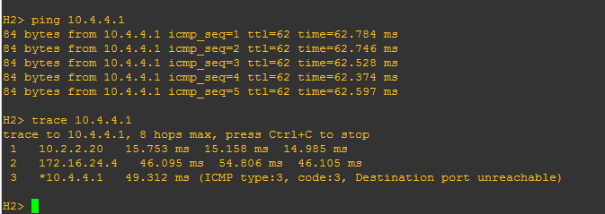
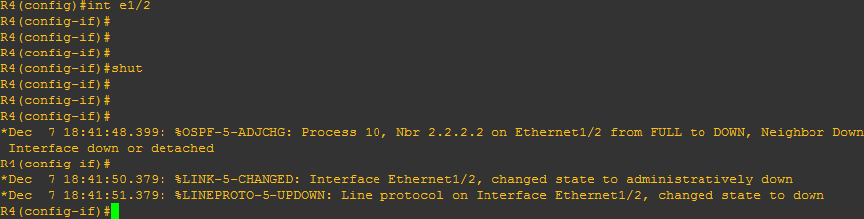
GNS 3 Cisco Router simulation
We have considered one demand to verify our observation. Considered demand H2->H4
We can see it takes the direct link , as indirect links have higher metric value. As, by default cisco routers takes 100/C (in Mbps) as the metric as shown in the below screenshots.
As we can see from screenshot in normal operation the communication from Host 2 – Host 4 takes place via the direct path which is 172.16.24.0/24 network.
Now we take down the direct link (link 3) as shown.

Slide 18
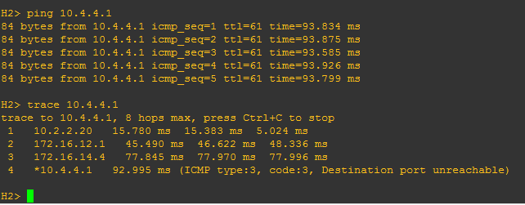
GNS 3 topology
There are three possible path-
H2->R2->R4->H4: Cost of link 3 = 10 - Direct Link
H2->R2->R1->R4->H4: Cost of link 1 + Cost of link 2 = 1+10 = 11 – Via R1
H2->R2->R3->R4->H4: Cost of link 4 + Cost of link 5 = 10+10 = 20 – Via R2
OSPF routers detect Link 3 failure when the dead interval expires. Now based on the above calculation, it takes 2nd least cost path which is via R1 with cost 11.

Slide 19
CONCLUSION
Comparison Between Link Path Re-establishment and Demand Flow Re-establishment
We successfully analysed link re-establishment and path re-establishment with aim of minimizing congestion delay in the network.
We found that for smaller network both the models performed equally well and had same network congestion delay, whereas as the network grows it’s better to use demand flow re-establishment.
Around 50% reduction in delay is observed during demand flow re-establishment.
More routing solution for each failure situation in the case of demand flow re-establishment.
Link Path Re-establishment | Demand Flow Re-establishment
Higher link load Observed (ye) | Lower link load Observed (ye)
Higher delay is Observed | Lower delay is Observed
Sparse capacity into consideration for restoration. | No Sparse capacity into consideration
Handles Single failure of link. | Can have multiple failures of links
Disjoint demand path not an issue as long as you have path for link re-establishment. | At least one demand path should be disjoint for all analysing all link failure situation

Slide 20
References
“Routing, Flow, and Capacity Design in Communication and Computer Networks” by Micha Pióro and Deepankar Medhi
https://en.wikipedia.org/wiki/Resilience_(network)
“CCNP Routing and Switching ROUTE 300-101 Official Cert Guide / Edition 1” by Kevin Wallace , CCIE No. 7945
Contribution
PRASAD: AMPL, Report and PPT
SNEHEIL: GNS3, Report and PPT

