Slide 1
#COVID19 – INDIA
#Hackathon Against Covid19
Title :- Smart Covid19 Detection Via X-ray and Mobile Application.
Domain :- Healthcare Innovations
Team Name :- Cyber bot
Team Leader Name :- Prasad Patharkar
Problem statement :- It has been a major challenge for the Government and District Administrations to track COVID-19 patients. Form a real-time information management system that captures the estimated number of patients going to the health facilities and gives a breakup of the major ailments that citizens are suffering from in the state. This has proved to be challenging for the Ministry of Health and would prove to be useful.

Slide 2
Idea/Approach Details :-
Creating Mobile Application and Machine Learning model for continuously Monitoring and Detect The Covid 19 patients using X-ray and Mobile camera.
Mobile application consist Pre-Trained machine learning model that detect the pneumonia Via Scanning the photo of patient X-rays.
Mobile application also has cloud database to store the patients symtops for suggesting them to take covid19 test .
Precautions Guidelines are also given in applications for safety using notifications of washing hands and latest update on corona virus.
ML algorithm processes the data captured by the camera of user of x-ray and process and check it using our machine learning model.
If doctor is not available mobile application detect the pneumonia and further instructions are given to patient.
ML model can predict the covid19 and also provide temporary precautions and feedback for goverment hospital about the patients
Application will display record and information collected from patients about fever ,cough and other symtomps
The application will give notification to the government authority in any case of Emergency about patients from application.

Slide 3
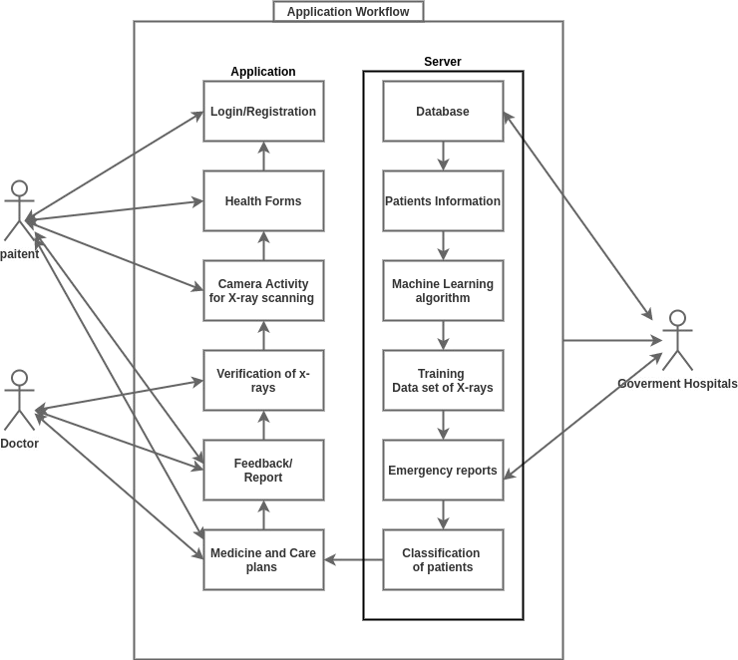
Block Diagram :-

Slide 4
Dependencies :-
Android Studio
FirebaseDB
Jupyter Notebook
RESTful API
Logistic Regression model
Python3 modules
TensorFlow lite
Training Data set etc.

Slide 5
Social Impact Analysis with COVID19
It will help to identify infected patients rapidly in less time preventing the spread of covid -19 virus in the community.
Doctors can monitor their patients through this application and thus it reduces the chances of health care workers and to get infected.
It will help people to moniter themselves and check weather they have the symptoms of the virus and can approach the doctors .

Slide 6
Link to the project
Github Link :
Google Drive link :-

