Slide 1


Project Name: Online Furniture Store
Branch C-DAC Sep-2022
Guided By:
Mrs. Bakul Joshi
Submitted By:
Kashiprasad Patil (220943020063)
Ritesh Nemade (220943020074)
Harshad Desmukh (220943020117)
Nadda Ashish Pawan (220943020057)

Slide 2
Introduction :
An online furniture store is a virtual marketplace where customers can purchase furniture from the comfort of their homes. Online furniture stores have become increasingly popular in recent years as people have become more comfortable shopping online.

Slide 3
EXISTING SYSTEM:
The existing system is very full of efforts.
User have to go to the market and then check different shops in order to buy what user want.
Existing system needs a lot of time to put upon.
Also it needs a lot of manual work in buying the furniture as well.

Slide 4
PROPOSED SYSTEM:
The proposed system is the automation of the offline
home furniture shops.
User can directly pick the Product which they want
to buy from the Catalogue itself or can add the same
to cart with an option to buy it later.
User can check his order history or the status of the
current order in my orders column.

Slide 5






OVERVIEW OF TOOLS & TECHNOLOGIES USED:
Java
Eclipse IDE
Visual Studio code IDE
Spring boot IDE
MYSQL database
React JS Library

Slide 6
SCOPE:
Online furniture stores can offer customers the convenience of shopping from their own homes, at any time of the day or night.
Online furniture stores can expand their reach beyond their physical location and target customers across the state.
Online furniture stores can offer customized furniture options, allowing customers to select the wood type of their furniture.
Online furniture stores can leverage social media platforms to reach new customers and promote their products through targeted advertising and influencer partnerships.

Slide 7
ROLES & THEIR FUNCTIONALITIES:
ADMIN :
Manage seller accounts and permissions
Monitor and moderate product listings and reviews
Manage customer accounts and permissions
Manage payment and shipping settings
Generate sales reports and analytics for all sellers
Manage site content and design

Slide 8
SELLER :
Sellers can register and create his own accounts.
Sellers can login.
Seller can upload product details and images of his inventory items.
Sellers can view and confirm orders.
Create and manage product listings.
Communicate with customers regarding orders and product inquiries.

Slide 9
CUSTOMER :
Browse and search for products
View product details and descriptions
Add products to cart and checkout
View order history and status
Communicate with sellers regarding orders and product inquiries

Slide 10
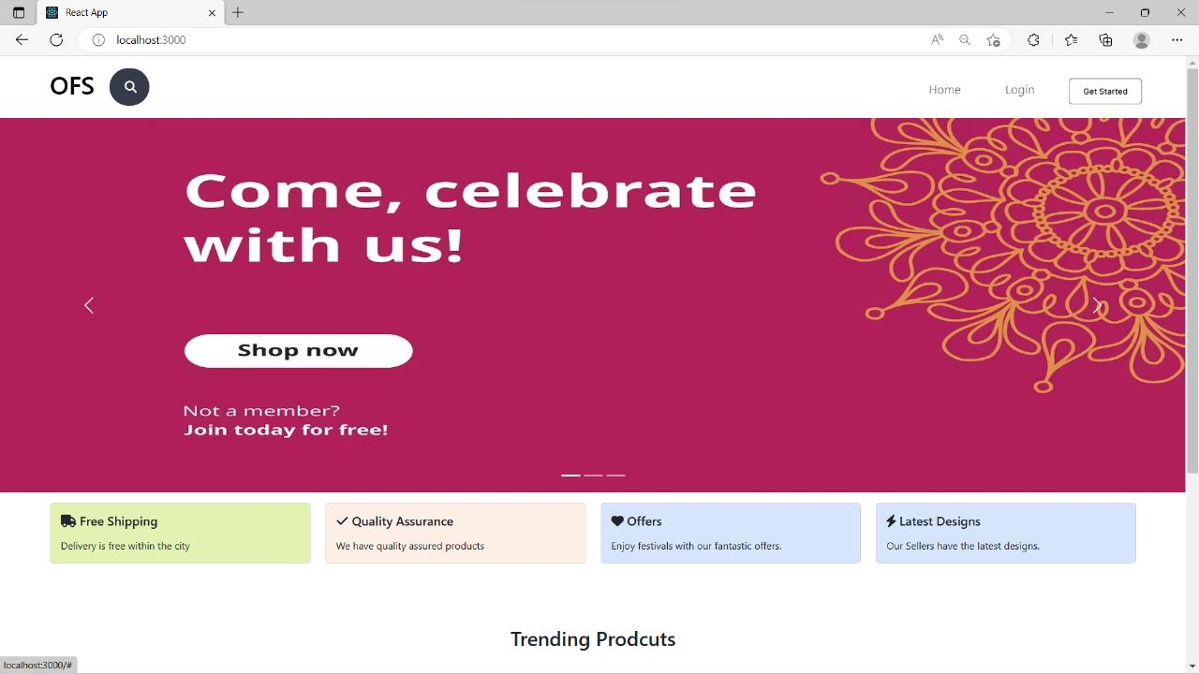
LAYOUTS: HOME PAGE

Slide 11
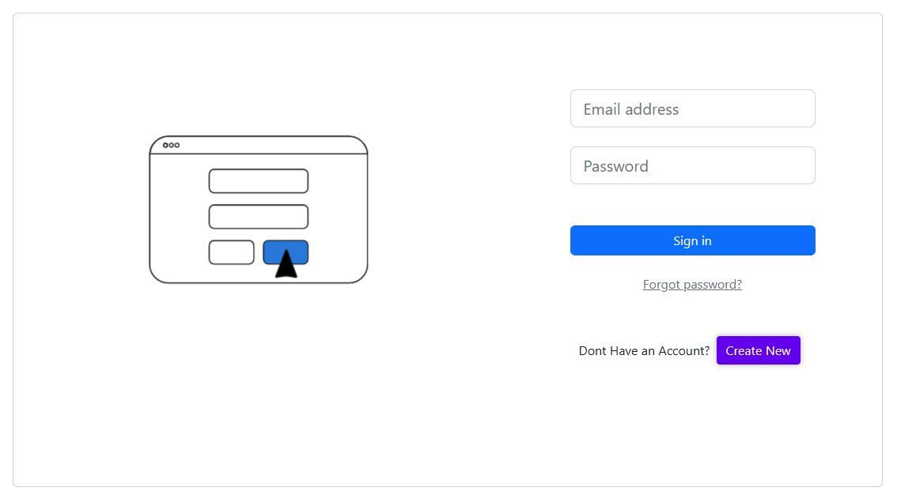
LAYOUTS: LOGIN PAGE

Slide 12
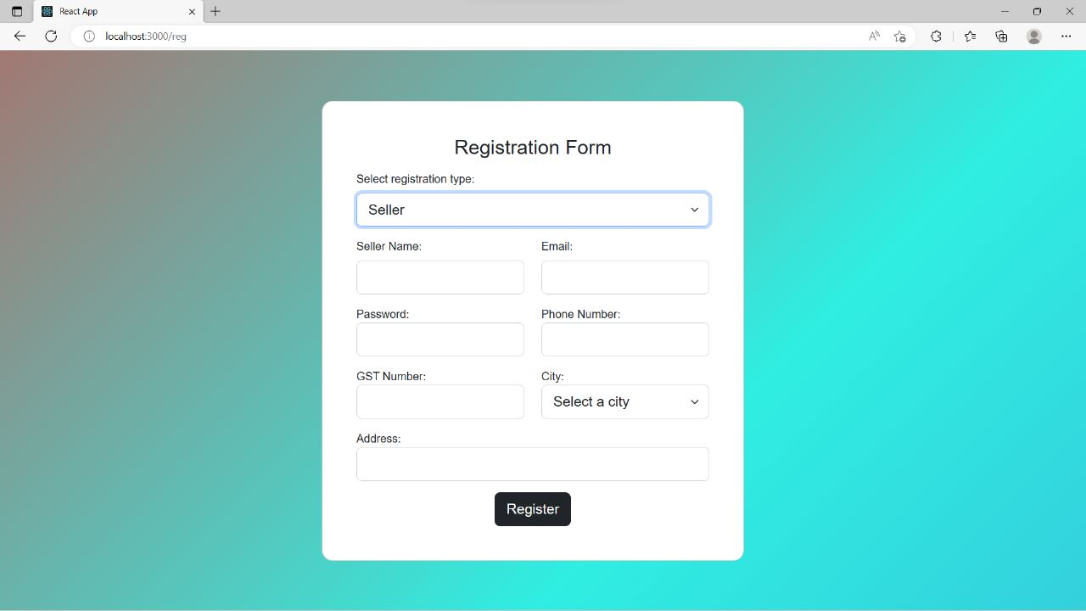
LAYOUTS: REGISTRATION FORM - SELLER

Slide 13
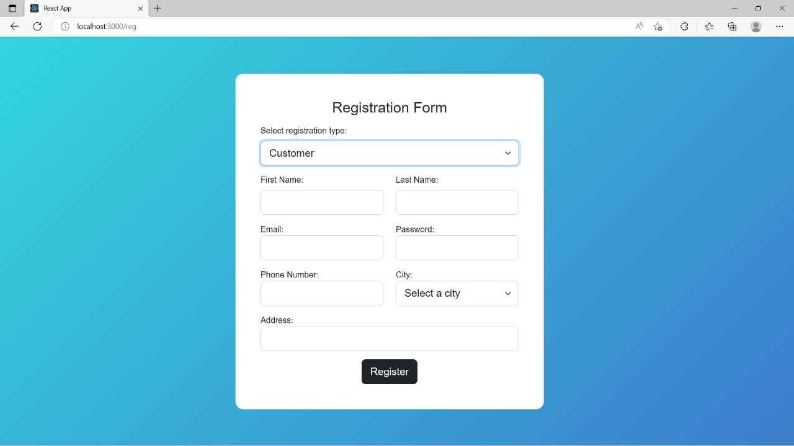
LAYOUTS: REGISTRATION FORM - CUSTOMER

Slide 14
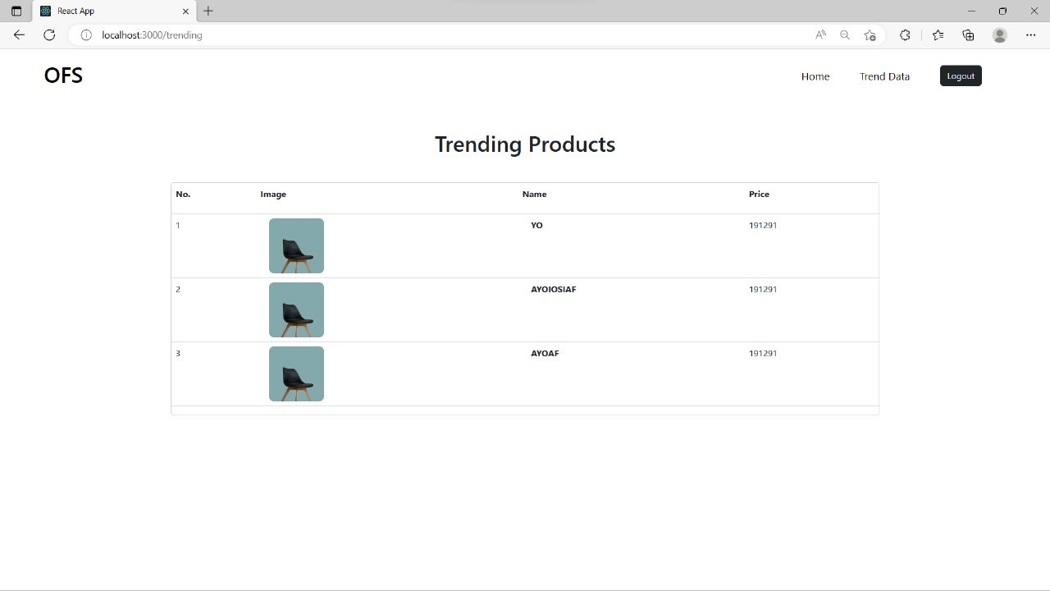
LAYOUTS: TRENDING PRODUCT

Slide 15
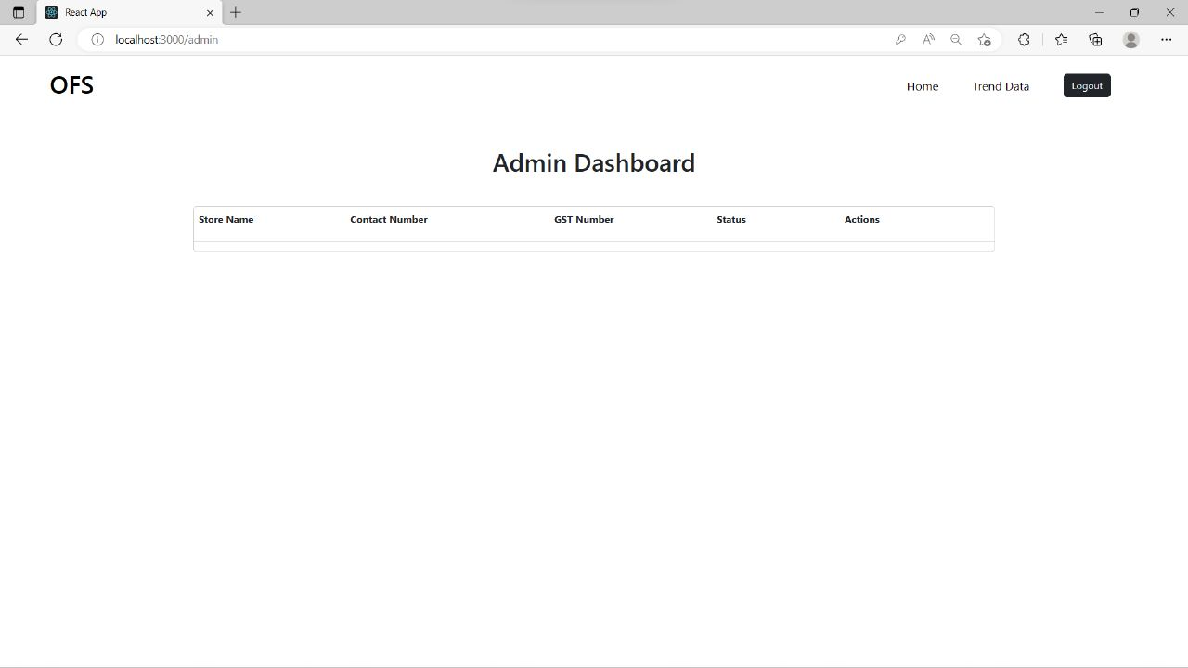
LAYOUTS: ADMIN DASHBOARD

Slide 16
BENEFITS OF ONLINE FURNITURE STORE:
Tastefully picked products.
Local and International Brands.
Best quality products.
Affordable Prices.
Excellent Customer Service.
Interesting trends in home designs.

Slide 17
FUTURE SCOPE:
Personalization: Online furniture stores can leverage data and machine learning algorithms to offer personalized recommendations to customers based on their browsing and purchase history.
Sustainability: As consumers become more environmentally conscious, there is a growing demand for sustainable furniture options. Online furniture stores can emphasize eco-friendliness and offer products made from recycled or renewable materials.
Social Commerce: Online furniture stores can leverage social media platforms to reach new customers and promote their products through targeted advertising and influencer partnerships.

Slide 18
Conclusion:
In conclusion, an online furniture store web application can provide many benefits for both customers and businesses. With this type of platform, customers can conveniently browse and purchase furniture from the comfort of their own homes, while businesses can expand their customer reach and streamline their operations.
However, to ensure the success of an online furniture store web application, it's important to prioritize user experience and design a user-friendly interface that's easy to navigate.
Overall, an online furniture store web application can be a valuable tool for businesses in the furniture industry to increase sales and improve customer satisfaction

Slide 19
THANK YOU

