Slide 1
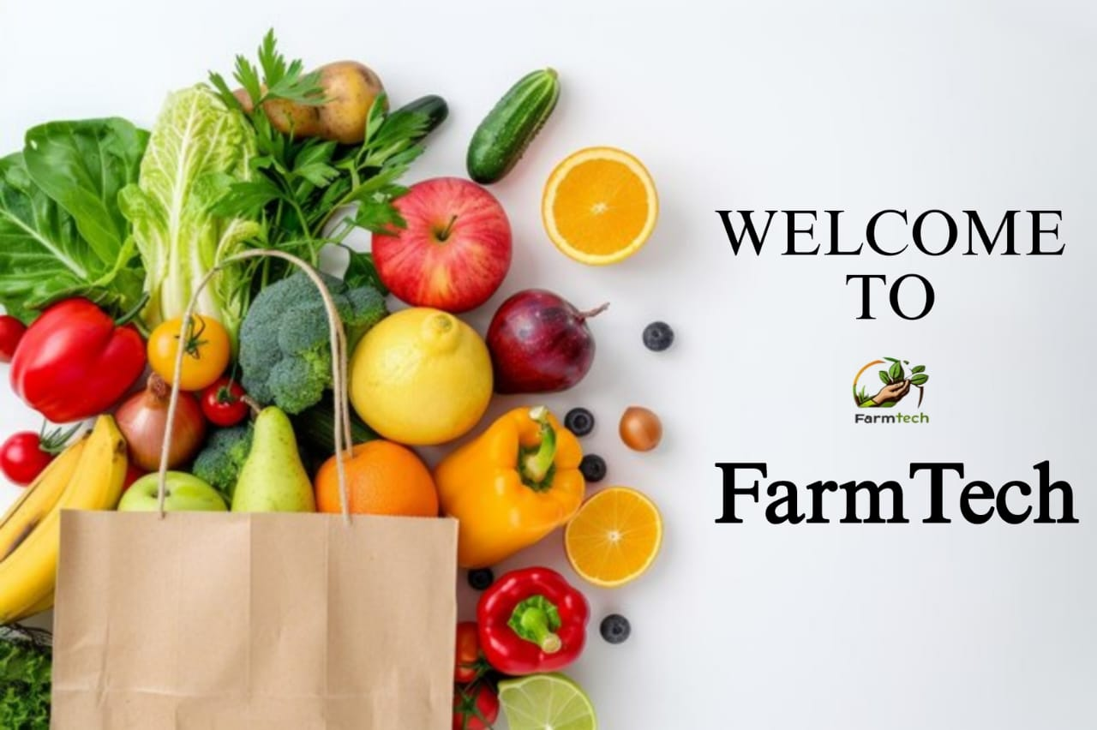
Presented By :
Dev D. Khairmode (3339)
Prasad P. Chougule (3338)
Prathamesh P. Lavhate(3340)
Pratik A. Sutar (3341)

Slide 2
INTRODUCTION
“FarmTech: Smart Farming Solutions for Small-Scale Farmers" is a transformative initiative aimed at integrating advanced technologies into traditional agriculture, specifically designed to benefit small-scale farmers. As the global demand for food rises, the agricultural sector faces challenges like resource scarcity, climate change, and the need for sustainable practices. Small-scale farmers, who are often limited by resources, are especially vulnerable to these challenges. FarmTech solutions, including precision farming, IoT (Internet of Things) devices, data analytics, and mobile applications, offer them the tools to optimize crop yield, reduce costs, and minimize environmental impact.

Slide 3
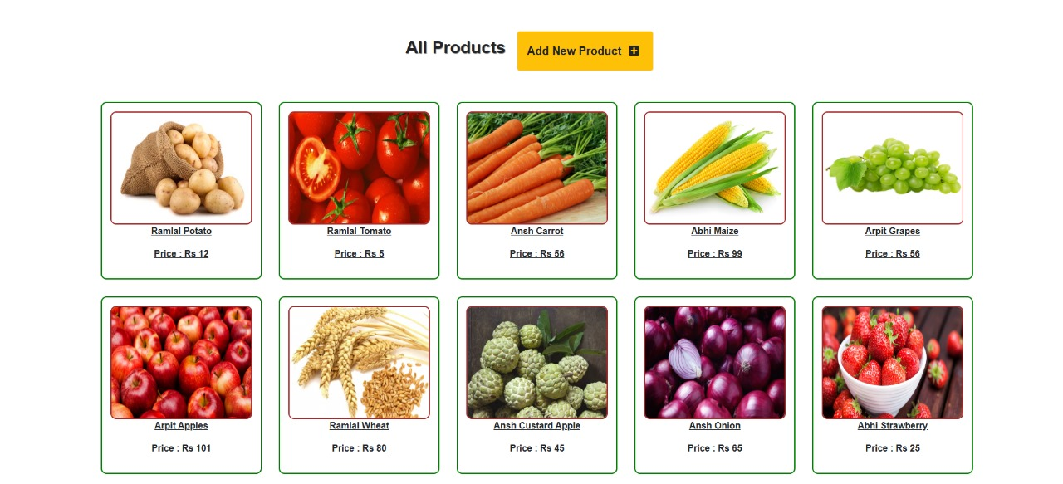
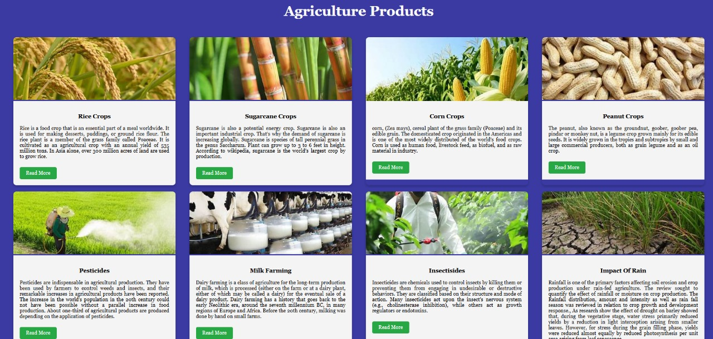
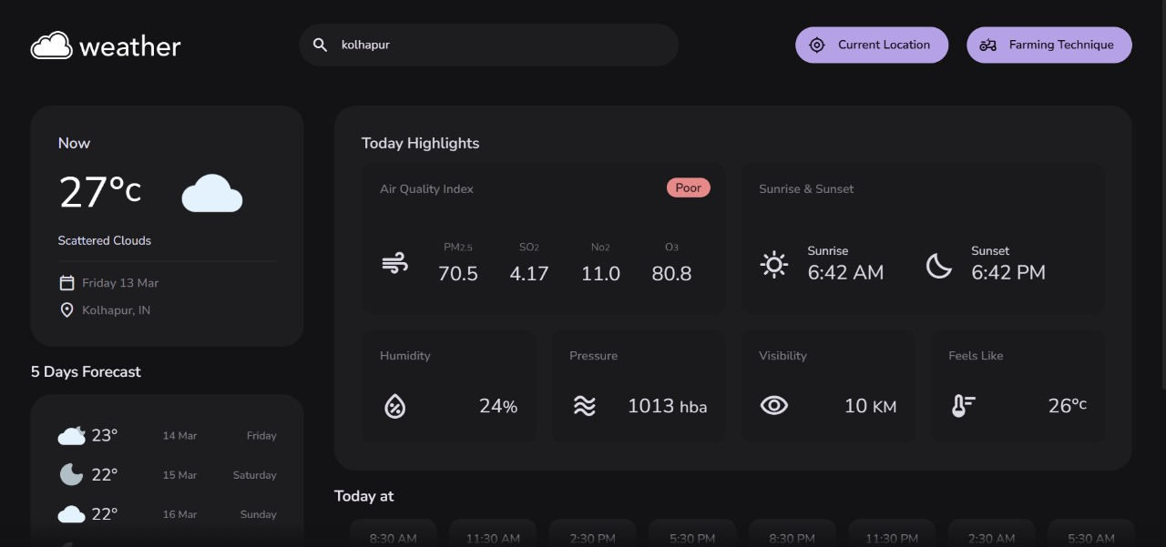
Features Of Farm Tech :
E-Commerce for Agri Products
(Options for buying, selling, and renting farm equipment.)
Community & Knowledge Hub
(Educational content on modern farming techniques, organic farming, and agribusiness trends.)
Weather Forecasting
(Real-time weather updates and forecasts.)
Chatbot for farmer support
(Expert advice on crop diseases, pest control, and best farming practices)

Slide 4
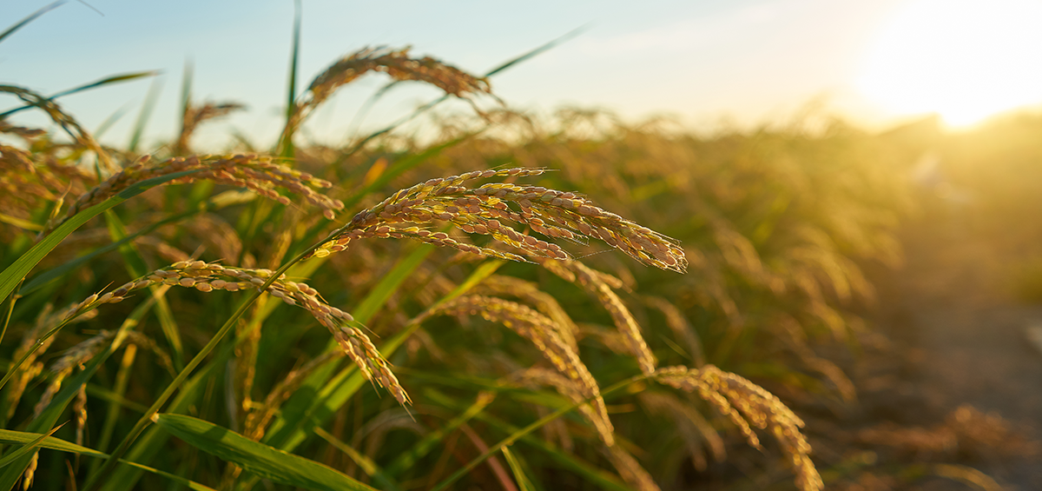
Benefits Of Farm Tech :
Improved Crop Management
(AI-driven crop recommendations based on soil and weather conditions,
Precision farming techniques to optimize resource use.)
Increased Productivity
(IoT-based automated irrigation and smart farming solutions,
Pest and disease detection with AI-powered insights.)
Real-Time Weather Alerts & Updates
(Timely weather forecasts to prevent crop damage,
Alerts for extreme weather conditions to aid decision-making.)
Market Access & Fair Pricing
(Live market price updates to help farmers get better deals,
Direct buyer-seller connections to eliminate middlemen.)

Slide 5
Scope :
The scope of the farmtech website is limited to the basic support for farmers and agribusinesses.
First, it could be made more user-friendly by providing easy access of relevant information such as crop prices, weather updates, and farming techniques.
Second, it could be made more efficient by using a database to store agricultural data like crop yields, soil health, and user preferences. This would allow for faster data retrieval and more personalized recommendations for users.
Third, it could be made more interactive by incorporating real-time communication tools, like chat support or expert consultations, enabling farmers to get instant advice or solutions.
Fourth, it could be made more secure by adding data encryption and user authentication to protect sensitive information and ensure that only verified users can access and manage their data.

Slide 6
Technology Stack :
Frontend: CSS,HTML
Backend: Php
Database: MySql

Slide 7
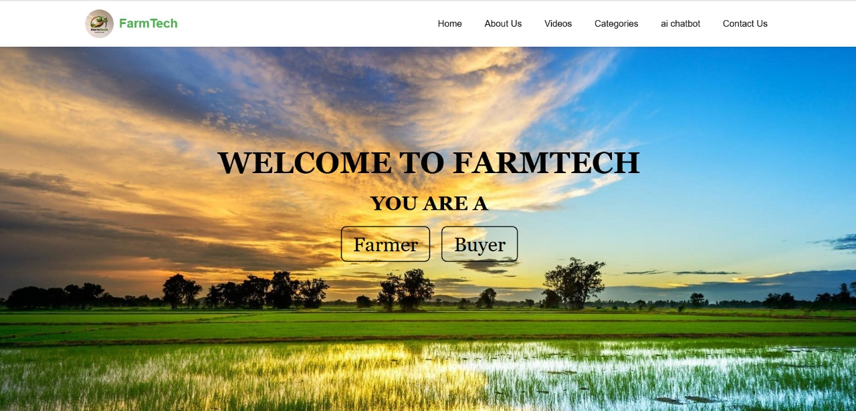
The homepage of FarmTech provides a welcoming interface for users, allowing them to choose between roles as a Farmer or Buyer. It features a visually appealing agricultural landscape with navigation options for exploring various sections like videos, categories, and an chatbot.

Slide 8
The image showcases an AgriTech e-commerce platform where farmers can list and sell fresh agricultural products such as potatoes, tomatoes, carrots, and more. It features a user-friendly interface with product images, prices, and an option to add new products for direct farm-to-consumer sales.

Slide 9

The Knowledge Hub provides educational content on modern farming techniques, organic farming, and agribusiness trends. It offers insights into sustainable practices, innovative technologies, and market opportunities in agriculture. Farmers and agribusiness professionals can access expert knowledge, success stories, and networking opportunities to enhance productivity and sustainability.

Slide 10
The weather forecasting webpage provides real-time weather updates as well as displaying the current temperature, air quality index, and a five-day forecast. It also includes key highlights like humidity, pressure, visibility, and sunrise/sunset timings in a sleek, dark-themed interface.

Slide 11
Thank You…!!!

