Slide 1
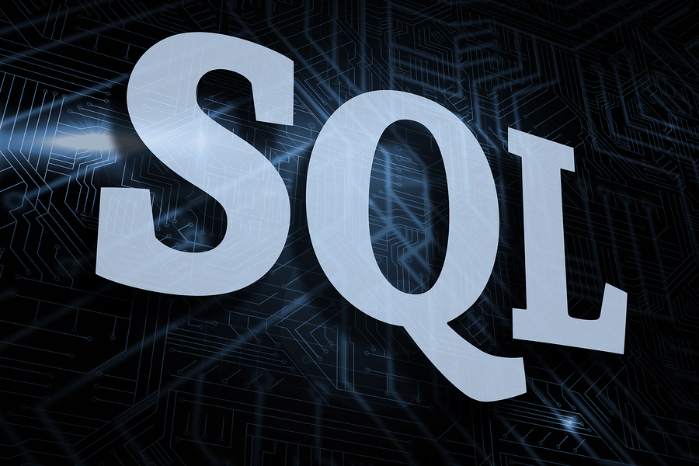
Presented By:
NAVYA SREE CHEGGOJU

Slide 2
Contents
Introduction
SQL statements
Joins
What is SQL?

Slide 3
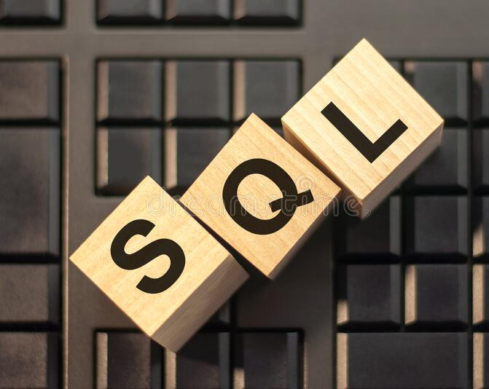


Slide 4
SQL Query language
SQL stands for Structured Query Language.
SQL is used to communicate with a database.
Statements are used to perform tasks such as update data on a database or retrieve data from a database.

Slide 5
SQL STATEMENTS
DDL(Data Definition Language)
DML(Data Manipulation Language)
DTL(Data Transaction Language)
DCL(Data Controlled Language)
DQL(Data Query Language)

Slide 6
1.DDL(Data Definition Language):
" DDL is used to construct an object in the database and deals with the Structure of the Object "
1.CREATE
2. RENAME
3. ALTER
4. TRUNCATE
5. DROP.
2.DML(Data Manipulation Language):
It is used to Manipulate the Object by performing insertion , updating and deletion .
1.INSERT
2. UPDATE
3. DELETE

Slide 7
3.DTL(Data Transaction Language):
"It is used to control the transactions done on the database ".
1.COMMIT
2. ROLLBACK
3. SAVEPOINT
4.DCL(Data Controlled Language):
"This statement is used to control the flow of data between the users”
We have 2 statements :
1.GRANT
2. REVOKE
5.DQL(Data Query Language):
1. SELECT
2. PROJECTION
3. SELECTION
4. JOIN

Slide 8
Important clauses
Divided into “clauses” each of which does a particular piece of work.
SELECT – Chooses the individual fields (columns) from the database (not necessarily a particular table)
FROM – Chooses which table(s) we are working with
WHERE – Provides criteria for the selection

Slide 9
Begin From SQL Query
Get one FROM & WHERE clauses
Combine with SELECT clause
Yes
Execute SQL
Return result
More Clauses?
No
END

Slide 10
Types of JOINS
1. CARTESIAN JOIN / CROSS JOIN
2. INNER JOIN / EQUI JOIN
3. OUTER JOIN
i. LEFT OUTER JOIN
ii. RIGHT OUTER JOIN
iii. FULL
4. SELF JOIN
5. NATURAL JOIN .

Slide 11
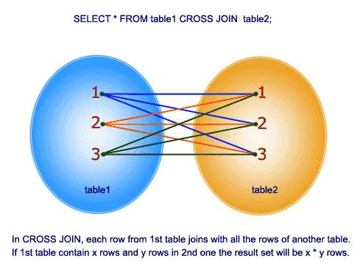
CARTESIAN JOIN / CROSS JOIN
“In Cartesian Join a record from table 1 will be merged with All the records of table 2 “

Slide 12
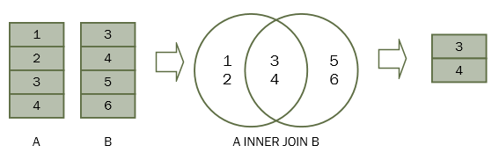
INNER JOIN / EQUI JOIN
"It is used to Obtain only Matching Records " Or " A records which has a Pair "

Slide 13
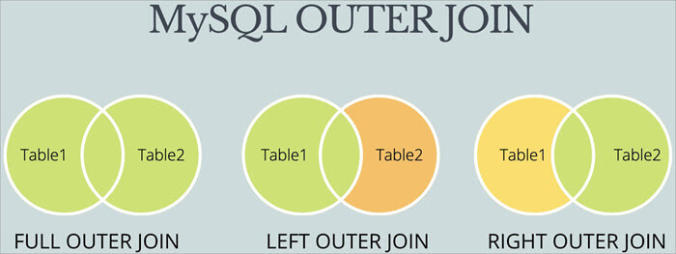
OUTER JOIN
"It is used to Obtain Un-Matched Records”

Slide 14
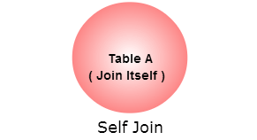
SELF JOIN
"Joining a table by itself is known as Self Join “

Slide 15
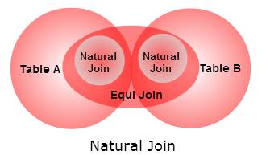
NATURAL JOIN
“It behaves as INNER JOIN if there is a relation between the given two tables , else it behaves as CROSS JOIN"

Slide 16
Thank you

