Slide 1
Problem Statement and Objective
The retailer offers a wide variety of grocery items, but not all products contribute significantly to revenue or customer demand.
Managing an extensive inventory leads to high costs and operational inefficiencies.
By rationalizing the assortment, the retailer can enhance store profitability and improve customer experience.
To optimize the product assortment in the grocery department of one of the largest retailers in Europe.
Identify underperforming items.
Determine high-demand items that may need increased shelf space or stock.
Suggest rationalization strategies to improve profitability, reduce working capital and increase customer satisfaction.

Slide 2
Data Overview
Total Brands – 4
Brands Name – A, B, C, D, E
Total Categories - 6
Categories Name – Snacks , Frozen, Dairy, Bakery, Produce, Beverages
Total Product Type – 5000
Quantifiable Data – Price , Cost, Units Sold, SKU, Shelf Space, Customer Ratings, Frequency of Purchase, Sales, Gross Margin, Total Customers, Total Transactions

Slide 3
Data Analysis Approach
Data Transformation
Data Visualization
Insight Generation and Interpretation
Recommendation
&
Strategic Conclusion
Data Cleaning
Data Familiarization
Defining Analytical Metrics and KPI’s

Slide 4
Analytical KPI’s
Sales - Total Revenue Contribution
Gross Margin - Product Profitability
Total Customers - Unique Customers
Sales Per Customer - Average Spending Per Customer
Customer Rating Proxy - Combines Satisfaction And Repeat Purchase To Measure True Customer Demand.
Sales Per Shelf Space - Evaluates Revenue Efficiency Relative To Space Allocated
Gross Margin Per Shelf Space - Shows Profit Efficiency Per Space Unit
Units Sold Per Shelf Space - Measures Movement Of Units Per Space

Slide 5
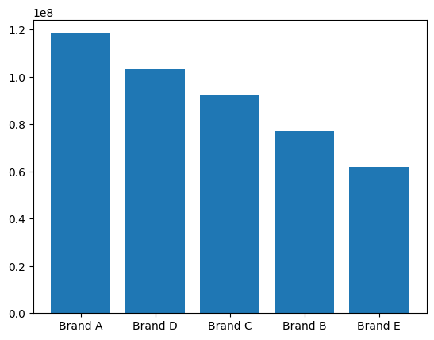
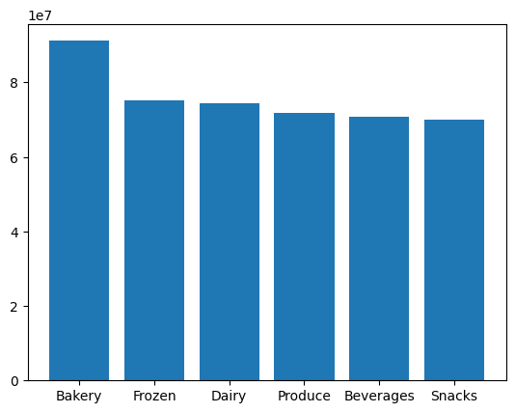
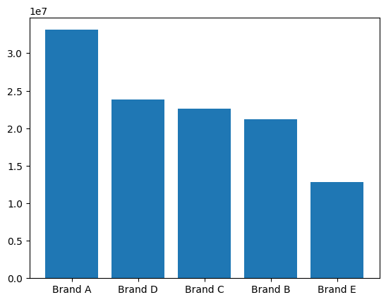
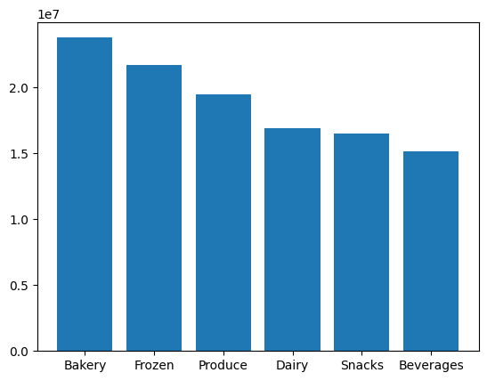
Descriptive Analysis
Sales Distribution
In Million
Gross Margin Distribution
In Million

Slide 6
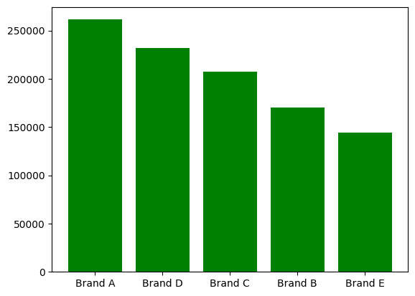
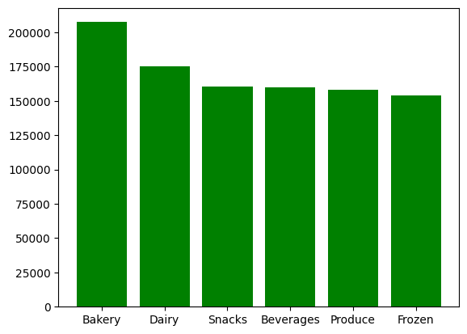
Customer Demand
CUSTOMER RATING PROXY
Brand | Rating | Customer Rating Proxy | Percentage
Brand B | Snacks | 26717.7 | 2.6%
Brand B | Frozen | 26304.5 | 2.5%
Brand B | Produce | 25737.9 | 2.5%
Brand E | Dairy | 25319.1 | 2.4%
Brand E | Snacks | 24853.7 | 2.4%
Brand E | Frozen | 24062.8 | 2.3%
Brand E | Produce | 21475.0 | 2.1%
Brand E | Beverages | 21066.0 | 2.0%
Brand | Rating | Customer Rating Proxy | Percentage
Brand A | Bakery | 52624.6 | 5.1%
Brand A | Dairy | 48233.4 | 4.7%
Brand D | Bakery | 47828.7 | 4.7%
Brand A | Produce | 46405.5 | 4.5%
Brand C | Bakery | 44172.5 | 4.3%
Brand A | Snacks | 39095.3 | 3.8%
Brand D | Beverages | 39018.4 | 3.8%
Brand A | Frozen | 38367.1 | 3.7%
Top Performers
Low Performers

Slide 7
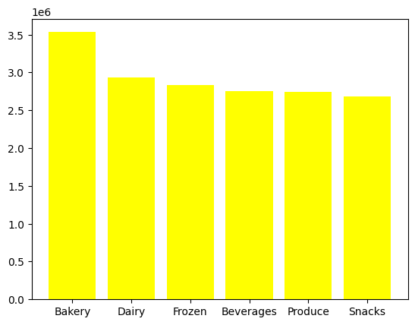
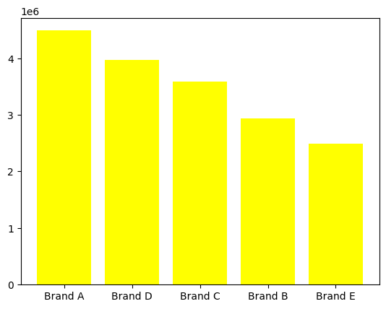
Inventory Analysis
BRANDS | Categories | Units Sold
Brand A | Bakery | 845724
Brand A | Dairy | 825099
Brand A | Produce | 797491
Brand D | Bakery | 794998
Brand C | Bakery | 777062
Brand A | Frozen | 709316
Brand A | Snacks | 674137
Brand D | Snacks | 659152
Brand D | Beverages | 657692
Brand C | Beverages | 640941
Brand A | Beverages | 638396
Brand D | Frozen | 638320
Brand B | Bakery | 629562
Brand D | Dairy | 620230
Brand D | Produce | 605868
Brand C | Dairy | 566835
Brand C | Snacks | 547095
Brand C | Frozen | 543478
Brand C | Produce | 513963
Brand B | Frozen | 508453
Brand E | Bakery | 486745
Brand B | Dairy | 483903
Brand B | Produce | 454832
Brand E | Frozen | 439030
Brand E | Dairy | 435103
Brand B | Beverages | 434357
Brand B | Snacks | 424140
Brand E | Snacks | 380034
Brand E | Beverages | 378496
Brand E | Produce | 370923
Product Name | Units Sold
Product 2060 | 188
Product 2598 | 248
Product 1276 | 306
Product 3090 | 327
Product 2194 | 379
Product 3461 | 400
Product 3777 | 406
Product 2123 | 442
Product 3357 | 443
Product 961 | 472
Product 3466 | 474
Product 4055 | 482
Product 3025 | 486
Product 2282 | 493
Product 77 | 493
Product 240 | 508
Product 4029 | 518
Product 3640 | 531
Product 1976 | 531
Product 3712 | 534
Units Sold
In Million
Top 20 Slow Moving Items
Units Sold
In Million

Slide 8
Performance Summary
Performance Tier | Percentile Range | Performance Score | Performance Score % | Total Items | Shelf Space | Shelf Space %
Top Performers | < 25th | 5209 | 34% | 1248 | 2470.69 | 19%
Medium Performers | > 25th & < 75th | 7400 | 48% | 2495 | 7184.25 | 54%
Under Performers | > 75th | 2665 | 17% | 1248 | 3672.79 | 28%

Slide 9


Recommendations
By eliminating under-performing and replacing mid-performing products and reallocating shelf space toward top performers, the retailer can significantly improve profitability, reduce inventory cost, and enhance customer satisfaction, achieving a efficient assortment.
Retain & Expand High Performers
Increase shelf space for top-performing products.
Improve visibility through better placement (eye-level, end caps).
2. Optimize Medium Performers
Conduct category-level review of mid performers to identify:
Run promotional strategies (bundles, discounts) to boost mid-tier items with potential.

Slide 10

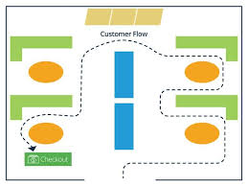
Recommendations
3. Rationalize Underperformers
Prioritize phasing out or replacing products contributing <25th percentile performance.
Free up 28% shelf space currently wasted and move it to higher-performing SKUs.
4. Improve Assortment Profitability
Redirect space saved from underperformers toward:
  High-margin products
  Fast-moving SKUs
  Customer-preferred brands/products

