Slide 1
Bluestock Mutual Fund Analytics Capstone Project
Prepared By: Hema Durga Prasad Sunkara B.Tech CSE

Slide 2
Problem Statement & Objectives
Problem Statement
Investors often struggle to evaluate mutual fund performance, risk, and market trends due to large volumes of financial data.
Objectives
Build an ETL pipeline
Clean and validate datasets
Create a SQLite data warehouse
Perform EDA and analytics
Evaluate fund performance
Build an interactive Power BI dashboard
Generate actionable insights

Slide 3
Data Sources
Datasets Used
Fund Master
NAV History
AUM by Fund House
Monthly SIP Inflows
Category Inflows
Industry Folio Count
Scheme Performance
Investor Transactions
Portfolio Holdings
Benchmark Indices

Slide 4
System Architecture
.
Raw CSV Data
Data Ingestion
Data Cleaning
SQLite Database
EDA & Analytics
Advanced Analytics
Power BI Dashboard
Business Insights

Slide 5
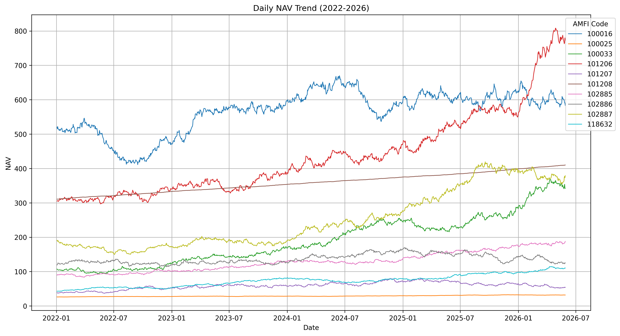
EDA Highlights 1
NAV Trend Analysis
Analyzed daily NAV movement for all schemes
Identified growth patterns and market corrections
Most funds demonstrated long-term upward trends
Key Insight
Long-term investment strategies benefited from sustained NAV growth despite short-term volatility.

Slide 6
EDA Highlights 2
AUM & SIP Growth Analysis
Compared fund house AUM growth
Evaluated SIP inflow trends from 2022–2025
Retail participation increased significantly
Key Insight
Rising SIP inflows indicate growing investor confidence and financial awareness.

Slide 7
Performance Analytics
Metrics Computed
CAGR (1Y, 3Y, 5Y)
Sharpe Ratio
Sortino Ratio
Alpha
Beta
Maximum Drawdown
Key Findings
High Sharpe funds delivered better risk-adjusted returns
Positive Alpha funds outperformed benchmarks
Drawdown analysis highlighted downside risk exposure

Slide 8
Advanced Analytics
Advanced Models Implemented
Value at Risk (VaR)
Conditional VaR (CVaR)
Rolling Sharpe Ratio
Investor Cohort Analysis
SIP Continuity Analysis
HHI Concentration Analysis
Fund Recommendation System

Slide 9
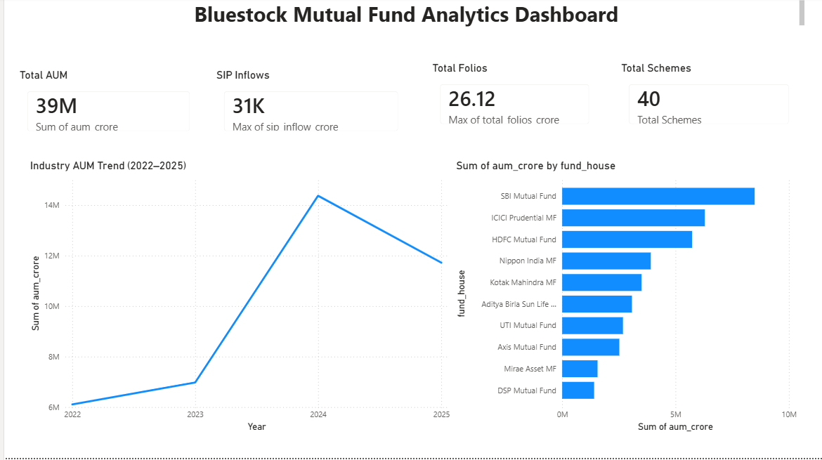
Dashboard Screenshot
Industry Overview Dashboard
Features:
Total AUM
SIP Inflows
Total Folios
Industry Trends
AUM by AMC

Slide 10
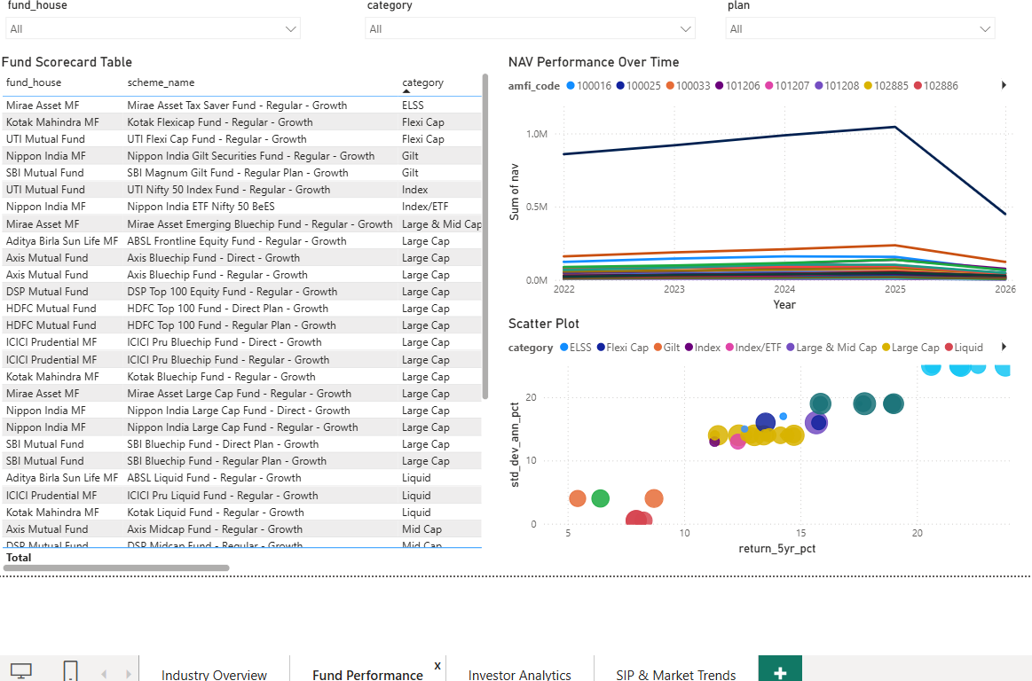
Dashboard Screenshot
Fund Performance Dashboard
Features:
Return vs Risk Scatter Plot
Fund Scorecard
NAV Trend Analysis
Interactive Filters

Slide 11
Key Findings
Major Findings
SIP participation increased significantly
Large-cap funds showed stable performance
Risk-adjusted returns varied considerably
Investor activity concentrated in major states
Certain funds demonstrated superior Sharpe Ratios
Portfolio concentration differed across schemes
Dashboard enabled efficient investment analysis

Slide 12
Thank You
Bluestock Mutual Fund Analytics
Prepared By: Hema Durga Prasad Sunkara

