Slide 1
RAG-Powered Search Engine
Q&A with Retrieval-Augmented Generation
Final Capstone Project · IITG · AI Application Development
LangChain · Azure OpenAI (gpt-5-chat) · local MiniLM embeddings · FAISS · Streamlit
Author: Prasad Thipparthi · Project Option #2

Slide 2
OVERVIEW
Project Overview & Problem Statement
THE PROBLEM
LLMs cannot answer questions about private or recent documents (knowledge cut-off), and they hallucinate — confident but false answers — when they don't know.
THE GOAL
Answer natural-language questions over a custom document collection; ground every answer in retrieved passages, cite sources, and abstain when the answer is absent.
THE SOLUTION — RETRIEVAL-AUGMENTED GENERATION
Combine vector similarity search over the documents with an LLM that is instructed to answer only from the retrieved context.
WHY IT MATTERS
Grounding + citations make answers verifiable; explicit abstention is the key anti-hallucination behaviour. Embeddings run locally, so only the chat completion incurs API cost.
RAG-Powered Search Engine · IITG Final Capstone · LangChain · Azure OpenAI (gpt-5-chat) · FAISS · Prasad Thipparthi

Slide 3
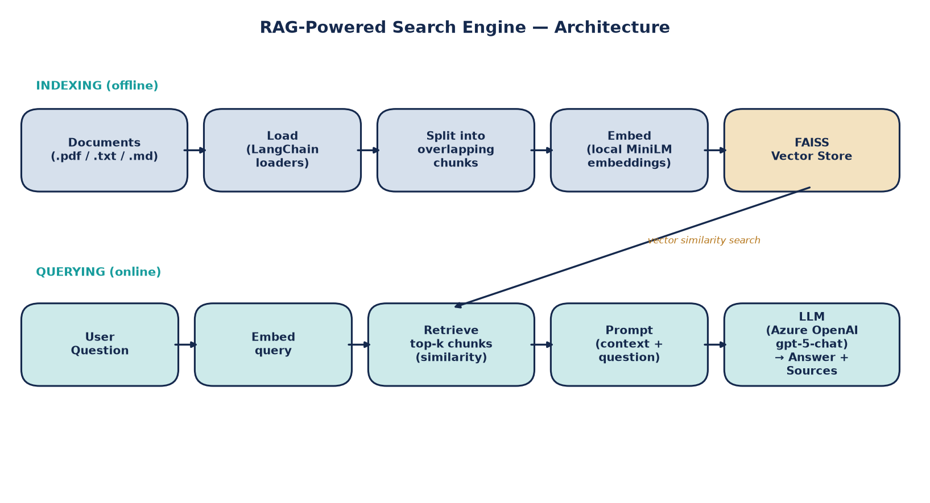
ARCHITECTURE
Two-Phase RAG Architecture
Offline INDEXING turns documents into a FAISS vector store; online QUERYING retrieves relevant chunks and generates a grounded, cited answer.
RAG-Powered Search Engine · IITG Final Capstone · LangChain · Azure OpenAI (gpt-5-chat) · FAISS · Prasad Thipparthi

Slide 4
WORKFLOW
How a Question Becomes a Grounded Answer
INDEXING (offline)
• Load — read .pdf / .txt / .md files into LangChain Documents with source metadata.
• Split — RecursiveCharacterTextSplitter → ~1000-char chunks, 150-char overlap.
• Embed — each chunk → dense vector via local all-MiniLM-L6-v2 (offline, free).
• Index — vectors stored in an in-memory FAISS index (persistable to disk).
QUERYING (online)
• Embed query — the question is embedded with the same model.
• Retrieve — FAISS returns the top-k (default 4) most similar chunks.
• Augment — chunks injected into a system prompt that forbids out-of-context answers.
• Generate — Azure OpenAI gpt-5-chat produces a grounded answer + cited sources.
RAG-Powered Search Engine · IITG Final Capstone · LangChain · Azure OpenAI (gpt-5-chat) · FAISS · Prasad Thipparthi

Slide 5
IMPLEMENTATION
Tech Stack & Configuration
Component | Choice | Role
Orchestration | LangChain (LCEL) | Chains load → retrieve → prompt → generate
Chat LLM | Azure OpenAI gpt-5-chat | Generates the grounded answer
Embeddings | all-MiniLM-L6-v2 (local) | Encodes chunks & queries — offline, no cost
Vector store | FAISS (in-memory) | Fast similarity search over chunk vectors
Loaders / splitter | PyPDF + RecursiveCharacterTextSplitter | Ingest & chunk documents
UI / deployment | Streamlit | Upload docs, ask questions, view citations
KEY SETTINGS
chunk_size = 1000 · chunk_overlap = 150 · top_k = 4. Provider is auto-detected from environment variables (Azure → OpenAI fallback); embeddings backend is switchable (local / azure / openai). gpt-5-chat uses its default temperature.
RAG-Powered Search Engine · IITG Final Capstone · LangChain · Azure OpenAI (gpt-5-chat) · FAISS · Prasad Thipparthi

Slide 6
RESULTS
Testing & Evaluation
RETRIEVAL QUALITY — hit@k
For every evaluation question, the expected source document appeared among the top-k retrieved chunks.
5 / 5
hit@4 retrieval
GENERATION QUALITY
In-corpus questions answered correctly with quoted evidence and citations; the out-of-corpus question was correctly refused — "I don't know based on the provided documents."
Evaluation question | Expected source | Retrieved?
What is a token in an LLM? | llm_concepts.md | Yes
Common distance metric for text embeddings? | vector_databases.md | Yes
Good starting chunk size for RAG? | rag_overview.md | Yes
Stock price of Apple on 1 Jan 2026? (out-of-corpus) | — none — | Abstained
RAG-Powered Search Engine · IITG Final Capstone · LangChain · Azure OpenAI (gpt-5-chat) · FAISS · Prasad Thipparthi

Slide 7
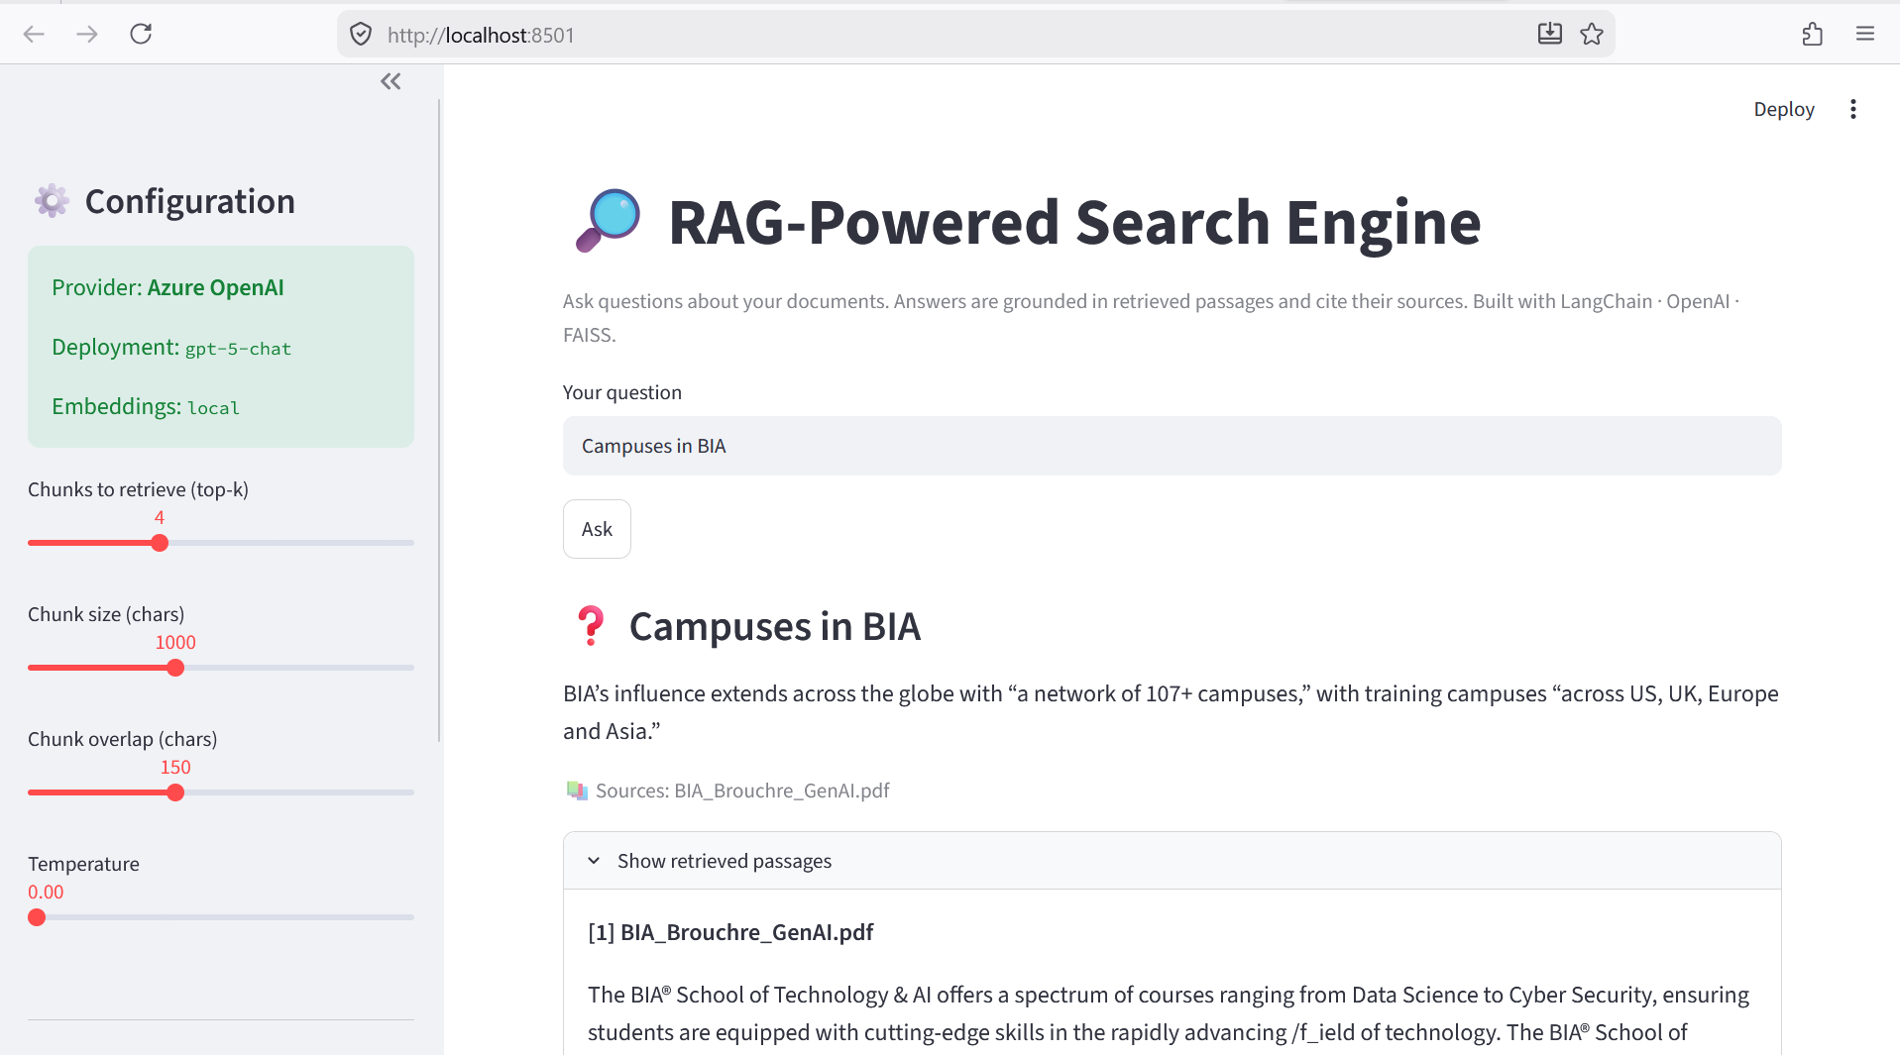
SCREENSHOTS
Demo — Streamlit App
[ Insert screenshot here ]
Run `streamlit run app.py`, build the knowledge base, ask a question, and capture the answer with its cited sources and the 'Show retrieved passages' panel expanded.
RAG-Powered Search Engine · IITG Final Capstone · LangChain · Azure OpenAI (gpt-5-chat) · FAISS · Prasad Thipparthi

Slide 8
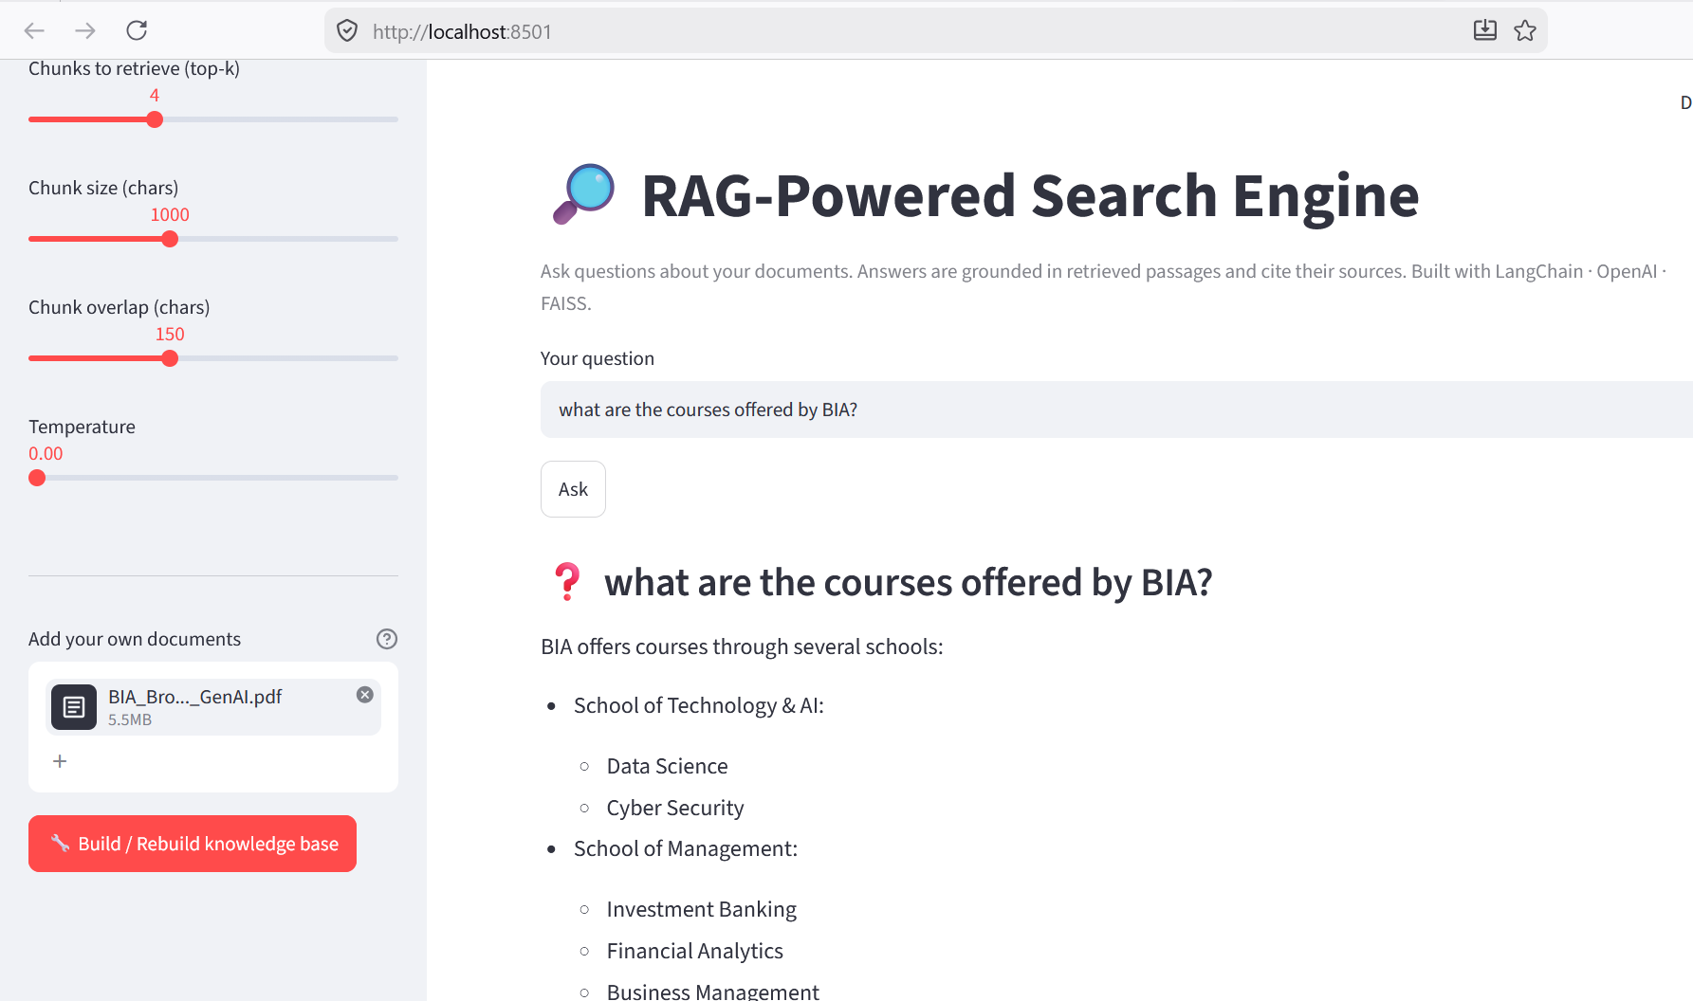
SCREENSHOTS
Demo — Streamlit Results
[ Insert screenshot here ]
Capture the evaluation cells from project.ipynb (the hit@k output and the abstention test) and the final batch of answered questions.
RAG-Powered Search Engine · IITG Final Capstone · LangChain · Azure OpenAI (gpt-5-chat) · FAISS · Prasad Thipparthi

Slide 9
CHALLENGES
What Was Hard
• Chunking trade-offs — chunks too large dilute relevance; too small lose context. 1000/150 balanced both for this corpus.
• Faithfulness vs. helpfulness — a strict 'answer only from context' prompt can over-abstain; it was tuned to synthesize across retrieved chunks while staying grounded.
• Model constraints — Azure gpt-5-chat rejects temperature=0 (default only); the pipeline omits the parameter on Azure so the call succeeds.
• Cost & latency — running embeddings locally removed embedding API cost; persisting the FAISS index avoids re-embedding on every run.
TAKEAWAY
Most effort went into grounding behaviour and provider quirks, not the happy path.
RAG-Powered Search Engine · IITG Final Capstone · LangChain · Azure OpenAI (gpt-5-chat) · FAISS · Prasad Thipparthi

Slide 10
ROADMAP
Future Improvements
• Cross-encoder re-ranking after vector retrieval for higher precision.
• Hybrid search — combine BM25 keyword matching with dense vectors.
• Conversational memory and response streaming for multi-turn Q&A.
• Automated faithfulness scoring with RAGAS.
• Swap FAISS for a managed vector DB (Pinecone / pgvector / Weaviate) at scale.
RAG-Powered Search Engine · IITG Final Capstone · LangChain · Azure OpenAI (gpt-5-chat) · FAISS · Prasad Thipparthi

Slide 11
Thank You
Code, notebook and demo app included in Final_Capstone_Project.zip

