Slide 1

Analytics Vidya Job A Thon- September 2021
Supplement Sales Prediction
By Prasad Vasant Verulkar

Slide 2
Problem Statement
To predict the store sales for each store in the test set for the next two months.

Slide 3
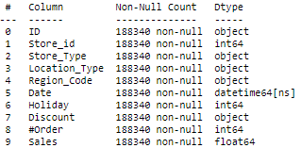
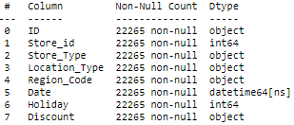
Dataset Description
Train Data
Rows: 188340, Columns: 10
Y Variable: Sales
Date: 1
Columns
Numerical: 3
Nominal: 4
Categorical:4
Ordinal: 0
Unique Identifier: 1
Test Data
Rows: 22265, Columns: 8

Slide 4
Steps in Building ML Model
Setting up Validation Strategy
Cross Validation
1
Reading Data
5
9
Splitting train and validation set based on date.
To make model robust and reduce over fitting
Data Preprocessing
Feature Scaling
2
Handling Missing values
Handling Outliers
Check for Duplicates
6
MinMax Scaler
Exploratory Data Analysis
Feature Selection
3
Exploring Data to reveal hidden insights.
7
Since features in dataset were already less, hence feature selection is not performed.
Feature Engineering
Model Building
4
Generating New Features
Categorical Encodings
8

Slide 5
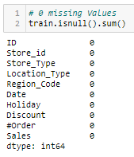
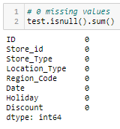
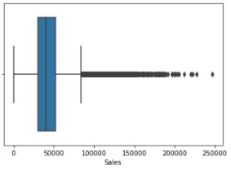
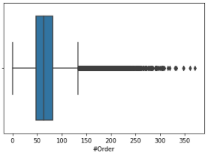


Data Pre processing
Exploratory Data Analysis
Feature Engineering
Feature Scaling
Validation Strategy
Model Building & Comparison
Check for Missing Values
Handling Outliers
No missing Values in Dataset
Sales and Orders column contain outliers.
3.1% of Sales values are greater than upper whisker.
3.76% of Orders values are greater than upper whisker.
Can’t remove them since these data points reveal important information.
Therefore, Trees and Ensemble techniques can be used for model building.
Train
Test
Sales
Orders
Check for Duplicated Rows

Slide 6
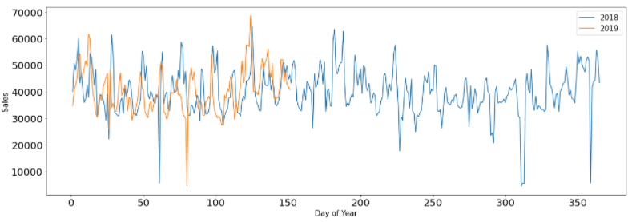
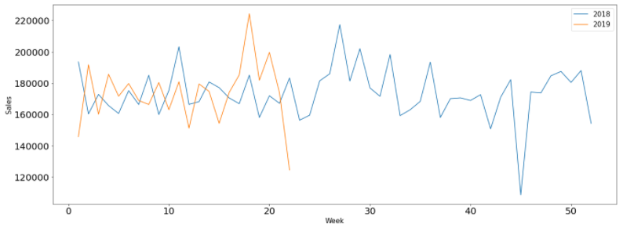
Data Pre processing
Exploratory Data Analysis
Feature Engineering
Feature Scaling
Validation Strategy
Model Building & Comparison
Median Daily Sales
Median Weekly Sales

Slide 7
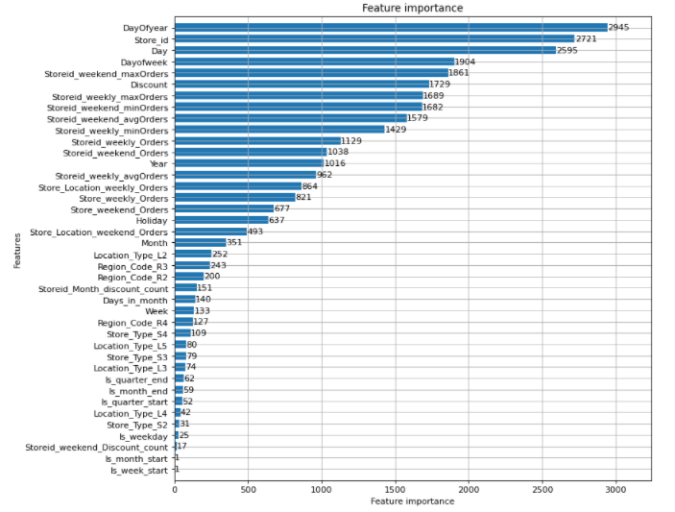

Data Pre processing
Exploratory Data Analysis
Feature Engineering
Feature Scaling
Validation Strategy
Model Building & Comparison
New Features
Total Weekly Orders based on Store_type.
Total weekends orders in every week of a month based on store_type.
Total Weekly Orders based on Store_type & Location_Type.
Total Weekend Orders based on Store_type & Location_Type.
Total Weekly Orders by Store_id
Total weekends orders in every week of a month based on Store_id.
Avg Weekly Orders by Store_id
Avg weekends orders in every week of a month based on Store_id.
store.
Minimum Weekly Orders by Store_id
Minimum weekends orders in every week of a month based on Store_id.
Maximum Weekly Orders by Store_id
Maximum weekends orders in every week of a month based on Store_id.
Count of discounts offered by each store in every month
Count of discounts on weekends of every week in a month for every store.
Feature Encoding
One Hot Encoding for nominal categorical variables
Total Features after Feature Encoding & One Hot Encoding: 45

Slide 8
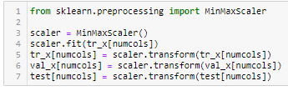
Data Pre processing
Exploratory Data Analysis
Feature Engineering
Feature Scaling
Validation Strategy
Model Building & Comparison
Min-Max Scaler for Numeric Columns

Slide 9
Data Pre processing
Exploratory Data Analysis
Feature Engineering
Feature Scaling
Validation Strategy
Model Building & Comparison
Model evaluation on Validation set
KFold Cross validation
Train-Validation Split
Data Before 1st April 2019 : Train Set
Data from 1st April 2019: Validation Set
Building models and tuning hyper parameters on train set and evaluating on validation set.
KFold cross validation on train set for final model evaluation.

Slide 10
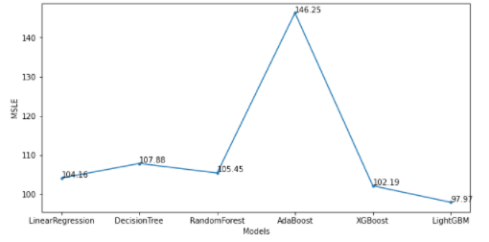
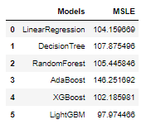
Data Pre processing
Exploratory Data Analysis
Feature Engineering
Feature Scaling
Validation Strategy
Model Building & Comparison
Total Models Built: 6
Linear Regression | Decision Tree | Random Forest | AdaBoost | XgBoost | LightGBM
Best Performing model is LightGBM
Being the lowest MSLE of 0.97, LightGBM Regressor model is selected among all other models.
These scores are for the validation set and thus final scores are evaluated using Cross Validation.

