Slide 1





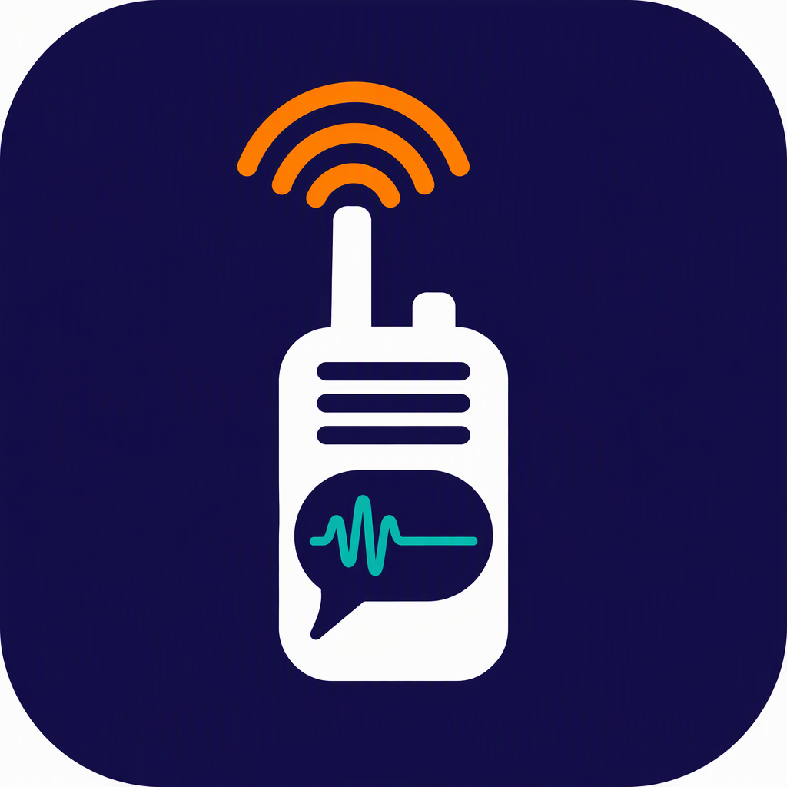
SMART INDIA HACKATHON 2026
TITLE PAGE
Problem Statement ID – SIH26173
Problem Statement Title- iTantra – Indian Multilingual TTS & STT Aided Neural Transceiver Radio Access for low bitrate links
Theme- Smart Automation
PS Category- Software
Team ID- 188881
Team Name (Registered on portal) Team Turtle
Website
Demo film
Code
APK
iTantra
Speak. Send text. Hear it back — offline.

Slide 2
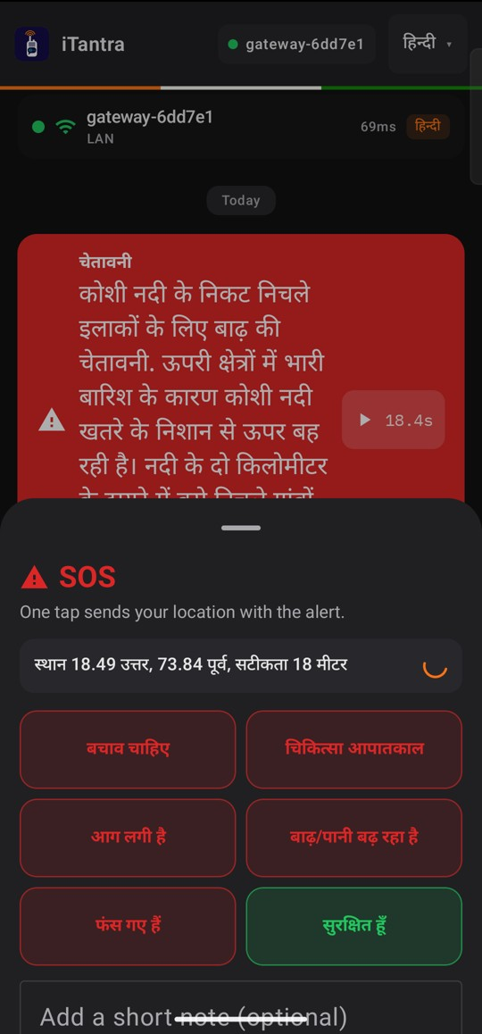
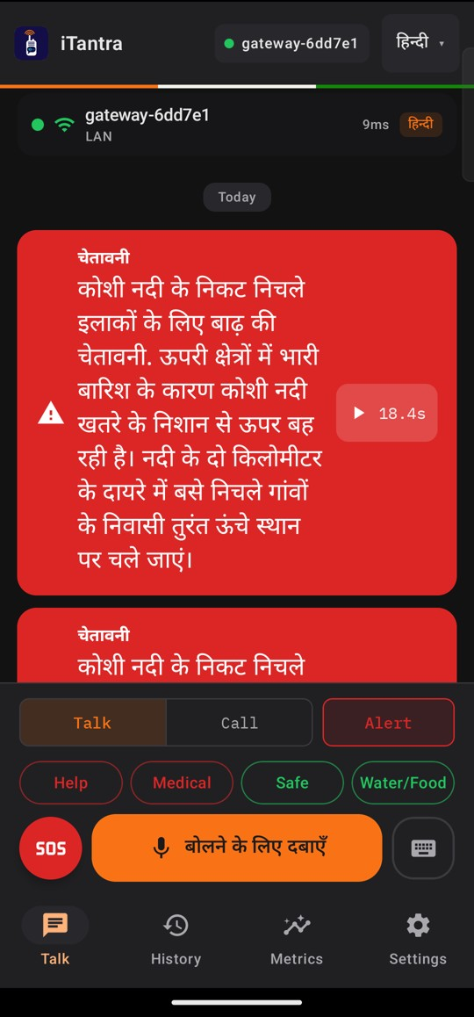






iTantra: Speak. Send Text. Hear It Back — Offline
Team Turtle
Proposed Solution (Describe your Idea/Solution/Prototype)
Problem: when towers fail after a flood or cyclone, only thin links remain — Bluetooth, a crowded hotspot or LoRa radio at ~250 bps. Voice needs 256 kbps raw, ~12 kbps with a good codec.
Our idea: send the meaning, not the sound. Speech becomes text on the phone, only the text travels, and it is spoken again on arrival. No tower, no internet, no cloud.
Speak
hold to talk
Speech → text
on the phone
Tiny frame
≈62 bytes*
Any link
Wi-Fi · Direct · BLE
Text → speech
own language
Detailed explanation of the proposed solution
How it addresses the problem
Innovation and uniqueness of the solution
10 Indian languages. Hindi, Bengali, Marathi, Telugu, Tamil, Gujarati, Kannada, Malayalam, Odia, English — speech in and out.
ALERT mode. Plays on the alarm stream at full volume with vibration (16/16 in test).
SOS. One tap sends 1 of 6 templates with GPS/NavIC location, read aloud on arrival.
Talk your way. Push-to-talk, hands-free call mode and live captions.
Speech is the codec. Text on the wire; the voice is rebuilt in the listener's language.
One frame, any link. Wi-Fi, then Wi-Fi Direct (4 s), then Bluetooth LE (8 s), with no user action.
Trusted alerts. ALERTs are Ed25519-signed; messages are encrypted after QR pairing.
Adapts to the phone. LITE profile turns on by itself below 6 GB RAM.
bits/s for one spoken sentence (log scale)
≈1,500× less data than raw audio — a sentence fits LoRa's ~250 bps.
62 B per sentence in binary vs 524 B as JSON.
Still speech at the end, so people who cannot read are included.
Sender · SOS
Receiver · ALERT
Watch the demo film · 1 min 55 s
Real screens from the running prototype (v0.1.0), vivo I2202, Snapdragon 870. Try it: itantra-106.pages.dev
*Median of 310 FLEURS sentences (unit test), before encryption and link headers. Bars assume a ~3 s sentence.

Slide 3







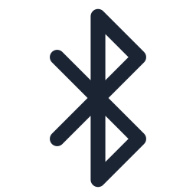




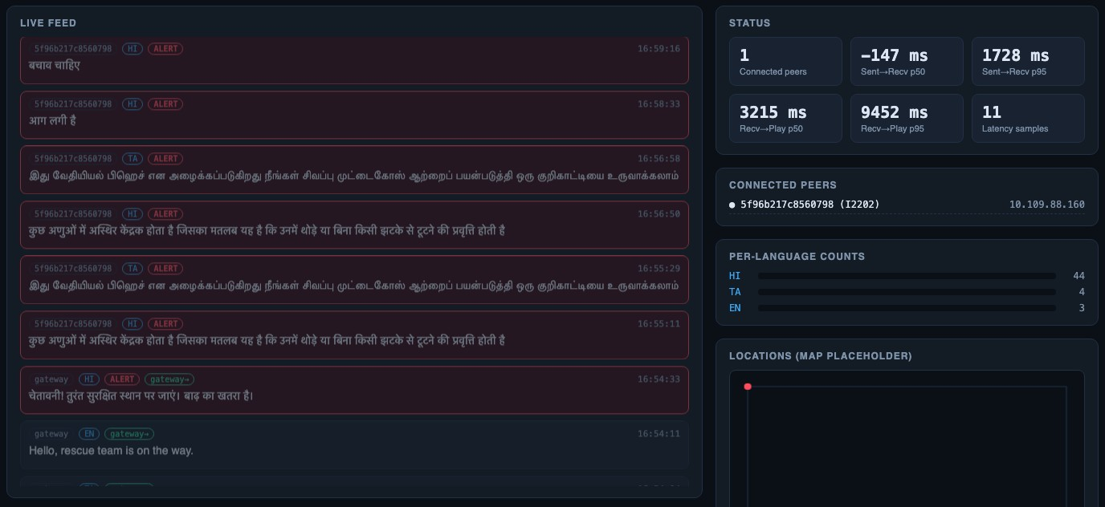
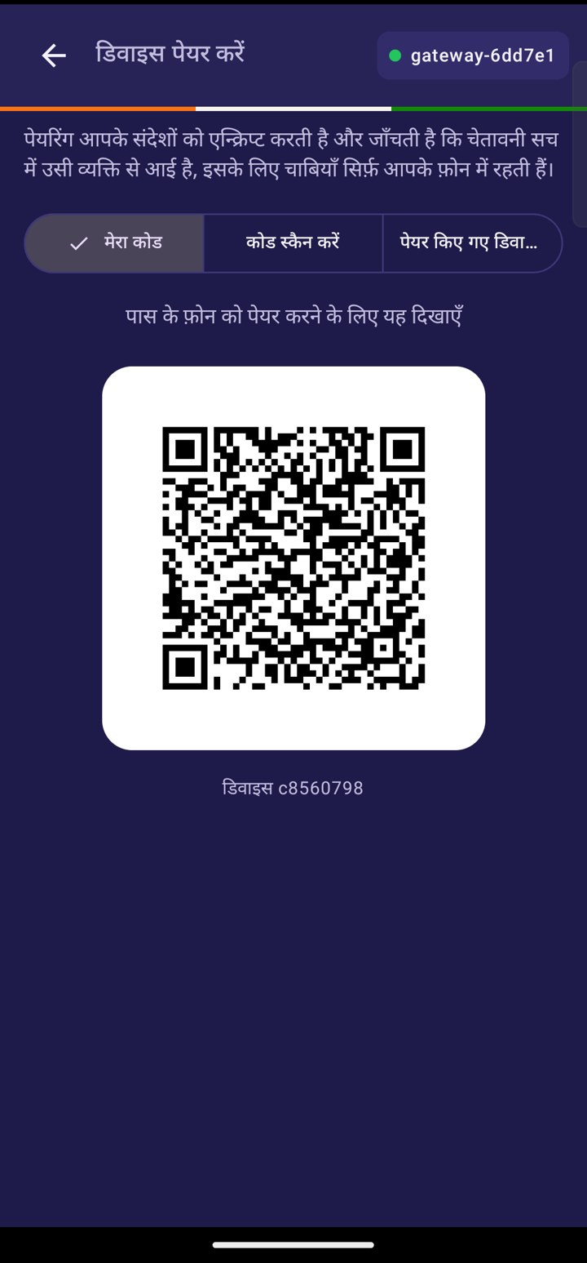
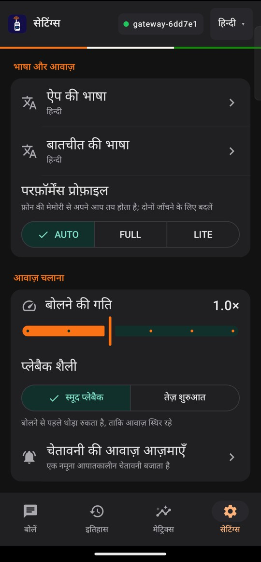
TECHNICAL APPROACH
Team Turtle
Technologies to be used (e.g. programming languages, frameworks, hardware)
Methodology and process for implementation (Flow Charts/Images/ working prototype)
Layer | Technology
App | Kotlin 2.4, Jetpack Compose; Android 8.0+, 64-bit ARM
Voice detection | Silero VAD (0.6 MB) — a pause ends the sentence
Speech-to-text | SraVaani-1.0 (IISc), int8 ONNX on sherpa-onnx
Text-to-speech | VITS Rasa (6 languages), Indic-Mio via llama.cpp (4)
Links | Wi-Fi mDNS/TCP, Wi-Fi Direct, BLE GATT
Security | X25519, ChaCha20-Poly1305, Ed25519; QR pairing
Radio | ESP32-S3 + SX1262 LoRa, 865–867 MHz, RadioLib
Control room | Python gateway, SQLite log, CAP 1.2 alert parser
SENDER PHONE
ANY LINK — same frame
RECEIVER PHONE
Mic 16 kHz
Wi-Fi LAN (first)
Verify · decode · ACK
VAD: cut at pause
Wi-Fi Direct (+4 s)
Numbers → words
Speech-to-text
Bluetooth LE (+8 s)
TTS, own language
Pack · sign · encrypt
Control room / LoRa
Voice note / ALERT
Built and running
Push-to-talk, call mode, 10-language STT/TTS, ALERT, SOS, LITE profile, control room.
Partial · test pending
Encryption covers binary mode; LoRa firmware compiles; Wi-Fi Direct/BLE two-phone test.
Planned
On-device translation (IndicTrans2), smaller voices, phone-to-phone mesh relay.
Working prototype — real screens
Prototype v0.1.0, APK 60 MB
Models 1.2 GB, installed once
Tested on Snapdragon 870 and 8 Gen 3
Reviewer install guide
PC control room
QR pairing
LITE profile

Slide 4
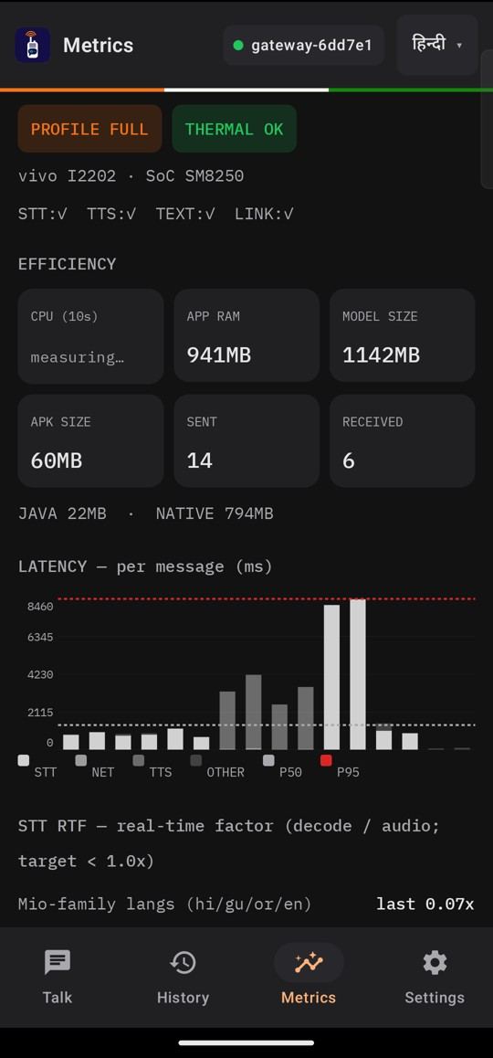
FEASIBILITY AND VIABILITY
Team Turtle
Analysis of the feasibility of the idea
Measured: 4 GB-class memory test, in-app logging
14×
0.6 s
765 MB
0.3%
Alive
faster than speech
real-time factor 0.07, 10/10 languages
speech end → text
median; range 0.42–0.70 s
app RAM when idle
1.8 GB peak while speaking
idle CPU
of one core, push-to-talk
app not killed
Android closed 115 other processes
Method: 12 GB vivo I2202 (Snapdragon 870) with RAM reserved so only ~1.7 GB stayed free, LITE profile; the chip was not slowed, so a budget phone will be slower. Also measured: 41 ms message → ACK over Wi-Fi · 0 audio underruns in 5 languages · word error rate 5.9% (preliminary, 10 clips).
Potential challenges and risks | Strategies for overcoming these challenges
Voice starts 3–6 s after arrival in LITE | Keep the listener's language loaded; add small, fast voices for hi/gu/or/en
1.14 GB of speech models on the phone | Download only the languages a user needs; installer checks every file's SHA-256
Wi-Fi Direct / BLE: two-phone test pending | Field tests on two phones; Wi-Fi stays the primary link; LoRa bridge for range
Noise, accents and code-mixing | Boost alert keywords; 30-clip-per-language evaluation; typed text as a fallback
Viability
₹0 per message: no airtime, SIM, server or cloud fees.
Phones people own: Android 8.0+; LITE mode for less RAM.
Low-cost range: ESP32-S3 + LoRa node ≈ ₹1,900–3,200.
Open licences: MIT, Apache-2.0 and CC-BY-4.0 models.
Fits alert systems: the control room reads CAP 1.2 alert files.
Next steps: two-phone field test of every link · flash and range-test the LoRa bridge · 30-clip-per-language accuracy run · smaller voices for hi/gu/or/en.
In-app metrics (real screen)

Slide 5


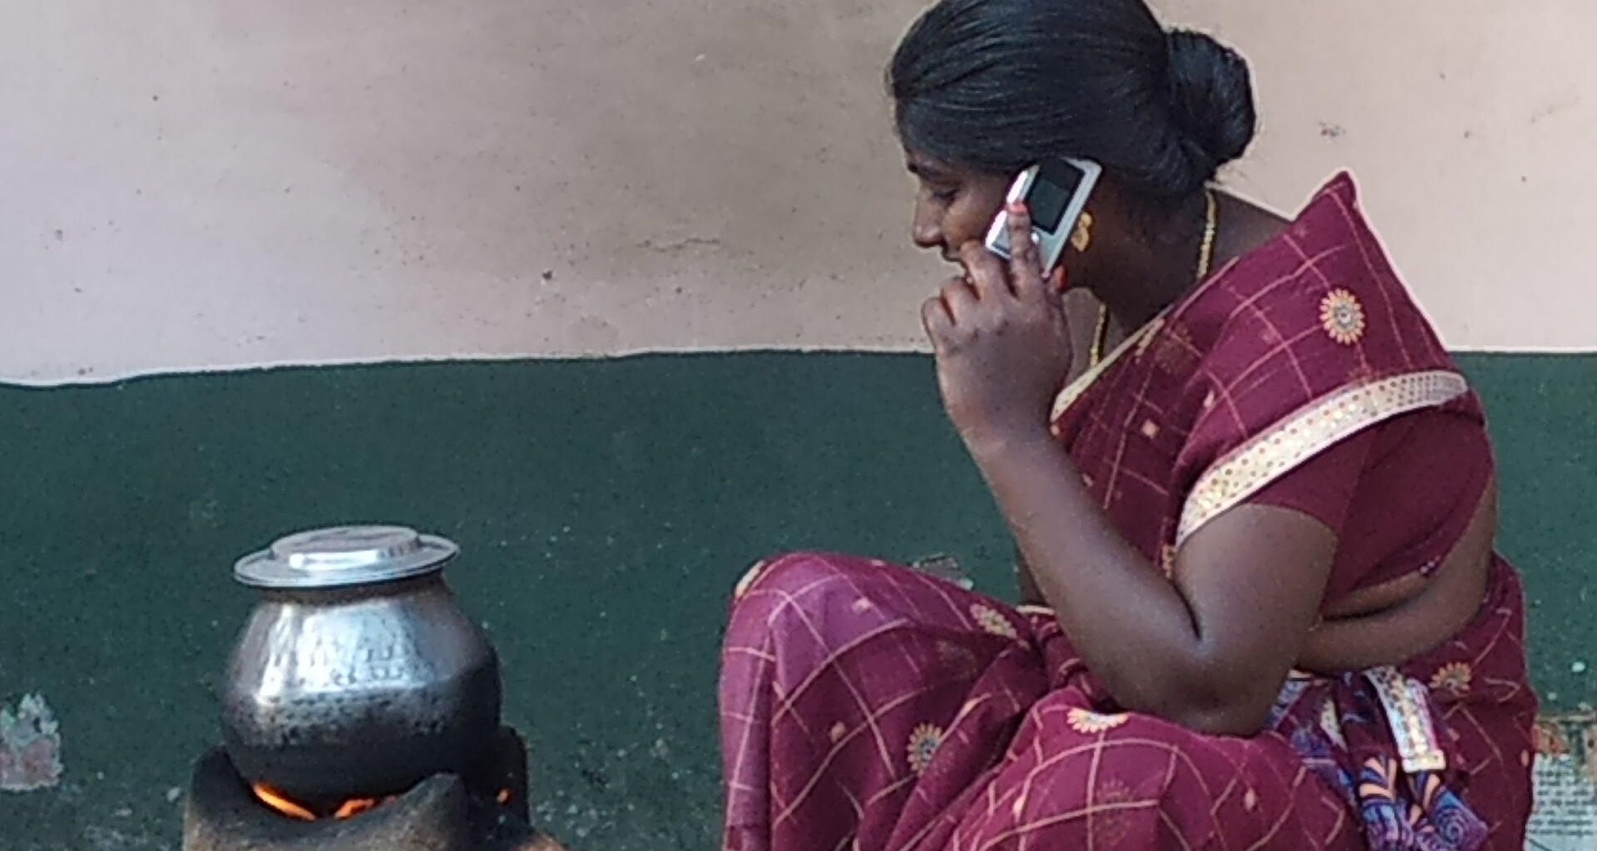




IMPACT AND BENEFITS
Team Turtle
Potential impact on the target audience
Disaster response teams
Coordinate rescue by voice when towers and internet are down.
Coastal fishing communities
Cyclone warnings spoken in their own language, with no data plan.
Low-literacy users
An alert they can hear instead of read, in 10 languages.
Remote field staff
A voice link for teams working where coverage is poor.
≈1,500×
less data than raw audio*
1.03 s
ALERT arrival → spoken aloud (Wi-Fi)
10
Indian languages, speech in and out
Benefits of the solution (social, economic, environmental, etc.)
Social
Economic
Environmental
Alerts spoken aloud in Indian languages — people who cannot read are included.
SOS carries location to rescuers in one tap.
No airtime, SIM, cloud or licence fees.
Runs on phones people own; a LoRa node costs ≈ ₹1,900–3,200.
Fewer bytes per message means less radio time on air.
No servers or data centres needed. Battery gain not yet measured.
Fits India's alert system: the control room reads CAP 1.2 alert files — the format behind NDMA SACHET — and re-broadcasts them as spoken alerts in each listener's language.
*62 B per ~3 s sentence (unit-test median) vs 256 kbps raw audio. No field pilot yet.
Photos, Wikimedia Commons: NDRF – MHA, GODL-India · fishermen – Saral Shots, CC0 · woman on phone – Ammalu, CC BY-SA 3.0 · rail workers – David Brossard, CC BY-SA 2.0

Slide 6









RESEARCH AND REFERENCES
Team Turtle
Details / Links of the reference and research work
Website
overview · results
Open models
Runtimes and libraries
Standards and data
SraVaani-1.0 STT · ARTPARK, IISc
huggingface.co/ARTPARK-IISc/SraVaani-1.0
sherpa-onnx
github.com/k2-fsa/sherpa-onnx
OASIS CAP 1.2 alerts
docs.oasis-open.org/emergency/cap/v1.2/CAP-v1.2.html
Indic-Mio TTS · SPRING Lab, IIT-M
huggingface.co/SPRINGLab/Indic-Mio
llama.cpp / ggml
github.com/ggml-org/llama.cpp
NDMA SACHET
sachet.ndma.gov.in
Demo film
1 min 55 s
VITS Rasa 13 TTS · AI4Bharat
huggingface.co/ai4bharat/vits_rasa_13
mio-tts-cpp
github.com/mmnga/mio-tts-cpp
Google FLEURS (STT test set)
huggingface.co/datasets/google/fleurs
Silero VAD
github.com/snakers4/silero-vad
Bouncy Castle (encryption)
www.bouncycastle.org
Codec2 (bitrate baseline)
github.com/drowe67/codec2
IndicTrans2 (planned translation) · AI4Bharat
github.com/AI4Bharat/IndicTrans2
RadioLib (LoRa)
github.com/jgromes/RadioLib
Meshtastic (LoRa mesh)
meshtastic.org
Code
GitHub
Android guides
Our work
Wi-Fi Direct
developer.android.com/develop/connectivity/wifi/wifi-direct
Source code
github.com/prasadxa/itantra
Website and results
itantra-106.pages.dev
APK
Android 8+
Bluetooth and BLE
developer.android.com/develop/connectivity/bluetooth
4 GB-class memory test
github.com/prasadxa/itantra/tree/main/tools/lowram
Demo film, 1 min 55 s
itantra-106.pages.dev/demo
Audio focus (ALERT)
developer.android.com/media/optimize/audio-focus
Model pack (1.2 GB)
r2.dev/models/v1/manifest.json
Reviewer install guide
itantra-106.pages.dev/#try

