Slide 1

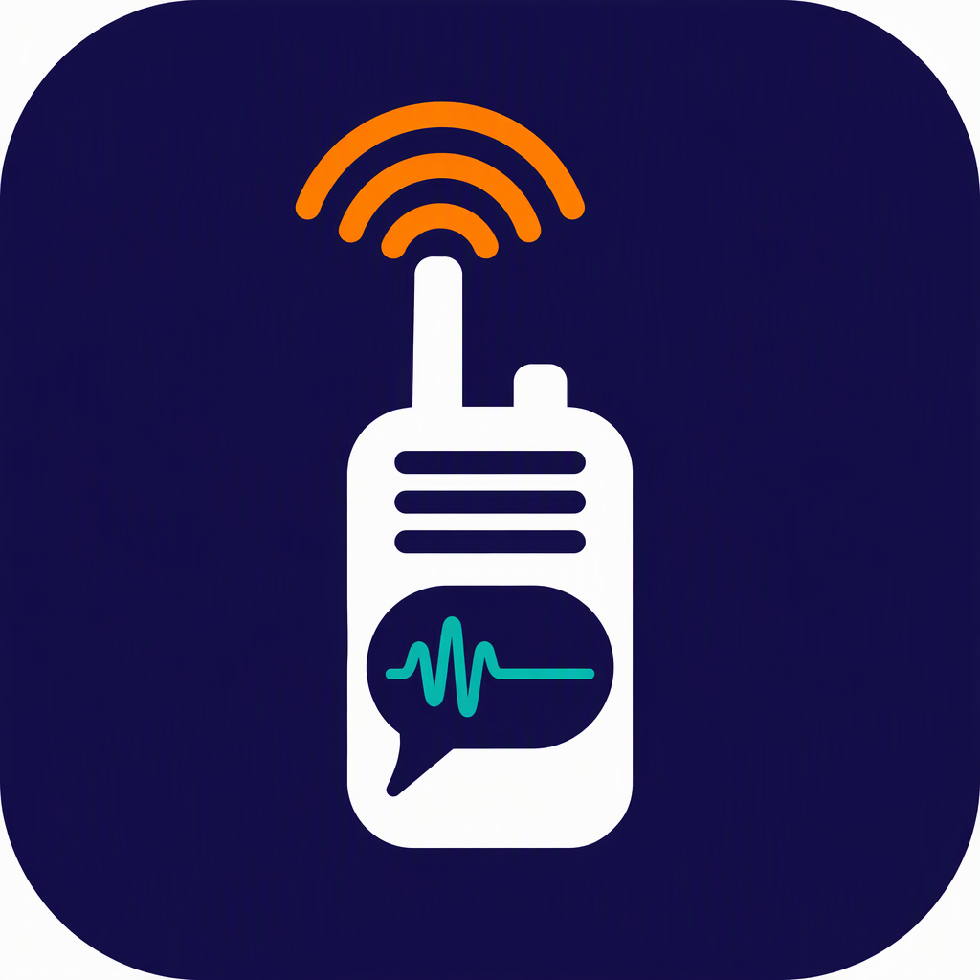
SMART INDIA HACKATHON 2026
TITLE PAGE
Problem Statement ID – SIH26173
Problem Statement Title- iTantra – Indian Multilingual TTS & STT Aided Neural Transceiver Radio Access for low bitrate links
Theme- Smart Automation
PS Category- Software
Team ID- 188881
Team Name (Registered on portal) Team Turtle
iTantra
Speak. Send text. Hear it back — offline.

Slide 2

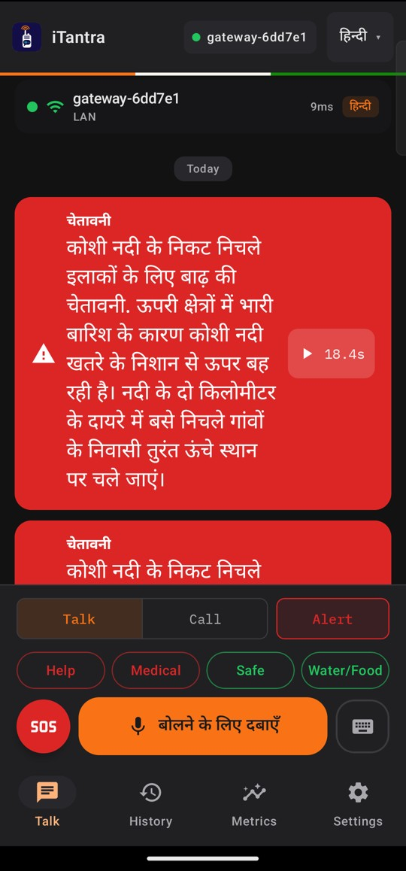
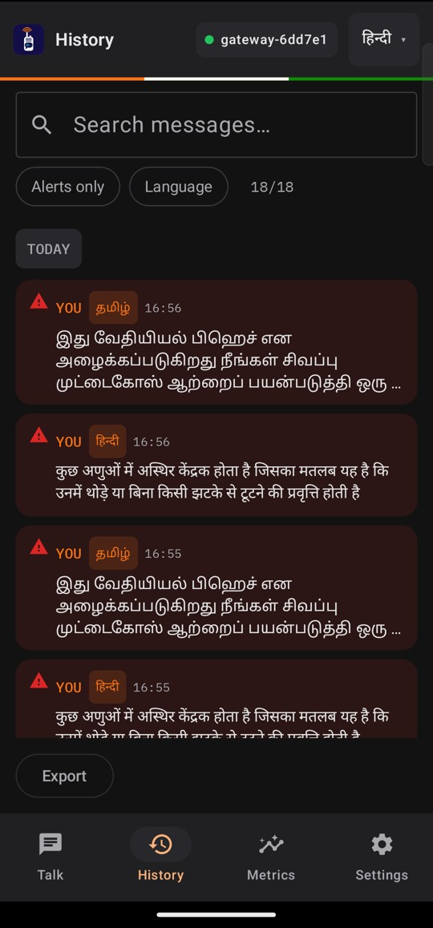












iTantra: Speak. Send Text. Hear It Back — Offline
Team Turtle
Proposed Solution (Describe your Idea/Solution/Prototype)
Demo film
1 min 55 s
itantra-106.pages.dev/demo
An Android app that turns speech into text on the sender's phone, sends only the text, and speaks it aloud on the receiver's phone. No tower, no internet, no cloud.
1 Speak
2 Speech → text
3 Text frame
4 Any link
5 Text → speech
push-to-talk; a pause ends the sentence
on-device STT, 10 languages
median 62 bytes per sentence*
Wi-Fi → Wi-Fi Direct → Bluetooth LE
spoken aloud; ALERT at alarm volume
Sender
Receiver
Detailed explanation of the proposed solution
How it addresses the problem
Innovation and uniqueness of the solution
10 Indian languages, speech and voice, fully on the phone
Speech → text → speech used as the codec for thin links
Alerts re-voiced on arrival, cannot be interrupted
ALERT plays at alarm volume; one-tap SOS sends GPS/NavIC location
Auto link fallback, one packet format on every link
Push-to-talk walkie-talkie and hands-free call mode
bits per second, one spoken sentence (log scale)
Output is still speech — people who cannot read are included
LITE profile switches on by itself below 6 GB RAM
*Median over 310 FLEURS sentences in a unit test; excludes encryption, alert signature and link headers. Bars assume a ~3 s sentence.

Slide 3













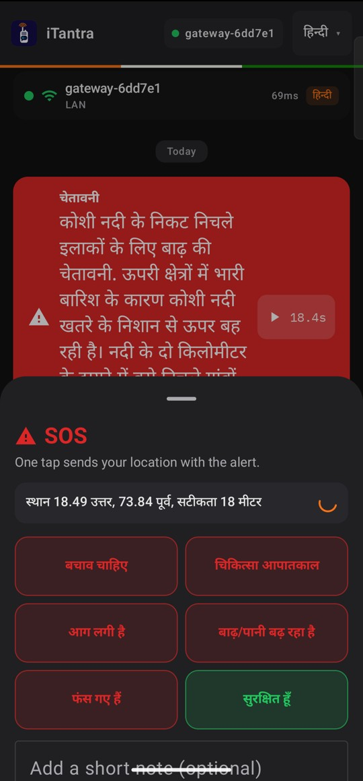
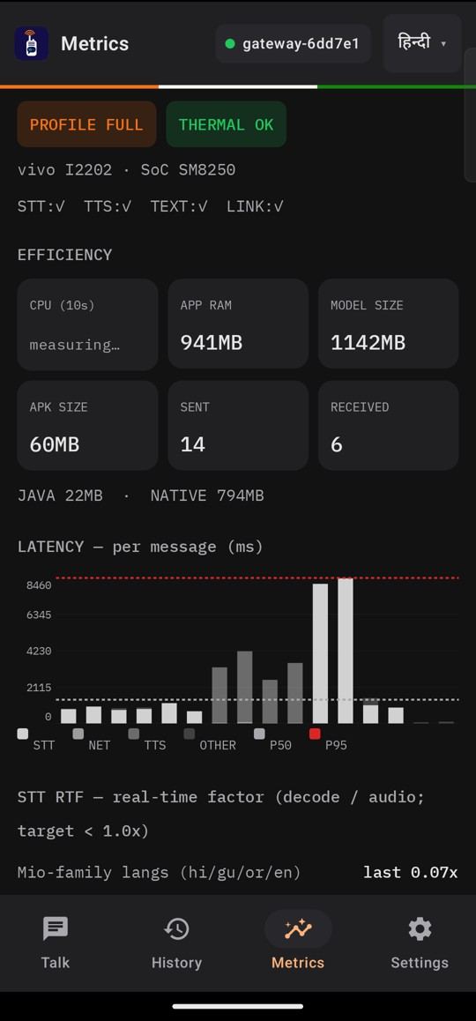

TECHNICAL APPROACH
Team Turtle
Technologies to be used (e.g. programming languages, frameworks, hardware)
Methodology and process for implementation (Flow Charts/Images/ working prototype)
Android app
SENDER PHONE
LINK — same frame everywhere
RECEIVER PHONE
Kotlin · Jetpack Compose
Mic 16 kHz
Wi-Fi LAN (primary)
Decode · ACK
Voice detection
VAD: cut at pause
Wi-Fi Direct +4 s
Numbers → words
Silero VAD
Speech-to-text
STT (int8)
Bluetooth LE +8 s
TTS engine
SraVaani-1.0 · int8 · sherpa-onnx
Compact frame
PC control room
Voice note / ALERT
Text-to-speech
VITS Rasa · Indic-Mio
Links
Working prototype — real screens
BUILT & RUNNING
Wi-Fi (mDNS/TCP) · Wi-Fi Direct · BLE
Push-to-talk, call mode, 10-language STT/TTS, ALERT, SOS + location, LITE profile, compact frame, PC control room
Hardware
BUILT · TEST PENDING
Any Android phone · PC control room
Wi-Fi Direct and Bluetooth LE fallback, phone-to-phone
PLANNED
Smaller voices (hi/gu/or/en), per-language model download, encrypted SOS location, ESP32 radio bridge
Talk + ALERT
SOS + location
Live metrics

Slide 4










FEASIBILITY AND VIABILITY
Team Turtle
Analysis of the feasibility of the idea
Measured in a 4 GB-class memory test (in-app logging)
14×
0.6 s
765 MB
0.3%
Alive
faster than speech
speech end → text ready
app RAM when idle
idle CPU
app not killed
STT real-time factor 0.07
median, 10 languages
1.8 GB peak while speaking
of one core
115 other apps closed
4 GB-class test: 12 GB Snapdragon 870 phone with RAM locked so only ~1.7 GB was free, LITE profile. The chip was not slowed — a budget phone will be slower. Word error rate 5.9% (preliminary, 10 clips) unchanged.
Potential challenges and risks
Strategies for overcoming these challenges
Voice starts 3–6 s after arrival in LITE
Keep the listener's language loaded; smaller fast voices for hi/gu/or/en (planned)
1.14 GB of model files
Per-language on-demand download and smaller voices for hi/gu/or/en (planned)
Wi-Fi Direct / Bluetooth not yet tested phone-to-phone
Two-phone tests on real devices; normal Wi-Fi stays the primary link
Noise, accents, code-mixing raise errors
Keyword boosting for alert words; 30-clip-per-language evaluation; typed text as fallback
Viability
No airtime, server or cloud fees
Open models: MIT · Apache-2.0 · CC-BY-4.0
One packet format on every link

Slide 5










IMPACT AND BENEFITS
Team Turtle
Potential impact on the target audience
Disaster response teams
Coastal fishing communities
Low-literacy users
Remote field staff
Voice coordination when towers and internet are down
Spoken local-language alerts over weak links
Hear an alert a text message would miss
Offline voice link in poor-coverage areas
≈1,500×
less data than raw audio*
1.03 s
ALERT arrival → spoken aloud (measured, Wi-Fi)
10
Indian languages, speech in and out, on the phone
Benefits of the solution (social, economic, environmental, etc.)
Social
Economic
Environmental
Alerts spoken aloud in Indian languages — usable by people who cannot read
No airtime, cloud or licence fees; runs on phones people already own
Fewer bytes per message means less radio airtime (battery gain not yet measured)
*62 B per ~3 s sentence vs 256 kbps raw audio; 62 B is a unit-test median. No field pilot yet. Photos (Wikimedia Commons): NDRF – Ministry of Home Affairs, GODL-India; fishermen – Saral Shots, CC0; woman on phone – Ammalu, CC BY-SA 3.0; rail workers – David Brossard, CC BY-SA 2.0.

Slide 6




RESEARCH AND REFERENCES
Team Turtle
Details / Links of the reference and research work
Open models (all run on the phone)
Runtime and evaluation data
SraVaani-1.0 speech-to-text · ARTPARK, IISc · MIT
huggingface.co/ARTPARK-IISc/SraVaani-1.0
sherpa-onnx on-device ASR/TTS runtime · Apache-2.0
github.com/k2-fsa/sherpa-onnx
Indic-Mio text-to-speech · SPRING Lab, IIT Madras · Apache-2.0
huggingface.co/SPRINGLab/Indic-Mio
Google FLEURS speech clips (STT evaluation)
huggingface.co/datasets/google/fleurs
VITS Rasa 13 text-to-speech · AI4Bharat · CC-BY-4.0
huggingface.co/ai4bharat/vits_rasa_13
Website
overview · results · APK
Silero VAD voice detection · MIT
github.com/snakers4/silero-vad
Android platform guides
Our work
Wi-Fi Direct (Wi-Fi P2P)
developer.android.com/develop/connectivity/wifi/wifi-direct
Prototype code and measurements
github.com/prasadxa/itantra
Bluetooth and BLE GATT
developer.android.com/develop/connectivity/bluetooth
Project website: overview, results, APK
itantra-106.pages.dev
Demo film
1 min 55 s
Audio focus (ALERT playback)
developer.android.com/media/optimize/audio-focus
Demo film, 1 min 55 s, captioned
itantra-106.pages.dev/demo
Licences as stated on each model card. No cloud API is used for speech recognition or speech synthesis.

