Slide 1
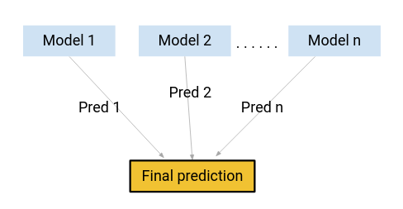
BOOSTING
Boosting is an ensemble learing
It’s work on sequential
Mininize traning errors
Incorrect prediction are assigned more weight
converting multiple weak learners into a single strong learning model
That gives you a decent 77%accurancy on the validation dataset

Slide 2
Types of Boosting
1.Adaboost
2.Gradientboost
3.Xgboost
4.Lgboost
5.Catboost

Slide 3
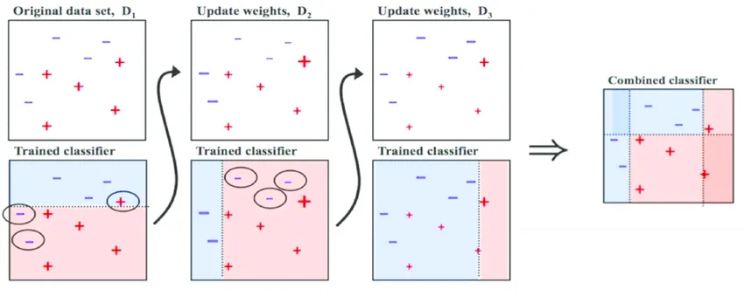
AdaBoost
It’s using for Classificartion and Regression.
It’s a meta_estimator that begins by fitting a classifier.
It’s same to Boosting concepts.
The weight of instances are adjusted according to the error of the current weight prediction
Reduce bias and variance W=1/N

Slide 4
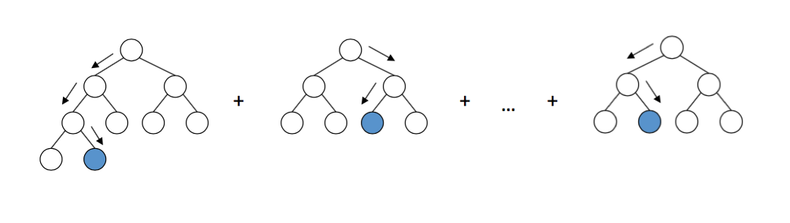
Gradientboost
It’s allows for the optimization of arbitrary differentiable loss function.
This estimators builds an additive model in a forward stage.
Gradient descent is used to minimize the loss.
Gradient boosting can be used for regression and classification problems.

Slide 5
3.Xgboost(EXTREME GRADIENT BOOSTING)
Same as Gradient boosting but has additional functionality
That can be used for Classifiction or Regression
Ensembles are constructed from dicision tree models.
K_fold cross_validation and reports the mean absolute error.
Distributed machine learing process.
XgBoost is it’s efficient handling of missing values.

Slide 6
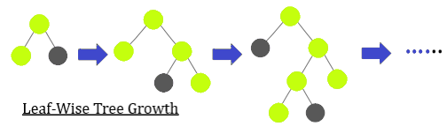
4.Lgboost
Capable of handling large_scale data.
Poor in small dataset.
Leaf_wise growth and not depth_wise growth.
Support of parallel,distributed.
Light GBM supports Categorical feature

Slide 7
5.Catboost
CatBoost supports categorical features.
CatBoost can be used for Regression and Classification problems.
The feature is used when making right and left splits at each level of the tree.
It’s handling of null values.

