Slide 1
Digital Portfolio
STUDENT NAME: M.Prasanna Priya
REGISTER NO:212401021
NMID: 3F0F96A3BD13928A946459D18FFA6844
DEPARTMENT: COMPUTER APPLICATION
COLLEGE: COLLEGE/ UNIVERSITY: Prince shri Venkateshwara arts and science college

Slide 2
PROJECT TITLE Prasanna Priya Portfolio

Slide 3


AGENDA
Problem Statement
Project Overview
End Users
Tools and Technologies
Portfolio design and Layout
Features and Functionality
Results and Screenshots
Conclusion
Github Link
3/21/2024 Annual Review

Slide 4

PROBLEM STATEMENT In today’s fast-paced world, skill development and personalized learning are critical for individual growth. "Naan Mudhalvan" aims to address the gap in accessible platforms that cater to personalized skill development, particularly in educational contexts. The project targets creating a streamlined, interactive platform for skill-building that is both user-friendly and effective for learners of all ages

Slide 5

PROJECT OVERVIEW This platform provides a tailored learning experience, using advanced technologies to monitor progress and offer personalized recommendations. The goal is to make education more accessible, flexible, and efficient for users globally.

Slide 6
WHO ARE THE END USERS? The primary end users of "Naan Mudhalvan" include students, professionals looking for upskilling opportunities, and individuals aiming to explore new areas of interest. The platform is designed to cater to both beginners and advanced learners, offering features that adapt to the individual needs and goals of each user.

Slide 7

TOOLS AND TECHNIQUES he project is built using HTML, CSS, and JavaScript for the front-end, with backend technologies like Node.js and MongoDB for database management. Cloud services, such as AWS, provide the necessary infrastructure for hosting and data storage. Additionally, machine learning algorithms are employed to provide personalized recommendations based on users’ learning progress.

Slide 8
POTFOLIO DESIGN AND LAYOUT
The portfolio is designed with a clean, professional layout to showcase the project’s features, functionality, and results in a visually appealing manner. The design focuses on ease of navigation, ensuring that potential employers, collaborators, or users can quickly grasp the purpose of the project and its value. Simple yet effective graphics and layouts are used to highlight key areas such as problem-solving methods, technologies used, and the results achieved.
8

Slide 9
FEATURES AND FUNCTIONALITY The key features of "Naan Mudhalvan" include personalized learning paths, interactive quizzes, real-time progress tracking, and a resource hub with video tutorials, articles, and more. Users can receive feedback based on their performance and improve specific skills. The platform also supports gamification, enabling users to earn badges and rewards as they progress through different levels of learning.

Slide 10
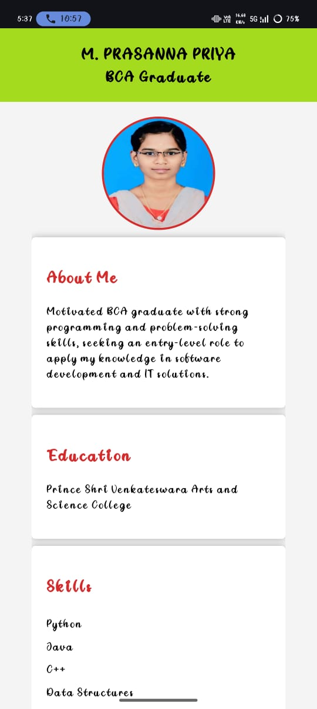

RESULTS AND SCREENSHOTS
Since the project’s inception, there has been significant positive feedback from users, with many highlighting the personalized nature of the learning experience. Screenshots showcasing the platform’s user interface demonstrate the seamless integration of educational content and interactivity. The project’s results also include improved user engagement and learning outcomes, as evidenced by user surveys and usage statistics
3/21/2024 Annual Review
10

Slide 11
CONCLUSION that bridges the gap between traditional education and modern technology. With its focus on personalized learning, the platform provides an engaging and effective way to develop new skills. Moving forward, the platform will continue to evolve, incorporating new features and content to further enhance the user experience.
11

Slide 12
Github link
https://github.com/prasanapriya-0/Portfolio.git

