Slide 1
Digital Portfolio
STUDENT NAME: Prasandh.M
REGISTER NO AND NMID: 2426j1542 and asbruaz2426j1542
DEPARTMENT: B.sc information technology
COLLEGE: KPR college of arts science and research/bharathiyar university

Slide 2
PROJECT TITLE
"Data-Driven Portfolio: Visualizing Growth and Impact"
Notes:
"Data-Driven Portfolio: Visualizing Growth and Impact"

Slide 3


AGENDA
Problem Statement
Project Overview
End Users
Tools and Technologies
Portfolio design and Layout
Features and Functionality
Results and Screenshots
Conclusion
Github Link
3/21/2024 Annual Review

Slide 4

PROBLEM STATEMENT
In today’s fast-evolving job market, individuals need to effectively track and showcase their professional growth to stand out to employers and stakeholders. However, it is often challenging to objectively represent progress in skills, quantify project accomplishments over time, and demonstrate the tangible impact of internship or work experiences.
Without clear visualization, it becomes difficult for individuals to analyze their development trajectory, identify areas for improvement, or communicate their value in a compelling way.
This project aims to leverage data visualization techniques to create an interactive portfolio that:
Tracks skill progression over time with measurable metrics,
Illustrates the number of projects completed each year,
Highlights the impact of internships and work experience on overall growth,
thus empowering users to better understand their career development and present it in a visually engaging and insightful manner.

Slide 5

PROJECT OVERVIEW
Professionals and students alike often struggle to effectively track and demonstrate their growth over time. While skills improve, projects accumulate, and internships add valuable experience, this progress is frequently recorded in a scattered or non-visual manner, such as plain resumes or lists. These formats lack the clarity and engagement needed to analyze growth trends or showcase achievements dynamically.
Without a clear, data-driven representation, it is hard to:
Monitor how specific skills evolve and improve over time,
Quantify the volume and timeline of completed projects,
Understand and communicate the real impact of internships or work experiences on career development.
This results in missed opportunities for self-assessment, goal setting, and impressing potential employers or mentors with concrete evidence of growth.
Creating an interactive, data-driven portfolio that visualizes skill progress, project milestones, and experiential impact will address these challenges by making career development transparent, trackable, and visually compelling.

Slide 6

WHO ARE THE END USERS?
Students and Recent Graduates Looking to track their skill development, document projects, and showcase internships to improve their job prospects.
Early-Career Professionals Wanting to visualize their growth over time, demonstrate the impact of their work experience, and prepare compelling portfolios for promotions or job changes.
Career Coaches and Mentors Helping mentees or clients understand their progress, set development goals, and identify strengths and weaknesses through clear visual data.
Hiring Managers and Recruiters Interested in quickly assessing a candidate’s growth trajectory, skills proficiency, and practical experience through data-driven portfolios.
Educators and Training Providers Using visualized progress and project data to monitor student outcomes and the effectiveness of internships or practical training.

Slide 7

TOOLS AND TECHNIQUES
Tools:
Data Storage: Google Sheets, SQL databases
Data Processing: Python (Pandas), Excel
Visualization: Tableau, Power BI, Python (Matplotlib, Plotly), D3.js
Web Development: React, HTML/CSS/JS, GitHub Pages
Techniques:
Line charts for skill progress over time
Bar charts for projects completed yearly
Heatmaps for internship/work experience impact
Interactive dashboards with filters and annotations

Slide 8
POTFOLIO DESIGN AND LAYOUT
1. Landing Page / Overview
Brief intro about you
Summary metrics: total skills tracked, projects completed, internships
2. Skill Progress Section
Line chart showing skill levels over time
Filters to select specific skills or time ranges
Short insights or milestones annotated on the chart
3. Projects Section
Bar chart showing number of projects completed each year
Project list with brief descriptions, technologies used, and links
4. Internship / Work Experience Impact
Heatmap or comparative chart visualizing skills improved during internships
Key takeaways or impact statements
5. Interactive Dashboard (Optional)
Combine above charts with filters (e.g., by year, skill type) for deeper exploration
6. Contact / About Me
Social links, resume download, contact form
8

Slide 9
FEATURES AND FUNCTIONALITY
Skill Progress Tracking: Visualize skill levels over time with interactive line charts.
Project Timeline: Display the number of projects completed per year using bar charts.
Internship Impact Visualization: Show how internships/work experience contributed to skill growth with heatmaps or comparative charts.
Interactive Filters: Allow users to filter data by skill, year, or project type.
Milestones & Annotations: Highlight important achievements or learning moments on charts.
Responsive Design: Portfolio works smoothly on desktop and mobile devices.
Download/Export Options: Export visual reports or resume summaries as PDFs.
Contact Section: Easy way for recruiters or mentors to reach out.

Slide 10
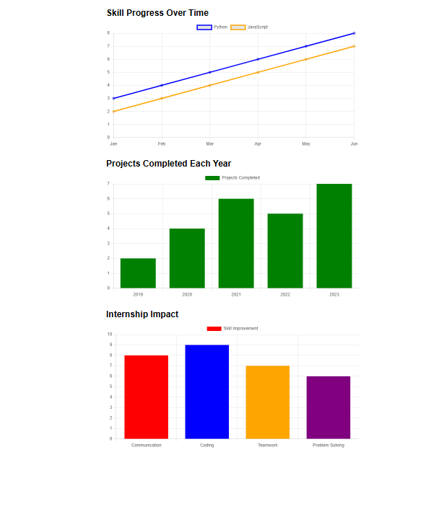
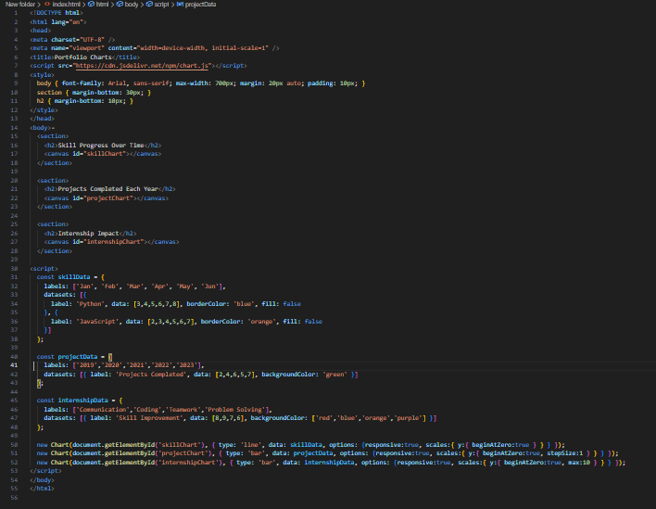

RESULTS AND SCREENSHOTS
3/21/2024 Annual Review
10

Slide 11
CONCLUSION
A data-driven portfolio offers a clear, engaging way to track and showcase personal growth, project accomplishments, and the impact of internships or work experience. By leveraging interactive visualizations, it helps individuals understand their development over time and effectively communicate their skills and achievements to potential employers or mentors. This approach not only enhances self-awareness but also creates a compelling narrative that sets users apart in competitive professional environments.
https://prasandh1.github.io/index/
11

