Slide 1

INTERACTION METHOD AND DEVICE

Slide 2
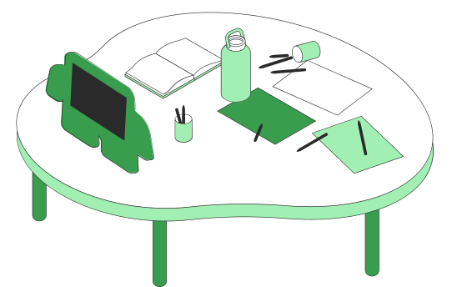
Method of Interacting
What is command language interaction?
What is menu interaction?
What is form interaction?
What is object based interaction?
Content
What to Know

Slide 3

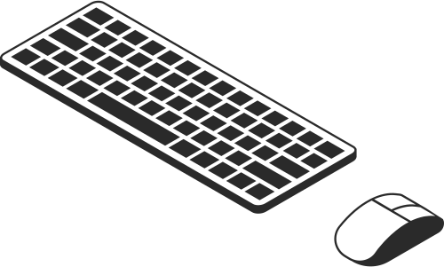
Method of Interaction
When designing the user interface, the most fundamental decision you make relates to the methods used to interact with the system.
The basic of five widely used style: command language, menu, form, object, and natural language.

Slide 4
COMMAND LANGEAGE INTERACTION
Command languages, also known as command-line interfaces (CLIs) or shell languages, allow users to interact with computer systems by typing specific commands. Some well-known command languages include the Unix shell (bash, sh, etc.), Windows Command Prompt, and PowerShell.

Slide 5
Example in window command prompt:
C:\Users\Username> dir
Documents Downloads Pictures
C:\Users\Username> cd Documents
C:\Users\Username\Documents> echo Hello > myfile.txt
C:\Users\Username\Documents> dir
myfile.txt

Slide 6
FORM INTERACTION
Form interaction refers to the process by which users provide information to a system via structured fields, often within web pages or software applications. Common elements in a form include text boxes, radio buttons, checkboxes, drop-down menus, and buttons.

Slide 7
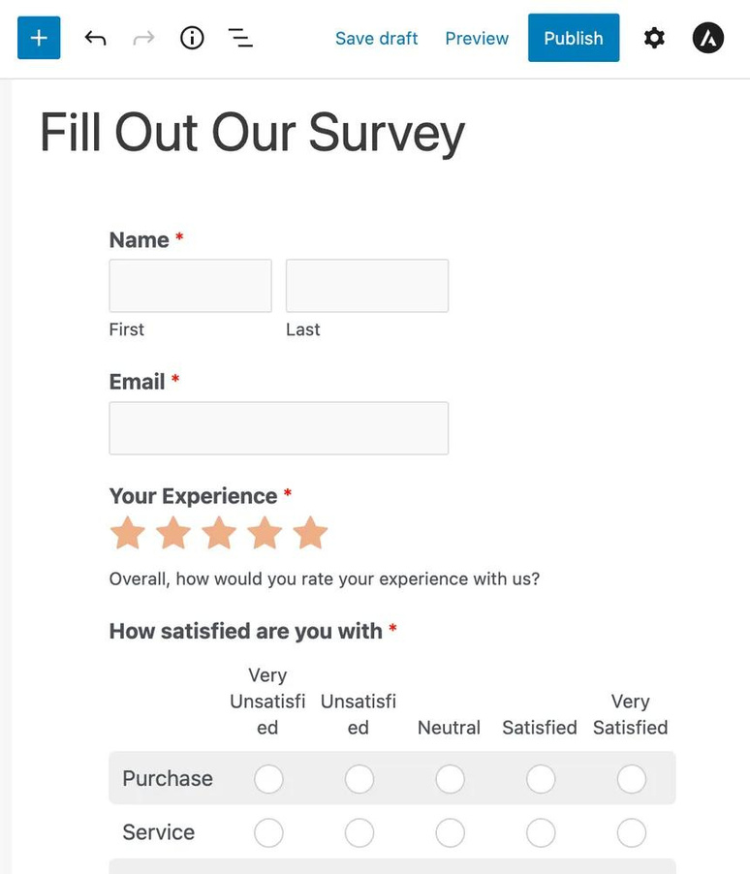
Example of form interaction

Slide 8
OBJECT BASED INTERACTION
Object-Based Interaction refers to the type of interaction where users interact with on-screen objects, typically represented by icons, buttons, windows, and other graphical elements. It's foundational to graphical user interfaces (GUIs), where users use a pointer (like a mouse cursor) to select and manipulate these objects.

Slide 9
Diagram of Object based interaction
_____________________________________________
| Desktop |
| |
| _______ _______ _______ |
| | | | | | | |
| | Icon1 | | Icon2 | | Icon3 | |
| |_______| |_______| |_______| |
| |
| [Open File] |
|_____________________________________________|
Drag and Drop

Slide 10
MENU INTERACTION
Menu interaction is a fundamental aspect of many user interfaces, particularly graphical user interfaces (GUIs). It allows users to choose commands or options from a set of items presented in a list format.

Slide 11

Diagram of Menu Interaction :
File Save Exit Edit
File
|-- New
|-- Open
| |-- Recent
| |-- Document1.txt
| |-- Document2.txt
|-- Save
|-- Exit
Edit
|-- Undo
|-- Cut
|-- Copy
|-- Paste
File
Save
Exit
Edit

Slide 12

Thank you
EMAIL
prasangaramanpokharel@gmail.com
WEB
prasangapokharel.com.np

