Slide 1
Guesstimate
Problem Statement
Number of Refrigerators sold in India Every Year.
Mentor : Nandini Khemariya
By Prasanjit Rout

Slide 2
Agenda of Guesstimate
Understanding Market
Identify Key Drivers
Estimating Annual Sales
Exhibits
Domestic or Professional ? Domestic

Slide 3
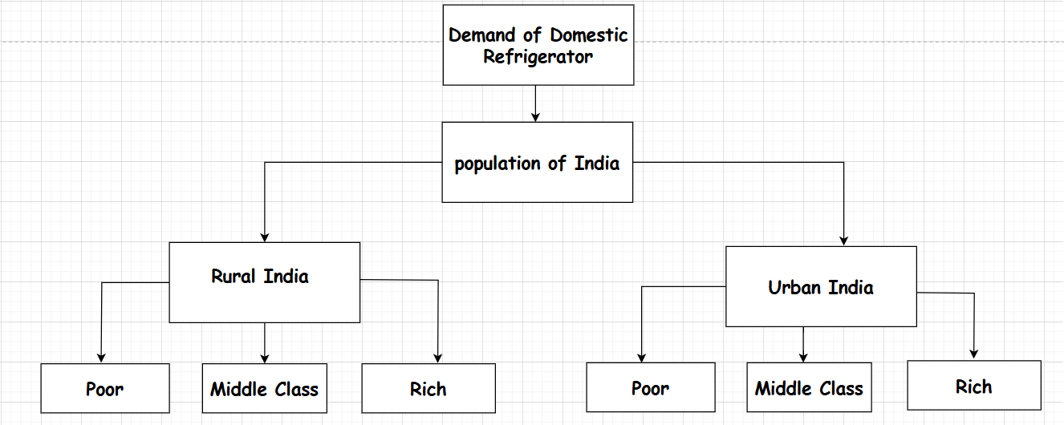
Structuring the framework

Slide 4
Demographics ANALYSIS
We have identified important key trends that demand our attention.
Data reveals a steady 70% of Indians live in Rural areas whereas 30% live in Urban areas.
Generally Indian families constitute 4 members in a family.
Approx 35crore families are present in India.
Rural

Slide 5
Income ANALYSIS

Slide 6
Assumptions for Rural Demand
Poor People have no Refrigerator.
Middle Class & Rich have 1 Refrigerator.
Refrigerator penetration ratio is 40% among Middle class and 60% among Rich in Rural India.
Assumptions for Urban Demand
Poor People have no Refrigerator.
Middle Class & Rich have 1 & 2 Refrigerator Respectively
Refrigerator penetration ratio is 80% in Urban India.

Slide 7
Calculations for Rural Estimation
 | Poor | Middle Class | Rich | Total
Percentage | 60 | 30 | 10
Number of Families | 14.7 Crore | 7.45 Crore | 2.45 Crore | 24.5 crore
Refrigerator | 0 | 1 | 1
Penetration | 0 | 60 | 80
Total | 0 | 2.9 Crore | 1.5 crore | 4.4 Crore
Calculation for Urban Estimation
 | Poor | Middle Class | Rich | Total
Percentage | 30 | 50 | 20
Number of Families | 3.15 Crore | 5.25 Crore | 2.1 Crore | 10.5 crore
Refrigerator | 0 | 1 | 2
Penetration | 0 | 80 | 80
Total | 0 | 4.2 Crore | 3.36 crore | 7.5 Crore

Slide 8
Key Factors Influencing Refrigerator Demand
1
Rate of Growth
Demand for growth increases per year with the rate of 6 %.
Growth= 11Crore *0.6 = 66 lakh Approx
2
Replacement of Refrigerator
Assuming 10% of existing refrigerator will be replaced
in every life cycle of a refrigerator(10 Years).
Replacement = 11core*0.1 =1.1 Crore Approx
Estimated Annual Refrigerator Sales in India
The Domestic annual refrigerator sales in India are estimated to be around 1.7 million units.

Slide 9
Thank You
Prasanjit rout routprasanjit933@gmail.com

