Slide 1
ACCOUNTING DETAILS IN ALV FORMAT CONVERT ITAB DATA TO EXCEL AND DOWNLOAD FORM

Slide 2

GROUP8 Sai Shiva Maddi Prasad Thatha Poorna Lakshmi Prasanna Ananthu

Slide 3
INTRODUCTION
Select the fields from tables using Inner joins or ForAll Entries.
Display an OALV of all this selected fields on screen along with buttons ‘Download XLSX’ and ‘Display Form’.
The downloaded Excel should have the same data that displayed on ALV.
On ALV screen if any row is selected and click on ‘Display Form’ it should generate the Adobe Form.
Package Name: ZGROUP8

Slide 4
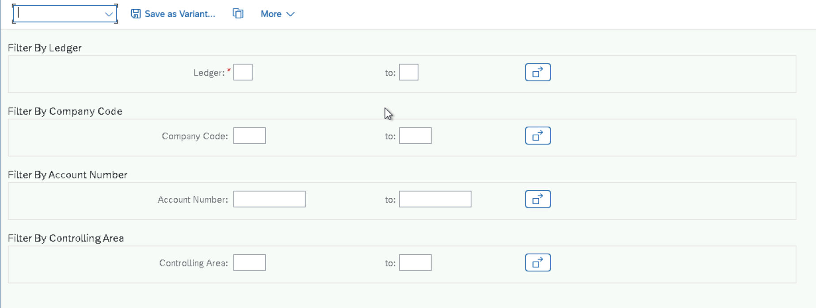
INPUTS

Slide 5
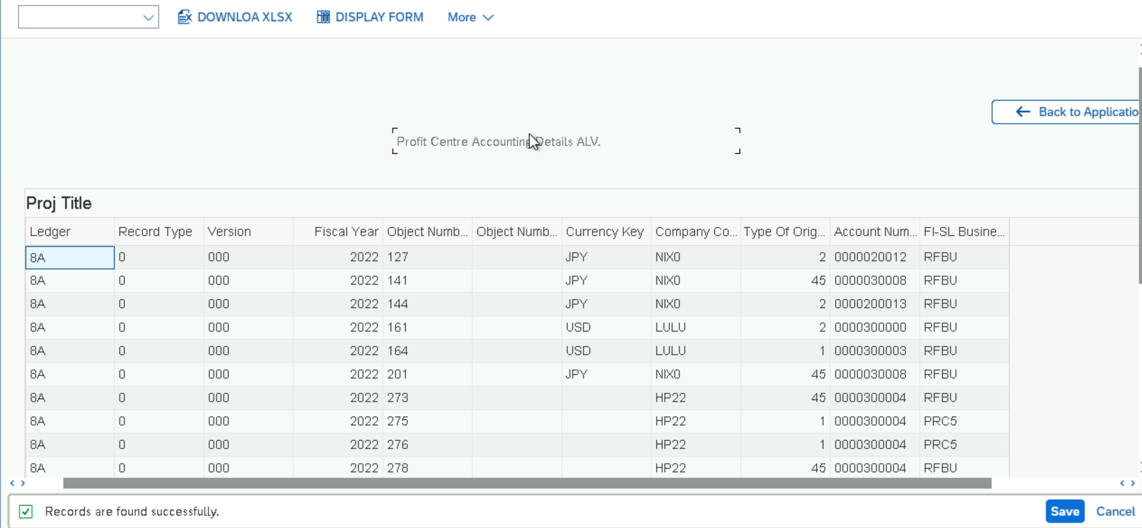
OUTPUTS

Slide 6
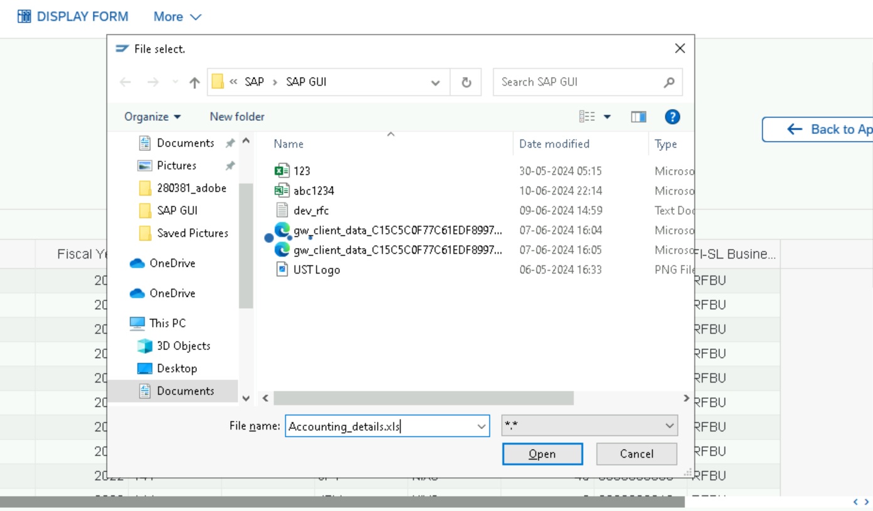
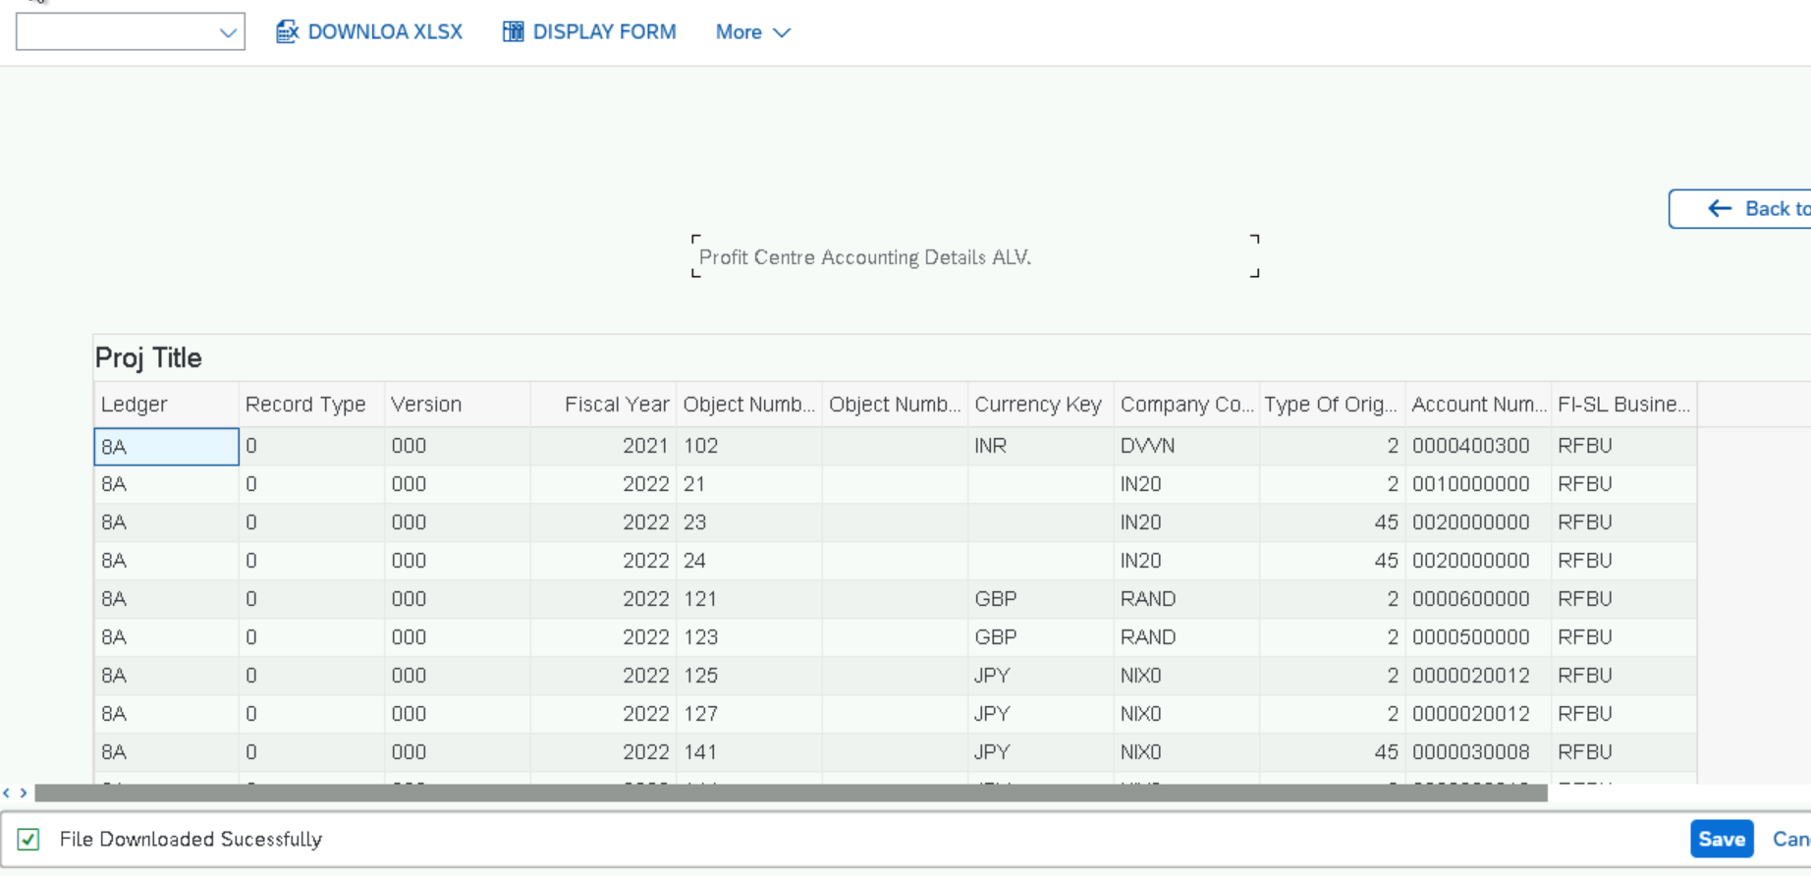
Downloading Excel From ITAB DATA

Slide 7
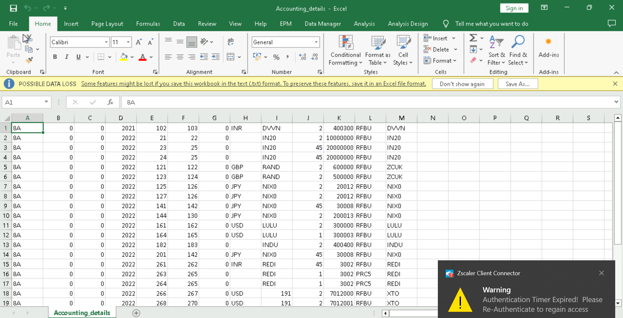
Downloaded Excel

Slide 8
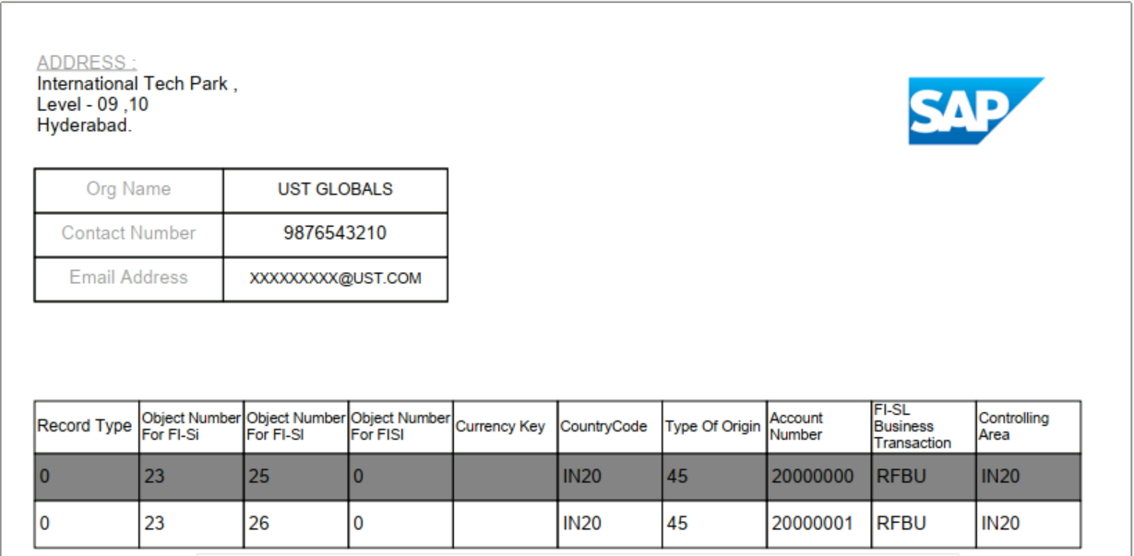
ADOBE FORM

Slide 9
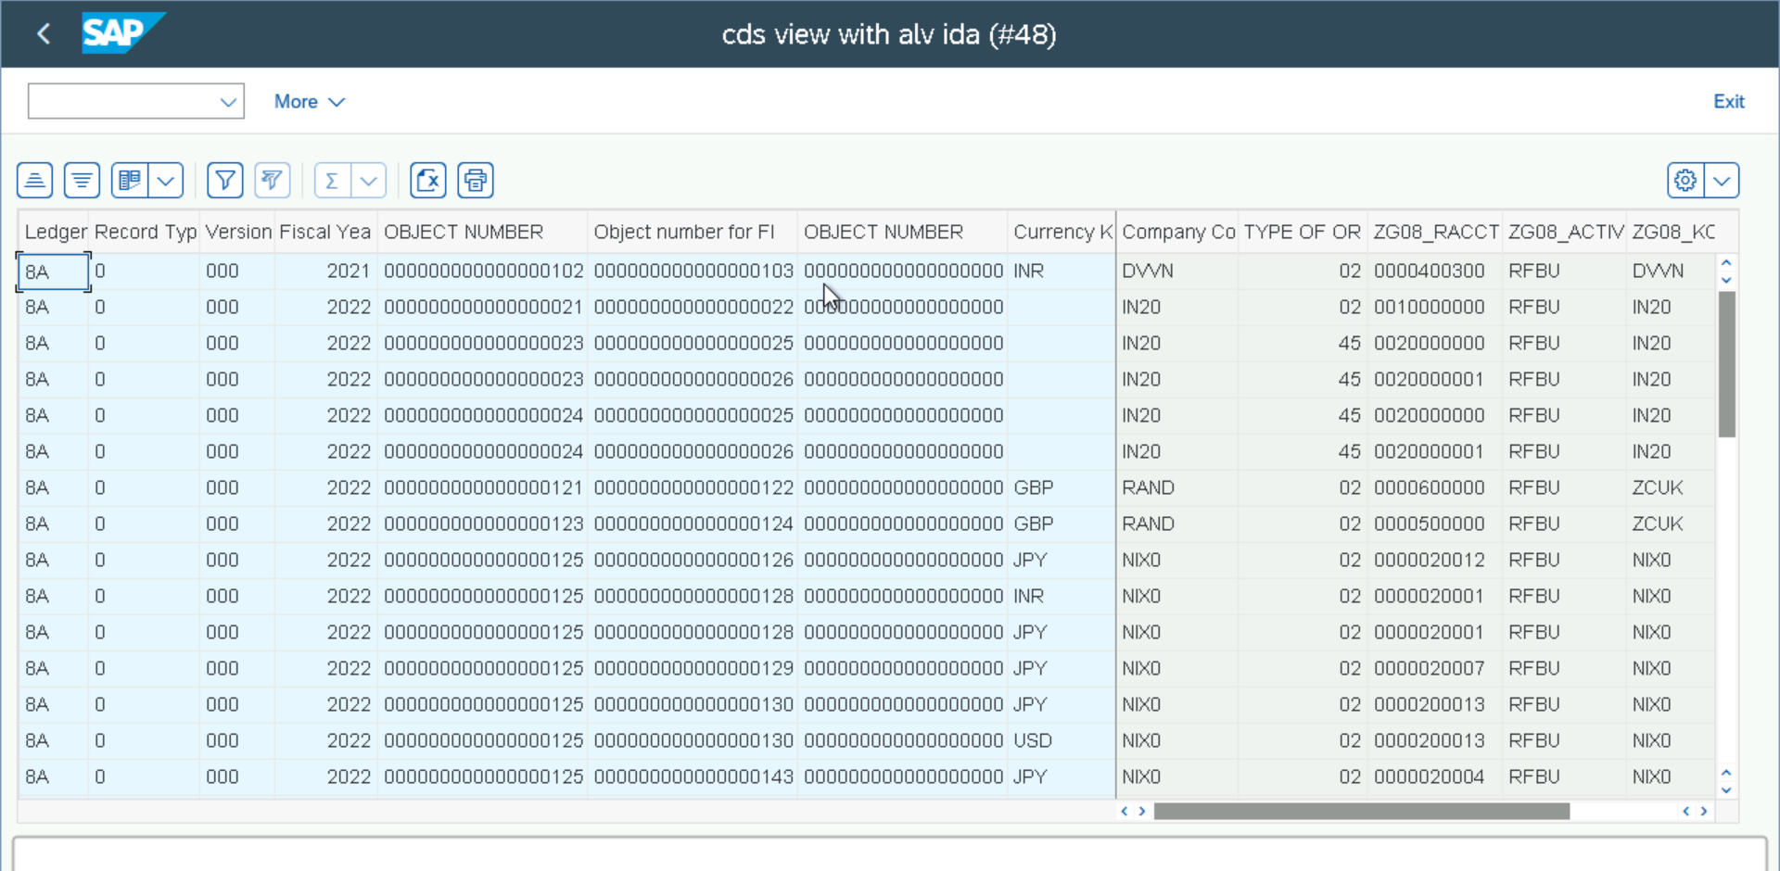
CDS VIEW with ALV IDA

Slide 10
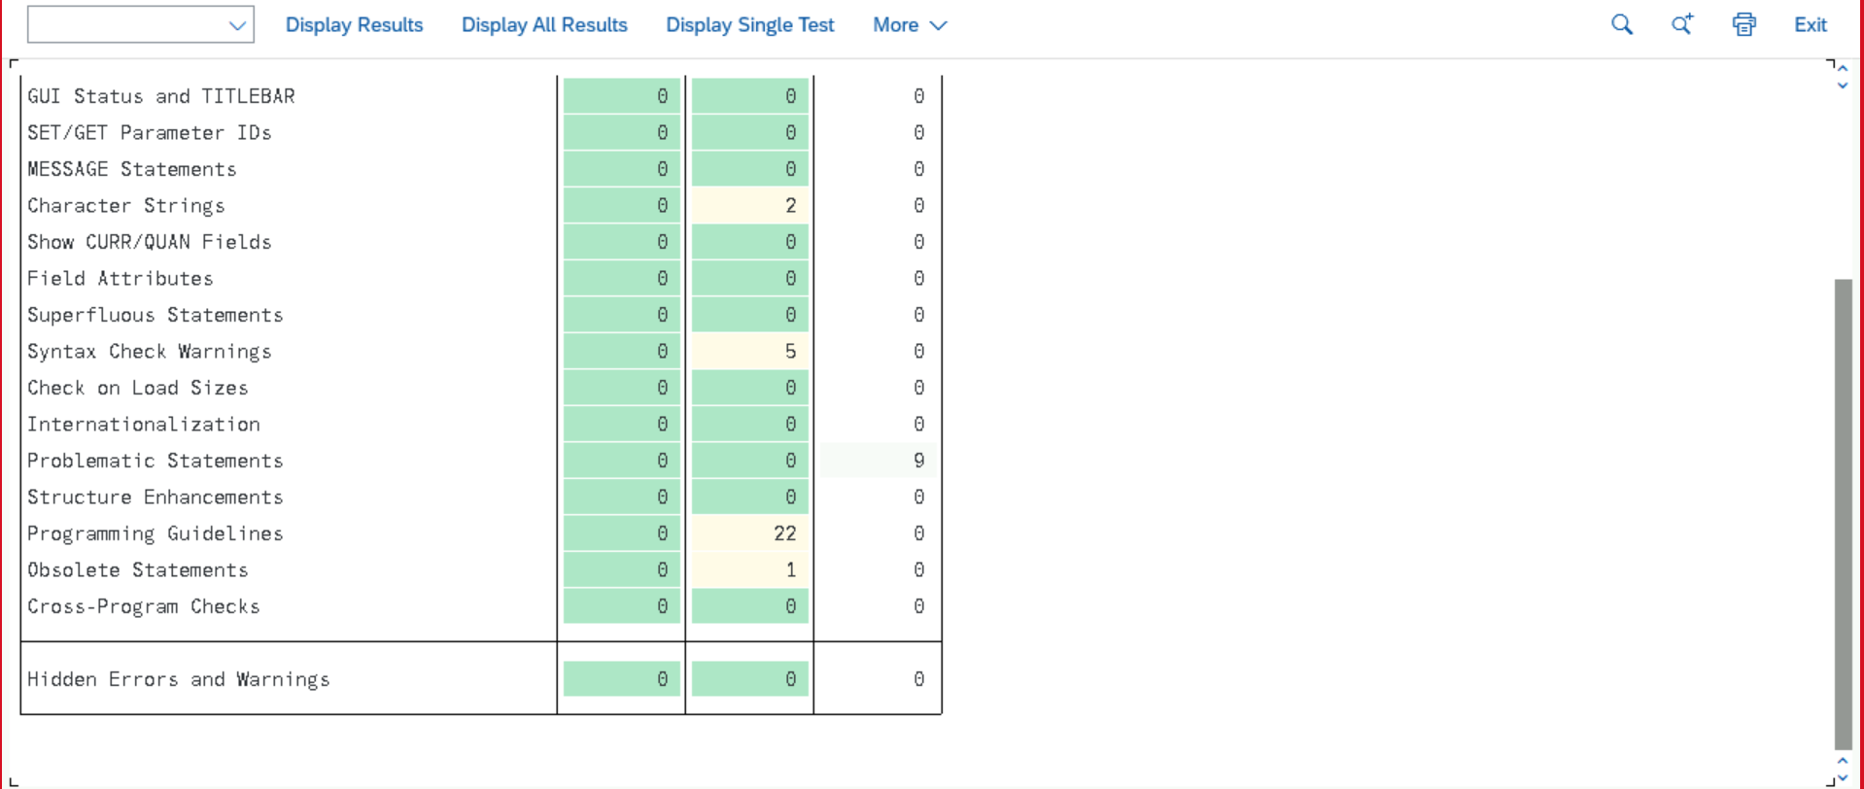
Performance tunning tool - EPC

Slide 12
ANY QUERIES?

