Slide 1

B.V.V.Sangha’s
Basaveshwar Engineering College Bagalkote
Department of Artificial Intelligence and Machine Learning

Slide 2
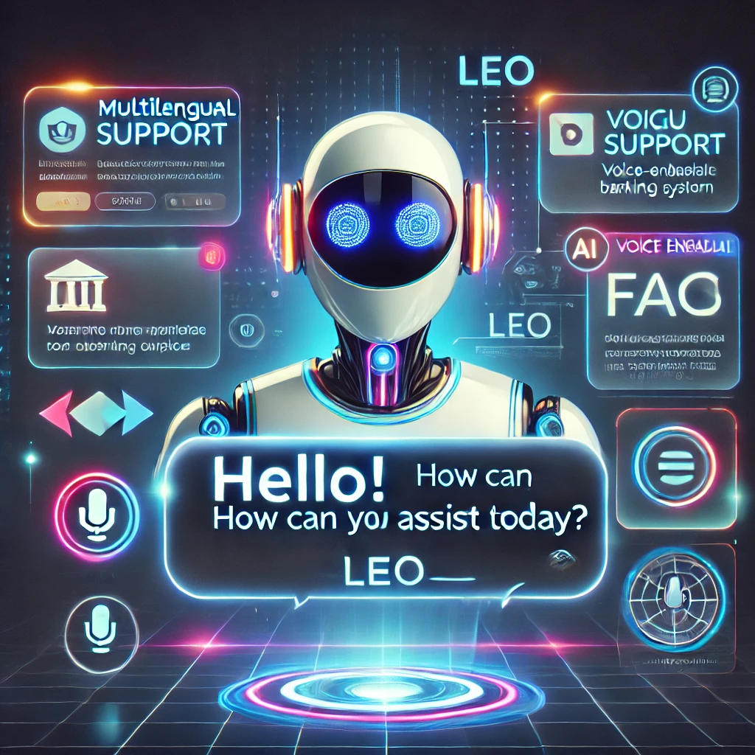
TITLE
A BANKING CHATBOT
An Intelligent Assistant System Using Natural Language Processing(NLP)

Slide 3
TEAM MEMBERS
Name | USN
Abhishek. R. Adannavar | 2BA21AI005
Prasanna.S. Nagarale | 2BA21AI030
Sukesh Padagatti | 2BA21AI054
Supreeth Madari | 2BA21AI055
Project Guide Coordinator Head Of Department
Prof. Jayasheela D. K. Prof. Jayasheela D. K Dr. Anil D Devangavi

Slide 4
Table of Contents
Sl.no | Topics
01 | Introduction
02 | Problem Definition
03 | Literature survey
04 | Objectives
05 | Hardware and Software requirements
06 | System Architecture and proposed Methodology
07 | Advantages
08 | Result and Discussion
09 | Applications
10 | Conclusion

Slide 5
INTRODUCTION
01

Slide 6
With the rapid growth of Natural Language Processing (NLP) and Machine Learning (ML), chatbots have become widely used in many fields, especially in banking. In today’s digital age, customers want fast, efficient, and personalized support available 24/7.
Traditional ways of customer service, like phone support or visiting a bank in person, often fall short because of long waiting times and limited hours.
A chatbot is a type of software designed to have a conversation with a user in everyday language, similar to talking to a human.
These chatbots use artificial intelligence (AI) to understand questions, provide accurate answers, and share relevant information from their knowledge base.
INTRODUCTION
01

Slide 7
PROBLEM DEFINITION
02

Slide 8
This project aims to improve slow and expensive customer service in banks by creating a smart chatbot using Natural Language Processing(NLP). Traditional customer service methods often have long wait times and can be confusing. The chatbot will provide quick, clear answers to questions about account types, loans and bank policies, making it easier for customer to get help anytime. This will also reduce the bank workload and costs.
PROBLEM DEFINITION
02

Slide 9
LITERATURE SURVEY
03

Slide 10
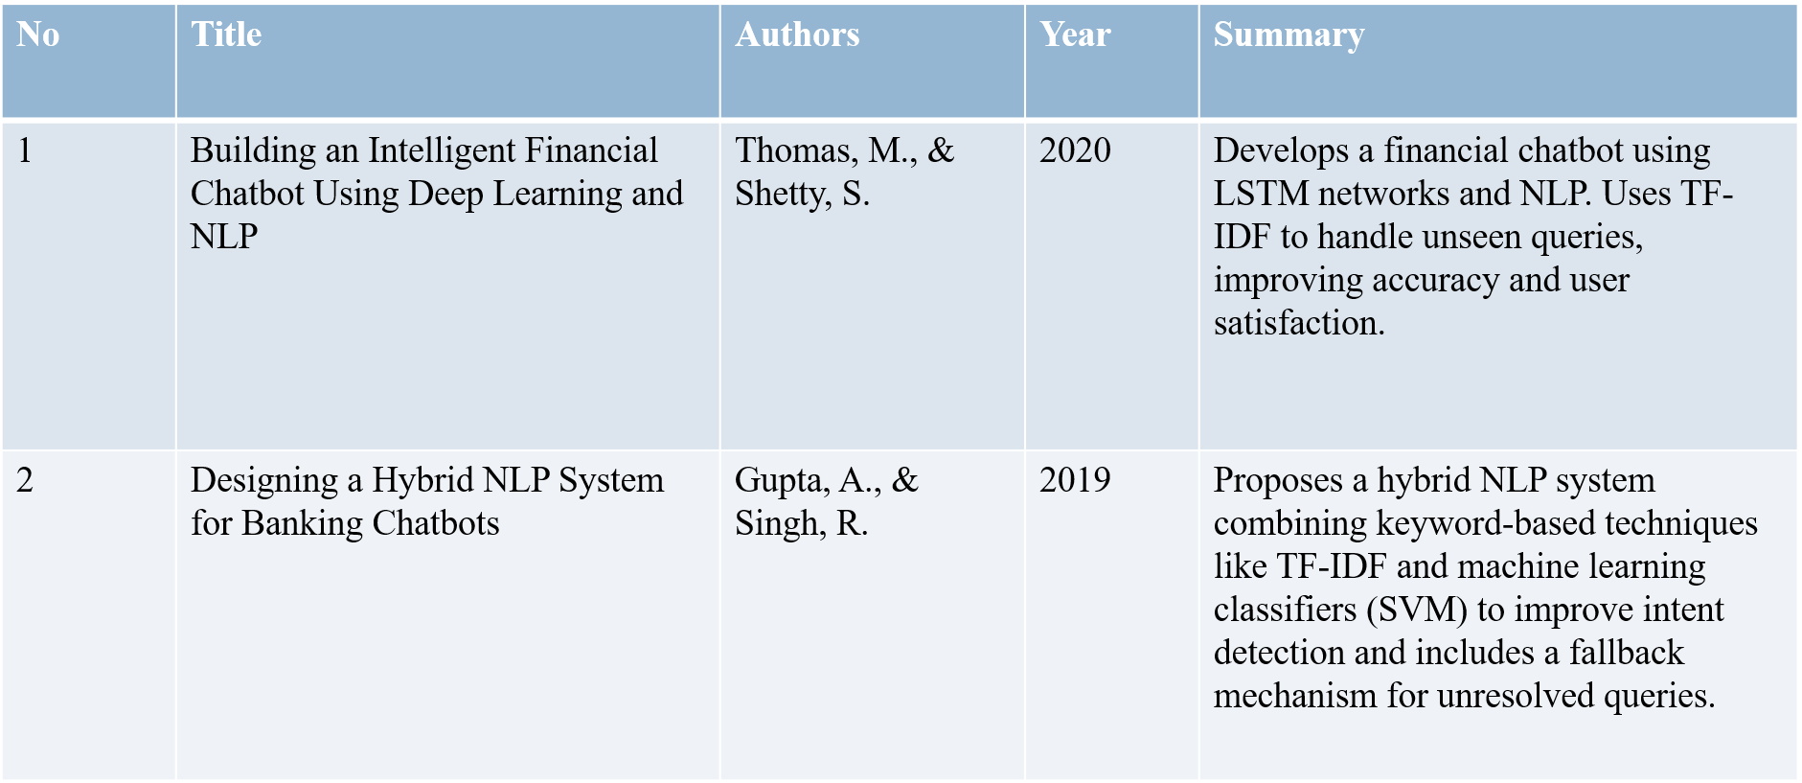
LITERATURE SURVEY
03

Slide 11
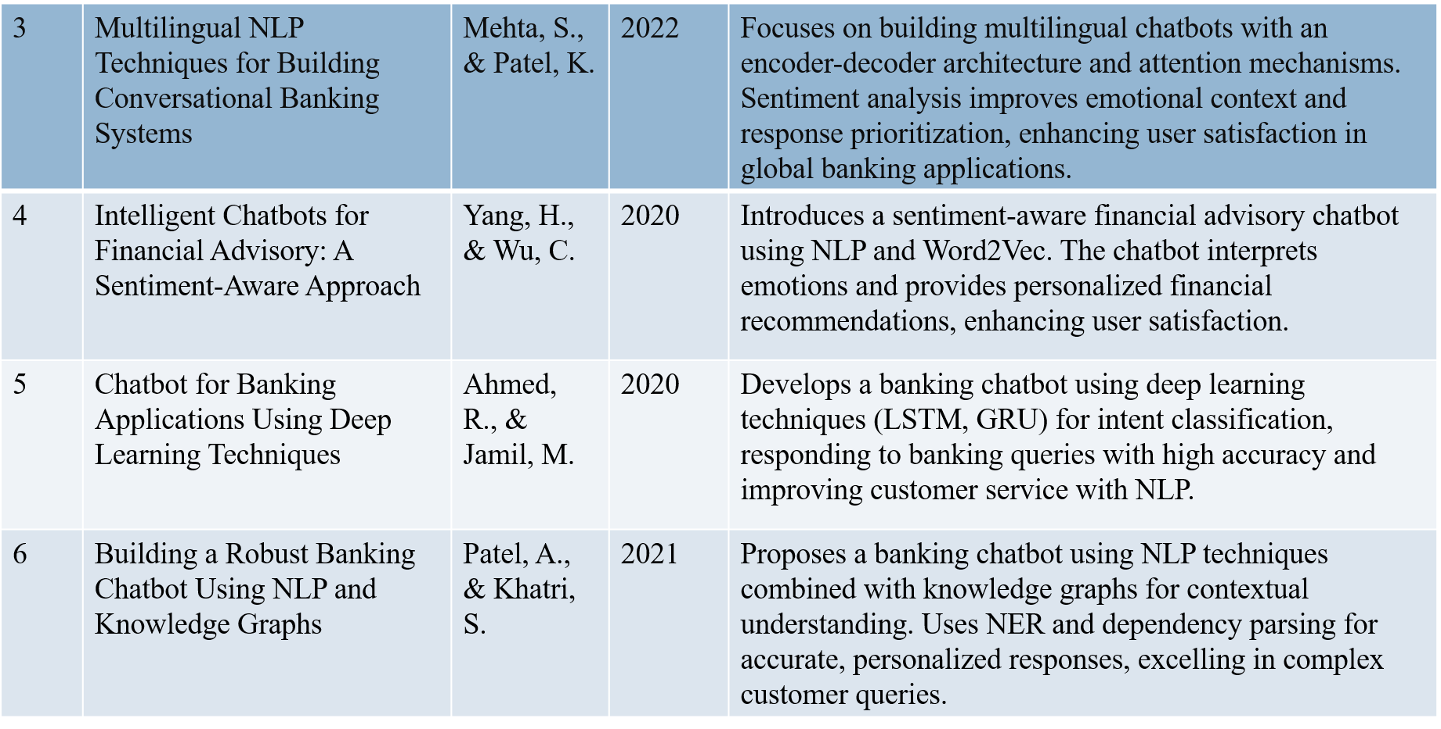
LITERATURE SURVEY
03

Slide 12
OBJECTIVES
04

Slide 13
The primary objectives of developing the Banking Chatbot LEO using Natural Language Processing (NLP) Specific objectives include:
Provide Efficient Customer Service : To offer customers a virtual assistant that can handle queries efficiently in natural language, mimicking a real human conversation, thereby improving customer experience.
Reduce Wait Times and Minimize Human Load: To address customer inquiries promptly without the need for human intervention, thus reducing wait times and easing the burden on human customer service representatives.
Increase Availability of Customer Support: To make customer support accessible 24/7, allowing customers to receive assistance at any time without being limited by traditional business hours.
Enhance Accessibility and Ease of Use: To create an intuitive, user-friendly interface that can be accessed on various platforms, such as web browsers and mobile devices, providing a seamless experience across all devices.
Automate Common Queries and Information Delivery : To answer frequent questions on topics like bank policies, loans, fixed deposits, and other banking products, helping reduce the influx of common inquiries that would otherwise require staff assistance.
Reduce Operational Costs and Boost Productivity : To streamline customer service processes, cut down on operational costs related to human staffing, and increase the productivity of customer service by enabling faster, automated responses.
OBJECTIVES
04

Slide 14
Provide Efficient Customer Service : To offer customers a virtual assistant that can handle queries efficiently in natural language, mimicking a real human conversation, thereby improving customer experience.
Reduce Wait Times and Minimize Human Load: To address customer inquiries promptly without the need for human intervention, thus reducing wait times and easing the burden on human customer service representatives.
Increase Availability of Customer Support: To make customer support accessible 24/7, allowing customers to receive assistance at any time without being limited by traditional business hours.
Enhance Accessibility and Ease of Use: To create an intuitive, user-friendly interface that can be accessed on various platforms, such as web browsers and mobile devices, providing a seamless experience across all devices.
Automate Common Queries and Information Delivery : To answer frequent questions on topics like bank policies, loans, fixed deposits, and other banking products, helping reduce the influx of common inquiries that would otherwise require staff assistance.
Reduce Operational Costs and Boost Productivity : To streamline customer service processes, cut down on operational costs related to human staffing, and increase the productivity of customer service by enabling faster, automated responses.
OBJECTIVES
04

Slide 15
HARDWARE REQUIREMENTS
HARDWARE AND SOFTWARE REQUIREMENTS
SOFTWARE REQUIREMENTS
Operating System
Development: Windows 10/11, macOS, or Linux (Ubuntu 20.04+ preferred).
Deployment: Any server-compatible OS (e.g., Linux-based distributions for scalability).
2. Programming Language and Frameworks
Python 3.7+: Required for the chatbot backend and script execution.
b) Flask: Lightweight web framework for building and hosting the chatbot. Install via pip install flask.
c) NLTK: For natural language processing tasks such as tokenization and lemmatization. Install via pip install nltk.
d) scikit-learn: For TF-IDF vectorization and similarity calculations. Install via pip install scikit-learn.
e) pyttsx3: For text-to-speech functionalities. Install via pip install pyttsx3.
f) SpeechRecognition: To capture and process voice input. Install via pip install SpeechRecognition.
g) Googletrans or Deep Translator: For language translation support. Install via pip install googletrans==4.0.0-rc1 or pip install deep-translator.
Processor:
Minimum: Intel Core i3 or equivalent
Recommended: Intel Core i5 or higher
RAM:
Minimum: 4 GB
Recommended: 8 GB or higher
Storage: Recommended: SSD for faster data access
Speakers:
Essential for audio output when in Voice mode
5.Microphone:
A working microphone is essential for voice-based input in Voice mode (for recognizing speech).
6.Internet:
Required for:
Downloading NLP models and other NLTK data.

Slide 16
SYSTEM ARCHITECTURE & PROPOSED METHODOLOGY
05

Slide 17
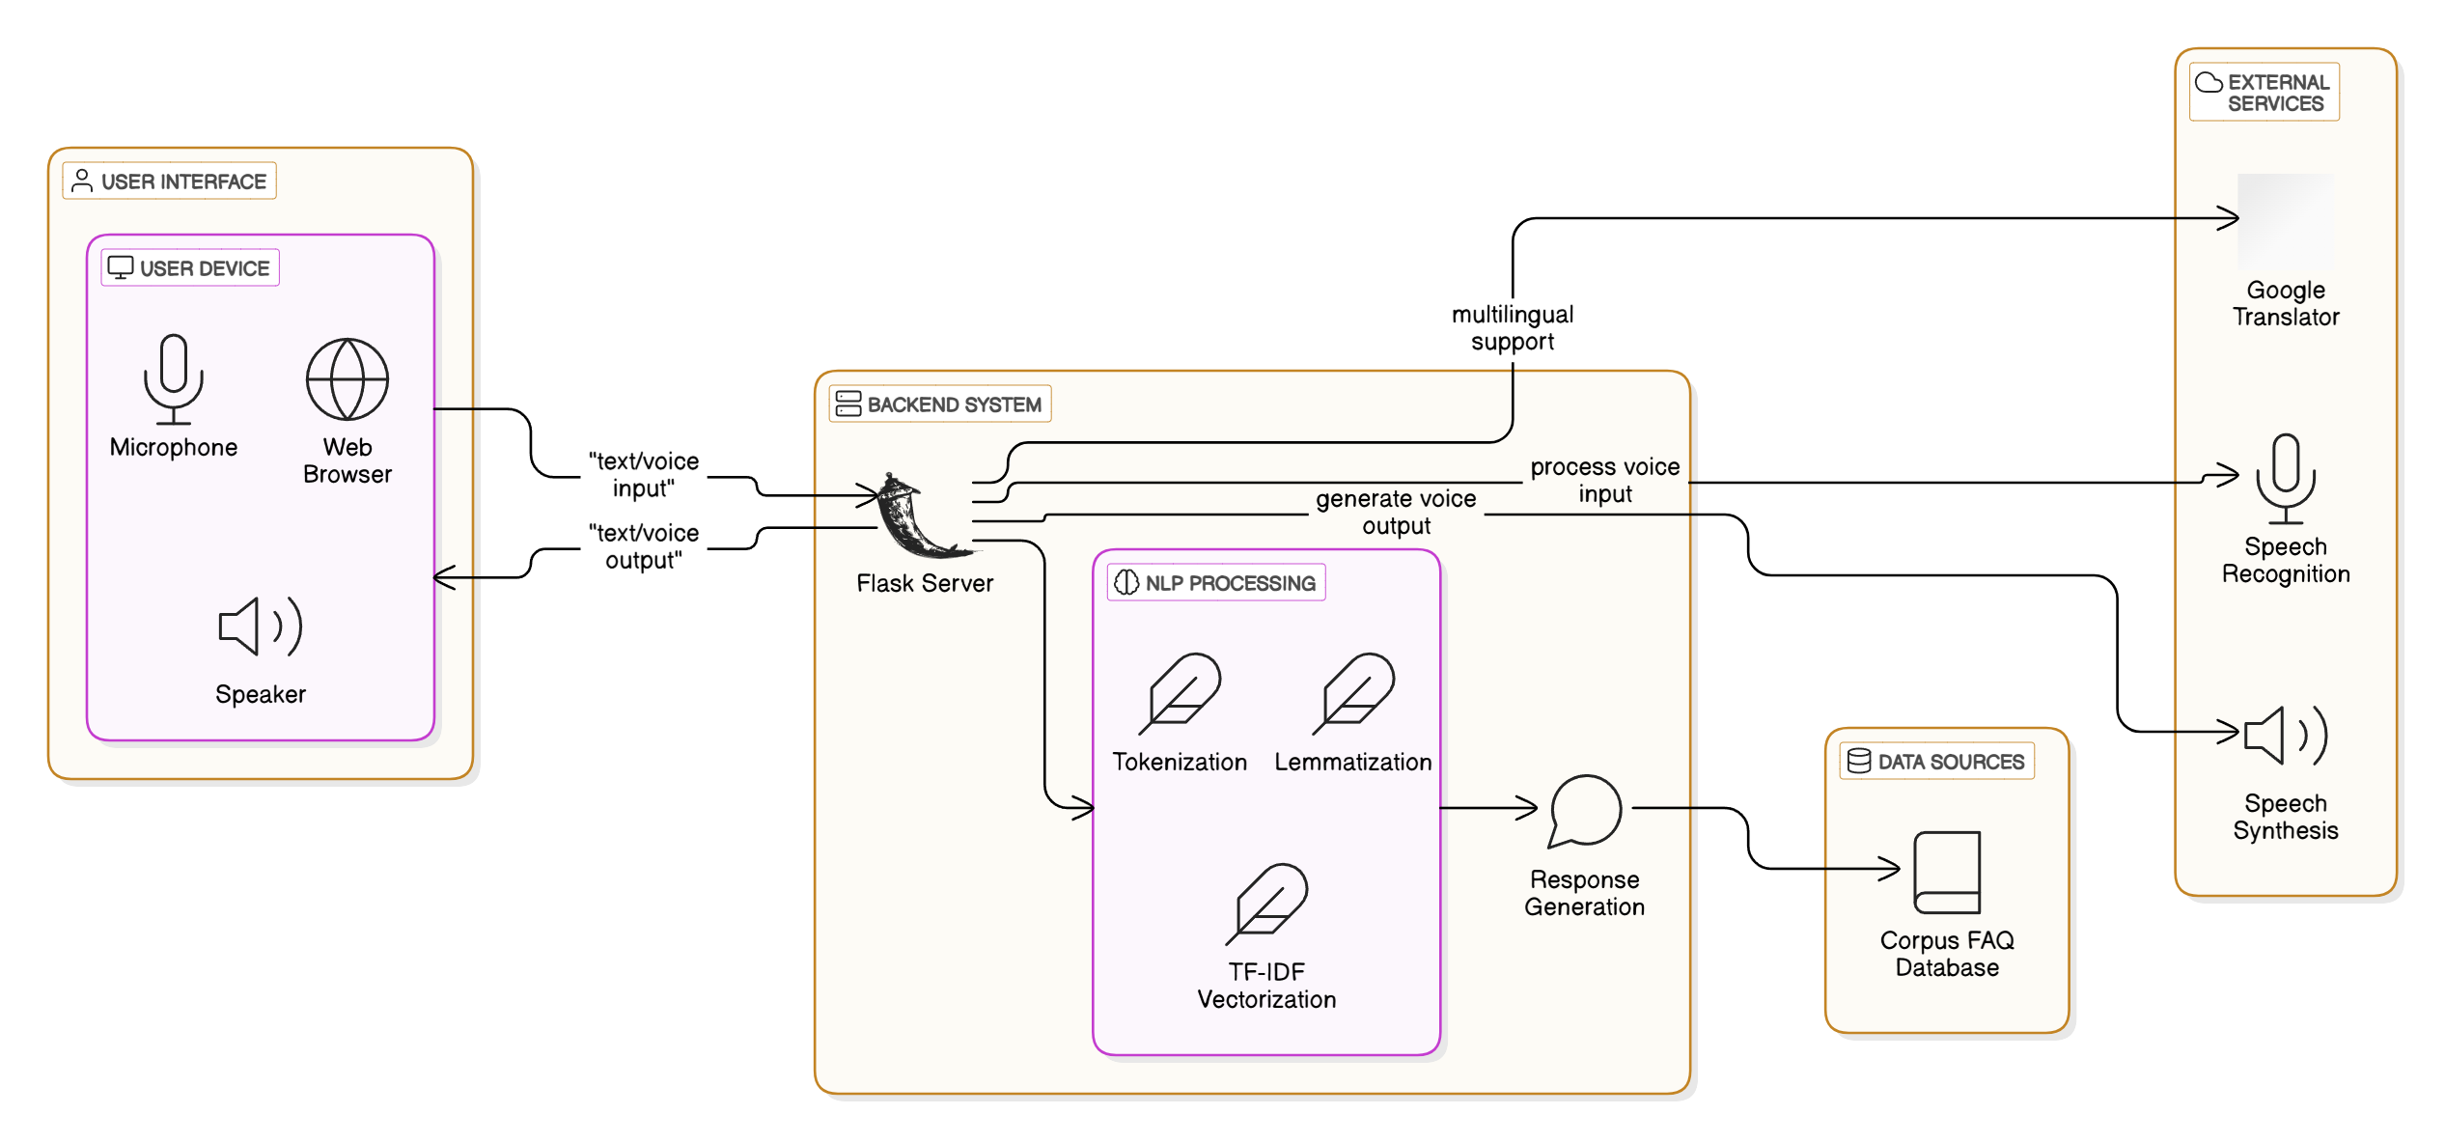
SYSTEM ARCHITECTURE
SYSTEM ARCHITECTURE & PROPOSED METHODOLOGY
05

Slide 18
The LEO chatbot system is built to support both text and voice-based interactions, allowing users to choose their preferred communication mode. It also offers multilingual support, enabling users to select from languages like English, Hindi, or Kannada. The frontend, developed with HTML, CSS, and JavaScript, ensures smooth message exchange, while voice input is converted to text using Google Speech Recognition.
In the Natural Language Processing (NLP) layer, user input is processed through tokenization, lemmatization, and punctuation removal. The system detects greetings and responds appropriately. For general queries, it uses TF-IDF and cosine similarity to match user input with predefined responses, ensuring relevant replies. If no match is found, the chatbot apologizes.
The backend, powered by Flask, manages the user input and response flow. It interacts with the chatbot’s predefined FAQ corpus and translates responses using Google Translate for multilingual support. Text-to-speech output is handled by pyttsx3, enhancing the voice interaction experience. This architecture ensures a seamless and engaging user experience.
SYSTEM ARCHITECTURE & PROPOSED METHODOLOGY
05

Slide 19
PROPOSED METHODOLOGY
05

Slide 20
Data Collection and Preprocessing:
Load and preprocess a text corpus for training, including tokenization, lemmatization, and punctuation removal using NLTK.
Greeting Recognition:
Detect greetings in the user’s input and return an appropriate random greeting response.
User Input Handling:
Handle both text and voice input. Voice input is converted to text using the Speech Recognition library.
4. Response Generation:
Use TF-IDF vectorization and cosine similarity to find the most relevant pre-existing sentence from the corpus and generate a response.
If no relevant response is found, provide a default response.
5. Language Translation:
Translate responses into the selected user language using the google trans library.
6. Text-to-Speech (TTS):
If in voice mode, use pyttsx3 to read the response aloud after translation.
7. Session Flow:
Prompt the user for language and interaction mode at the start. Continue conversation until the user exits with a "bye".
8. Error Handling:
Gracefully handle speech recognition errors, API issues, and unrecognized queries with default fallback responses.
9. Evaluation:
Test the system for accuracy in response relevance and user satisfaction based on interactions.
PROPOSED METHODOLOGY
05

Slide 21
Data Collection and Preprocessing:
Load and preprocess a text corpus for training, including tokenization, lemmatization, and punctuation removal using NLTK.
Greeting Recognition:
Detect greetings in the user’s input and return an appropriate random greeting response.
User Input Handling:
Handle both text and voice input. Voice input is converted to text using the Speech Recognition library.
4. Response Generation:
Use TF-IDF vectorization and cosine similarity to find the most relevant pre-existing sentence from the corpus and generate a response.
If no relevant response is found, provide a default response.
5. Language Translation:
Translate responses into the selected user language using the google trans library.
6. Text-to-Speech (TTS):
If in voice mode, use pyttsx3 to read the response aloud after translation.
7. Session Flow:
Prompt the user for language and interaction mode at the start. Continue conversation until the user exits with a "bye".
8. Error Handling:
Gracefully handle speech recognition errors, API issues, and unrecognized queries with default fallback responses.
9. Evaluation:
Test the system for accuracy in response relevance and user satisfaction based on interactions.
PROPOSED METHODOLOGY
05

Slide 22
Data Collection and Preprocessing:
Load and preprocess a text corpus for training, including tokenization, lemmatization, and punctuation removal using NLTK.
Greeting Recognition:
Detect greetings in the user’s input and return an appropriate random greeting response.
User Input Handling:
Handle both text and voice input. Voice input is converted to text using the Speech Recognition library.
4. Response Generation:
Use TF-IDF vectorization and cosine similarity to find the most relevant pre-existing sentence from the corpus and generate a response.
If no relevant response is found, provide a default response.
5. Language Translation:
Translate responses into the selected user language using the google trans library.
6. Text-to-Speech (TTS):
If in voice mode, use pyttsx3 to read the response aloud after translation.
7. Session Flow:
Prompt the user for language and interaction mode at the start. Continue conversation until the user exits with a "bye".
8. Error Handling:
Gracefully handle speech recognition errors, API issues, and unrecognized queries with default fallback responses.
9. Evaluation:
Test the system for accuracy in response relevance and user satisfaction based on interactions.
PROPOSED METHODOLOGY
05

Slide 23
ADVANTAGES
06

Slide 24
Multilingual Support: The bot can handle multiple languages (English, Hindi, Kannada), making it accessible to a diverse customer base.
Voice & Text Interaction: Users can choose between voice or text mode, enhancing accessibility and convenience.
Natural Language Processing (NLP): Uses tokenization, lemmatization, and cosine similarity for accurate, context-aware responses to customer queries.
Scalability: The bot can easily be extended with more banking-related FAQs and services.
24/7 Availability: Provides round-the-clock support, improving customer engagement and satisfaction.
Error Handling: Gracefully handles speech recognition errors and unrecognized inputs, ensuring a smooth user experience.
Text-to-Speech: Offers hands-free interaction, useful for users on the move.
Easy Customization: The bot’s responses can be easily updated, allowing quick adaptation to new banking products and services.
Proactive Assistance: Can be used for reminders, advice, and alerts, enhancing customer service.
ADVANTAGES
06

Slide 25
Multilingual Support: The bot can handle multiple languages (English, Hindi, Kannada), making it accessible to a diverse customer base.
Voice & Text Interaction: Users can choose between voice or text mode, enhancing accessibility and convenience.
Natural Language Processing (NLP): Uses tokenization, lemmatization, and cosine similarity for accurate, context-aware responses to customer queries.
Scalability: The bot can easily be extended with more banking-related FAQs and services.
24/7 Availability: Provides round-the-clock support, improving customer engagement and satisfaction.
Error Handling: Gracefully handles speech recognition errors and unrecognized inputs, ensuring a smooth user experience.
Text-to-Speech: Offers hands-free interaction, useful for users on the move.
Easy Customization: The bot’s responses can be easily updated, allowing quick adaptation to new banking products and services.
Proactive Assistance: Can be used for reminders, advice, and alerts, enhancing customer service.
ADVANTAGES
06

Slide 26
Multilingual Support: The bot can handle multiple languages (English, Hindi, Kannada), making it accessible to a diverse customer base.
Voice & Text Interaction: Users can choose between voice or text mode, enhancing accessibility and convenience.
Natural Language Processing (NLP): Uses tokenization, lemmatization, and cosine similarity for accurate, context-aware responses to customer queries.
Scalability: The bot can easily be extended with more banking-related FAQs and services.
24/7 Availability: Provides round-the-clock support, improving customer engagement and satisfaction.
Error Handling: Gracefully handles speech recognition errors and unrecognized inputs, ensuring a smooth user experience.
Text-to-Speech: Offers hands-free interaction, useful for users on the move.
Easy Customization: The bot’s responses can be easily updated, allowing quick adaptation to new banking products and services.
Proactive Assistance: Can be used for reminders, advice, and alerts, enhancing customer service.
ADVANTAGES
06

Slide 27
RESULT & DISCUSSION
07

Slide 28
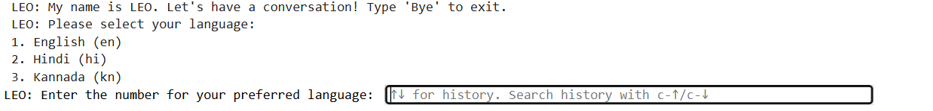
Final Result
RESULT & DISCUSSION
07
The Fig shows a text-based interface for a chatbot named LEO. The chatbot welcomes the user and provides instructions for starting a conversation. It also presents a list of language options: English, Hindi, and Kannada. The user is prompted to select their preferred language by entering the corresponding number.

Slide 29
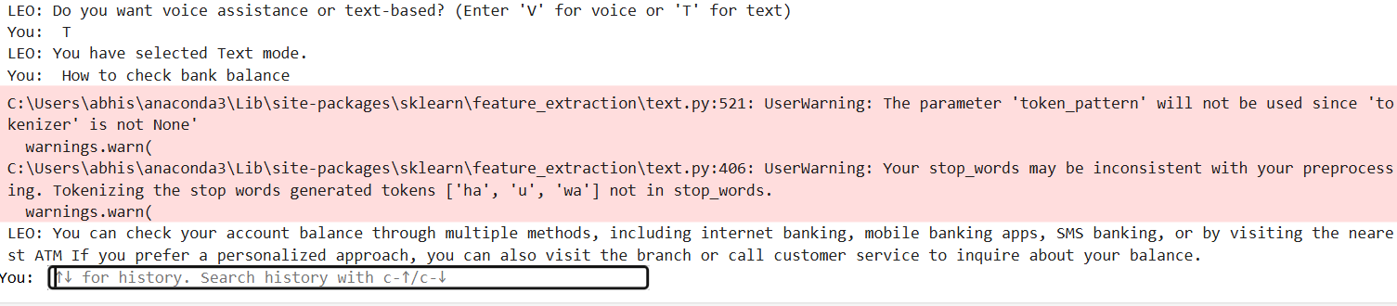
RESULT & DISCUSSION
07
The image shows a chat conversation between a user and a chatbot named LEO. The user requests information on how to check their bank balance. LEO responds by providing multiple methods, including online banking, mobile apps, and visiting a bank branch. The user then attempts to search their conversation history with the chatbot.

Slide 30
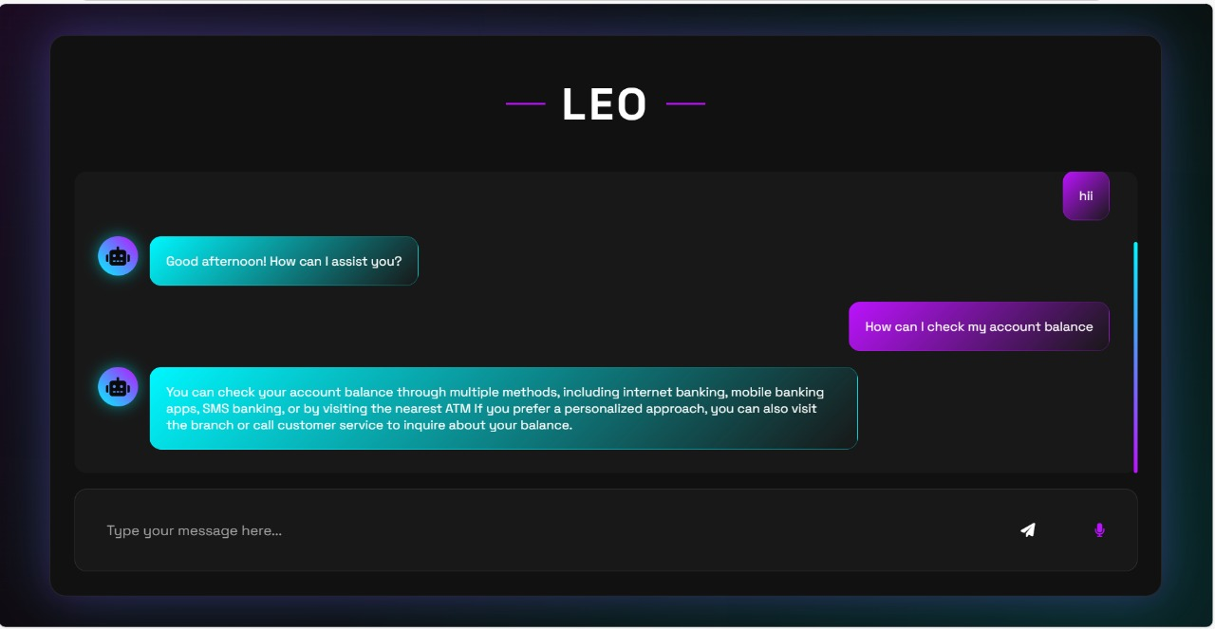
RESULT & DISCUSSION
07

Slide 31
APPLICATION
08

Slide 32
1.Customer Support Automation
Explanation: The chatbot can handle FAQs such as account opening procedures, interest rates, credit card details, and more. By automating these routine inquiries, it reduces the workload on human support agents and ensures 24/7 availability.
2.Multilingual Banking Services
Explanation: The chatbot’s support for multiple languages (like English, Hindi, and Kannada) enables it to cater to customers from diverse linguistic backgrounds. This increases accessibility and ensures effective communication.
3.Voice-Enabled Banking
Explanation: With its speech-to-text and text-to-speech capabilities, the chatbot allows hands-free banking interactions. This is especially useful for visually impaired customers or users who prefer voice commands.
4.Loan and Credit Services
Explanation: The chatbot provides information about loan types and Respective Interests and also give the information related to Credit and debit Cards.
5.Personalized Financial Advice
Explanation: The chatbot analyzes user inputs to offer personalized financial advice, such as budgeting tips or suitable investment plans. It acts as a virtual financial advisor
ADVANTAGES
08

Slide 33
1.Customer Support Automation
Explanation: The chatbot can handle FAQs such as account opening procedures, interest rates, credit card details, and more. By automating these routine inquiries, it reduces the workload on human support agents and ensures 24/7 availability.
2.Multilingual Banking Services
Explanation: The chatbot’s support for multiple languages (like English, Hindi, and Kannada) enables it to cater to customers from diverse linguistic backgrounds. This increases accessibility and ensures effective communication.
3.Voice-Enabled Banking
Explanation: With its speech-to-text and text-to-speech capabilities, the chatbot allows hands-free banking interactions. This is especially useful for visually impaired customers or users who prefer voice commands.
4.Loan and Credit Services
Explanation: The chatbot provides information about loan types and Respective Interests and also give the information related to Credit and debit Cards.
5.Personalized Financial Advice
Explanation: The chatbot analyzes user inputs to offer personalized financial advice, such as budgeting tips or suitable investment plans. It acts as a virtual financial advisor
ADVANTAGES
08

Slide 34
CONCLUSION
09

Slide 35
In conclusion, this banking chatbot project demonstrates the effective use of natural language processing (NLP) techniques to create an interactive and responsive system. By leveraging libraries like NLTK and Scikit-learn, the chatbot processes user inputs, recognizes greetings, and generates relevant responses based on text similarity. The integration of Flask allows for smooth communication between the front-end and back-end, enabling real time interactions. The chatbot is capable of learning from user input, adapting its responses accordingly, and ensuring a seamless conversational experience. While the system can handle a variety of queries, there is room for further enhancements, such as adding more complex banking-related functions or improving response accuracy. This project serves as a solid foundation for developing intelligent chatbots capable of assisting users in various domains, with potential for future scalability and customization.
References
1. N. Madrid and R. P. L. Leitão, "Bank chatbot: An intelligent assistant based on natural language processing." Proceedings of the 2018 IEEE International Conference on Systems, Man, and Cybernetics (SMC), pp. 292-297, 2018.
2. S. B. Srinivasan, S. Raja, and M. Kumar, "Intelligent bank chatbot using natural language processing." Proceedings of the 2018 International Conference on Smart Computing and Communication (ICSCC), pp. 21-25, 2018.
3. H. Liu and R. Li, "Design of an intelligent bank chatbot based on natural language processing." Proceedings of the 2019 International Conference on Intelligent Manufacturing and Automation (ICA), pp. 87-90, 2019.
4. Mohamed, A. Ibrahim, A. F. A. Jalil, and A. K. Abdullah, "Natural language processing based on bank chatbot." International Journal of Academic Research in Computer Engineering (IJARCE), vol. 1, no. 2, pp. 18-25, 2018.
5. S. S. Alghamdi, "Designing an intelligent chatbot for banking customer service using natural language processing." International Journal on Recent Trends in Business and Tourism, vol. 1, no. 1, pp. 1-10, 2019.
CONCLUSION
09

Slide 36
In conclusion, this banking chatbot project demonstrates the effective use of natural language processing (NLP) techniques to create an interactive and responsive system. By leveraging libraries like NLTK and Scikit-learn, the chatbot processes user inputs, recognizes greetings, and generates relevant responses based on text similarity. The integration of Flask allows for smooth communication between the front-end and back-end, enabling real time interactions. The chatbot is capable of learning from user input, adapting its responses accordingly, and ensuring a seamless conversational experience. While the system can handle a variety of queries, there is room for further enhancements, such as adding more complex banking-related functions or improving response accuracy. This project serves as a solid foundation for developing intelligent chatbots capable of assisting users in various domains, with potential for future scalability and customization.
References
1. N. Madrid and R. P. L. Leitão, "Bank chatbot: An intelligent assistant based on natural language processing." Proceedings of the 2018 IEEE International Conference on Systems, Man, and Cybernetics (SMC), pp. 292-297, 2018.
2. S. B. Srinivasan, S. Raja, and M. Kumar, "Intelligent bank chatbot using natural language processing." Proceedings of the 2018 International Conference on Smart Computing and Communication (ICSCC), pp. 21-25, 2018.
3. H. Liu and R. Li, "Design of an intelligent bank chatbot based on natural language processing." Proceedings of the 2019 International Conference on Intelligent Manufacturing and Automation (ICA), pp. 87-90, 2019.
4. Mohamed, A. Ibrahim, A. F. A. Jalil, and A. K. Abdullah, "Natural language processing based on bank chatbot." International Journal of Academic Research in Computer Engineering (IJARCE), vol. 1, no. 2, pp. 18-25, 2018.
5. S. S. Alghamdi, "Designing an intelligent chatbot for banking customer service using natural language processing." International Journal on Recent Trends in Business and Tourism, vol. 1, no. 1, pp. 1-10, 2019.
CONCLUSION
09

