Slide 1
DATABASE MANAGEMENT SYSTEM PROJECT REVIEW
Department of Artificial Intelligence and Data Science
Academic Year: 2024 – 2025 (Even Semester)
Register Number : 2303811724321082
Name : PRASANNA N
Year : II
Semester : IV
Section : B
Date : 04-06-2025

Slide 2
Title of the Project
PHARMACY MANAGEMENT SYSTEM

Slide 3
Problem Identified
Managing a pharmacy manually is difficult and error-prone.
Tracking medicines, handling prescriptions, and billing take time and may cause mistakes. Without real-time updates, stock management becomes challenging. Data can be lost or misused, and report generation is slow.
A Pharmacy Management System helps automate inventory, manage prescriptions, speed up billing, and improve security, making operations smooth and efficient.

Slide 4
Objective
The objective of this project is to design and develop a Pharmacy Management System that efficiently manages inventory, sales, customer records, and prescriptions in a pharmacy. The system enables real-time stock tracking, facilitates prescription management, automates invoicing, and generates reports on sales and stock usage. It ensures compliance with regulatory requirements, reduces errors in transactions, and enhances overall operational efficiency.

Slide 5
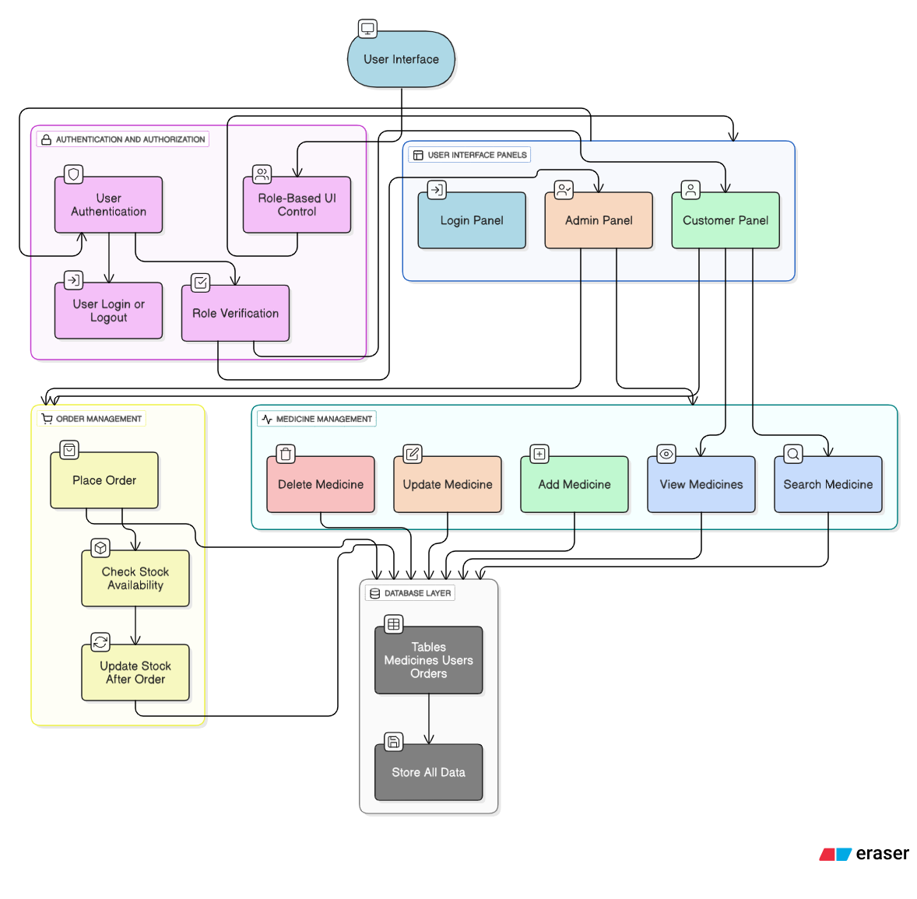
Proposed Architecture

Slide 6
Module List
User Authentication
Medicine Management
Order Management
Search & View Medicines
Role-Based UI Control

Slide 7
Module Implemented
1.User Authentication:
This module handles user login functionality by verifying usernames and passwords stored in the users table.
It identifies the role of the user (admin or customer) upon successful login and securely manages the user session.
The login panel is dynamically hidden after authentication, and the correct interface is shown based on user privileges.

Slide 8
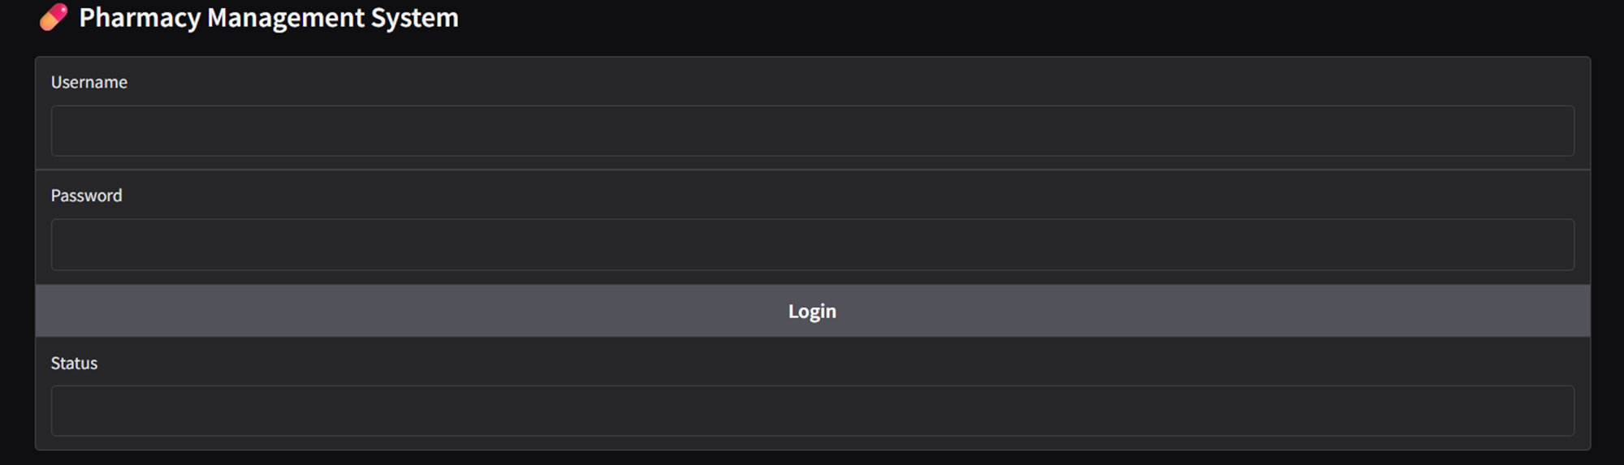
Module Implemented
USER AUTHENTICATION MODULE

Slide 9
Module Implemented
2. Medicine Management:
This module allows administrators to perform operations such as adding, updating, viewing, and deleting medicines.
Each medicine entry includes name, company, price, and quantity, and changes are stored in the medicines table.
Gradio elements are used for interactive data entry and status display, ensuring easy and real-time inventory control.

Slide 10
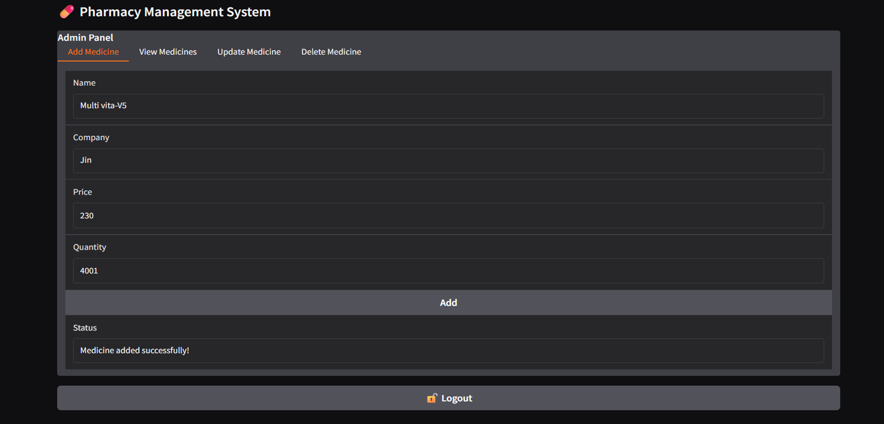
Module Implemented

Slide 11
Module Implemented
3. Order Management:
This module enables customers to place medicine orders while checking stock availability.
It verifies that the requested quantity is in stock before creating an order and deducting it from inventory.
The order details are recorded in the orders table to maintain accurate transaction records and support future tracking.

Slide 12
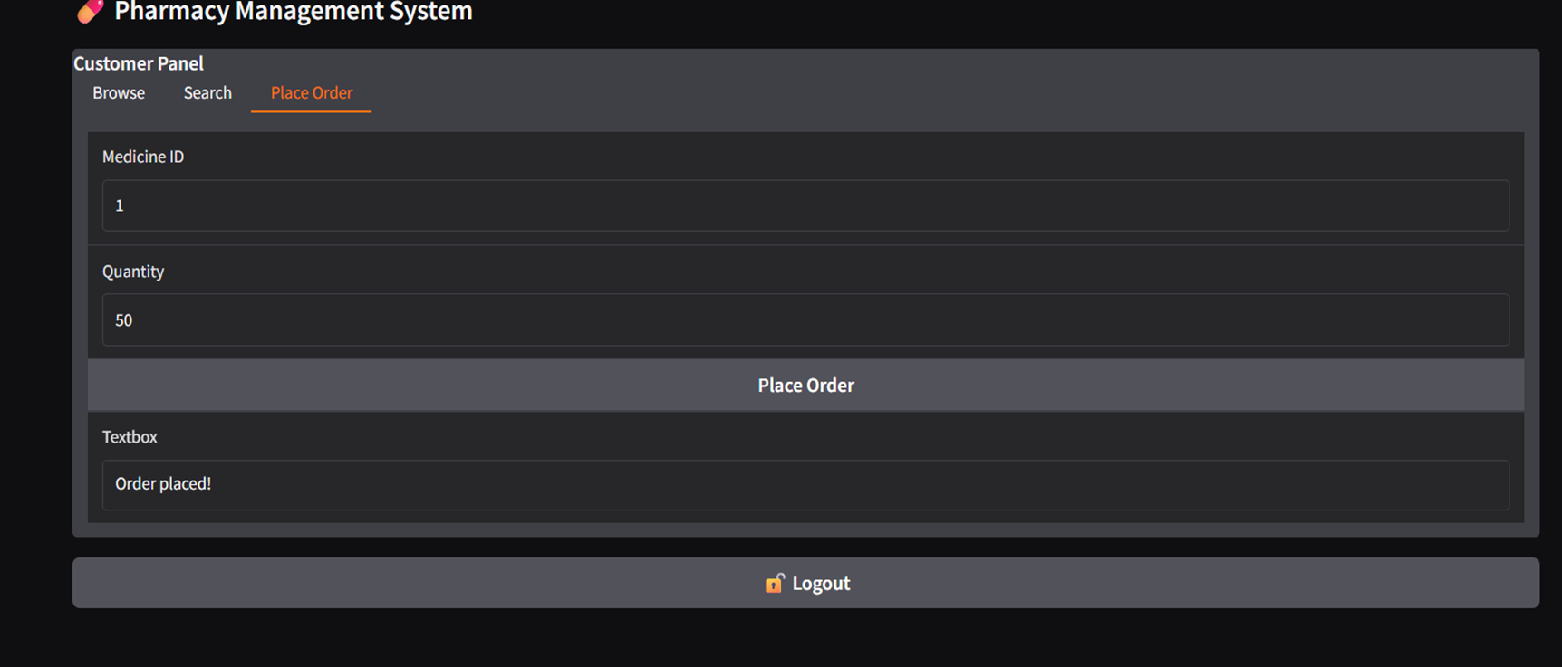
Module Implemented

Slide 13
Module Implemented
4. Search & View Medicines:
This module provides features for browsing all available medicines or searching by name.
Users can enter part or full medicine names to retrieve matching records from the database.
Search results and full inventory lists are displayed using Gradio's Dataframe component for clarity and ease of use.

Slide 14
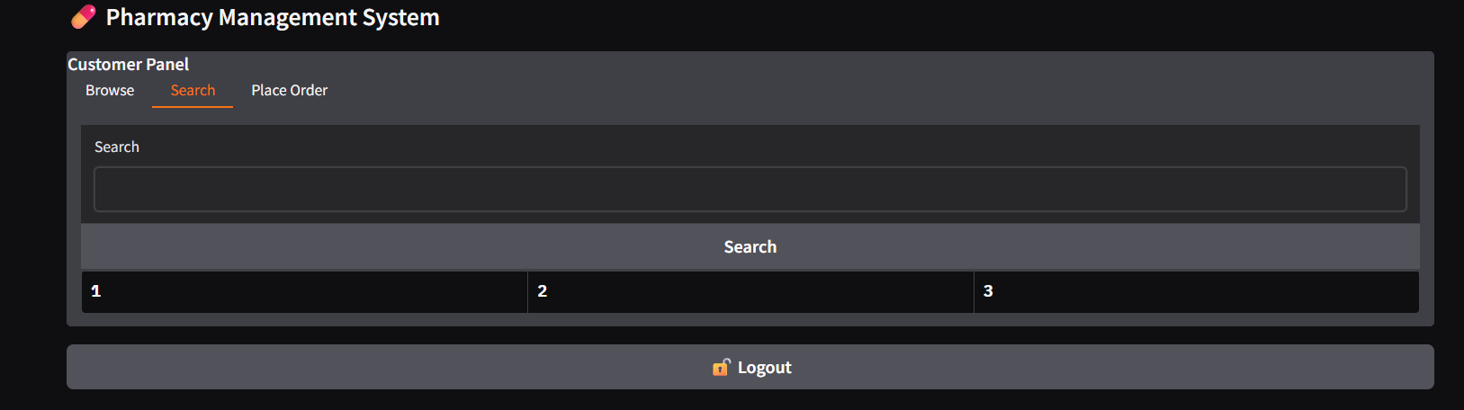
Module Implemented

Slide 15
Module Implemented
5. Role-Based UI Control:
This module ensures that only authorized users can access specific functionalities based on their assigned roles.
After login, the UI adjusts dynamically to show either the admin or customer panel using visibility controls.
This separation of access enhances security and improves user experience by presenting only the relevant options.

Slide 16
CONCLUSION & REFERENCES
Conclusion :
The Pharmacy Management System is a robust and efficient solution for modern pharmacies. It ensures seamless inventory control, accurate sales tracking, secure prescription handling, and fast billing while complying with medical regulations. Implementing this system enhances productivity, reduces errors, and improves customer service, making it an essential tool for pharmacy management.
Future Scope Enhancements:
Incorporate AI-driven demand forecasting to optimize stock levels and reduce waste.
Integrate with supplier systems via Electronic Data Interchange (EDI) for automated reordering.

Slide 17
Thank You
Any queries???

