Slide 1
How to run MediBuddy?
1) Execute the provided (.jar) file using windows command prompt,
Java –jar com.medibuddy-0.0.1-SNAPSHOT.jar
2) Open Chrome browser, and navigate to the below endpoint,
http://localhost:8080/index.html
Note: Java Runtime Environment should be available in the respective machine

Slide 2
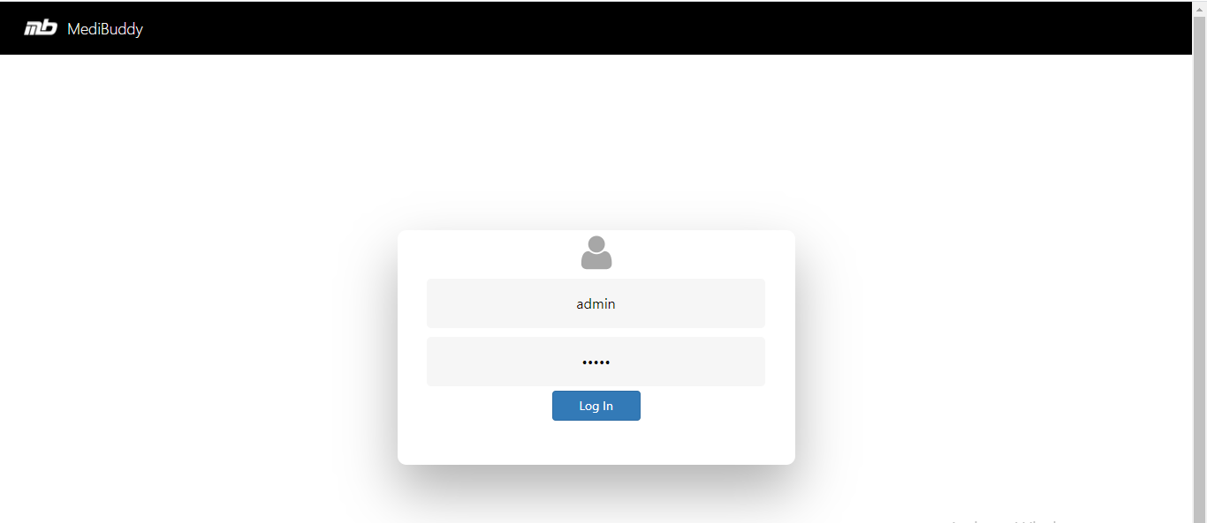
Login as Admin

Slide 3
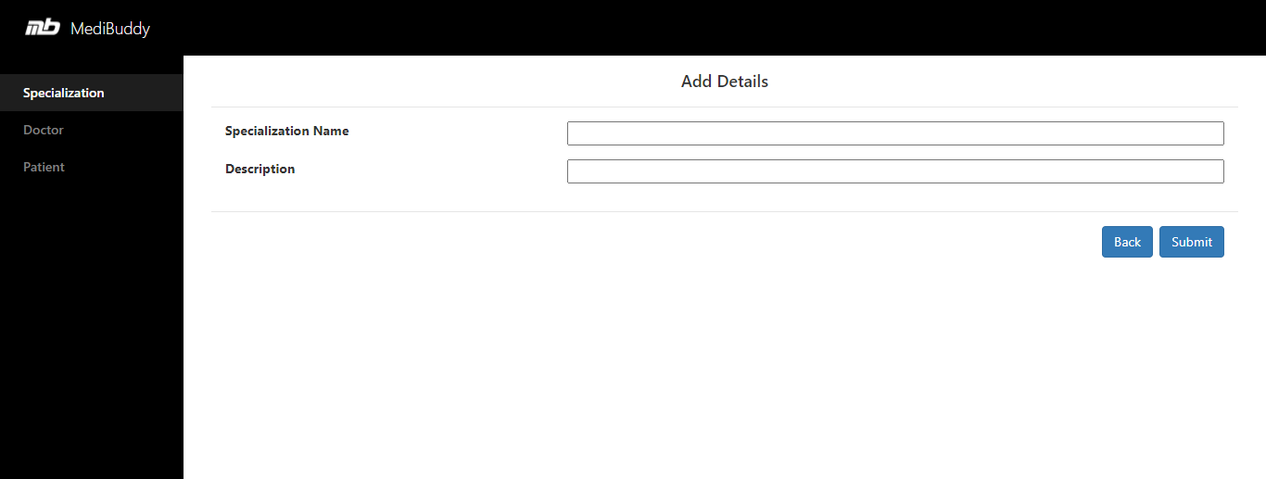
Add Specialization Details

Slide 4
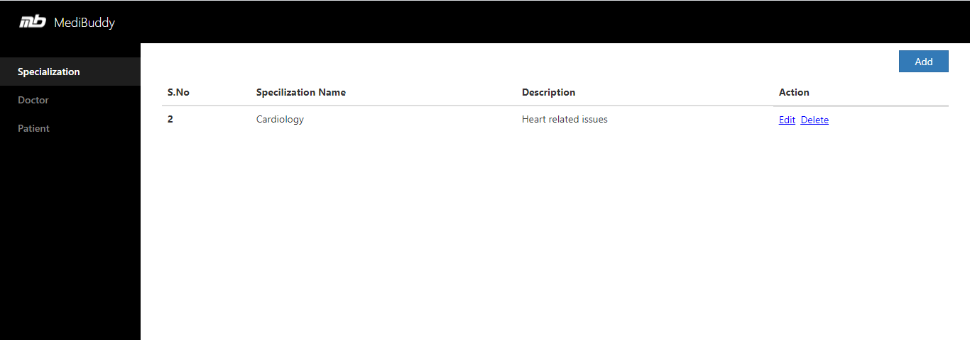
View Specialization Details

Slide 5
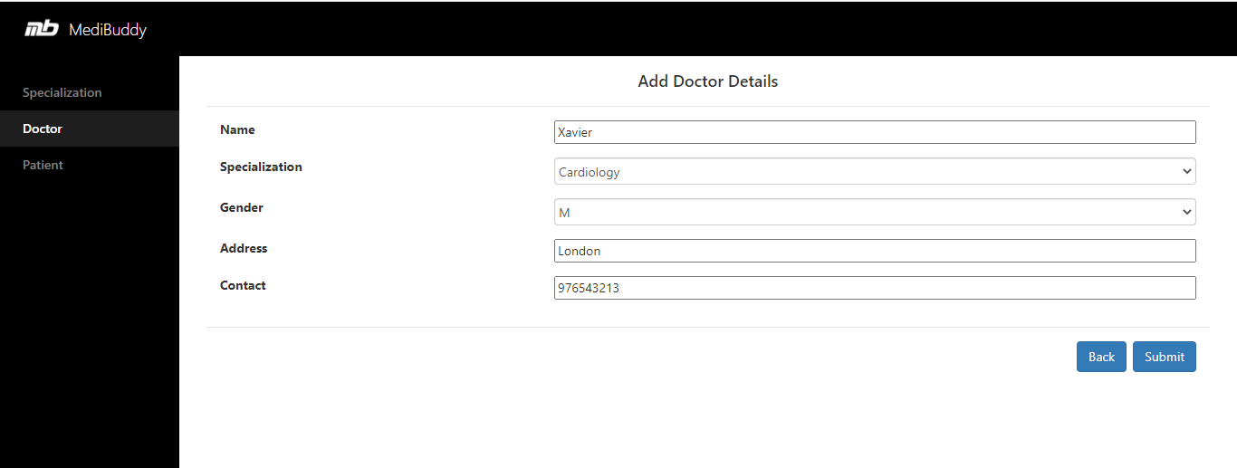
Add Doctor Details

Slide 6
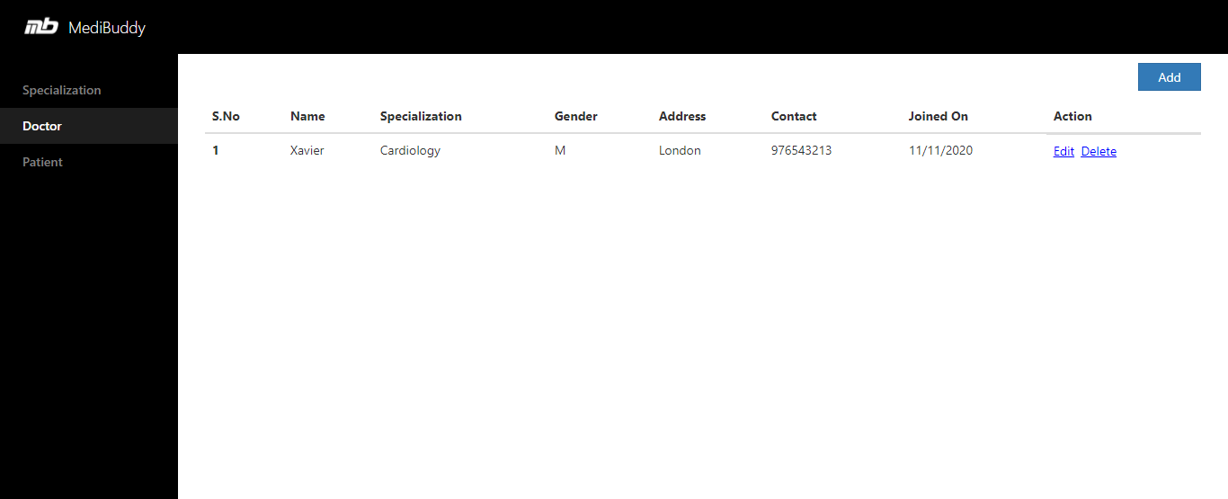
View Doctor Details

Slide 7
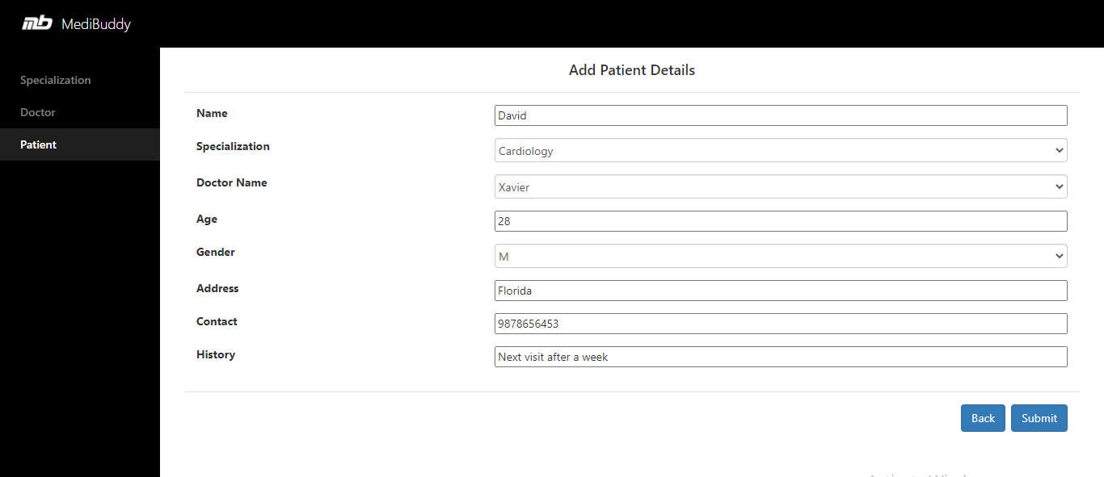
Add Patient Details

Slide 8
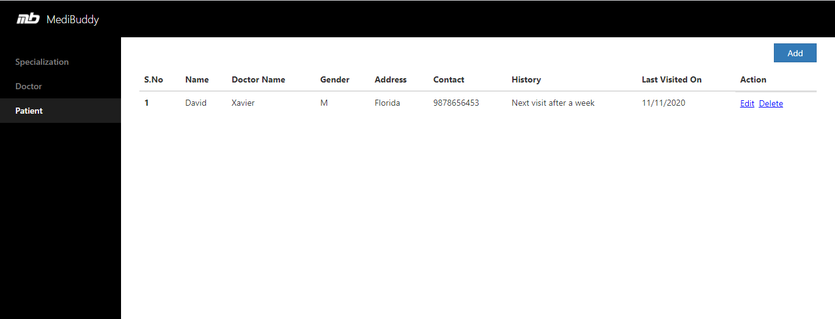
View Patient Details

