Slide 1







IBM Data Analyst Capstone Project: Analysis on Emerging Technology Skills and Trends
Prasanna Sriram
9th December 2024

Slide 2



OUTLINE
Executive Summary
Introduction
Methodology
Results
Visualization – Charts
Dashboard
Discussion
Findings & Implications
Conclusion
Appendix

Slide 3

EXECUTIVE SUMMARY
To remain competitive in the global IT industry, staying updated with rapidly evolving technologies is crucial. This report leverages data analytics to explore current and future trends in demand for skills related to programming languages, databases, and other technologies. It also examines the demographics of technology professionals.
The data was sourced from the Stack Overflow survey, IBM resources, and GitHub job postings. It underwent cleaning, exploratory analysis, and visualization through interactive dashboards.
The analysis revealed that Javascript is currently the most widely used programming language and is expected to maintain its dominance. While MySQL leads in database usage, PostgreSQL is predicted to gain more traction in the future
Additionally, most survey participants are male, based in the USA, and around 28 years old.

Slide 4

INTRODUCTION
This presentation report utilizes data analytics to identify current and future trends in the demand for skills related to programming languages, databases, platforms, and web frameworks.
The following key questions were addressed in the analysis:
Which programming languages are currently in high demand?
What are the most sought-after database skills?
Which IDEs and web frameworks are popular?
The research is aimed at IT professionals, HR managers, and anyone interested in understanding the most in-demand IT skills in their respective domains, both now and in the future.

Slide 5

METHODOLOGY
Data was collected in various formats, including the number of job openings for different technologies and locations, using the GitHub Jobs API in Python.
Programming languages and their annual salaries were obtained by scraping data from the IBM website. Additionally, a dataset from the 2019 Stack Overflow Developer Survey was downloaded and stored.
The data was cleaned and analyzed using Python. Exploratory data analysis (EDA) was performed to examine data distribution, detect outliers, and evaluate correlations between different columns.
Visualizations, including charts, graphs, and dashboards, were created using Python and Microsoft Power BI. All Python analyses were conducted in Jupyter Notebook.

Slide 6
RESULTS
The following provides a top-level summarization report of the current and next year comparison of the programming languages, database skills, IDE preferences and web frameworks

Slide 7
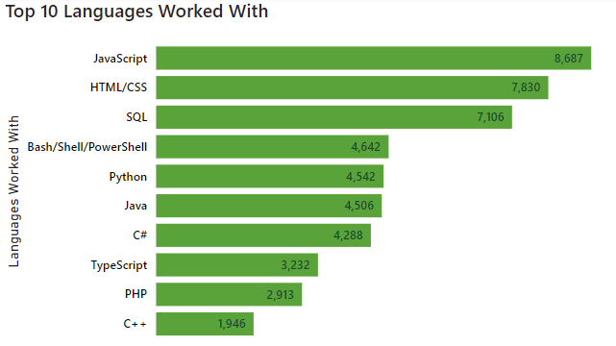
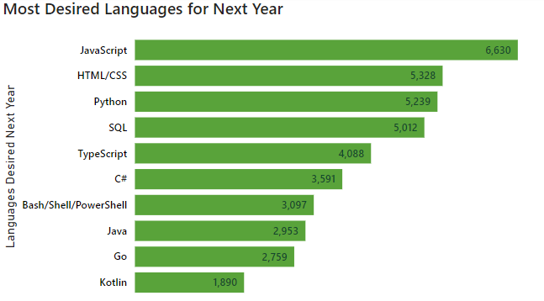
PROGRAMMING LANGUAGE TRENDS
Current Year
Next Year

Slide 8
PROGRAMMING LANGUAGE TRENDS - FINDINGS & IMPLICATIONS
Findings
JavaScript and HTML/CSS remain the most used programming languages, highlighting their essential role in web development.
SQL continues to be a vital skill for database management and querying.
Python and TypeScript are projected to experience substantial growth in the coming years. Python’s versatility in data analytics, machine learning, and web development is driving its growing popularity, while TypeScript is gaining preference for its enhanced structure and scalability in large-scale applications over JavaScript.
Implications
Organizations should emphasize training in Python and TypeScript to stay aligned with industry trends.
Python is indispensable for data analytics and AI, while TypeScript is emerging as the go-to language for building scalable, large-scale applications. Equipping employees with these skills will help modernize the workforce.
For career growth, professionals are encouraged to focus on mastering Python and TypeScript. Python opens doors in data science, machine learning, and web development, while TypeScript is increasingly sought after for large-scale application development.
Developing expertise in these languages will offer a significant competitive advantage in the job market.

Slide 9
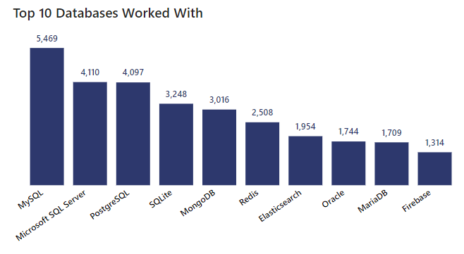
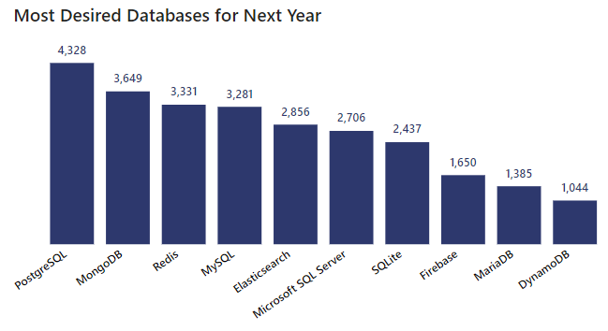
DATABASE TRENDS
Current Year
Next Year

Slide 10
DATABASE TRENDS - FINDINGS & IMPLICATIONS
Findings
MySQL and Microsoft SQL Server remain dominant in the database domain, valued for their reliability, extensive community support, and powerful capabilities for managing structured data.
These relational databases are the preferred choice for organizations requiring robust transaction handling and SQL-based functionalities.
PostgreSQL, however, is gaining popularity as a strong alternative, recognized for its advanced features such as support for complex queries, scalability, and high availability.
Implications
Organizations should explore adopting PostgreSQL as a forward-looking database solution, particularly for scenarios demanding scalability and high performance.
For applications dealing with unstructured data, NoSQL databases such as MongoDB and Redis offer the flexibility required to manage expanding data volumes efficiently.
Professionals are encouraged to develop expertise in PostgreSQL to align with the increasing demand for scalable relational database systems.

Slide 11

DASHBOARD
You can access or download the Microsoft Power BI Report from here - https://github.com/prasanna-sriram/tech-jobs-survey-analysis

Slide 12
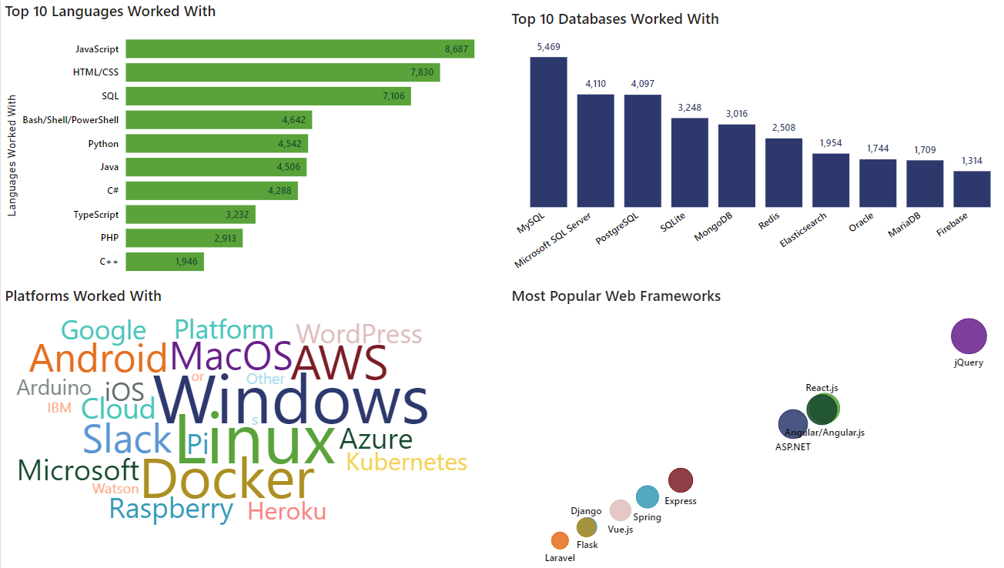
DASHBOARD TAB 1

Slide 13
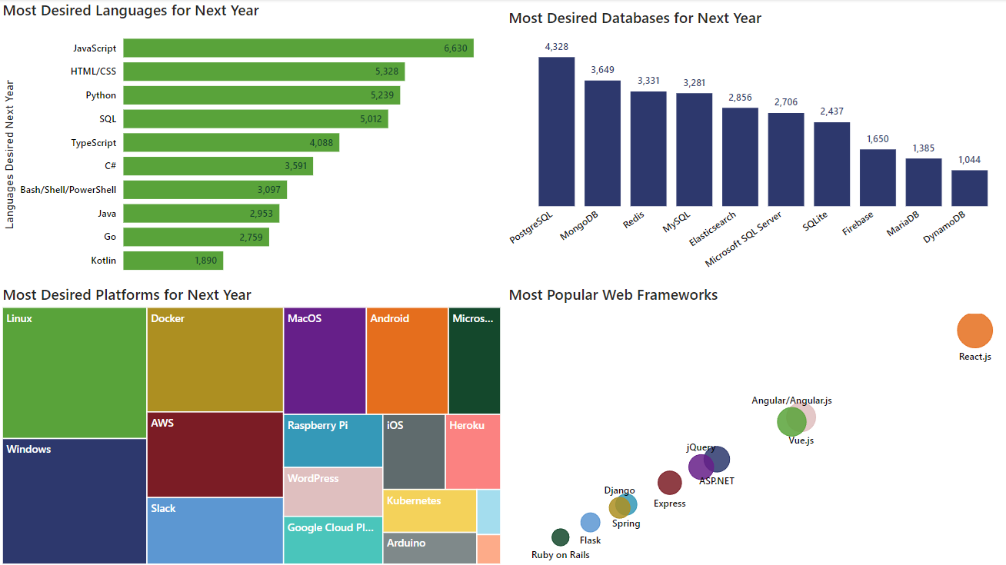
DASHBOARD TAB 2

Slide 14
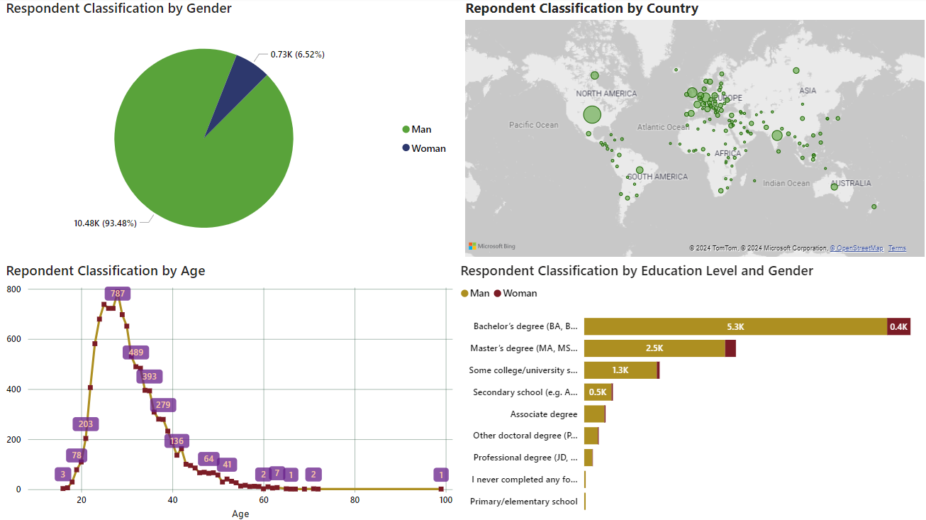
DASHBOARD TAB 3

Slide 15
DISCUSSION
What steps can be taken to bridge the significant gender gap in the technology industry?
Is pursuing a master’s or doctorate degree truly necessary for success in tech?
The rising demand for mobile development as Kotlin continues to gain popularity.
Expanding tech education, resources, and skill development in underdeveloped regions across Southeast Asia, South America, Africa, and parts of Europe.
Assessing the future relevance of Oracle SQL in an evolving tech landscape.

Slide 16
OVERALL FINDINGS & IMPLICATIONS
Findings
A majority of IT professionals hold a Bachelor’s degree.
Web development languages are currently the most popular and in-demand tools within the IT industry.
The tech sector is predominantly composed of young professionals under the age of 40.
PostgreSQL and React JS are the top technologies most respondents plan to learn in the coming year.
Implications
Data professionals should prioritize building expertise in NoSQL databases alongside traditional SQL databases.
Web development remains a highly lucrative and valuable skill in the tech industry.
Increased access to technology training and education is crucial for fostering growth in less developed countries.

Slide 17

CONCLUSION
The technology landscape continues to evolve, with Python and TypeScript poised for significant growth, especially in areas like data science, machine learning, and scalable application development. For organizations, investing in these technologies is crucial to maintaining a competitive edge.
Likewise, modern tools such as Kubernetes are becoming indispensable in cloud-native environments, enabling businesses to achieve efficient scalability.
To stay relevant, professionals should focus on acquiring in-demand skills like Python, TypeScript, and PostgreSQL. Mastery in these areas will open opportunities in data science, real-time systems, and other high-demand fields.
Despite many professionals holding advanced degrees, the tech workforce remains significantly gender-imbalanced. To drive innovation and foster inclusivity, organizations must prioritize diversity initiatives and work towards building a more equitable workplace.

Slide 18

APPENDIX
Number of Job Postings by Programming Languages
Number of Job Postings by Location
Average Annual Salary by Programming Languages

Slide 19
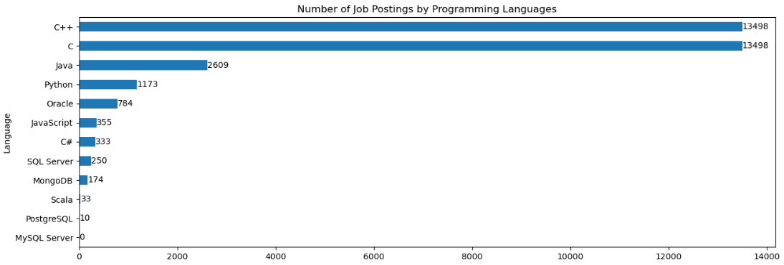
JOB POSTINGS

Slide 20
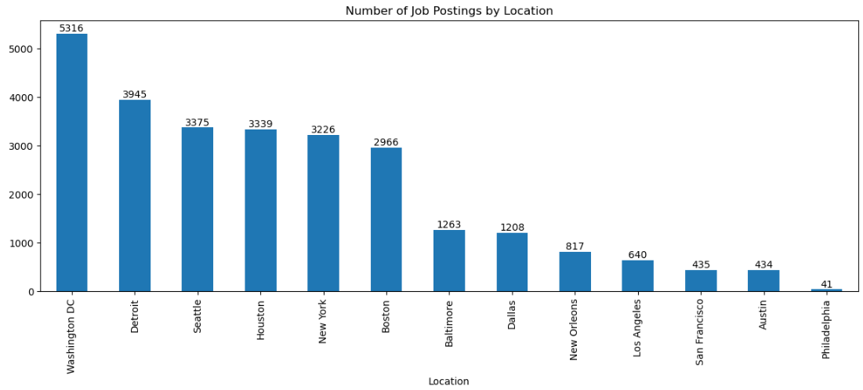
JOB POSTINGS

Slide 21
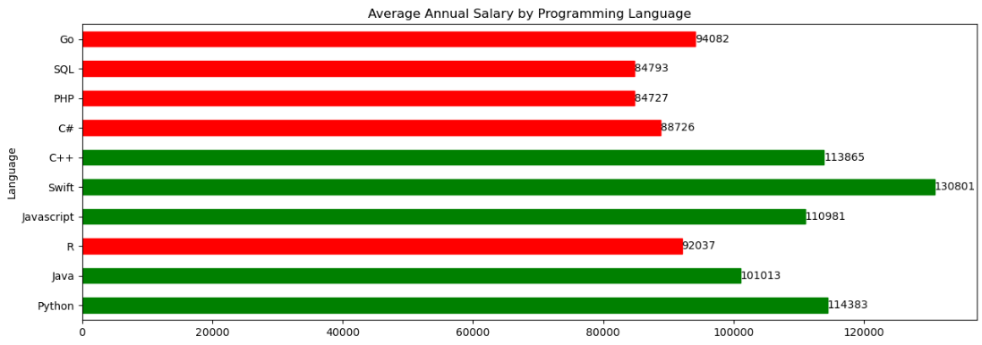
POPULAR LANGUAGES

