Slide 1
PRASANNAKUMAR AVB
FINAL PROJECT

Slide 2
PROJECT TITLE:
Traffic Sign Classification using Convolutional Neural Network
(CNN Keras)

Slide 3
AGENDA:
Expected Outcome:
A robust and accurate model capable of recognizing and classifying traffic signs in various conditions.
Dataset:
GTSRB - German Traffic Sign Recognition Benchmark [https://www.kaggle.com/datasets/meowmeowmeowmeowmeow/gtsrb-german-traffic-sign]
Overview of the dataset:
Contains 43 classes of traffic signs
Total of more than 50,000 images
Split into training and testing datasets

Slide 4
PROBLEM STATEMENT:
Traffic Sign Recognition Challenges:
Inaccurate detection and classification of traffic signs by autonomous vehicles.
Existing systems may not be robust enough to handle various environmental conditions.
Impact on Road Safety:
Incorrect interpretation of traffic signs can lead to accidents and traffic violations.
Need for a Reliable Solution:
A reliable and efficient system is required for accurate traffic sign detection and classification.

Slide 5
PROJECT OVERVIEW:
Objective:
To develop a Convolutional Neural Network (CNN) model for accurate classification of traffic signs using the GTSRB dataset.
Methodology:
Data collection, pre-processing, model development, training, and evaluation.
Expected Outcome:
A robust and accurate model capable of recognizing and classifying traffic signs in various conditions.

Slide 6
WHO ARE THE END USERS?:
Autonomous Vehicle Manufacturers:
Incorporating the model for improved traffic sign recognition in autonomous driving systems.
Traffic Management Authorities:
Utilizing the model for enhanced traffic sign detection and management.
General Public:
Benefiting from improved road safety through accurate traffic sign recognition.

Slide 7
YOUR SOLUTION AND ITS END USERS:
Solution:
A CNN model trained on the GTSRB dataset for traffic sign classification.
End Users:
Autonomous vehicle manufacturers, traffic management authorities, and the general public.
Benefits:
Improved road safety, reduced traffic violations, and enhanced performance of autonomous driving systems.

Slide 8
THE WOW IN YOUR SOLUTION:
Accuracy and Robustness:
Achieving high accuracy in traffic sign classification under various environmental conditions.
Real-time Processing:
Capable of real-time traffic sign detection and classification.
Scalability:
The model can be scaled and adapted for use in various autonomous driving systems and traffic management applications.

Slide 9
MODELLING:
Convolutional Neural Network (CNN) Architecture:
Multiple convolutional layers, max-pooling layers, dropout layers, and fully connected layers.
Training Parameters:
Loss function: Categorical Cross-Entropy
Optimizer: Adam
Number of epochs: 40
Batch size: 64
Performance Metrics:
Accuracy, Loss, Training and validation curves.

Slide 10
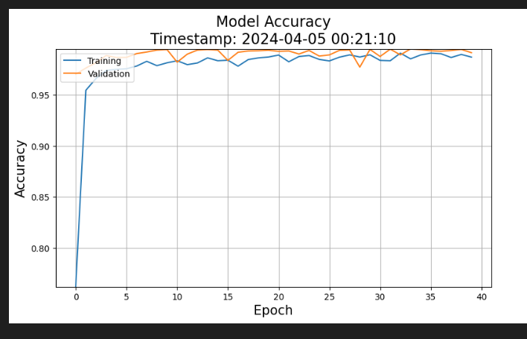
RESULTS:
Model Performance:
Achieved accuracy of 95.95% on the test dataset.
Confusion Matrix:
Visualization of the model's predictions, showcasing the accuracy of each traffic sign classification.

