Slide 1

Placement Management System
By:
Ayinaparthi Sai prasanna
EBEONO721406899

Slide 2
Overview
The project named “Placement Management System”, a student/company information system is a window based application created in Core Java.
The project has been developed on the basis of “Placement Cell” being presently used in the University for storing and retrieving the information of students and companies who are registered in placement cell.
The Placement Cell maintains a large database of students wherein all the information of student including the personal records and the academic performance in terms of the marks and grades is stored and company information including resume of company and facilities it provide.
The software retrieves this data and displays as per the user requirement.

Slide 3
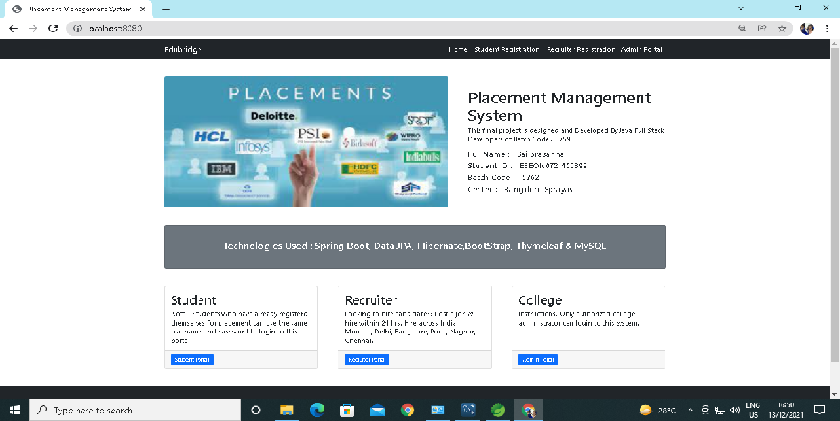
Home Page
This is a home page of website and it has menu like student, admin and recruiter login/signup option.

Slide 4
Modules
In this project, there is main 3 entities:
Student
Recruiter
Admin

Slide 5
1) Student Module
The project named “Placement Management System”, a student information system is a window based application created in Core Java. The project has been developed on the basis of “Placement Cell” being presently used in the University for storing and retrieving the information of students and companies who are registered in placement cell.
The Placement Cell maintains a large database of students wherein all the information of student including the personal records and the academic performance in terms of the marks and grades is stored and company information including resume of company and facilities it provide. The software retrieves this data and displays as per the user requirement.

Slide 6
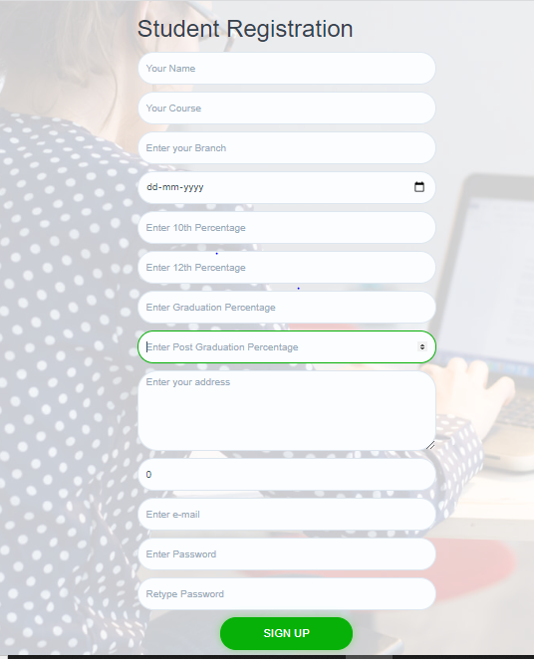
Signup
Signup page is a initial page for student to enrol herself/himself.
Once they create their profile, they can login on portal.

Slide 7
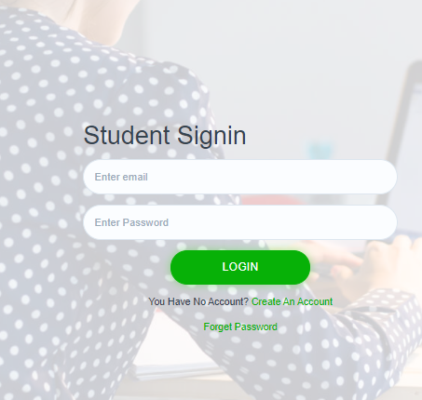
Login:
This is a login page by which student can login and check all his/her details.

Slide 8
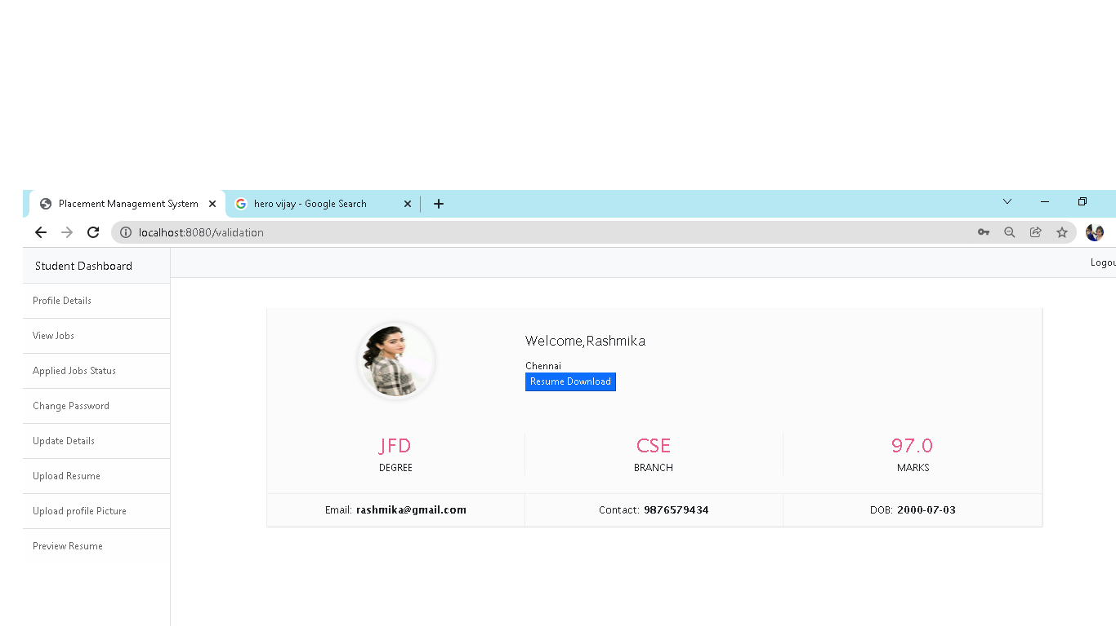
Dashboard
This is student interface and it’s includes options like student profile, jobs details etc.

Slide 9
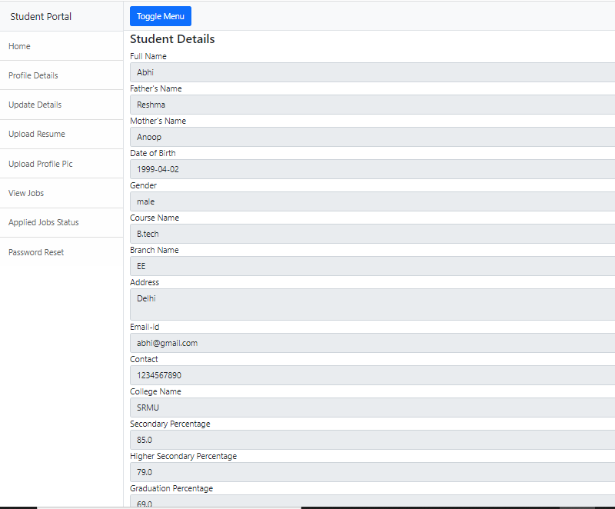
Profile details:
This is a page in which student’s all details will be appear.

Slide 10
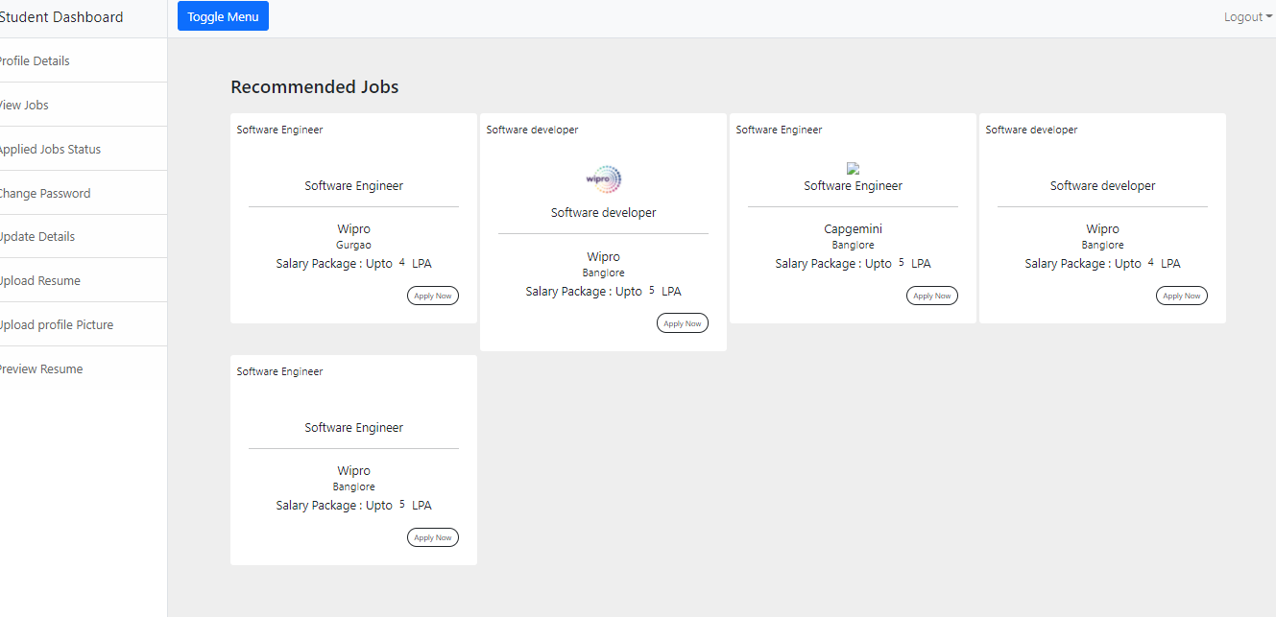
Job page:
This is a job recommended page and user can check jobs, eligibility and can apply.

Slide 11
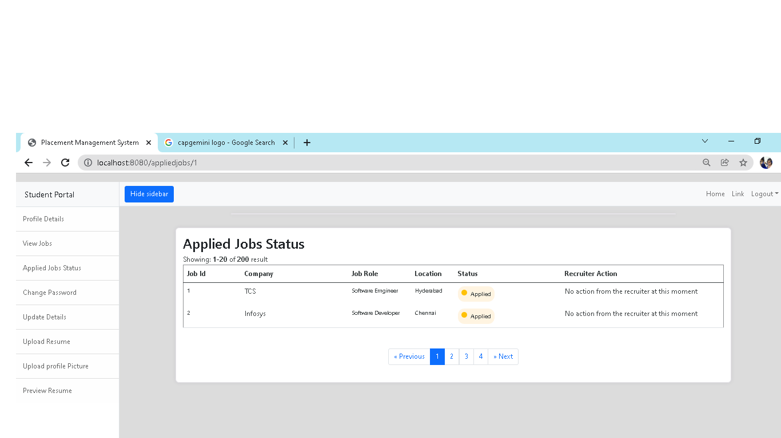
Job Status page:
This is a job status page where student can check their applied job’s status.

Slide 12
2) Recruiter Module:
The admin is the placement officer who views the students details and company details and post the selected students list.
Sending email to student for complete list of information for particular campus. Indication of hall ticket issued to candidates through mail. Login, View company details, View selected students details, Sending mail

Slide 13
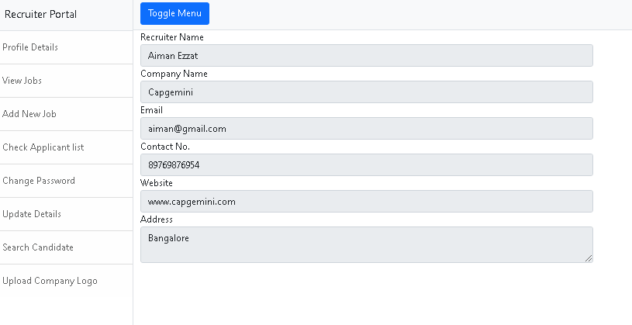
Recruiter details:
This is a page where recruiter can see their profile details after signup and login.

Slide 14
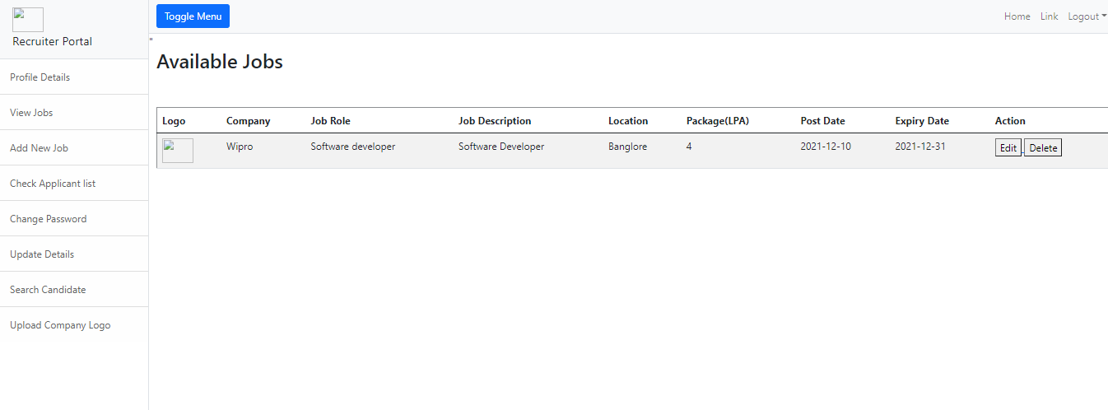
Available Jobs:
This is a page where recruiter can see posted job details and update and delete jobs.

Slide 15
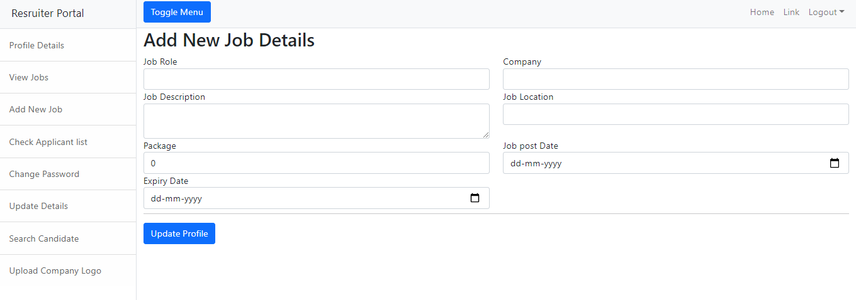
Add New Job:
Here recruiter can post new jobs.

Slide 16
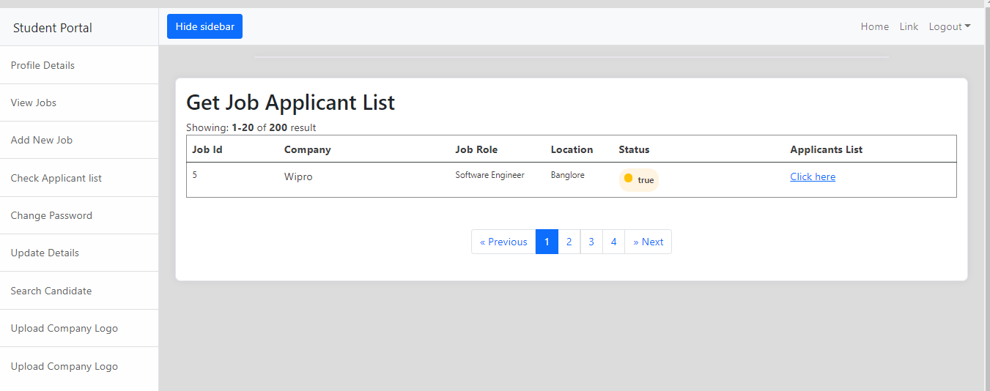
Applican’s details:
Here recruiter can take actions on all job applicants details.

Slide 17
3) Admin Module:
The admin is the placement officer who views the students details and company details and post the selected students list.
Sending email to student for complete list of information for particular campus. Indication of hall ticket issued to candidates through mail. Login, View company details, View selected students details, Sending mail

Slide 18
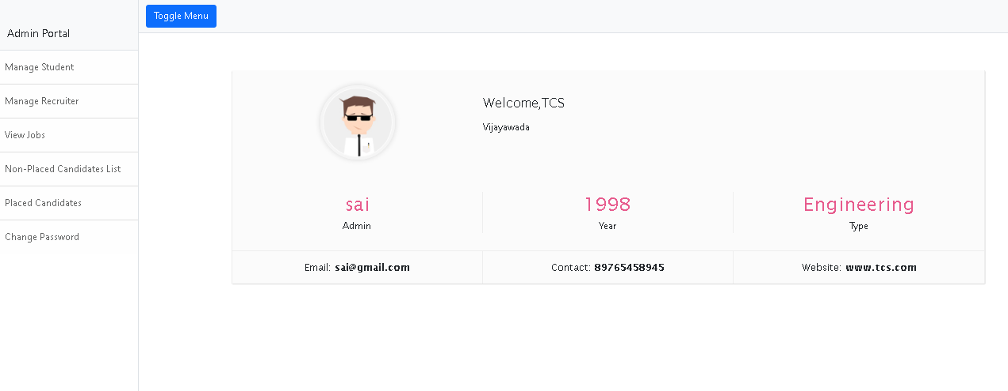
Admin details:
This is a admin page where admin can check their details after signup and login.
Admin can take all actions like student’s profile delete, modify, post new jobs, delete or update job’s status etc.

Slide 19
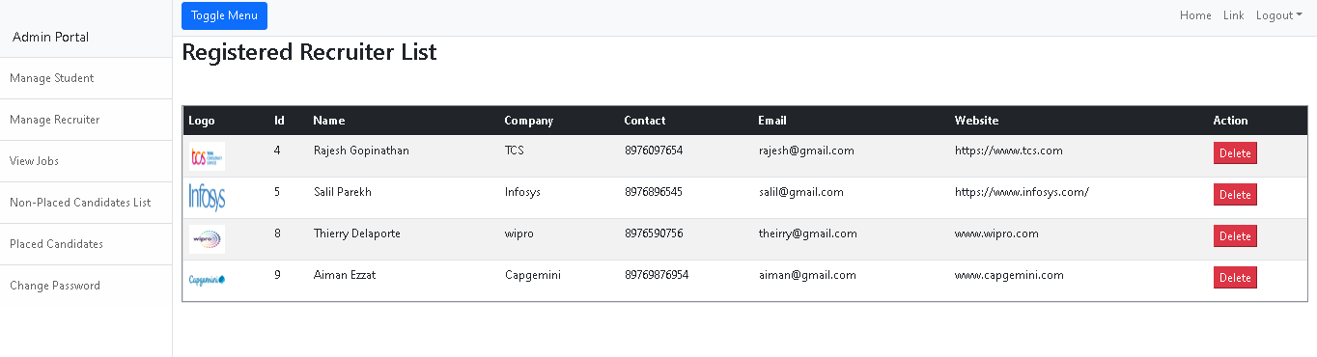
Manage Recruiter’s:
This is a registered recruiter list where admin can check recruiter’s details and take action at their profile like delete etc.

Slide 20
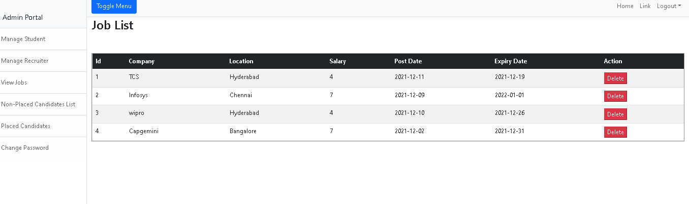
View Jobs:
This is a job page posted by recruiters and admin can take action at posted job profile like delete etc.

Slide 21
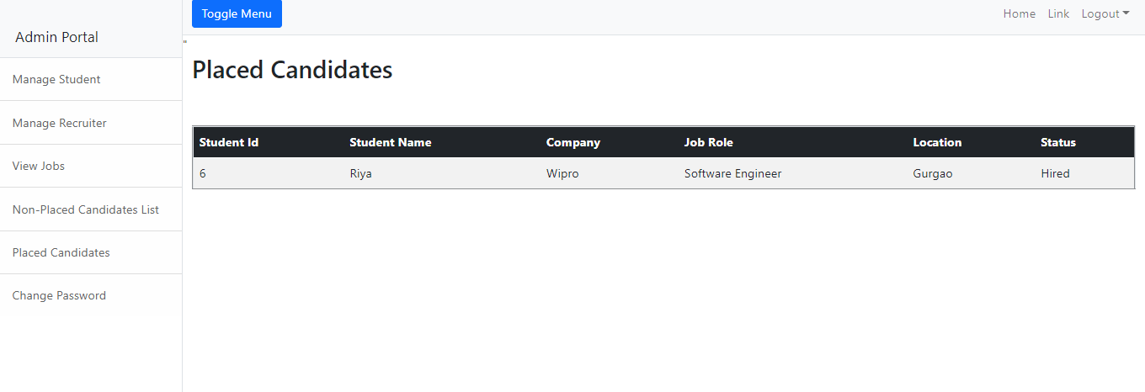
Placed student’s details:
Here admin can check all the placed students details.

Slide 22
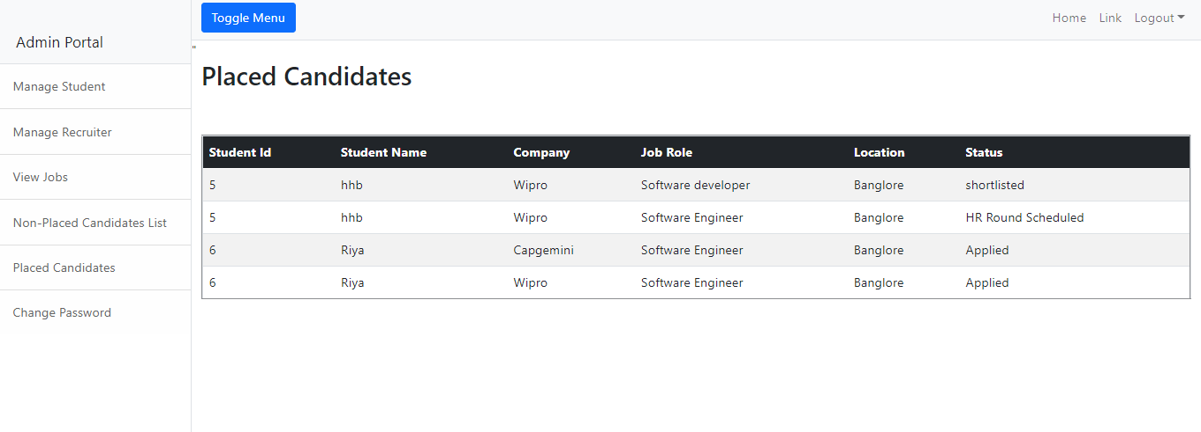
Non-placed student’s details:
Here admin can check all non-placed students details.

Slide 23
THANK YOU!

