Slide 1
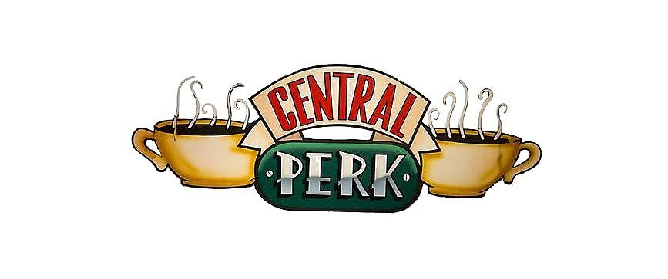
Revenue Improvement Recommendations
Central Perk
Jordan Boonstra
Deeksha Jha
Henrik Kowalkowski
Mao Mao
Prasanna Rajendran
Madhur Toshniwal
Section 2 Group 3

Slide 2

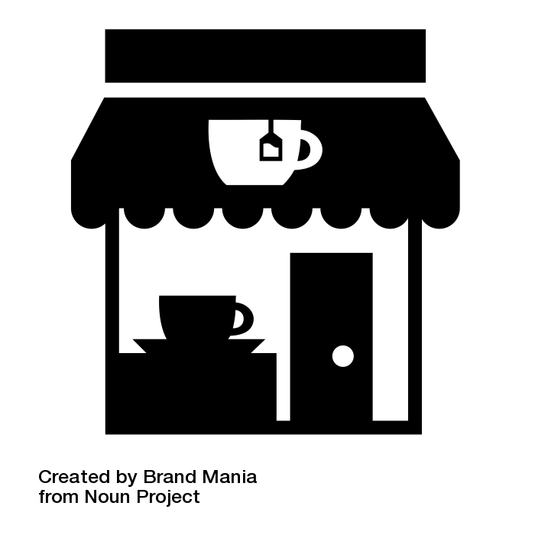
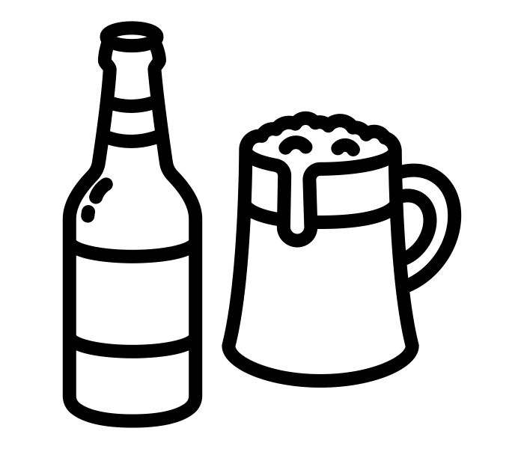

Generate profits by normalizing demand
and refining the brand
REFINING THE BRAND
DEMAND NORMALIZATION
Discounts on Beans
- 10% discounts on items in Beans category
Storewide Discounts
- Season based punch cards
- Evening offers on Tea and Non-Caffeinated drinks
Remove non profitable items
- Remove Beer items
Member specific Discounts
- Evening & Afternoon Combo offers
Notes:
To have customer centric offers, we need to analyse our customer base - CLUSTERING - defining personas
Remove Beer from the menu
Reduce Bean Prices

Slide 3
Generate profits by normalizing demand
and refining the brand
REFINING THE BRAND
DEMAND NORMALIZATION
Discounts on Beans
- 10% discounts on items in Beans category
Storewide Discounts
- Season based punch cards
- Evening offers on Tea and Non-Caffeinated drinks
Remove non profitable items
- Remove Beer items
Member specific Discounts
- Evening & Afternoon Combo offers
Notes:
To have customer centric offers, we need to analyse our customer base - CLUSTERING - defining personas
Remove Beer from the menu
Reduce Bean Prices

Slide 4
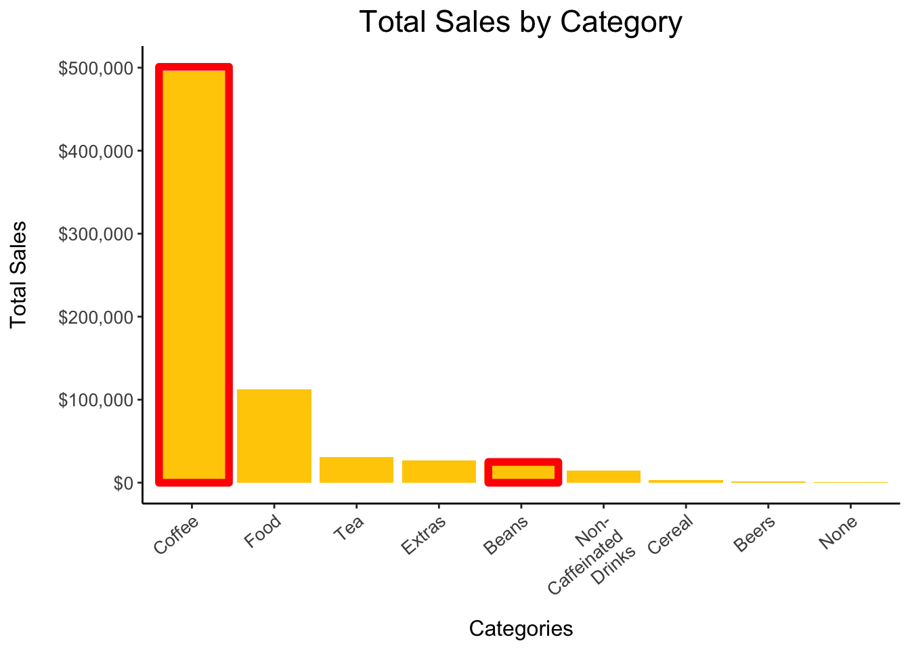
10% discounts on Beans to increase sales and fit the
brand image
Coffee Beans:
Fits brand image
Highest $ profit margin category
Serves our coffee-loving customers
Notes:
In order to redefine our brand image, we need to increase sales for profitable products such as coffee beans

Slide 5
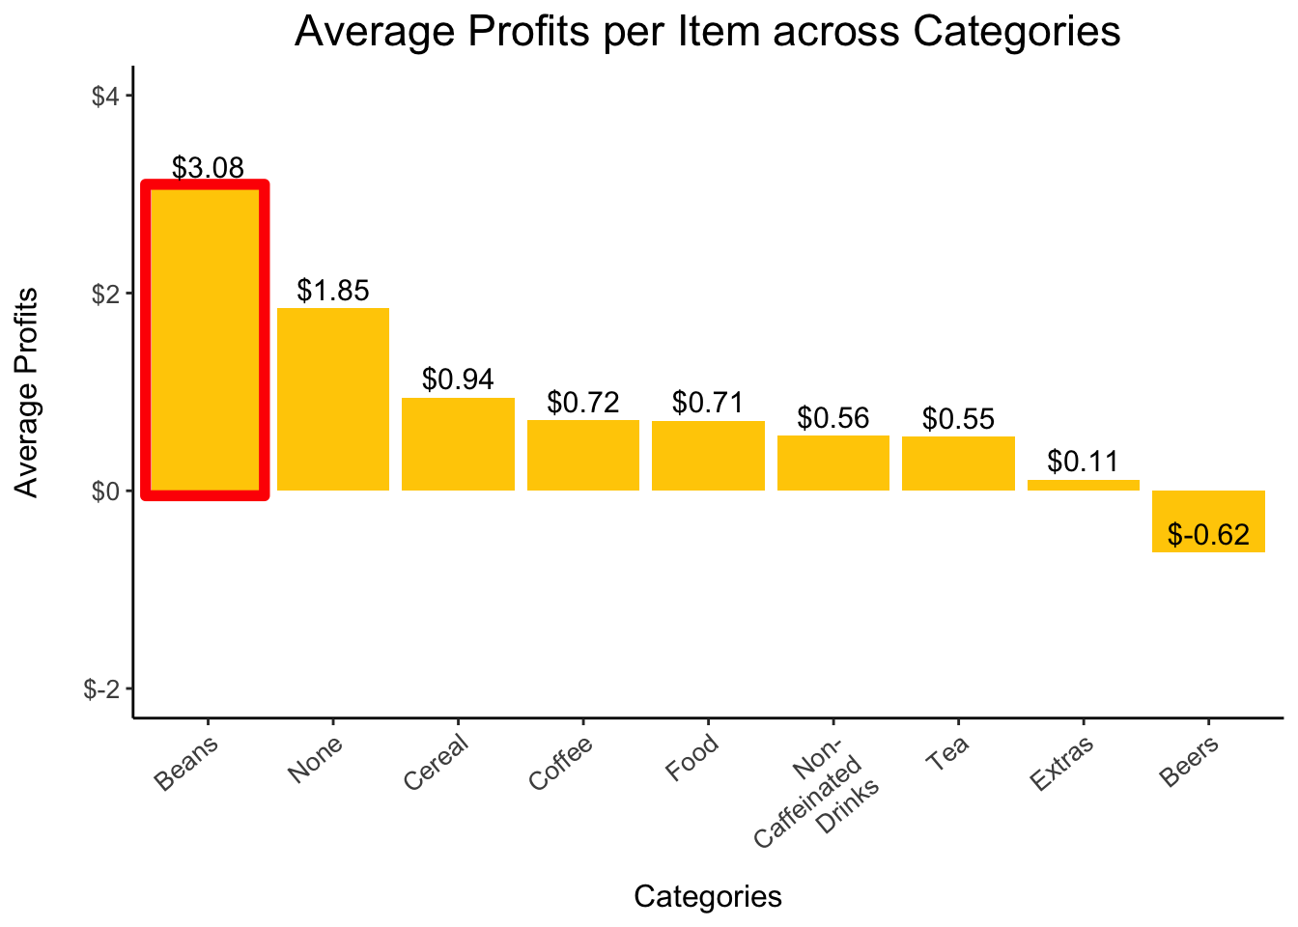
10% discounts on Beans to increase sales and fit the
brand image
Coffee Beans:
Fits brand image
Highest $ profit margin category
Serves our coffee-loving customers
Notes:
In order to redefine our brand image, we need to increase sales for profitable products such as coffee beans

Slide 6
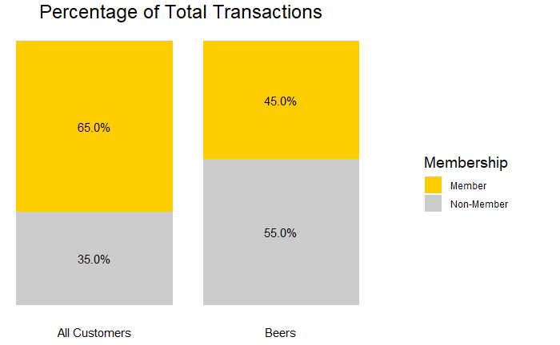
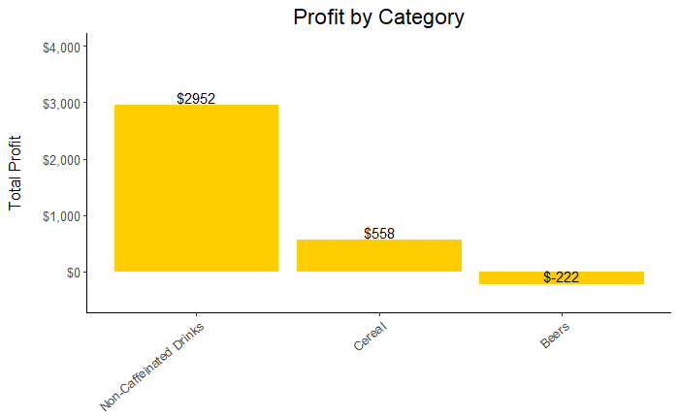
Central Perk should remove beers
as they generate a negative margin
Beer is not a profitable category
The proportion of members that buy beer is less than that of non-members
*Prices for a liquor license in New York City (https://www.sla.ny.gov/system/files)

Slide 7
Generate profits by normalizing demand
and refining the brand
REFINING THE BRAND
DEMAND NORMALIZATION
Discounts on Beans
- 10% discounts on items in Beans category
Storewide Discounts
- Season based punch cards
- Evening offers on Tea and Non-Caffeinated drinks
Remove non profitable items
- Remove Beer items
Member specific Discounts
- Evening & Afternoon Combo offers
Notes:
To have customer centric offers, we need to analyse our customer base - CLUSTERING - defining personas
Remove Beer from the menu
Reduce Bean Prices

Slide 8
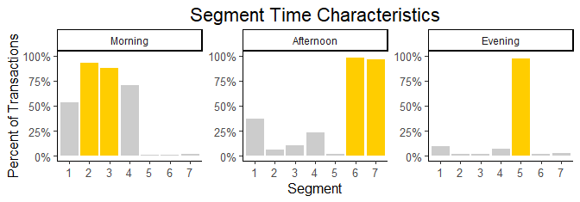
5 customer segments primarily visit the shop
during specific times of the day
Morning focus: 2 & 3
Afternoon focus: 6 & 7
Evening focus: 5
Notes:
To have customer centric offers, we need to analyse our customer base - CLUSTERING - defining personas

Slide 9
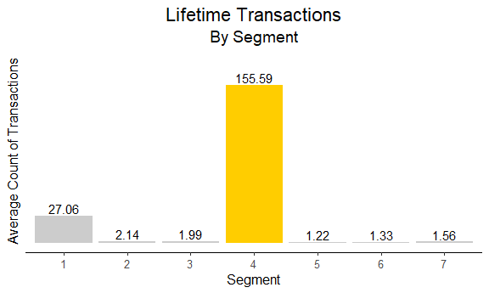
Different customer segments will help define
storewide and customer centric promotions
Segments 1 & 4 are our most valued customers
High value customers:
 | Segment 4 | Segment 1
Size | 0.18% | 2.69%
Transactions | 10% | 27%
Notes:
To have customer centric offers, we need to analyse our customer base - CLUSTERING - defining personas
Title: 2 customer segments are our most valuable customers

Slide 10
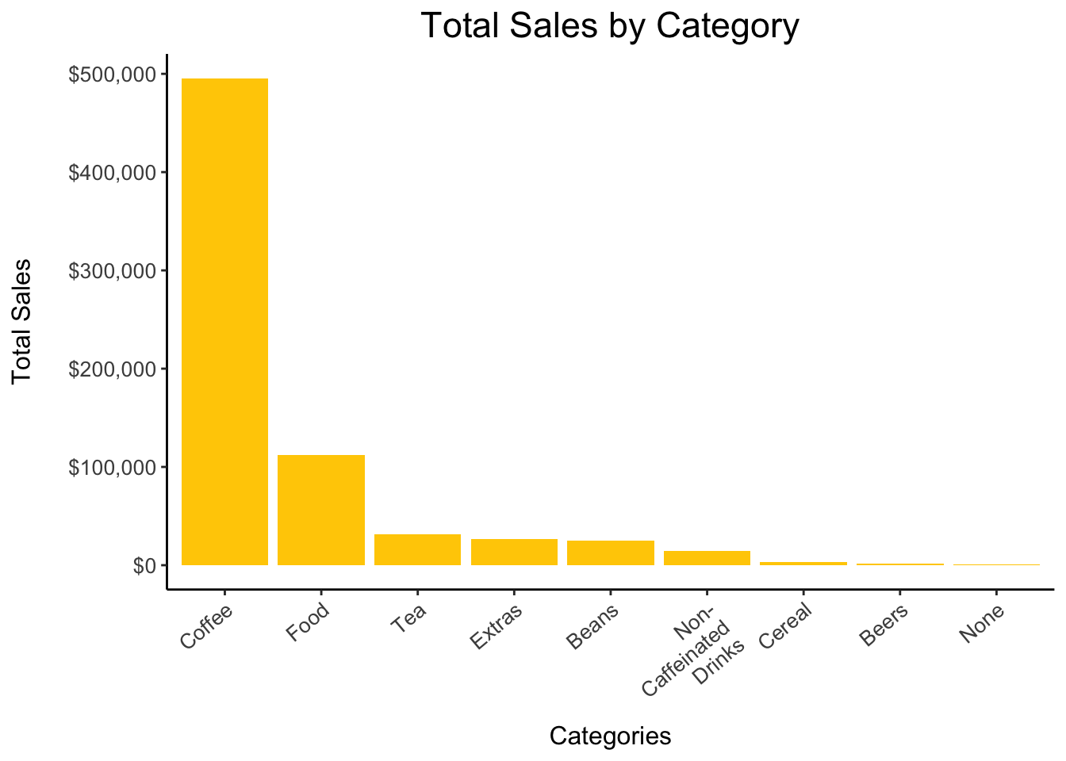
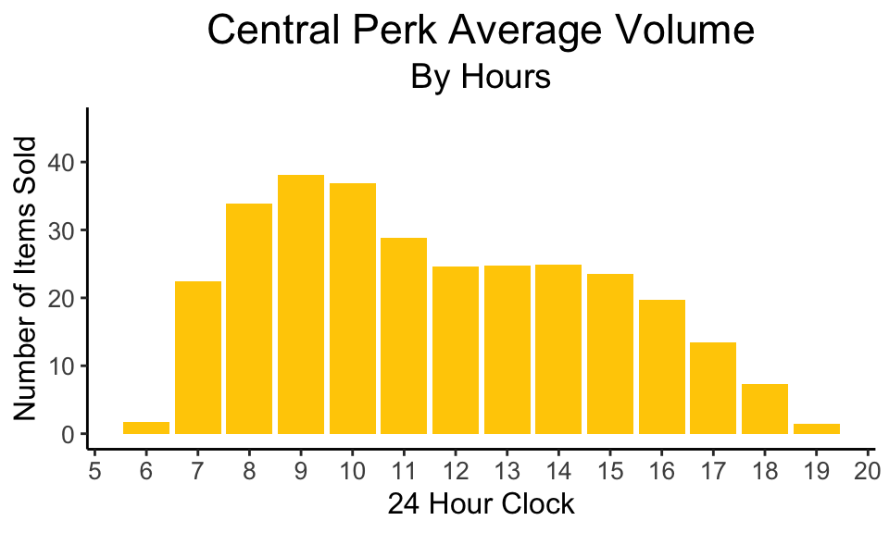
Offering a lunch punch card on food items will help improve afternoon sales
Food is the second most bought item
Afternoon’s have less sales than mornings

Slide 11
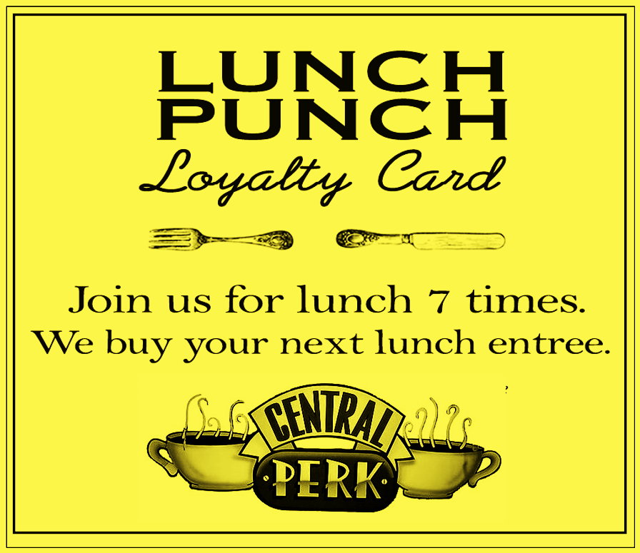
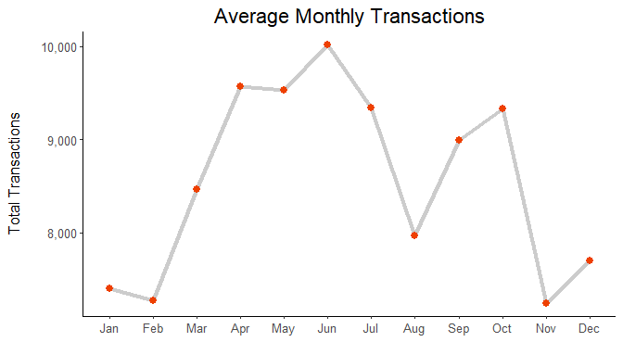
Customizing punch cards according to seasonal demand can increase chances of adoption
Punch card discount:
Winter (Nov - Feb)
Every 6th item is free
Summer (Mar - Oct)
Every 8th Item is free
Winter months have lower transactions

Slide 12
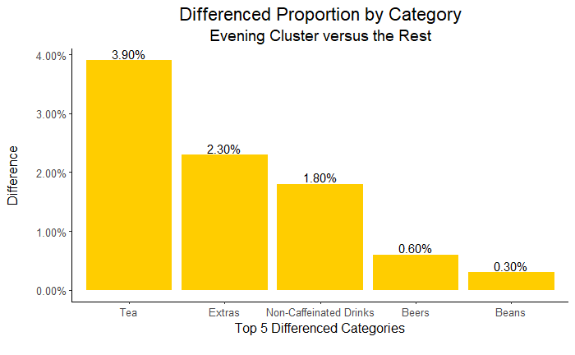
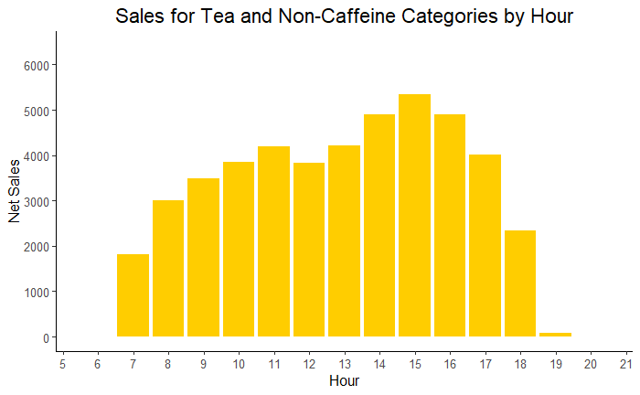
Discounts on Tea and Non-Caffeinated drinks
in evenings are likely to increase sales
We expect the customers to respond to the discounts especially the “Evening” segment
Sales for tea and non-caffeinated drinks rise during the evening hours

Slide 13
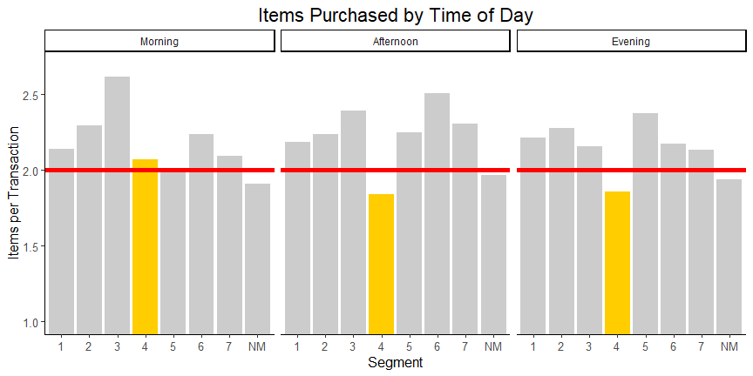
Discounts on second item can increase the basket size of high value customers
We can leverage our high valued customers to normalize the revenue during afternoon and evening hours

Slide 14
Generate profits by normalizing demand
and refining the brand
DEMAND NORMALIZATION
REDEFINING THE BRAND
Storewide Discounts
- Season based punch cards
- Evening offers on Tea and Non-Caffeinated drinks
Discounts on Beans
- 10% discounts on items in Beans category
Member specific Discounts
- Evening & Afternoon Combo offers
Remove non profitable items
- Cut down on Beer items
Notes:
To have customer centric offers, we need to analyse our customer base - CLUSTERING - defining personas
Remove Beer from the menu
Reduce Bean Prices

Slide 15
Thank you!

