Slide 1

Atlético Madrid
Group 5: Jordan Boonstra, Henrik Kowalkowski, Prasanna Rajendran, Shashank Singh, Shawn Tangen, Coltt Thunstrom

Slide 2
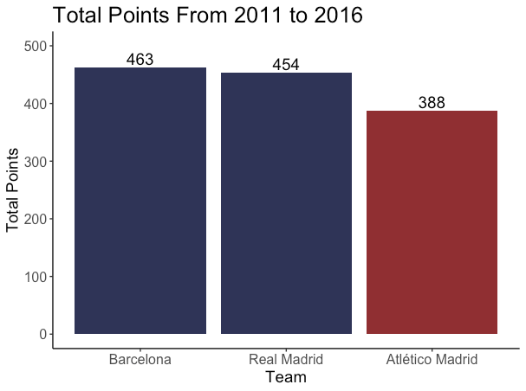
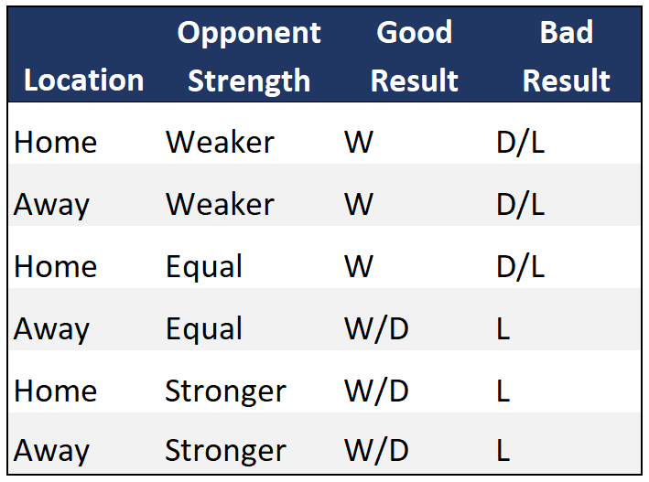
About this template
Atlético Madrid Consistently Finishes Third
Defining Success and Failure
Objective is to Surpass Barcelona and Real Madrid to Consistently Win La Liga
Notes:
Diego Simeone hired 2011
Atletico win league 2014
Finish 3rd or worse otherwise
Now: 2016 (2017 Season)
Goal: Get better than Barca and Real
Talk about success and failure

Slide 3
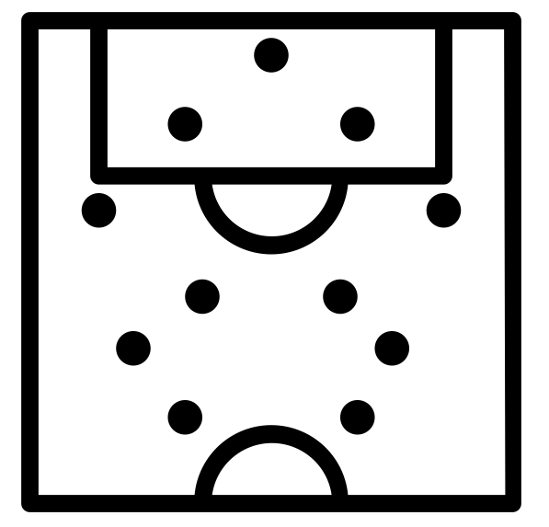

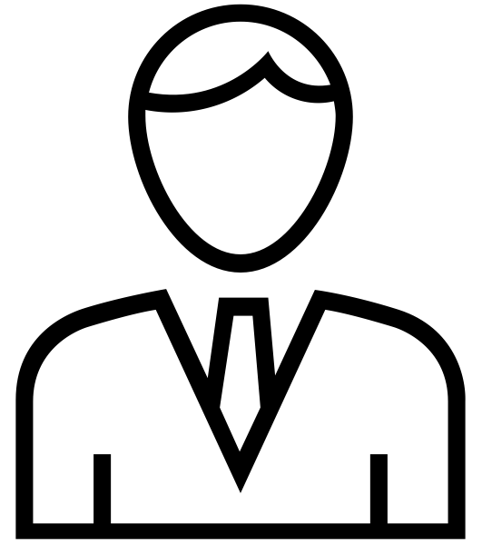
About this template
Incorporate Changes to Deliver Long Term Success
Formations
Discontinue ‘4-5-1’ formation and replace with ‘4-4-2’ formation
Playing Style
Avoid excessive crosses when attacking
Be more conservative while defending
MANAGER TACTICS

Slide 4
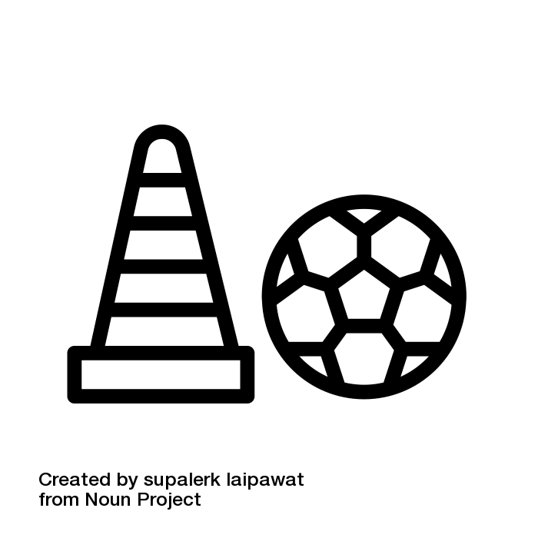

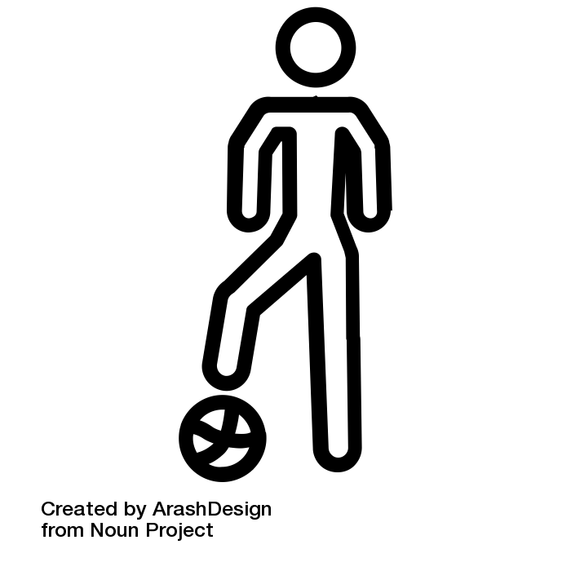
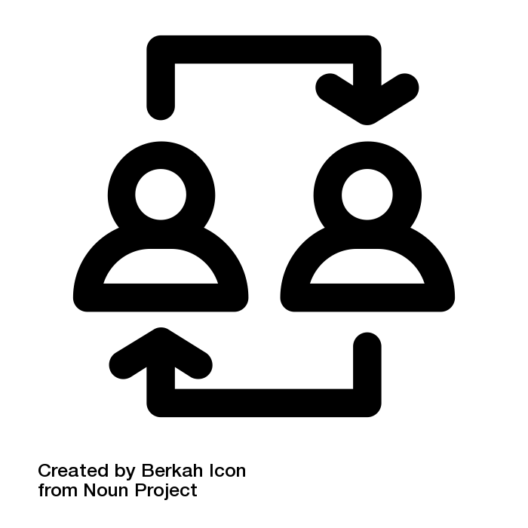
About this template
Incorporate Changes to Deliver Long Term Success
Formations
Discontinue ‘4-5-1’ formation and replace with ‘4-4-2’ formation
Playing Style
Avoid excessive crosses when attacking
Be more conservative while defending
MANAGER TACTICS
Training
Forwards: Finishing
Midfielders & Defenders: Crossing & Dribbling
Goalkeepers: Diving & Reflexes
Transfers
Replace older, underperforming players with younger players with higher potential
PLAYER DEVELOPMENT & ROSTER MANAGEMENT

Slide 5
About this template
Adjust Tactical Approach to Ensure Success
Formations
Discontinue ‘4-5-1’ formation and replace with ‘4-4-2’ formation
Playing Style
Avoid excessive crosses when attacking
Be more conservative while defending
MANAGER TACTICS
Training
Forwards: Finishing
Midfielders & Defenders: Crossing & Dribbling
Goalkeepers: Diving & Reflexes
Transfers
Replace older, underperforming players with younger players with higher potential
PLAYER DEVELOPMENT & ROSTER MANAGEMENT
Notes:
Manager Tactics

Slide 6
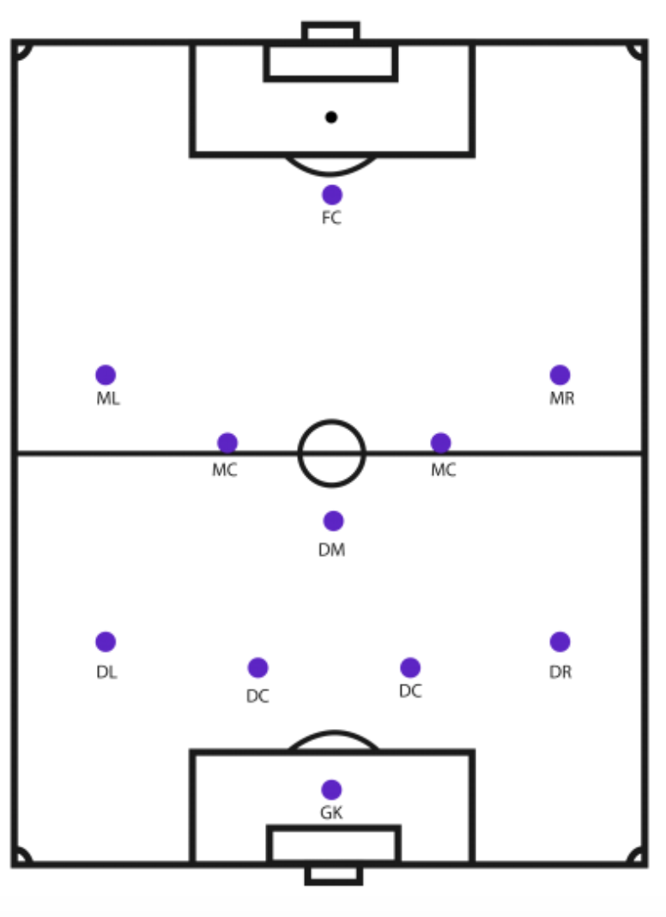
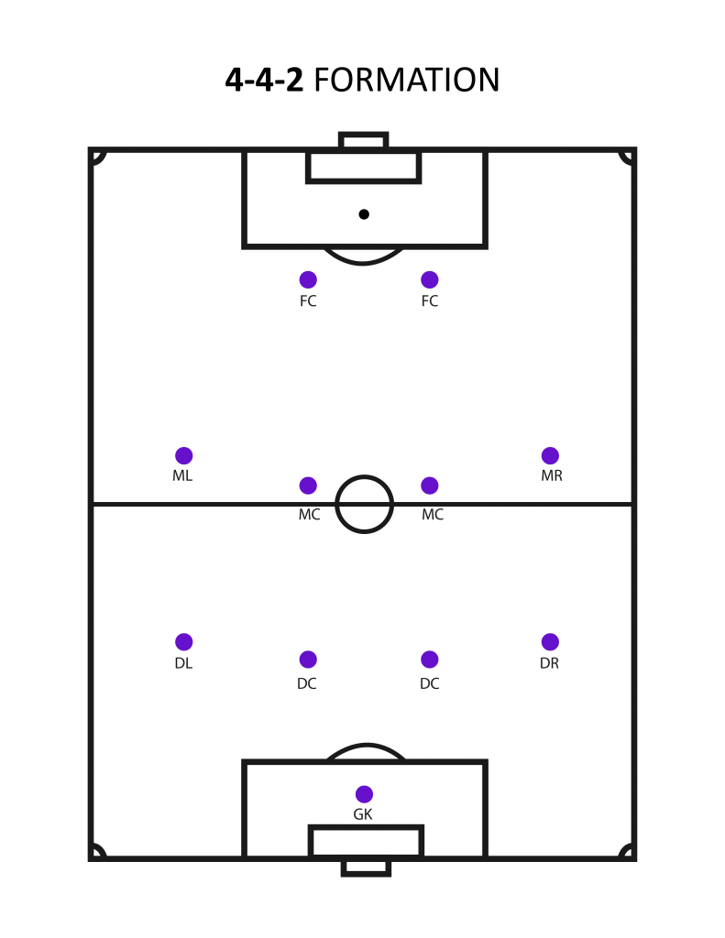
About this template
Eliminate Use of ‘4-5-1’ Formation
4-5-1 Formation
4-4-2 Formation
Prevent Leaking Points to Weak Opponents
Notes:
Eliminate Use of ‘4-5-1’ Formation to Prevent Losing to Weak Opponents

Slide 7
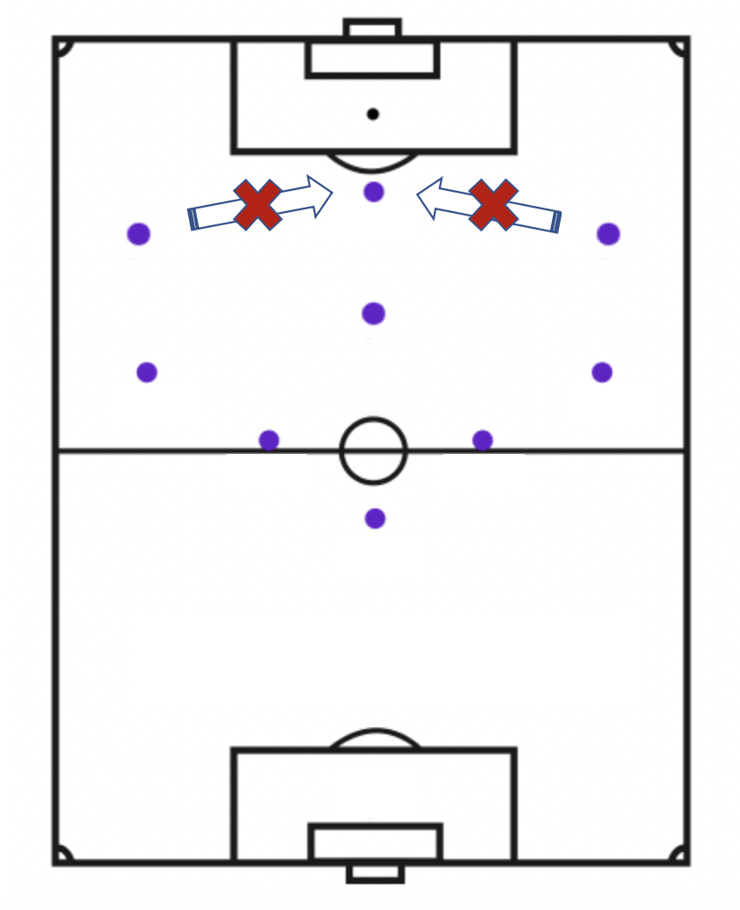
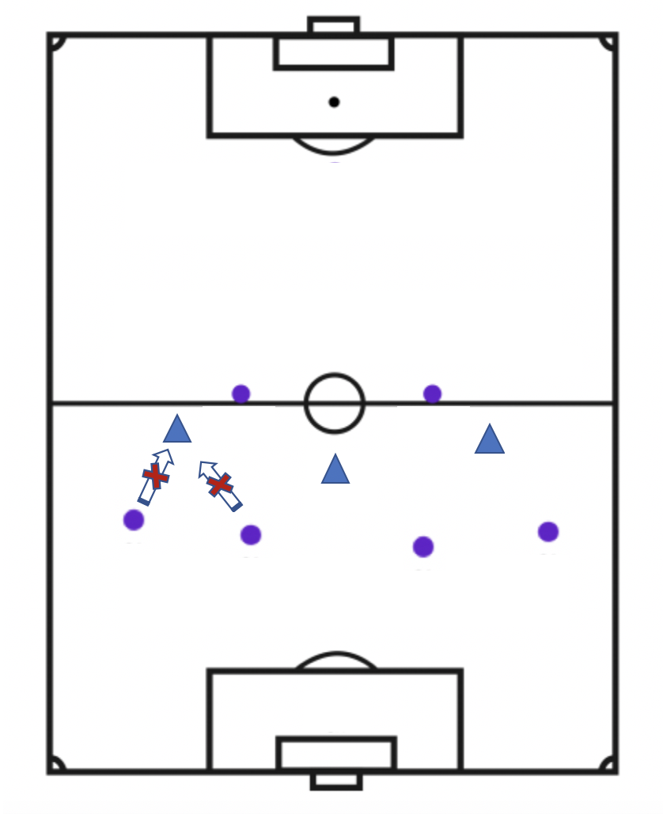
About this template
Reduce Crossing Frequency on the Attack and Be More Conservative on Defense
Lower Cross frequency
Reduce Defence Aggression
Lead to Greater Possession to:
Increase Scoring Opportunities
Reduce Opponent Scoring Opportunities
Notes:
Reduce Crossing Frequency on the Attack and Be More Conservative on Defense to Dominate Possession

Slide 8
About this template
Improve the Roster Through Player Development & Roster Management
Formations
Discontinue ‘4-5-1’ formation and replace with ‘4-4-2’ formation
Playing Style
Avoid excessive crosses when attacking
Be more conservative while defending
MANAGER TACTICS
Training
Forwards: Finishing
Midfielders & Defenders: Crossing & Dribbling
Goalkeepers: Diving & Reflexes
Transfers
Replace older, underperforming players with younger players with higher potential
PLAYER DEVELOPMENT & ROSTER MANAGEMENT
Notes:
Player Development & Roster Management

Slide 9
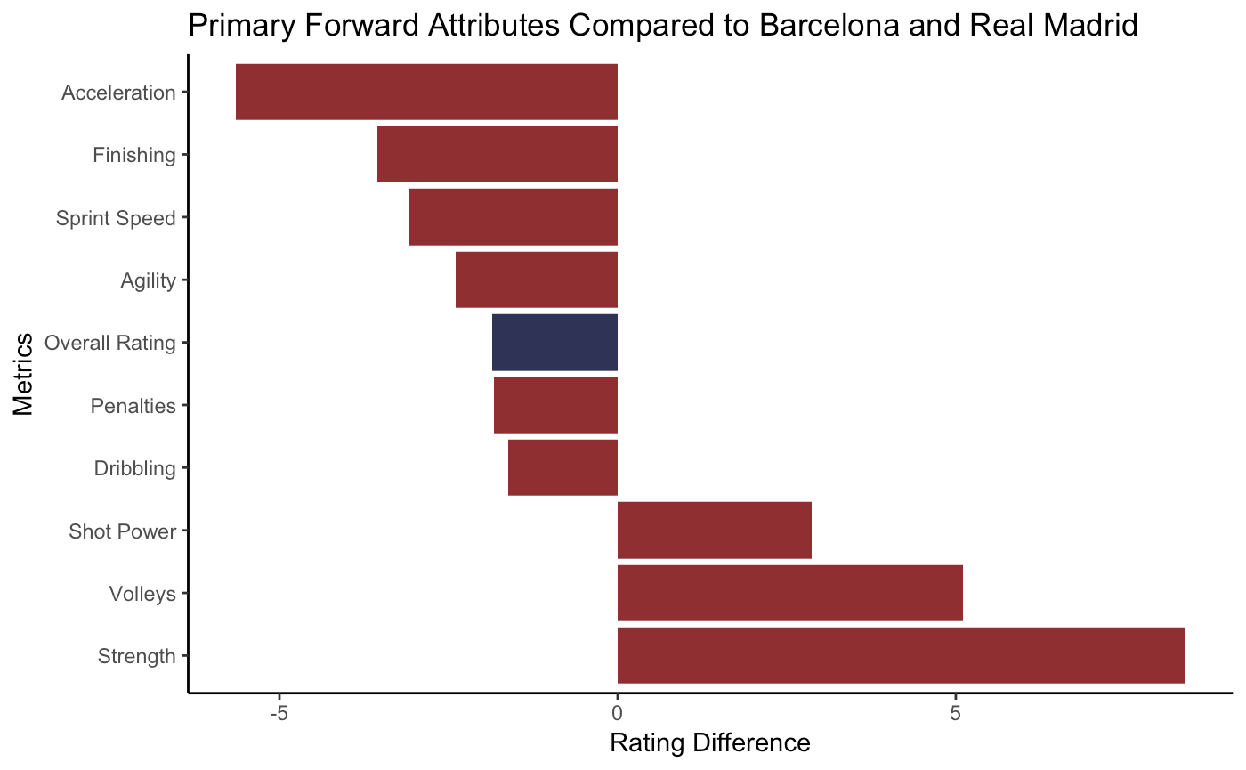
About this template
Forwards Must Improve Athleticism and Finishing
Core Weaknesses Are Athleticism and Finishing
Notes:
Forwards Lack athleticism, Replacements are Available

Slide 10
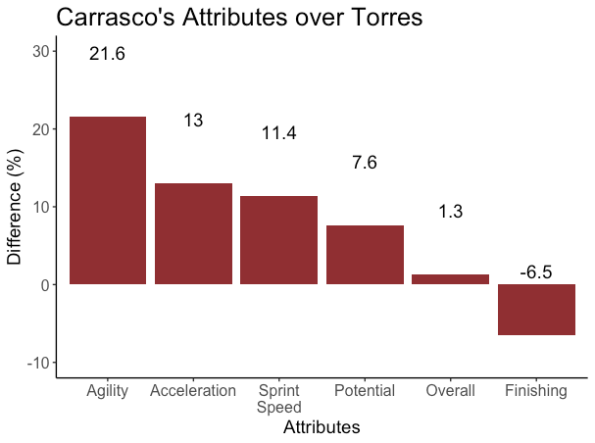
About this template
Internal Solution for Improving Athleticism and Finishing at Forward Position
Replace Fernando Torres (32) with Yannick Carrasco (23)
Worse in Most Attributes
Associated With Draws
Reached Full Potential
Notes:
Forwards Lack athleticism, Replacements are Available

Slide 11
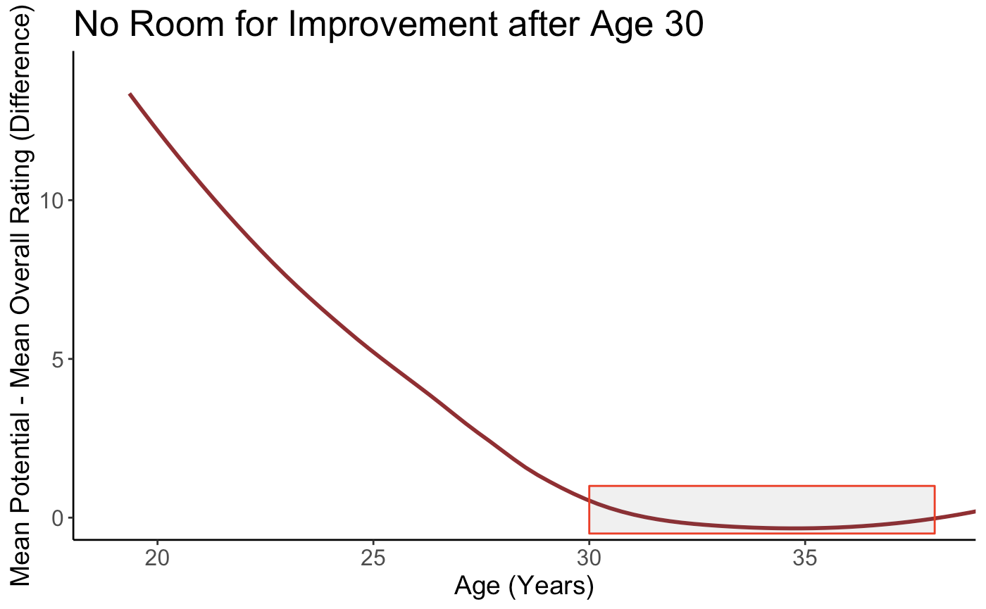
About this template
Replace Underperforming Players Over 30
Players Reach Their Performance Ceiling by Age 30
Notes:
Forwards Lack athleticism, Replacements are Available

Slide 12
About this template
Carrasco Must Improve Finishing
Focus Training on Finishing
Notes:
Forwards Lack athleticism, Replacements are Available

Slide 13
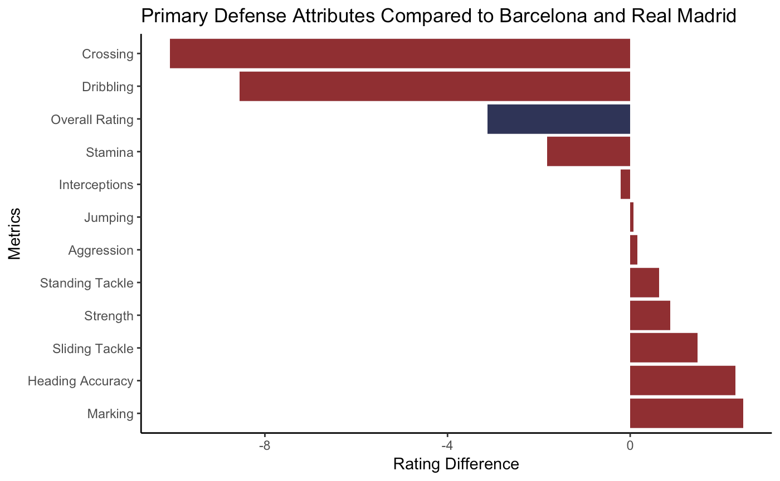
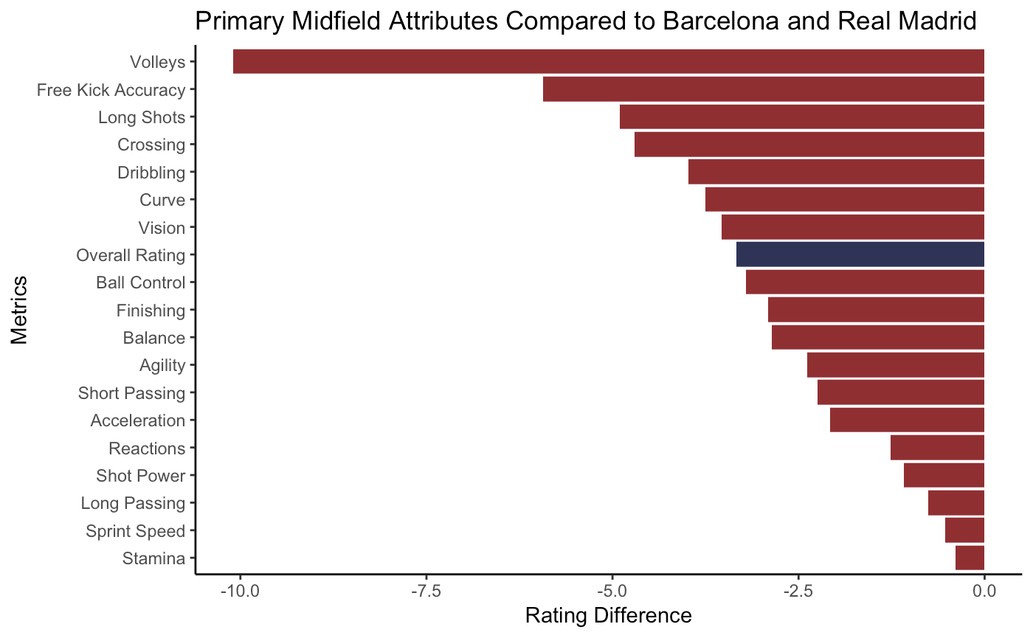
About this template
Increase Crossing and Dribbling Training for Midfielders and Defenders
Focus Training on Core Weaknesses
Notes:
Increase Training of Atlético midfielders and defenders are lacking crossing and dribbling skills
Crossing and Dribbling for Midfielders and Defenders

Slide 14
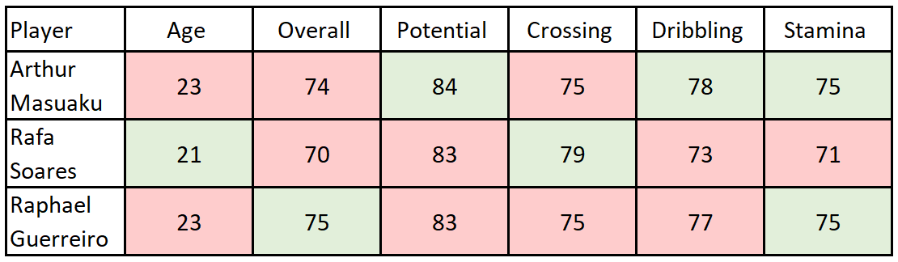
About this template
Sign a Defensive Prospect who Excels in Crossing and Dribbling
Replace Filipe Luis With a Young Defender With More Potential
Associated With Losses
Reached Full Potential
Notes:
Sign Defensive Prospect who Excels in Crossing and Dribbling

Slide 15
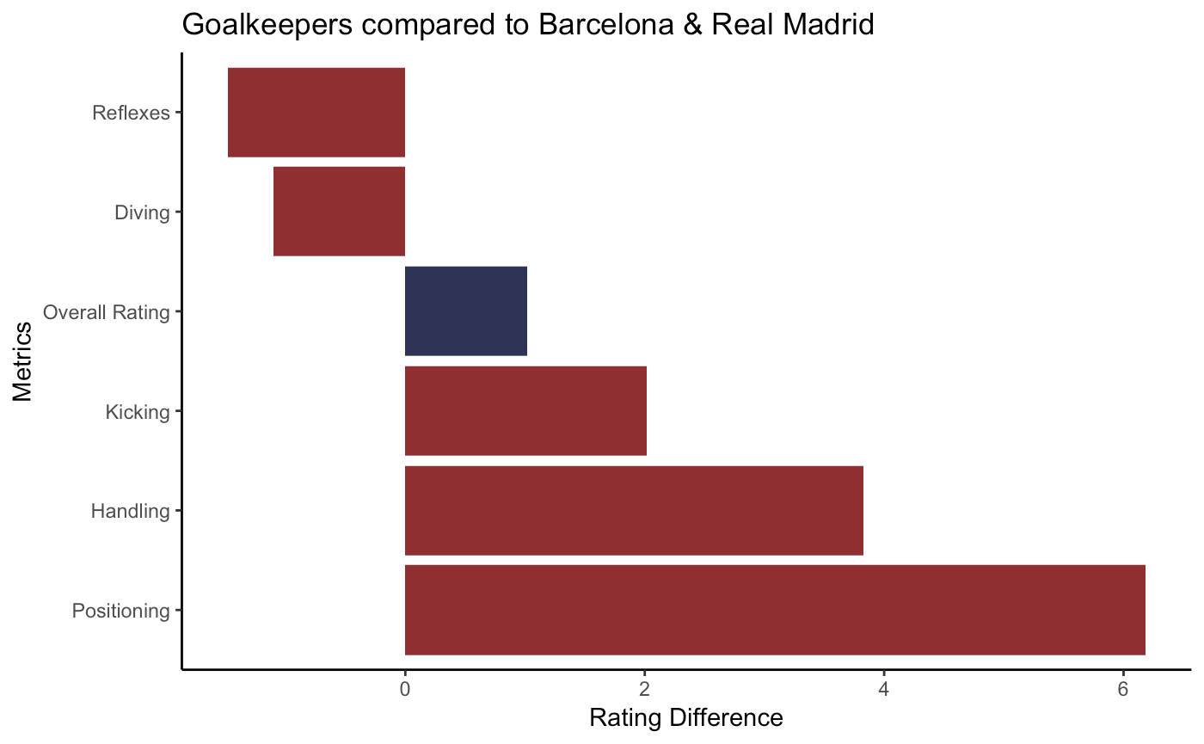
About this template
Focus Goalkeeper Training on Reflexes and Diving
Focus Training on Core Weaknesses for Continuous Improvement

Slide 16
About this template
Incorporate Changes to Deliver Long Term Success
Formations
Discontinue ‘4-5-1’ formation and replace with ‘4-4-2’ formation
Playing Style
Avoid excessive crosses when attacking
Be more conservative while defending
MANAGER TACTICS
Training
Forwards: Finishing
Midfielders & Defenders: Crossing & Dribbling
Goalkeepers: Diving & Reflexes
Transfers
Replace older, underperforming players with younger players with higher potential
PLAYER DEVELOPMENT & ROSTER MANAGEMENT

Slide 17
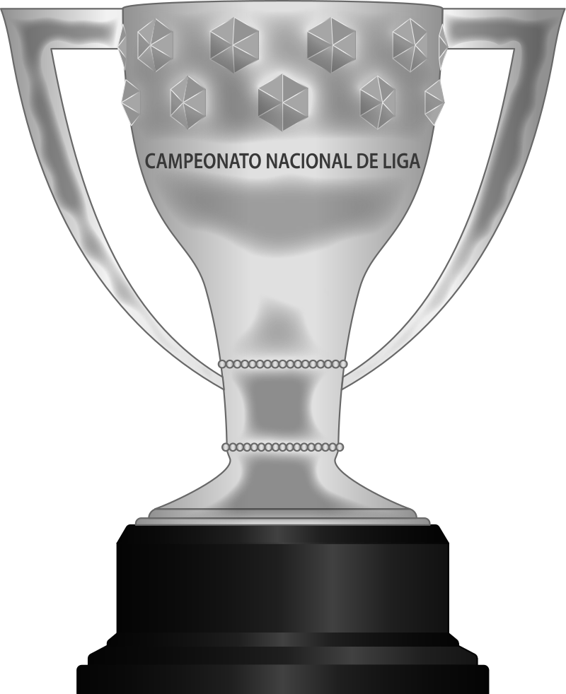
Thank you

