Slide 1
Need for Mathematical Language

Slide 2
Some Technical Background
The Need for Mathematical Language
Our Software for Tackling Machine Learning
Probability
Linear Combinations, Weighted Sums, and Dot Products
A Geometric View: Points in Space
Notation and the Plus-One Trick
Getting Groovy, Breaking the Straight-Jacket, and Nonlinearity
NumPy versus “All the Maths”
Floating-Point Issues
2

Slide 3
The Need for Mathematical Language
It is very difficult to talk about machine learning without discussing some mathematics.
The following concepts from the mathematical world are used in machine learning:
  Algebra
  Probability
  Geometry
  Symbol
3

Slide 4
Our Software for Tackling Machine Learning
The Python standard library includes itertools, collections, and functools.
Members of the Python number-crunching and data science stack are numpy, pandas, matplotlib, pytorch, and seaborn.
numpy is a Python package that stands for ‘Numerical Python’.
It is the core library for scientific computing, which contains a powerful n-dimensional array object.
pandas is a Python package providing fast, flexible, and expressive data structures.
It is designed to make working with relational or labeled data both easy and intuitive.
4

Slide 5
Our Software for Tackling Machine Learning (continued)
It has two primary data structures, namely, Series and DataFrame.
Series is one-dimensional, while DataFrame is two-dimensional.
pytorch is built based on python and torch library which supports computations of tensors on Graphical Processing Units.
The reason to use the number-crunching tools is because they form the foundation of, or work well with, scikit-learn.
sklearn is a great environment for playing with the ideas of machine learning.
It implements many different learning algorithms and evaluation strategies and gives a uniform interface to run them.
5

Slide 6
Our Software for Tackling Machine Learning (continued)
The tabula-py library can read a table from PDF.
It also enables you to convert a PDF file into a CSV/TSV/JSON file.
6

Slide 7
2.4 Probability
2.4.1 Primitive Events
2.4.2 Independence
2.4.3 Conditional Probability
2.4.4 Distributions
7

Slide 8
2.4 Probability (continued)
Probability theory is the mathematical framework that allows us to analyze chance events in a logically sound manner.
NumPy can be used to generate evenly weighted random events with np.random.randint.
randint is designed to mimic Python’s indexing semantics, which means that we include the starting point and we exclude the ending point.
np.histogram is used to count up how many times each event occurred.
It is designed around plotting buckets of continuous values.
8

Slide 9
2.4 Probability (continued)
Samples can be drawn from a binomial distribution with specified parameters, n trials and p probability of success.
Where, n is an integer >= 0 and p is in the interval [0,1].
9

Slide 10
2.4 Probability (continued)
import numpy as np
import matplotlib.pyplot as plt
#np.random.randint(1,7)
fewrolls = np.random.randint(1,7, size=10)
manyrolls = np.random.randint(1,7, size=1000)
fewcounts = np.histogram(fewrolls, bins=np.arange(.5, 7.5))[0]
manycounts = np.histogram(manyrolls, bins=np.arange(.5, 7.5))[0]
#General pattern:
#For values 1 to N, use 0.5 to N+0.5
fig, (ax1, ax2) = plt.subplots(1, 2, figsize=(8,3))
ax1.bar(np.arange(1,7), fewcounts)
ax2.bar(np.arange(1,7), manycounts)
10

Slide 11
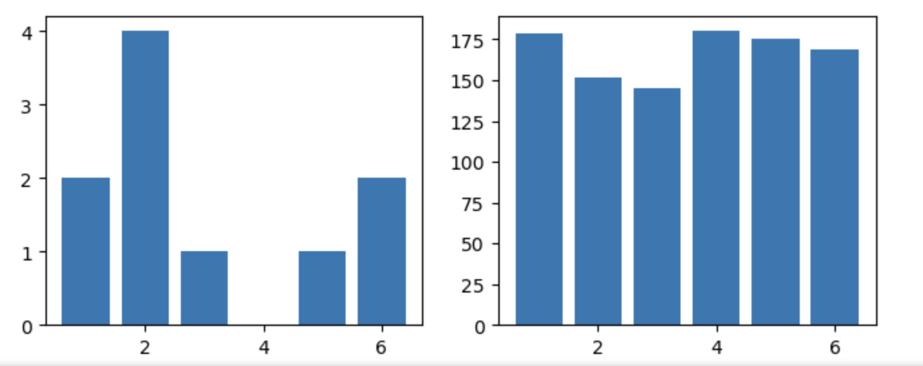
2.4 Probability (continued)
11

Slide 12
2.4.1 Primitive Events
An event is an outcome or defined collection of outcomes of a random experiment.
We can get probabilities of compound events by either counting primitive events or adding up the probabilities of primitive events.
12

Slide 13
2.4.1 Primitive Events (continued)
Here are some important aspects of probability:
  The sum of the probabilities of all possible primitive events in a universe is 1.
  The probability of an event not occurring is 1 minus the probability of it occurring.
  There are nonprimitive events.
  A compound event is a combination of primitive events.
  Compound events are recursive.
  We can create a compound event from other compound events.
  The two compound events overlap because they share primitive events.
13

Slide 14
2.4.2 Independence
Two events are independent if knowing one event occurred doesn't change the probability of the other event.
For example, if we flip a coin in the air and get the outcome as Head, then again if we flip the coin but this time we get the outcome as Tail.
In both cases, the occurrence of both events is independent of each other.
Independent probabilities work both ways: they are an if-and-only-if.
14

Slide 15
2.4.3 Conditional Probability
Conditional probability is defined as the likelihood of an event or outcome occurring, based on the occurrence of a previous event or outcome.
15

Slide 16
2.4.4 Distributions
The mapping between events and probabilities refers to a probability distribution.
    Example: Coin flip
    Event: getting Heads
    Probability: 0.5
    Event: getting Tails
    Probability: 0.5
    We’ve mapped:
    Heads → 0.5
    Tails → 0.5
When a group of events shares a common probability value—like the different faces on a fair die—we call it a uniform distribution.
16
Notes:
Easy example: Coin flip
Event: getting Heads
Probability: 0.5
Event: getting Tails
Probability: 0.5
We’ve mapped:
Heads → 0.5
Tails → 0.5

Slide 17
2.4.4 Distributions
When a group of events shares a common probability value—like the different faces on a fair die—we call it a uniform distribution.
Example: A fair die has outcomes 1, 2, 3, 4, 5, 6
Each one has the same probability:
P(1) = 1/6
P(2) = 1/6
P(3) = 1/6
P(4) = 1/6
P(5) = 1/6
P(6) = 1/6
17
Notes:
Easy example: Coin flip
Event: getting Heads
Probability: 0.5
Event: getting Tails
Probability: 0.5
We’ve mapped:
Heads → 0.5
Tails → 0.5

Slide 18
2.4.4 Distributions
Poisson distribution describes the distribution of binary data from an infinite sample.
  A Poisson distribution is used when:
    We count how many times something happens
    In a fixed interval (time, space, area)
    Events happen independently
examples: Each moment is basically yes/no (event happened or not), but we count how many total events occur.
  Number of emails you receive per hour
  Number of cars passing a toll booth per minute
  Number of typos on a page
  Key idea:
  Poisson = counting rare or random events over time or space.
18
Notes:
Easy example: Coin flip
Event: getting Heads
Probability: 0.5
Event: getting Tails
Probability: 0.5
We’ve mapped:
Heads → 0.5
Tails → 0.5

Slide 19
2.4.4 Distributions
Gaussian distribution (also known as normal distribution) is a continuous probability distribution wherein values lie in a symmetrical fashion around the mean.
This is the famous bell-shaped curve.
Examples:
Heights of students in a class
Exam scores
Measurement errors
Most values:
Cluster around the average (mean)
Fewer values appear as you move away from the mean
19
Notes:
Easy example: Coin flip
Event: getting Heads
Probability: 0.5
Event: getting Tails
Probability: 0.5
We’ve mapped:
Heads → 0.5
Tails → 0.5

Slide 20
2.4.4 Distributions (continued)
The normal distribution has the following characteristics:
  Its midpoint has the most likely value.
  It is symmetric.
  It can be mirrored about its midpoint.
  As we get further from the midpoint, the values fall off more and more quickly.
20

Slide 21
2.4.4 Distributions (continued)
Write a Python code to plot a probability distribution graph that illustrates the probability of flipping a coin 5 times.
Import scipy.stats as ss
b = ss.distributions.binom
for flips in [5, 10, 20, 40, 80]:
  success = np.arange(flips)
  ourdistb = b.pmf(success, flips, .5)
  plt.hist(success, flips, weights=ourdistb)
plt.xlim(0, 55)
21
Notes:
pmf = Probability Mass Function - What is the probability of getting k heads out of flips coin tosses?

Slide 22
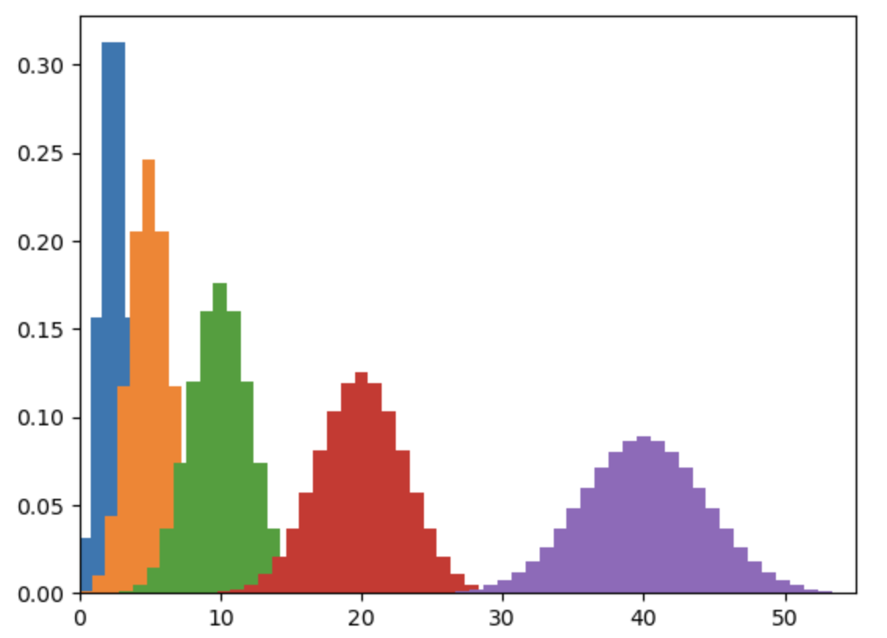
2.4.4 Distributions (continued)
22

Slide 23
2.4.4 Distributions (continued)
Write a Python code to plot a probability distribution graph that illustrates the probability of flipping a coin 6 times using subplots.
import numpy as np
import matplotlib.pyplot as plt
import scipy.stats as ss
# Binomial distribution
b = ss.distributions.binom
# Flip counts we want to display
flips_list = [5, 10, 20, 40, 80, 100]
# Create a 3x3 grid of subplots
fig, axes = plt.subplots(3, 3, figsize=(10, 8))
axes = axes.flatten() # make indexing easier
23
Notes:
pmf = Probability Mass Function - What is the probability of getting k heads out of flips coin tosses?

Slide 24
2.4.4 Distributions (continued)
for i, flips in enumerate(flips_list):
  # Possible number of successes (heads)
  success = np.arange(0, flips + 1)
  # Binomial probabilities
  probs = b.pmf(success, flips, 0.5)
  # Plot on the i-th subplot
  axes[i].bar(success, probs)
  axes[i].set_title(f"{flips} Flips")
  axes[i].set_xlabel("Number of Heads")
  axes[i].set_ylabel("Probability")
plt.tight_layout()
plt.show()
24
Notes:
pmf = Probability Mass Function - What is the probability of getting k heads out of flips coin tosses?

Slide 25
2.5 Linear Combinations, Weighted Sums, and Dot Products
2.5.1 Weighted Average
2.5.2 Sums of Squares
2.5.3 Sum of Squared Errors
25

