Slide 1

ONLINE BOOK STORE
TEAM - 2
VISHWAS
PRASANNA
ROHITH
SAIRAM
TASMIYA

Slide 2
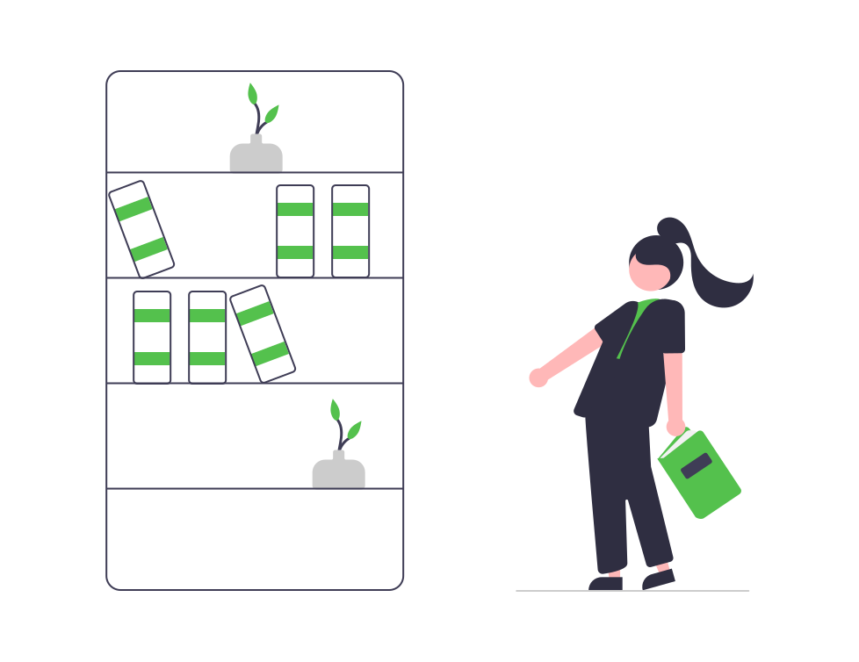
View List Of BOOKS
Add BOOKS To Cart
USER
Search a Book
ORDER BOOK
AND PAYMENT
PASSWORD SETTINGS

Slide 3

ADD NEW BOOKS
UPDATE BOOKS
ADMIN
OPERATIONS
View List Of BOOKS
DELETE BOOKS

Slide 4





DOCKER
HUB
DOCKERS
DOCKERFILE
ADD
BUILD
RUN
COMMIT
And
PUSH
CODE
DOCKER IMAGE
DOCKER
CONTAINER

Slide 5
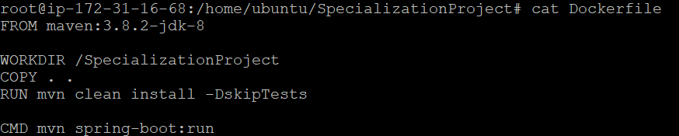
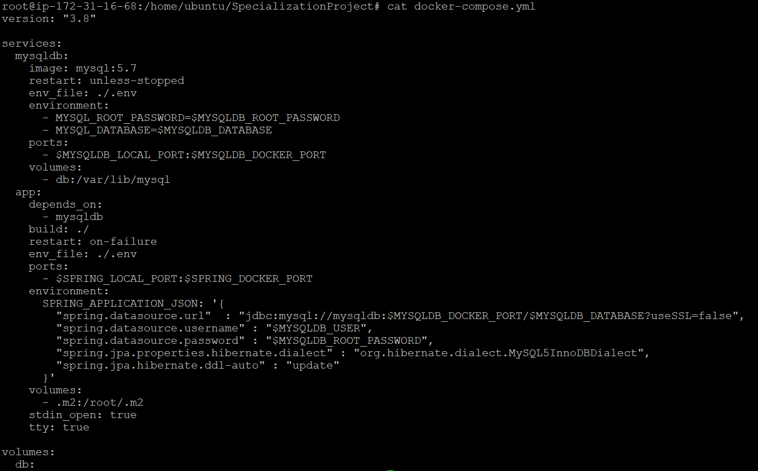
DOCKERS
1. DOCKERFILE
2. DOCKER-COMPOSE

Slide 6
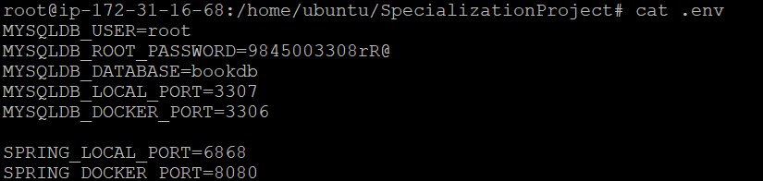
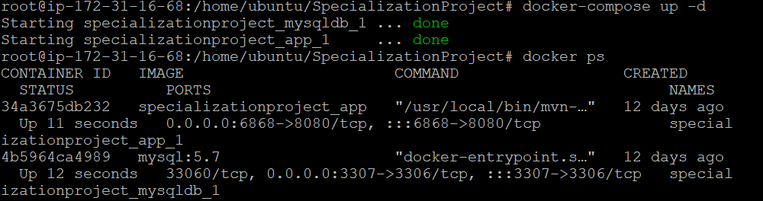
3. .ENV file as we have used Environment variables
4. docker-compose up command to Run DOCKERFILE and docker-compose file

Slide 7
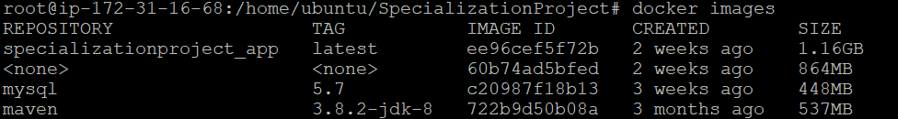
5. docker images are created
6. docker containers

Slide 8
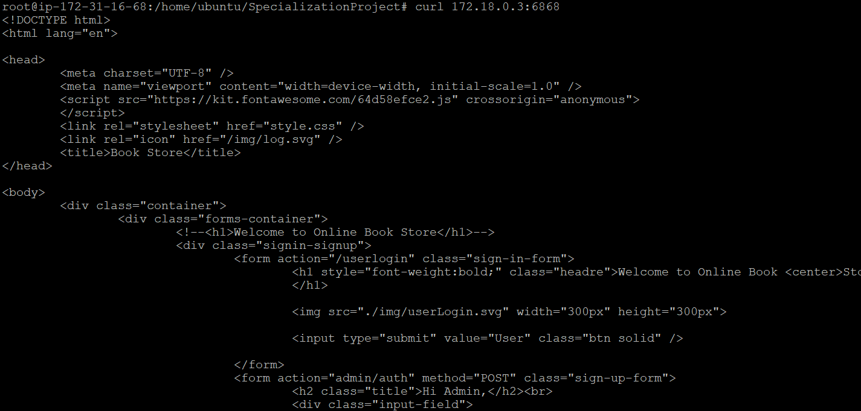
7. CURL command to hit index.html

Slide 9
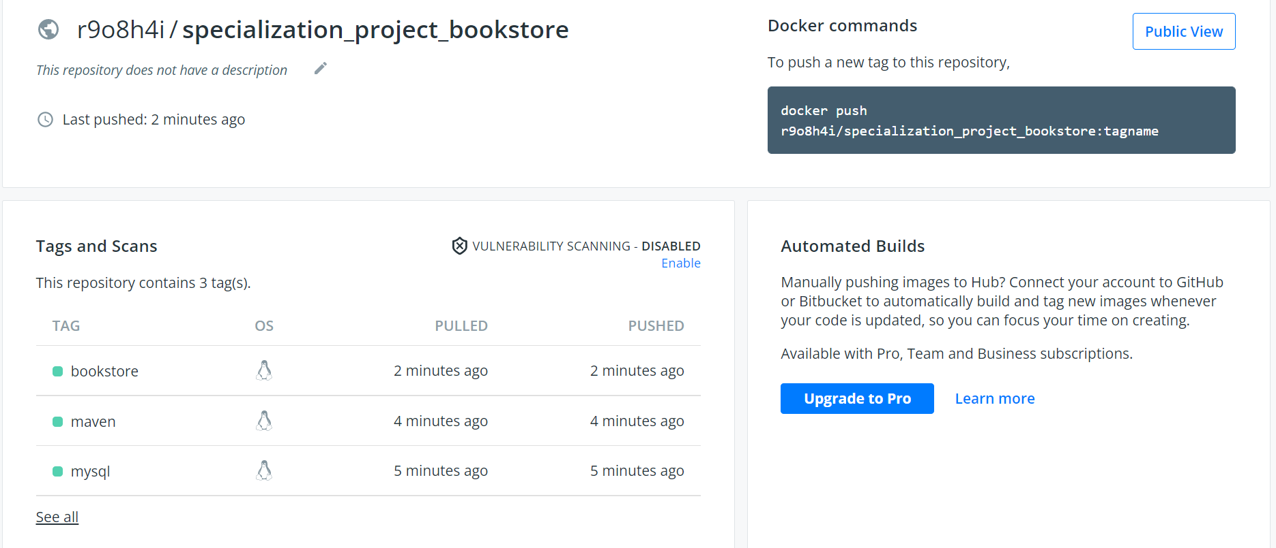
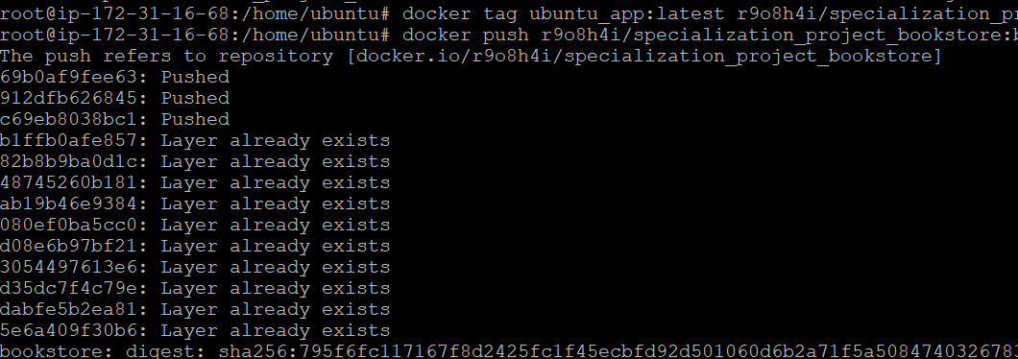
DOCKER HUB
2. Images in Docker-Hub
1. Pushing Images to Docker-Hub

Slide 10



GIT – JENKINS - NEXUS
COMMITS
BUILD
TRIGGERS
JAR FILE
RUN
DEPLOY
JENKINS PIPELINE

Slide 11

SWAGGER
Swagger is used together with a set of open-source software tools to design, build, document, and use RESTful web services.
Please click on the below link to view Swagger
Swagger-link

Slide 12


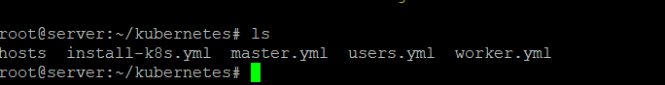
ANSIBLE - KUBERNETES
MASTER
SSH
SERVER
WORKER
SSH
1. Created directory KUBERNETES in server containing PLAYBOOKS

Slide 13
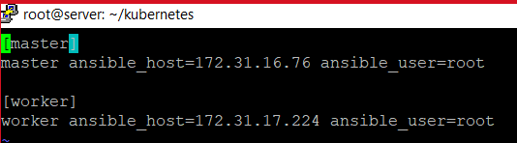
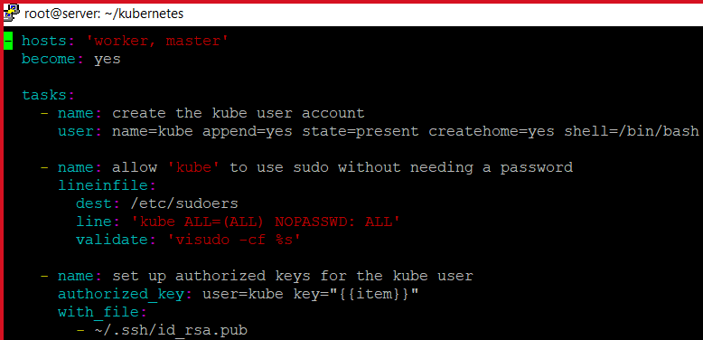
2. HOSTS file contains IP ADDRESS of MASTER and WORKER NODE
3. USERS PLAYBOOK TO CONFIGURE KUBERNETES IN BOTH MASTER AND WORKER

Slide 14
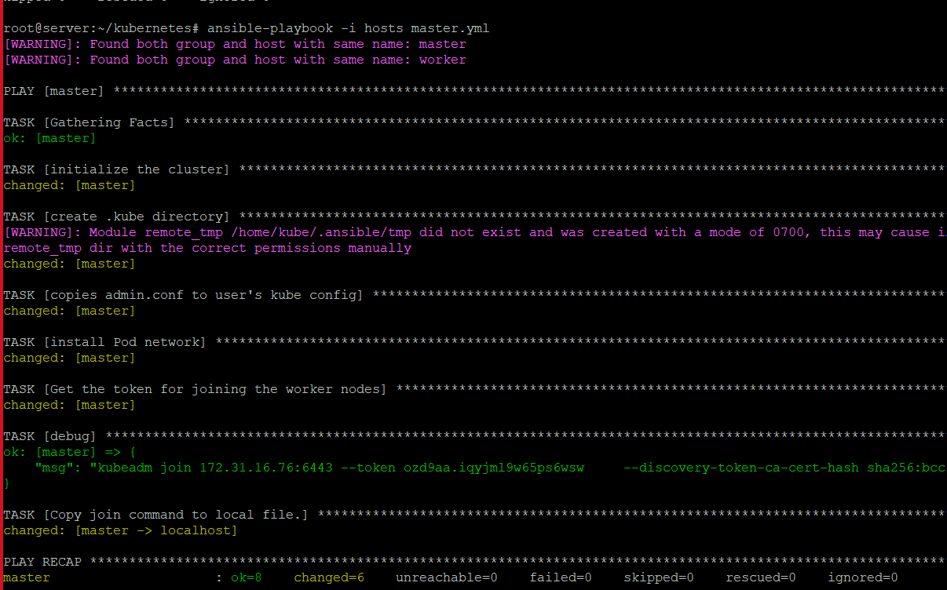
4. INSTALLING KUBERNETES IN BOTH MASTER AND WORKER USING install-k8s PLAYBOOK
5. SETTING UP MASTER CONFIGURATION FOR ONLY MASTER NODE USING PLAYBOOK

Slide 15
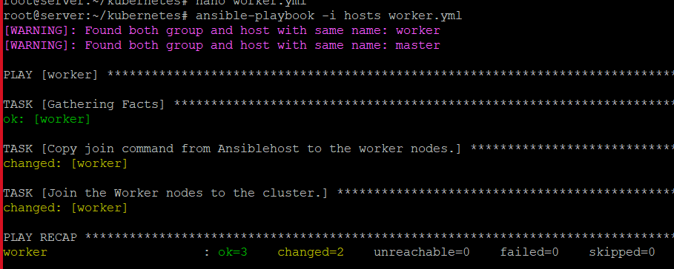
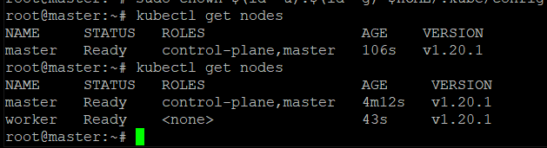
6. SETTING UP WORKER CONFIGURATION FOR ONLY WORKER NODE USING PLAYBOOK
7. MASTER NODE SHOWING ITS CONNECTION

Slide 16
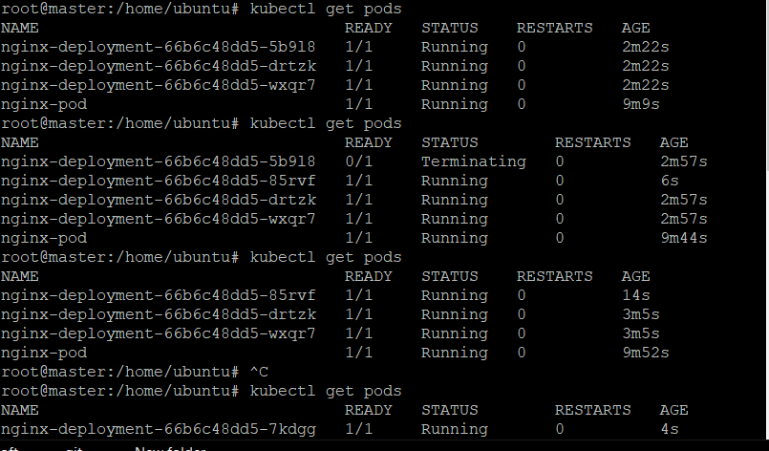
8. PODS BEFORE AND AFTER DELETING

Slide 17
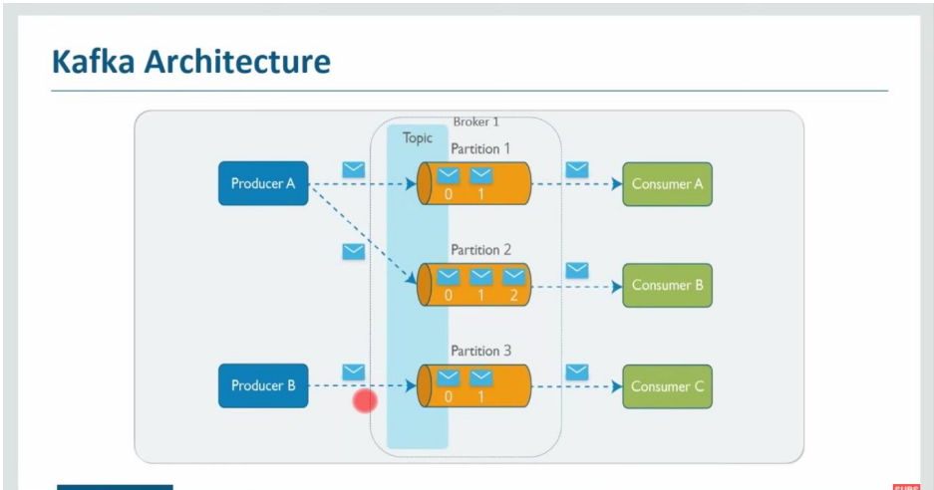
KAFKA

Slide 18
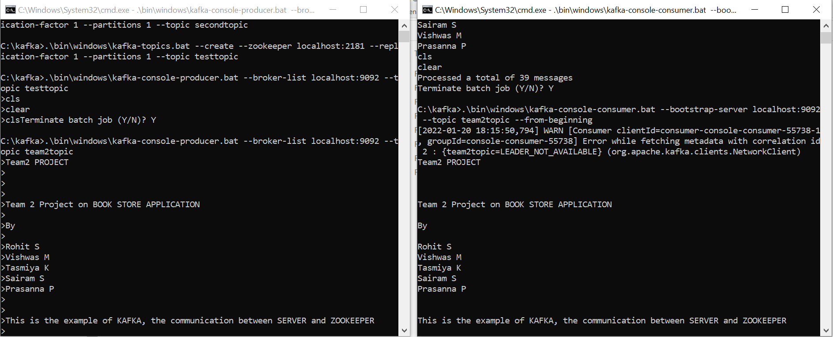
KAFKA

Slide 19

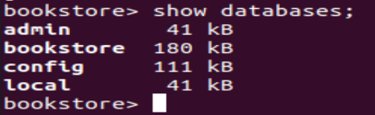
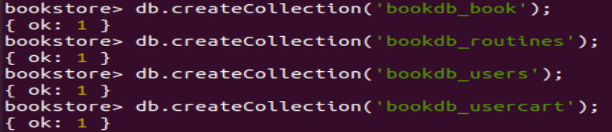
MONGODB
1. Creating Database
2. Displaying Databases
3. Creating Collections

Slide 20
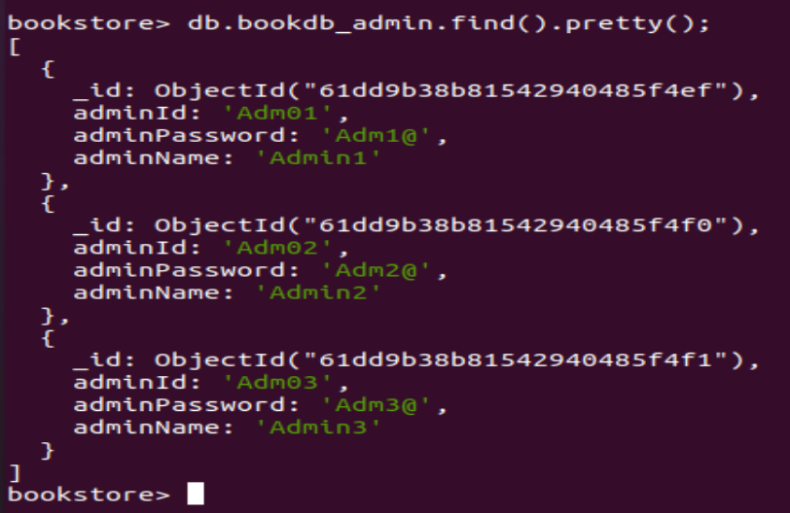
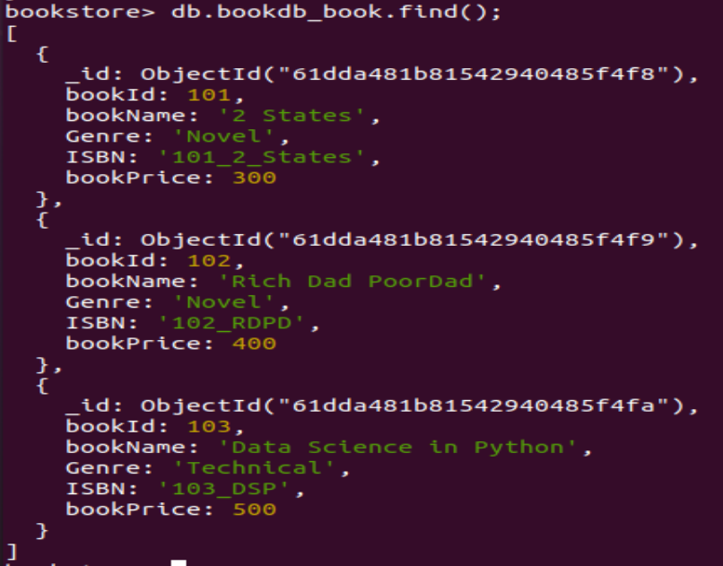
4. Inserting into collections
5. Displaying values in Admin collection
6. Displaying values in Book collection

Slide 21
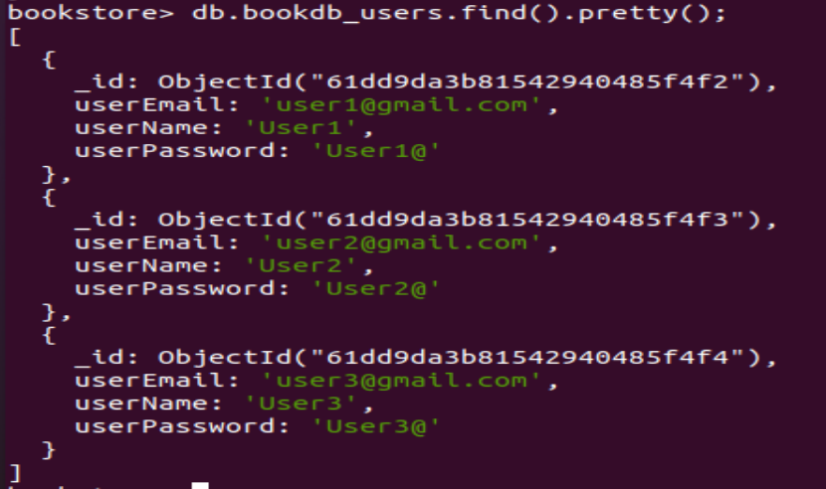
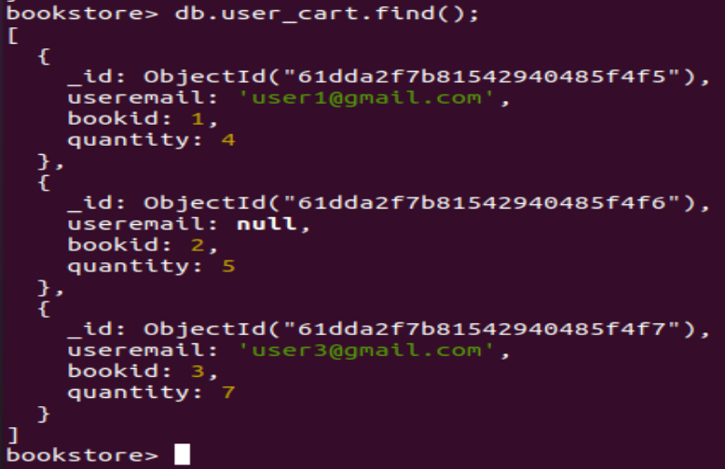
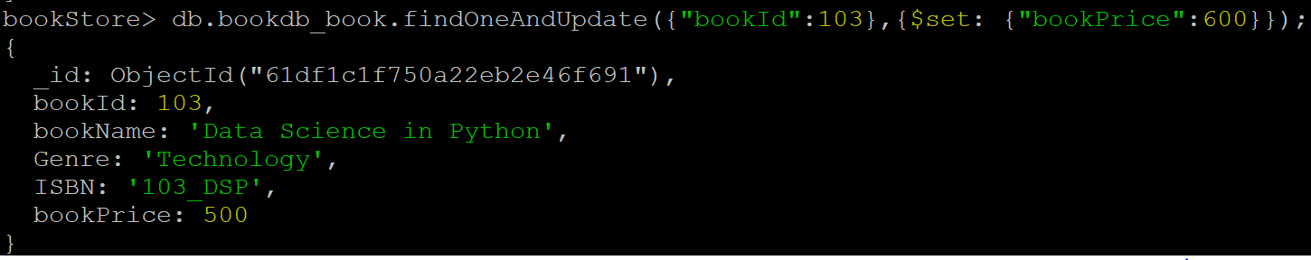
7. Displaying values in user Collection
8. Displaying values in Cart Collection
8. Updating Book Price

Slide 22
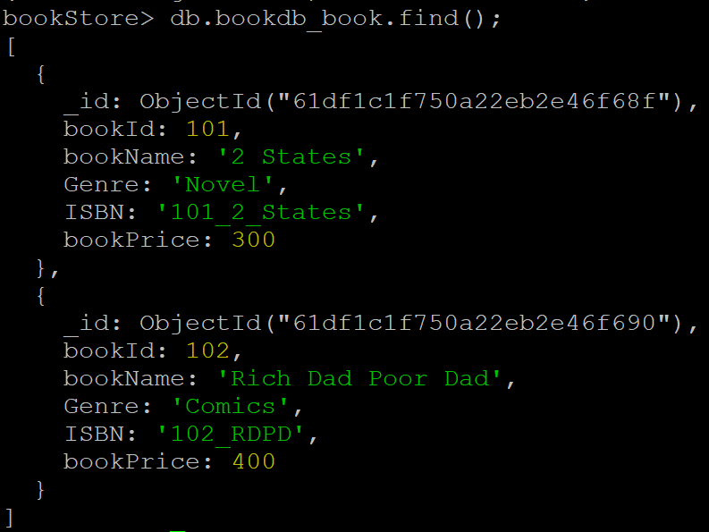
9. Deleting Book with ID.103
9. Displaying Books After Deleting
10. To Delete All Books

Slide 23
THANK YOU

