Slide 1
Forest Fire Detection using Deep learning
Tanmay Murlidhar Reddy
Prasanna Kumar Bantu

Slide 2
Satellite Images
Normal image taken from a digital camera record only visible spectrum (0.4 µm to 0.7 µm)
Satellite use sensors – Different spectral Data

Slide 3
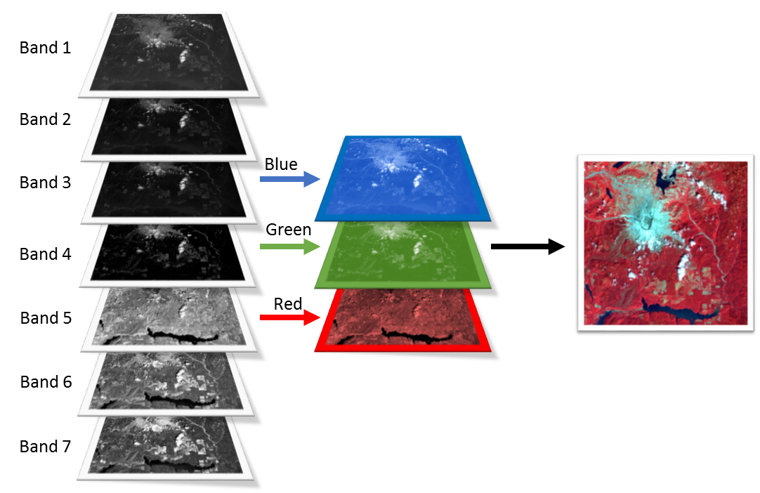
False Colouring
Different Spectral data can be mapped to different colours for visualization

Slide 4
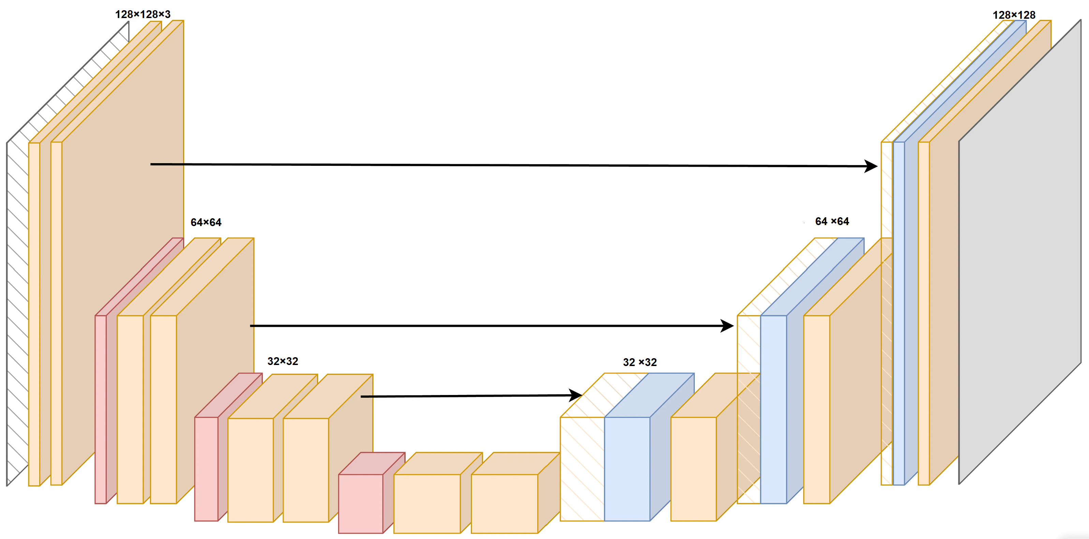
U-Net Architecture

Slide 5
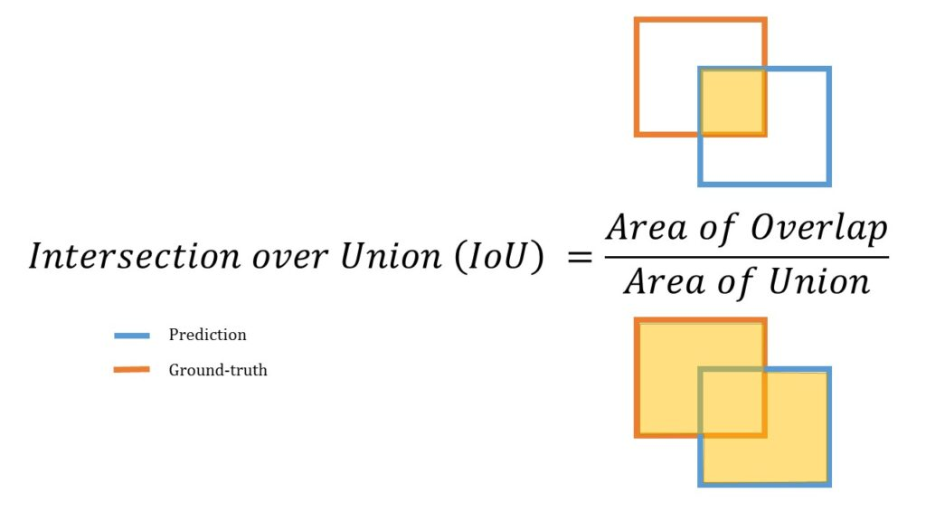
IOU- Intersection Over Union

Slide 6
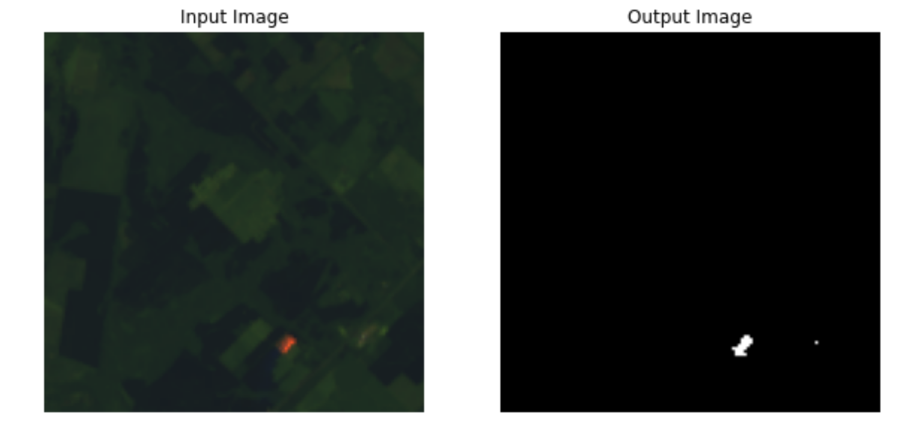
Results

Slide 7
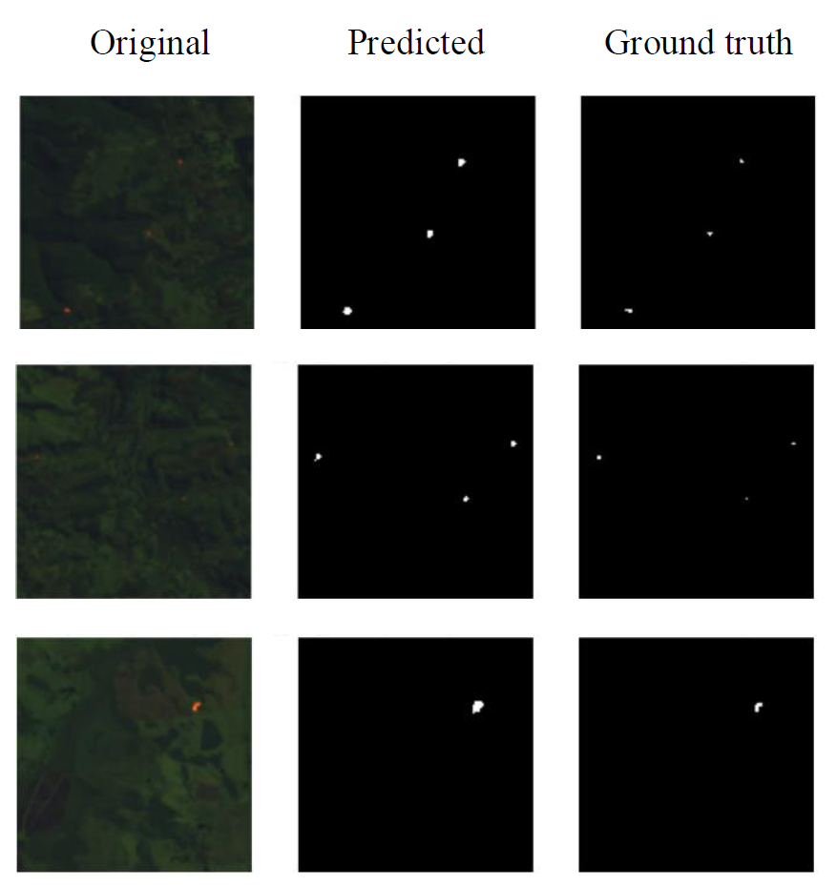
Results

Slide 8
Results

Slide 9
