Slide 1


M.Tech/MCA Program
Advanced Industry Integrated Programs
Jointly offered by University and LTIMindTree
Clinical Report Generation from Medical Images
Prasanna Venkatesh D (T8558)
Knowledge partner | Implementation partner

Slide 2
Clinical Report Generation from Medical Images
Introduction
Manual interpretation of MRI scans is time-consuming and error-prone.
Diseases like brain tumors, bone fractures, and kidney disorders require early detection.
Project automates image classification, disease detection, and clinical report generation.
Reports are generated in two modes: Doctor (technical) and Patient (simplified).

Slide 3
Clinical Report Generation from Medical Images
Objective
Classify medical images into organ categories: brain, bone, breast, kidney.
Detect domain-specific conditions: brain tumor, bone fracture, kidney disease, etc
Generate structured diagnostic outputs from CNNs.
Use LLMs to create dual-mode clinical reports.
Reduce radiologists’ workload and improve patient communication.

Slide 4
Clinical Report Generation from Medical Images
Module 1:
General CNN – Scan Classification
Input: MRI/X-ray image.
Task: Classify image type (Brain/Bone/Breast/Kidney).
Approach: CNN trained on labeled datasets with preprocessing (resize, normalize, augment).
Output: Selected domain-specific classifier.

Slide 5
Clinical Report Generation from Medical Images
Module 2:
Domain-Specific CNN
Task: Detect specific condition per domain.
Brain → Tumor detection.
Bone → Fracture detection.
Breast → Lesion/tumor detection.
Kidney → Cysts, stones, tumors.
Output: Structured diagnostic label.

Slide 6
Clinical Report Generation from Medical Images
Module 3:
Clinical Report Generation (LLM)
Task: Convert structured diagnosis into clinical report.
Approach: Pass diagnosis to LLM with prompt templates.
Modes:
Doctor Mode → Technical findings.
Patient Mode → Layman explanation & lifestyle advice.
Output: Report (with option to export as PDF).

Slide 7
Clinical Report Generation from Medical Images
Module 4:
User Interface
Upload medical image.
Select Doctor/Patient mode.
Display report with option to download.
Streamlit for deployment.

Slide 8
Clinical Report Generation from Medical Images
Methodology/Modeling Plan
Step 1: General CNN for body part classification.
Step 2: Domain-specific CNN for condition detection.
Step 3: Convert CNN output → structured JSON.
Step 4: LLM generates doctor & patient reports.
Step 5: UI for interaction.
Custom CNN Model

Slide 9
Clinical Report Generation from Medical Images
Data preprocessing & EDA
Preprocessing challenges:
Class imbalance → handled with augmentation & weighted loss.
Corrupted images → filtered/removed.
.pny format → converted to standard .png/.jpg.
EDA: Visualized class distributions, sample images, imbalance trends.

Slide 10
Clinical Report Generation from Medical Images
Approach/Algorithms/Tools
Custom CNN for classification & detection.
LLM (Gemini, MedPaLM) for report generation.
Tools: Python, PyTorch, TensorFlow, Streamlit, Gemini API.
Visualization: Grad-CAM heatmaps for explainability.

Slide 11
Clinical Report Generation from Medical Images
Project plan/milestones progress
Phase 1 → Literature Review
Phase 2 → Dataset Collection
Phase 3 → Preprocessing & EDA (Class imbalance, corrupted images handled)
Phase 4 → Baseline CNN models
Phase 5 → LLM integration (in progress)
Phase 6 → UI development & testing (upcoming)
Phase 7 → Final pipeline integration & evaluation (upcoming)

Slide 12
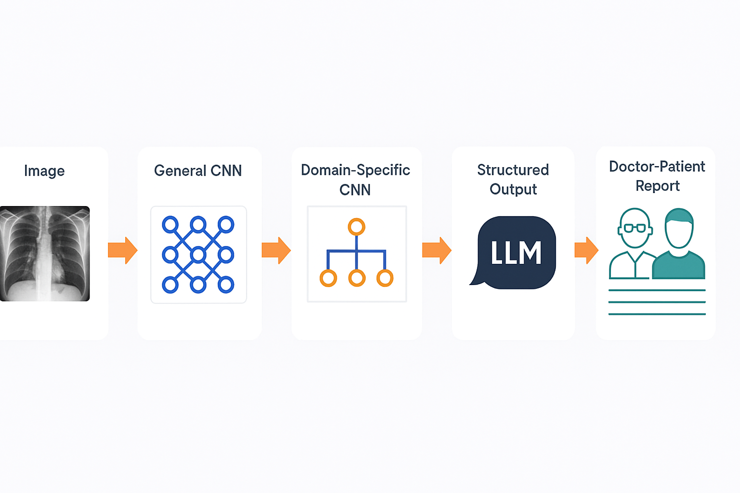
Clinical Report Generation from Medical Images
Pipeline structure

