Slide 1



Disney+ Hotstar Analysis

Slide 2
Analysis Overview
This analysis covers various aspects of movies available on Disney+ Hotstar, including:
- Distribution of Movies by Genre
- Average Running Time by Genre
- Movie Releases by Year
- Movies by Age Rating

Slide 3
Distribution of Movies by Genre
Key Insights:
- The genre with the highest number of movies is 'Drama' with 2,000 movies.
- 'Comedy' and 'Romance' follow with 800 and 600 movies respectively.
- Genres like 'Action', 'Reality', and 'Thriller' have fewer movies.

Slide 4
Average Running Time by Genre
Key Insights:
- 'Sports' movies have the highest average running time of 145.50 minutes.
- 'Biopic' and 'Mythology' genres also have relatively high average running times, 130 and 129 minutes respectively.
- 'Romance' movies have an average running time of 115.77 minutes.

Slide 5
Movie Release Trends by Year
Key Insights:
- The number of movies released annually was relatively flat from 1940 to 2000.
- There is a noticeable increase in the number of releases post-2000, with peaks around the late 2010s.

Slide 6
Movies by Age Rating
Key Insights:
- The majority of movies fall under the U and U/A 7+ ratings.
- U/A 13+ and U/A 16+ ratings also have significant representation.
- The average running time across different age ratings varies from 78 minutes (U) to 104 minutes (U/A 13+).

Slide 7
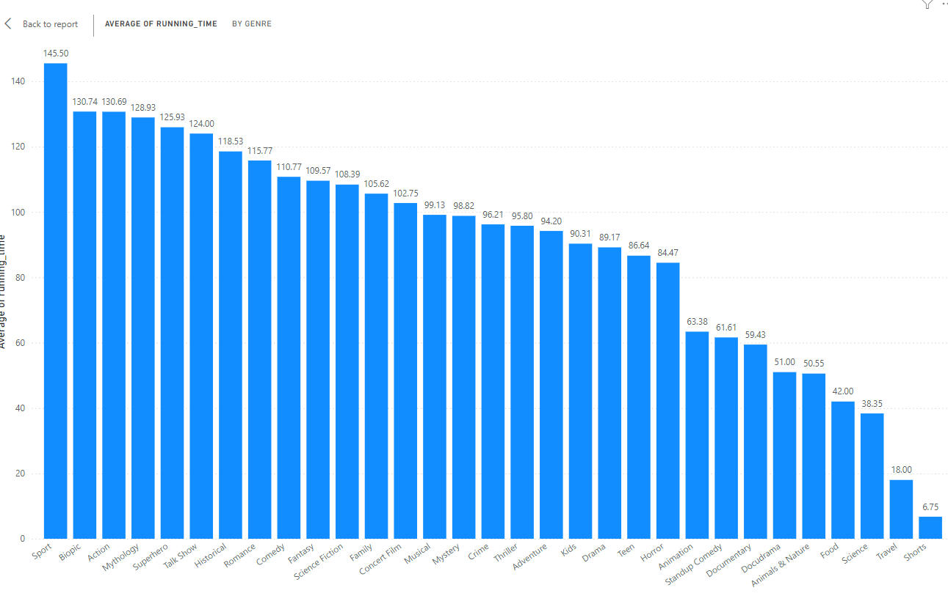
AVERAGE OF RUNNING TIME
INSIGTS:
The varying movie lengths suggest that content creators should tailor their offerings to different audience preferences. For instance, sports and action movies, with their longer runtimes, cater to viewers who enjoy immersive, detailed experiences, while shorter films and travel shows are perfect for quick, on-the-go viewing. Streaming platforms like Disney+ Hotstar can use this information to strategically position their content, promoting shorter pieces during the week and saving longer movies for weekends or holidays. Investing in genres with longer runtimes, like biopics, action, and superhero films, can be particularly lucrative, as these often attract dedicated fanbases and justify high production values.
FINDINGS:
Sports movies are the longest, averaging nearly 2.5 hours, likely due to their detailed storytelling. Biopics and action films also have longer runtimes, as they cover complex stories and feature intense scenes. Mythology and superhero movies are similarly lengthy, often involving intricate plots and special effects. On the other hand, short films, travel shows, and science content are much shorter, focusing on quick, impactful storytelling. Common genres like drama, comedy, and romance fall in the middle range, balancing depth and audience engagement. Documentaries and docudramas are shorter, usually under an hour, as they aim to inform without dragging on.

Slide 8
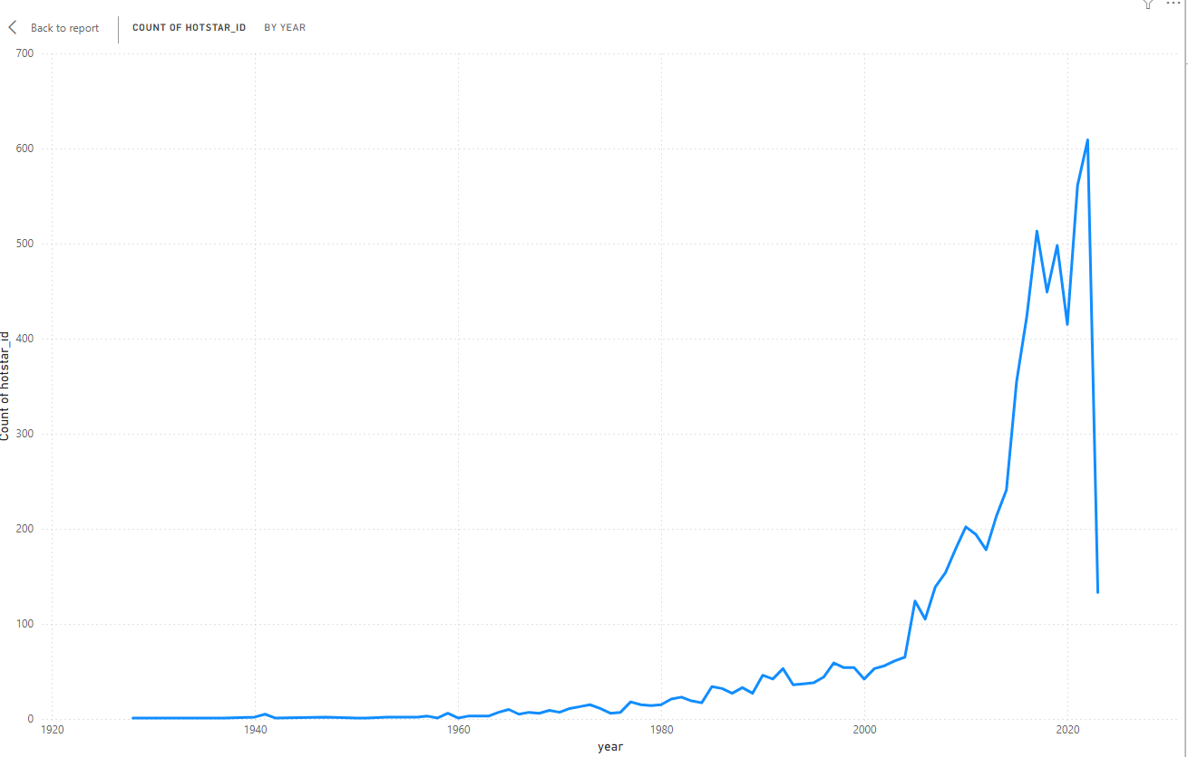
COUNT OF HOTSTAT ID
INSIGHT:
The graph shows a significant increase in the number of Hot star IDs over time. While there are some fluctuations, the overall trend is upward, particularly from the year 2000 onwards. This indicates that Hot star's popularity and user base have grown substantially in recent decades.
FINDINGS:
1. Steady Growth: The graph indicates a consistent increase in the number of Hotstar IDs over the years. This suggests a growing user base and increasing popularity of the platform.
2. Significant Spike: There's a noticeable surge in the number of Hotstar IDs around the year 2010. This might be attributed to factors like increased internet penetration, marketing campaigns, or the introduction of new features or content.
3. Continued Momentum: Even after the initial spike, the trend of growth continues, albeit at a slightly slower pace. This suggests that Hotstar has maintained its appeal and relevance among users.

Slide 9
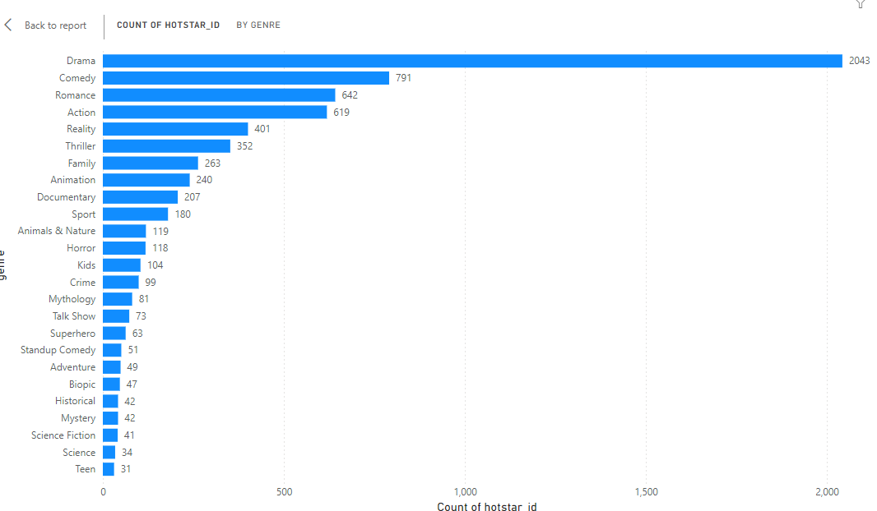
MOST COMMON MOVIE TYPES
FINDINGS:
The majority of the dataset consists of drama following by comedy.
INSIGHTS:
The dominance od drama indicates this format are the most produced.
Less common types might cater to specific audience segments or serve niche markets.

Slide 10
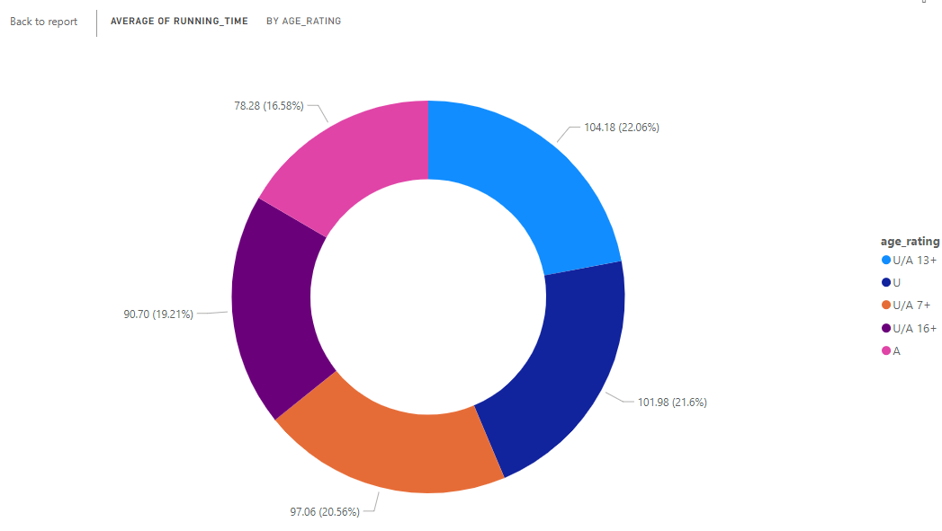
MOVIES BY AGE RATING:
FINDINGS:
All the movies are fall under equal proportion of ratings.
From this “U” is top with 17.41%
INSIGHTS:
The prevalence of “U” rated movies suggests that producers are targeting a broader adult audience
The “A” rated movies contains adult and violence so family audience and children's are don’t watching it.

Slide 11
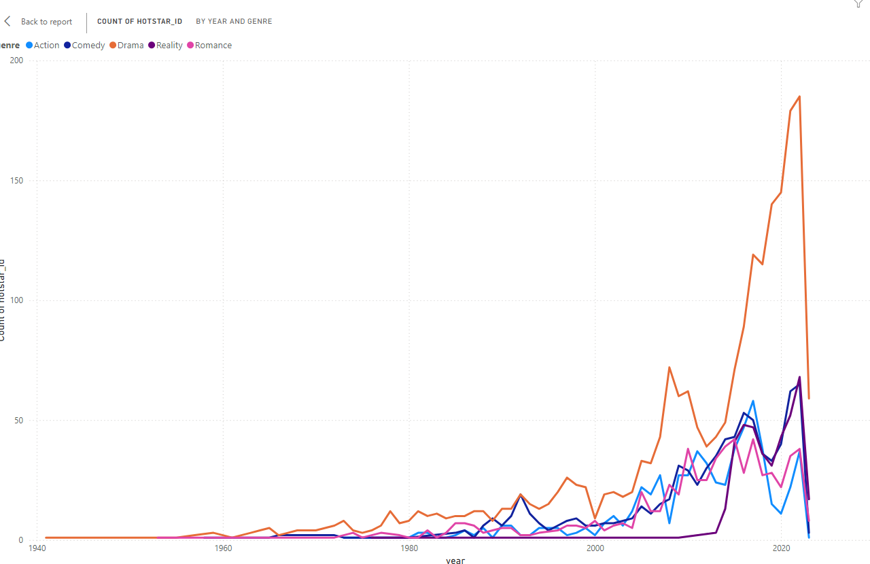
GENRE POPULARITY OVER TIME:
FINDINGS:
Genre like ‘Drama’ have seen consistent popularity, with noticeable peaks from 2007 to now.
Some genres, such as ‘Romance‘ and ‘Action’ have shown significant growth over time.
INSIGHTS:
The consistent popularity of certain genres indicates stable audience interest.
The growth in specific genres might be driven by trends technological advancements or changes in audience preferences.

Slide 12
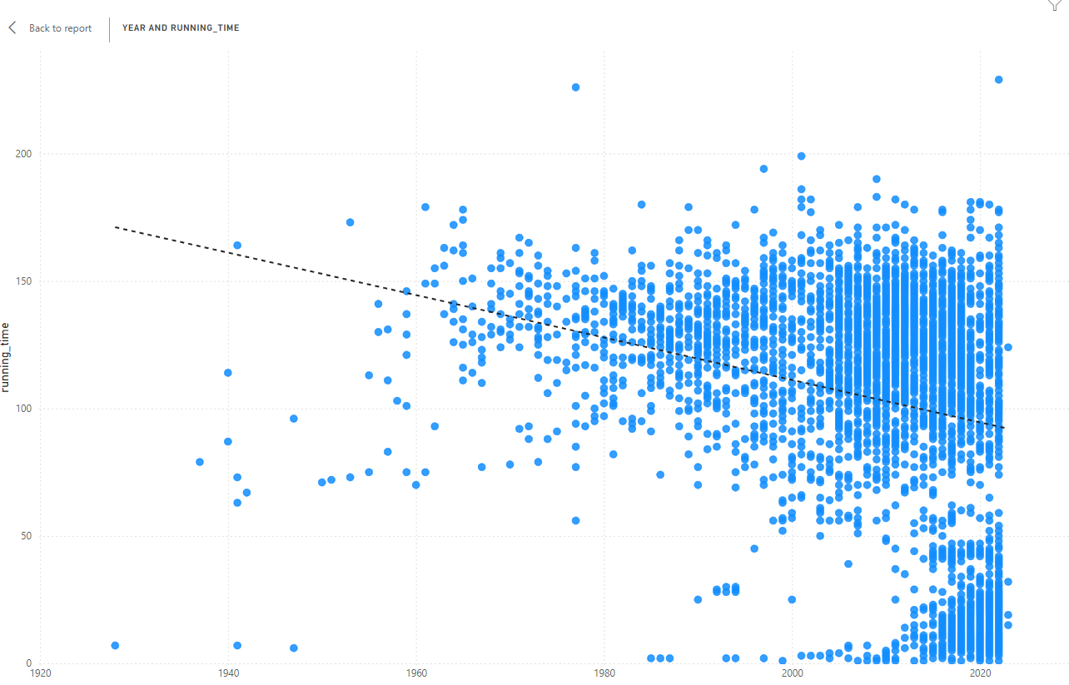
CORRELATION BETWEEN RUNNING TIME AND YEAR
FINDINGS :
Over the years the running time of movies are gradually decreased.
INSIGHTS:
Nowadays people don’t have patients to watch longer running time movies.
So slight decrease in running time in recent years that might reflect changes in production styles or audience preferences.

Slide 13
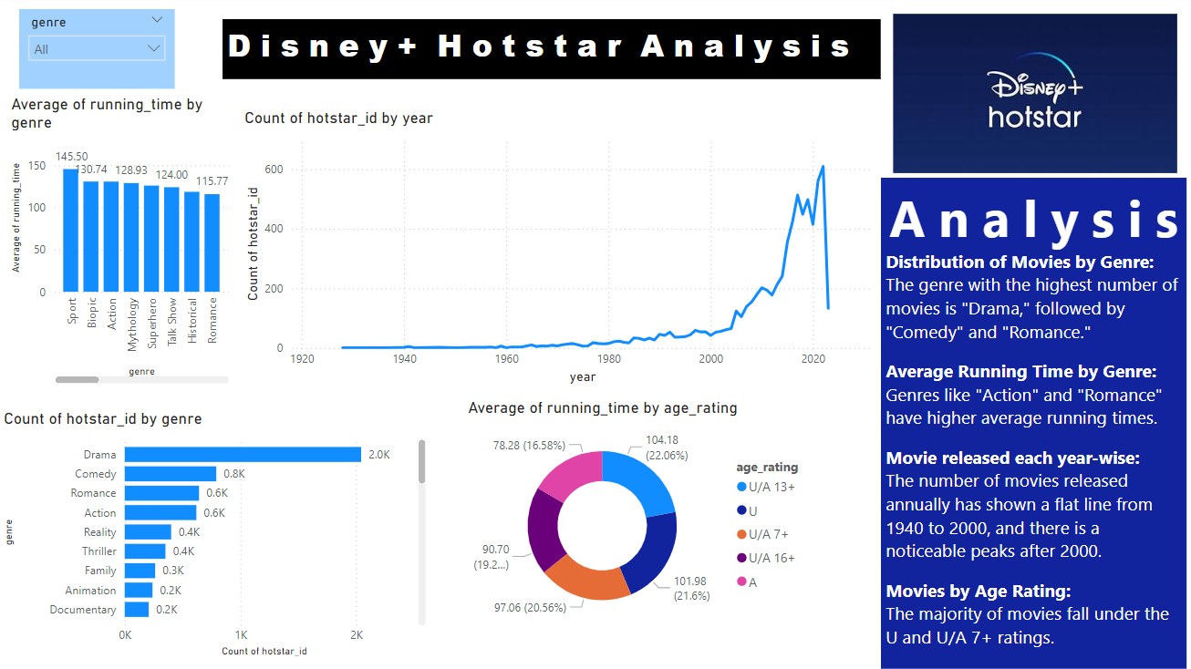
DASHBOARD

Slide 14
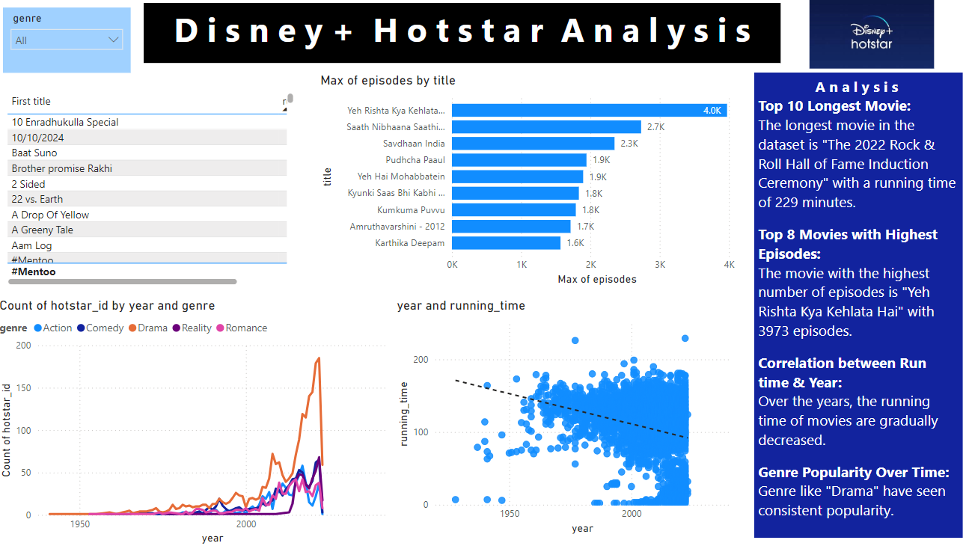
DASHBOARD

Slide 15
Conclusion
This analysis provides insights into the content available on Disney+ Hotstar, helping to understand the platform's movie library in terms of genre popularity, average running times, release trends, and age ratings. These findings highlight the platforms strategic focus on popular genres and broad audience appeal while also indicating opportunities for growth is less common genres and innovative content formats.

