Slide 1
A Recommender System for Gym and Gaming equipment Contractor
Applied Data Science Capstone
IBM Data Science Professional Certificate
Summer 2018

Slide 2
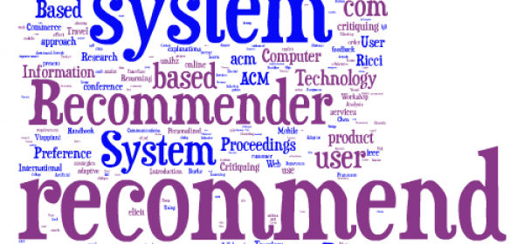
A Recommender System for gym and gaming equipment Contractor
Image is from this site: https://www.geo-viz.com/blog/business-aspects-recommender-systems<

Slide 3
Synopsis
Part 1: Problem Description
There is a gym and gaming equipment contractor in one of the boroughs of Toronto (Scarborough). This contractor provides equipment to places such as: Different types of Gyms and Gaming stores. The contractor wants to build a warehouse for the gym parts and gaming equipment as he brings the parts from other countries and from good manufactures to bring better "Quality of Service" to the customers.

Slide 4
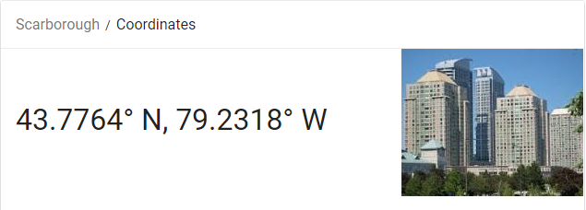
Synopsis
Part 2: Data We Need
We will need geo-locational information about that specific borough and the neighborhoods in that borough. We specifically and technically mean the latitude and longitude numbers of that borough. We assume that it is "Scarborough" in Toronto. This is easily provided for us by the contractor, because the contractor has already made up his mind about the borough. The Postal Codes that fall into that borough (Scarborough) would also be sufficient for us. In fact we will first find neighborhoods inside Scarborough by their corresponding Postal Codes.

Slide 5
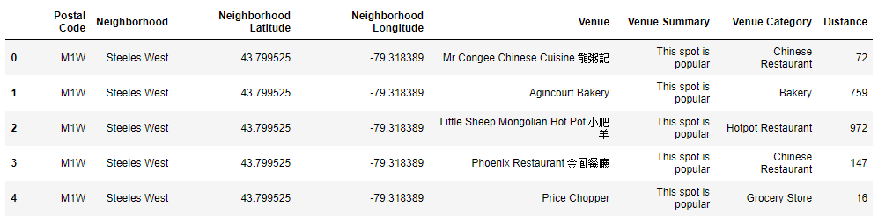
Synopsis
Part 2: Data We Need
b) We will need data about different venues in different neighborhoods of that specific borough. In order to gain that information we will use "Foursquare" locational information. A typical request from Foursquare will provide us with the following information:

Slide 6
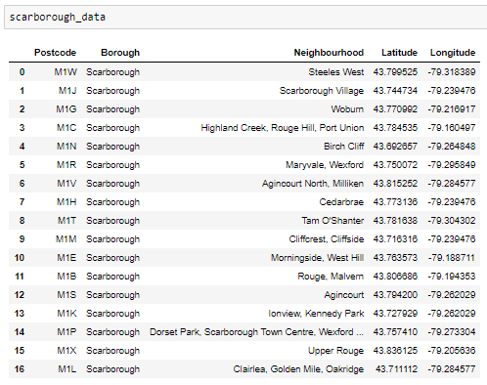
Main Article
Part 1: Identifying Postal Codes (and then Neighborhoods) in "Scarborough"

Slide 7
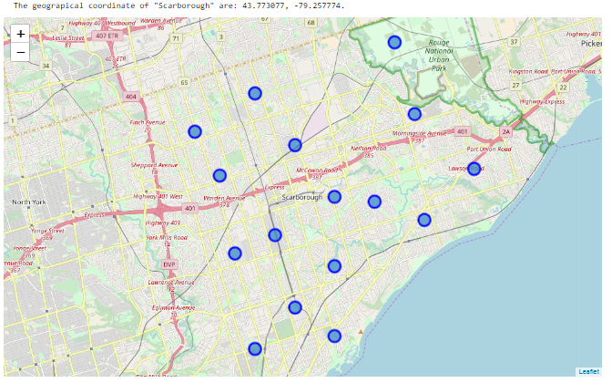
Main Article
Part 1: Identifying Postal Codes (and then Neighborhoods) in "Scarborough"

Slide 8
Main Article
Part 2: Connecting to Foursquare and Retrieving Locational Data for Each Venue in Every Neighborhood
After finding the list of neighborhoods, we then connect to the Foursquare API to gather information about venues inside each and every neighborhood. For each neighborhood, we have chosen the radius to be 1000 meter. It means that we have asked Foursquare to find venues that are at most 1000 meter far from the center of the neighborhood.

Slide 9
Main Article
Part 3: Processing the Retrieved Data and Creating a DataFrame for All the Venues inside the Scarborough
When the data is completely gathered, we will perform processing on that raw data to find our desirable features for each venue. Our main feature is the category of that venue. After this stage, the column "Venue's Category" will be One-hot encoded and different venues will have different feature-columns. After On-hot encoding we will integrate all restaurant columns to one column "Total Restaurants" and all food joint columns to "Total Joints" column.

Slide 10
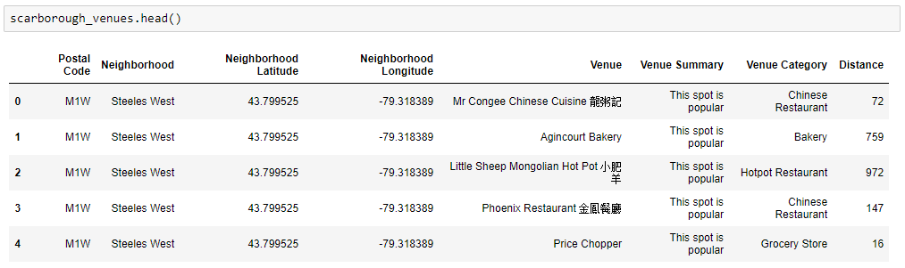
Main Article
Part 3: Processing the Retrieved Data and Creating a DataFrame for All the Venues inside the Scarborough

Slide 11
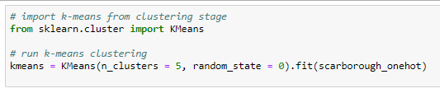
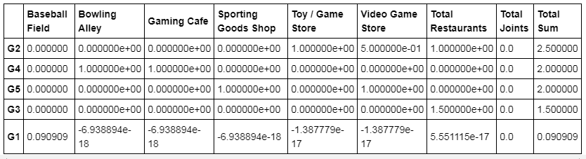
Main Article
Part 4: Applying one of Machine Learning Techniques (K-Means Clustering)

Slide 12
Decision Making and Reporting Results
Now, we focus on the centers of clusters and compare them. The group which its center has the highest "Total Sum" will be our best recommendation to the contractor. This algorithm although is pretty straightforward yet is strongly powerful.
Results:
Based on this analysis, the best recommended neighborhood will be:
{'Neighborhood': 'Dorset Park,Scarborough Town Centre,Wexford Heights',
'Neighborhood Latitude': 43.7528467}

Slide 13
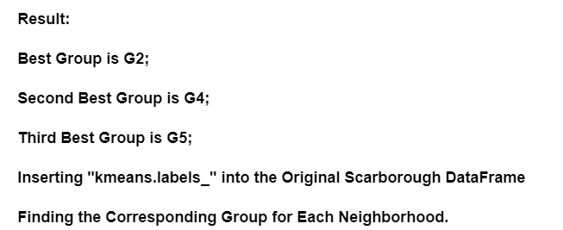
Decision Making and Reporting Results

Slide 14
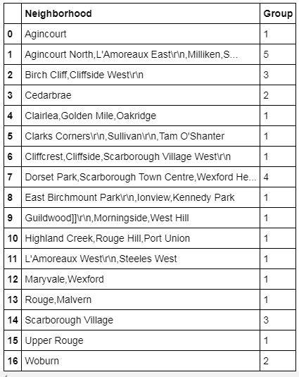
Decision Making and Reporting Results

Slide 15
Conclusion
We can conclude that 'Neighborhood': 'Dorset Park,Scarborough Town Centre,Wexford Heights' is the best place to place his warehouse for the on time supply.

Slide 16

Image is from: https://contenthub-static.grammarly.com/blog/wp-content/uploads/2017/10/thank-you-760x400.jpg

