Slide 1
MILESTONE 2 PROJECT PRESENTATION
Digital Twin AI - Personal Life Simulation & Decision Assistant
AI Core Layer Integration • Predictive ML Engine • Dynamic Multi-Domain Assistants
Submitted to: Academic & Project Mentor | Team 1 | Milestone 2 Review

Slide 2
MILESTONE 2: AI DIGITAL TWIN
Executive Summary & Milestone 2 Scope
Project Vision: Simulate • Optimize • Evolve
Milestone 2 Key Deliverables
• Digital Twin Concept: Constructs a data-driven personal digital twin modeling user habits, health metrics, financial streams, and study performance.
• Simulate & Predict: Uses Machine Learning algorithms to simulate future outcomes (weight trajectories, savings growth, exam marks, health risks).
• Actionable Guidance: Delivers personalized, actionable recommendations for diet, workout routines, budgets, and study schedules.
• Unified Decision Support: Acts as an intelligent decision copilot replacing fragmented individual tracking apps.
• AI Core Layer Integration: Implemented Machine Learning pipelines using Scikit-Learn, Joblib, and PyTorch for multi-domain prediction.
• Real Dataset Retraining: Trained core risk & performance models on real public datasets (CDC BRFSS 70k+ rows, UCI Obesity, ENSANUT, HF Calorie).
• 4 Integrated AI Assistants: Delivered Health, Financial, Productivity, and Fitness AI Assistants with interactive Streamlit UI.
• Model Registry & Audit: Built automated model versioning, record metrics tracking (AUC, R², MAE), and evaluation logging.

Slide 3
MILESTONE 2: AI DIGITAL TWIN
System Architecture & Technology Stack
1. Presentation Tier (UI/UX)
2. Application & API Tier
✔ Framework: Streamlit Web UI
✔ Responsive Cards & Interactive Tabs
✔ Plotly & Matplotlib Data Visualizations
✔ JWT User Authentication Portal
✔ Framework: FastAPI / Python 3.14
✔ RESTful Endpoint Architecture
✔ JWT Token Session & State Management
✔ Modular Service Controller Layer
3. AI Core & Machine Learning Tier
4. Data & Dataset Pipeline Tier
✔ Frameworks: Scikit-learn, PyTorch, Joblib
✔ Mifflin-St Jeor & BMR Equation Engines
✔ RandomForest, XGBoost, Regression Models
✔ Model Registry (`ai_models/<domain>`)
✔ Database: SQLite / SQLAlchemy ORM
✔ Public Datasets: CDC BRFSS, UCI, HF
✔ Cached Transformation (`data/real/`)
✔ Synthetic Data Fallback Engine

Slide 4
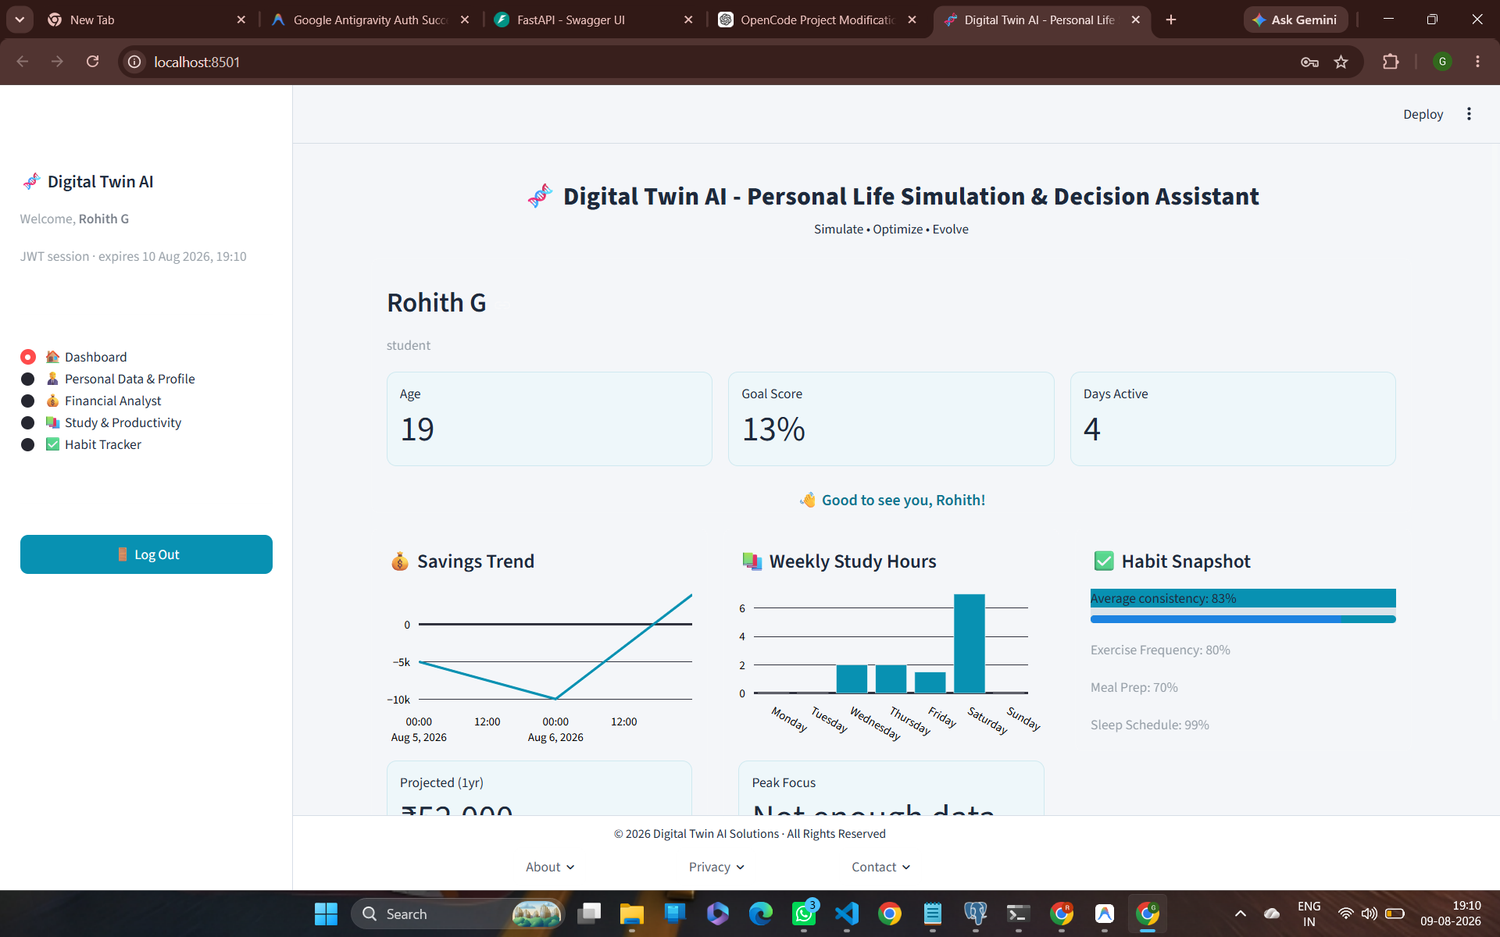
MILESTONE 2: AI DIGITAL TWIN
User Authentication & Interactive Main Dashboard
Dashboard Key Features & Overview
• JWT Session Authentication: Secure login/registration system managing user context, session expiration, and personalized profiles.
• Executive KPI Widgets: Displays key user indicators: Age (19), Overall Goal Score (13%), and Active Tracking Days (4).
• Integrated Multi-Module Cards: Real-time summary widgets showing Savings Trends, Weekly Study Hours breakdown, and Habit Snapshots.
• Behavioral Pattern Engine: Tracks dining out, daily study time, and sleep schedules to detect behavioral shifts and recommend improvements.

Slide 5
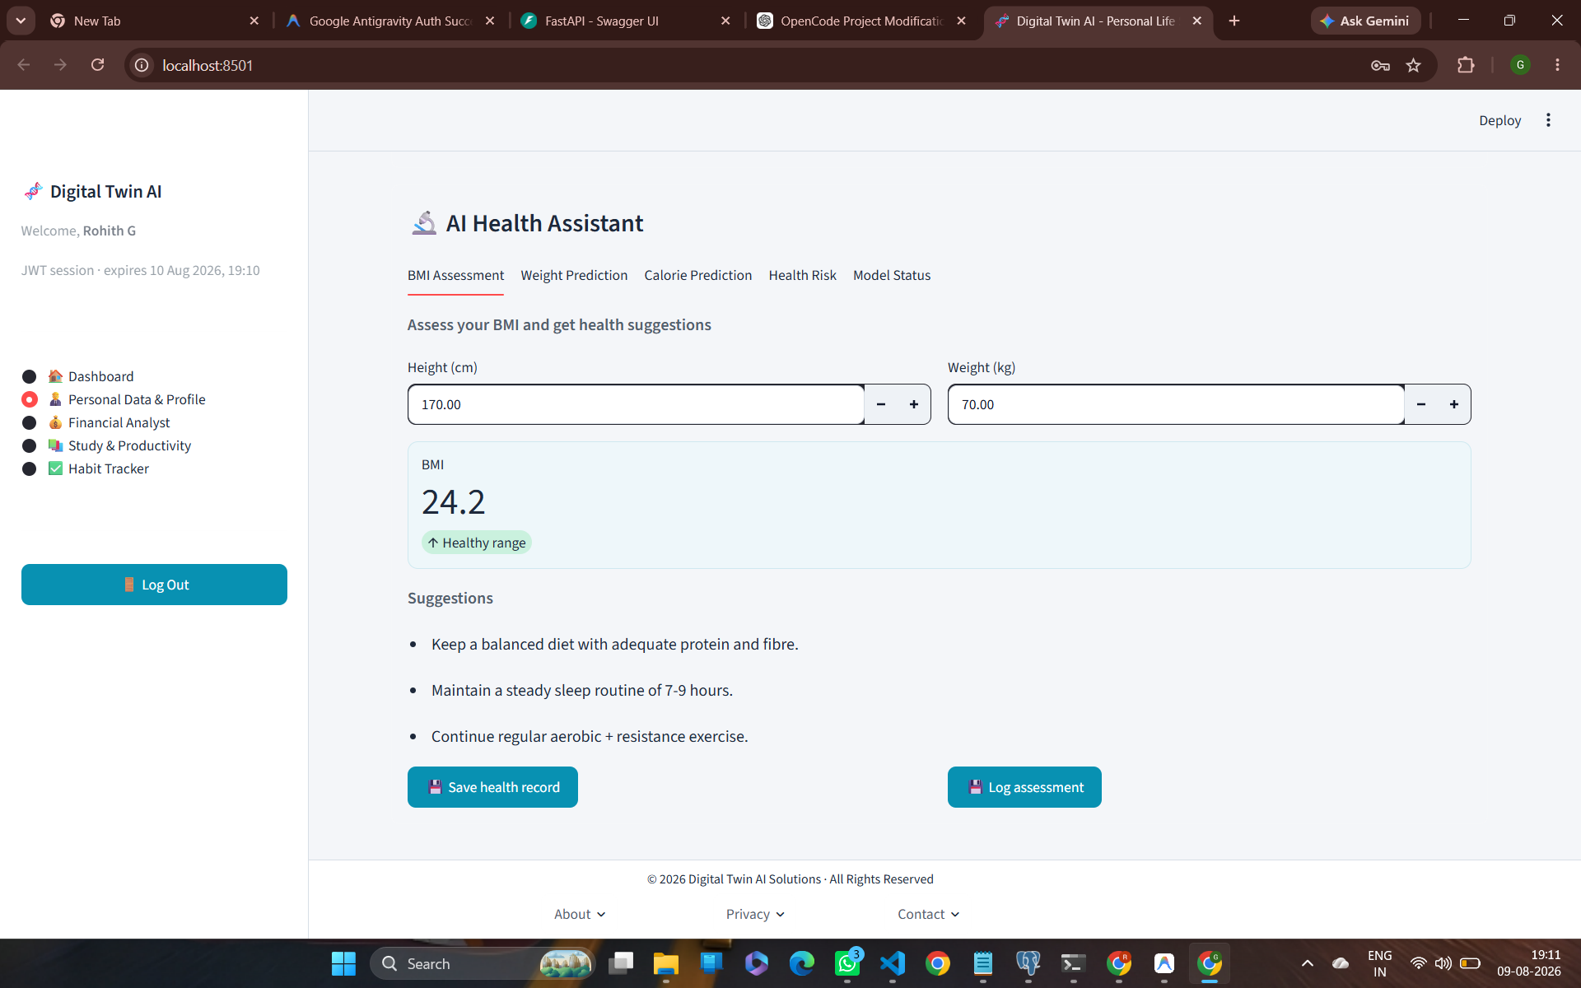
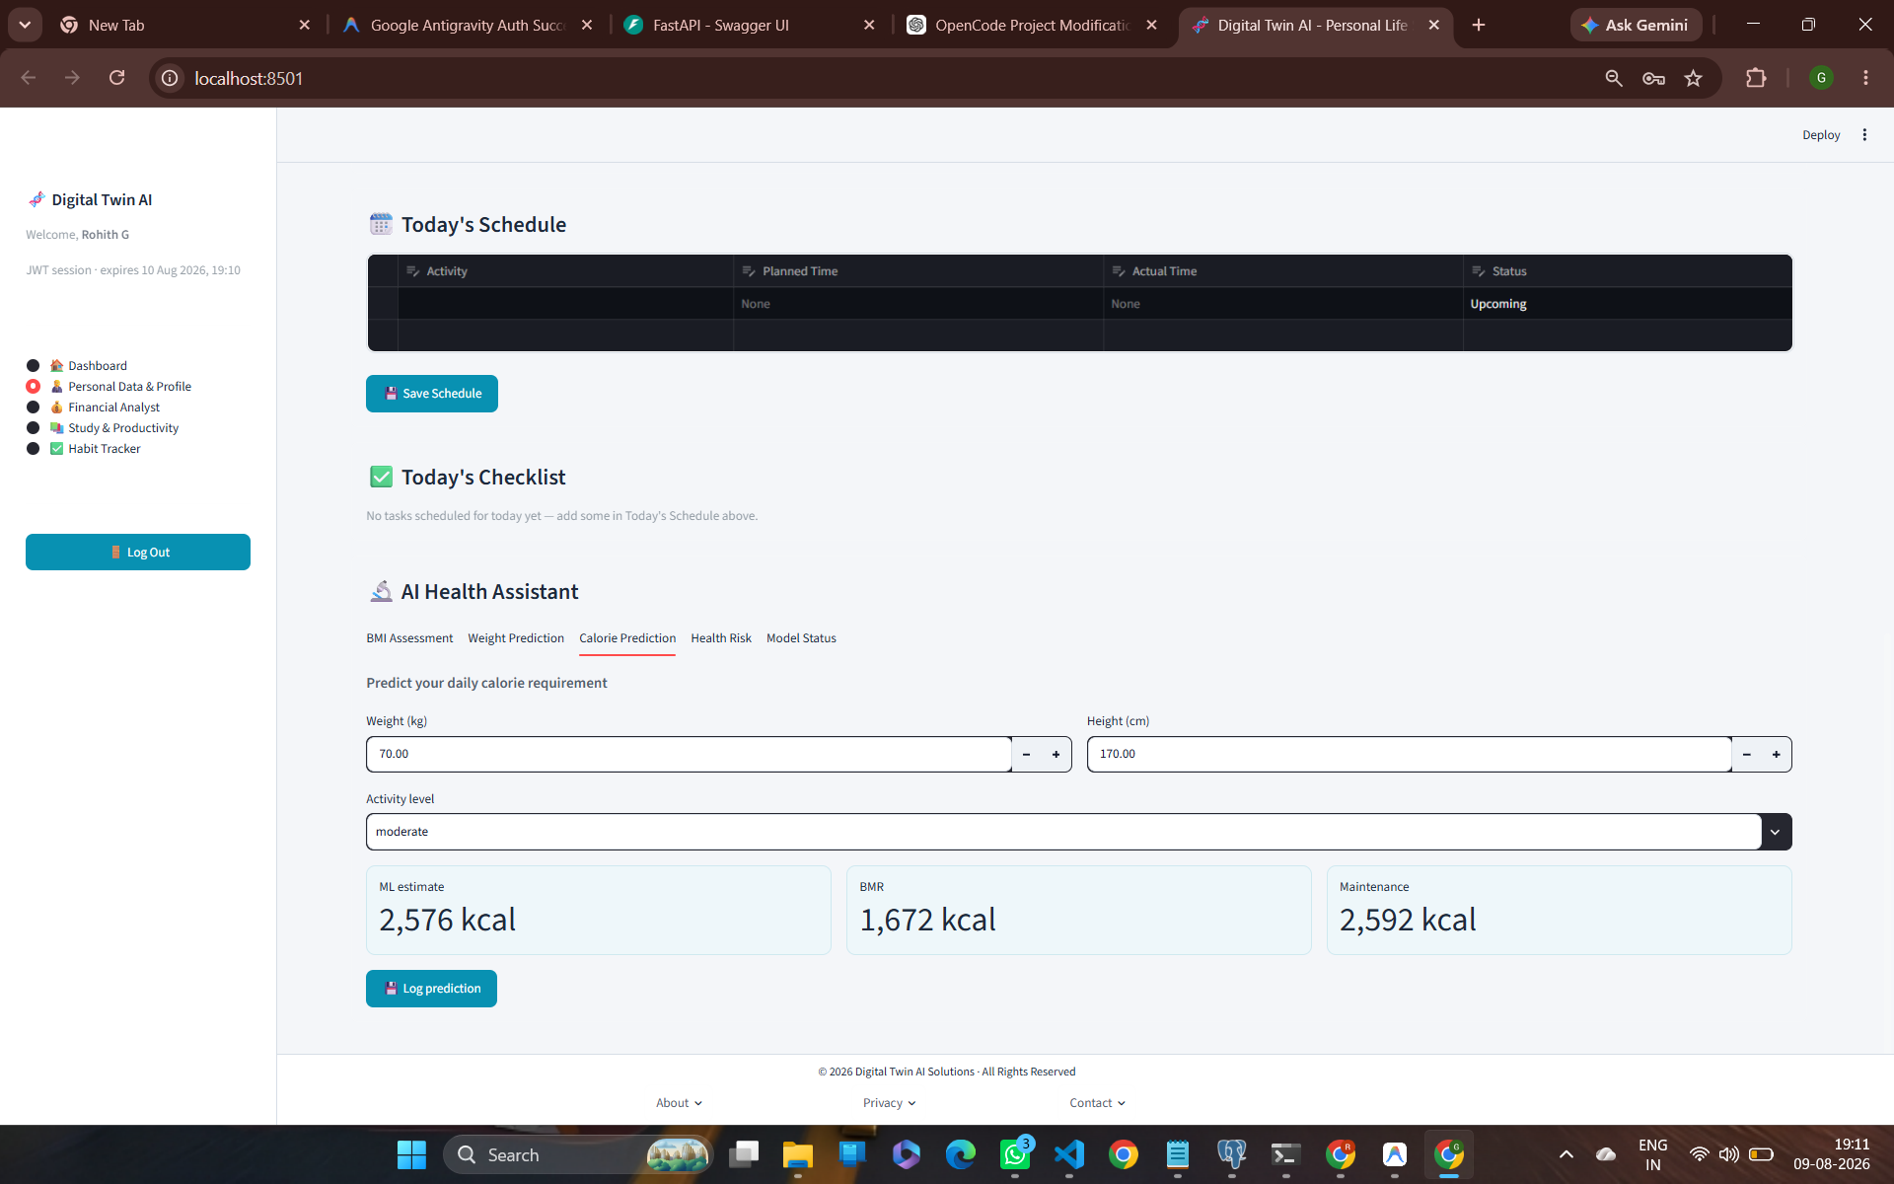
MILESTONE 2: AI DIGITAL TWIN
AI Health Assistant: BMI Calculator & Calorie Engine
Health Analytics & Caloric Modeling
• BMI Assessment: Calculates exact BMI (e.g. 24.2 - Healthy Range) from height & weight inputs, delivering tailored nutrition & activity suggestions.
• Mifflin-St Jeor BMR Engine: Computes Basal Metabolic Rate (1,672 kcal) based on biometric parameters.
• Daily Maintenance Requirement: Factors in physical activity levels to determine daily maintenance calories (2,592 kcal).
• Machine Learning Predictor: Trained on Hugging Face calorie dataset (15,000 records, MAE 1.72 kcal, R² 0.998) to estimate specific burn requirements (2,576 kcal).

Slide 6
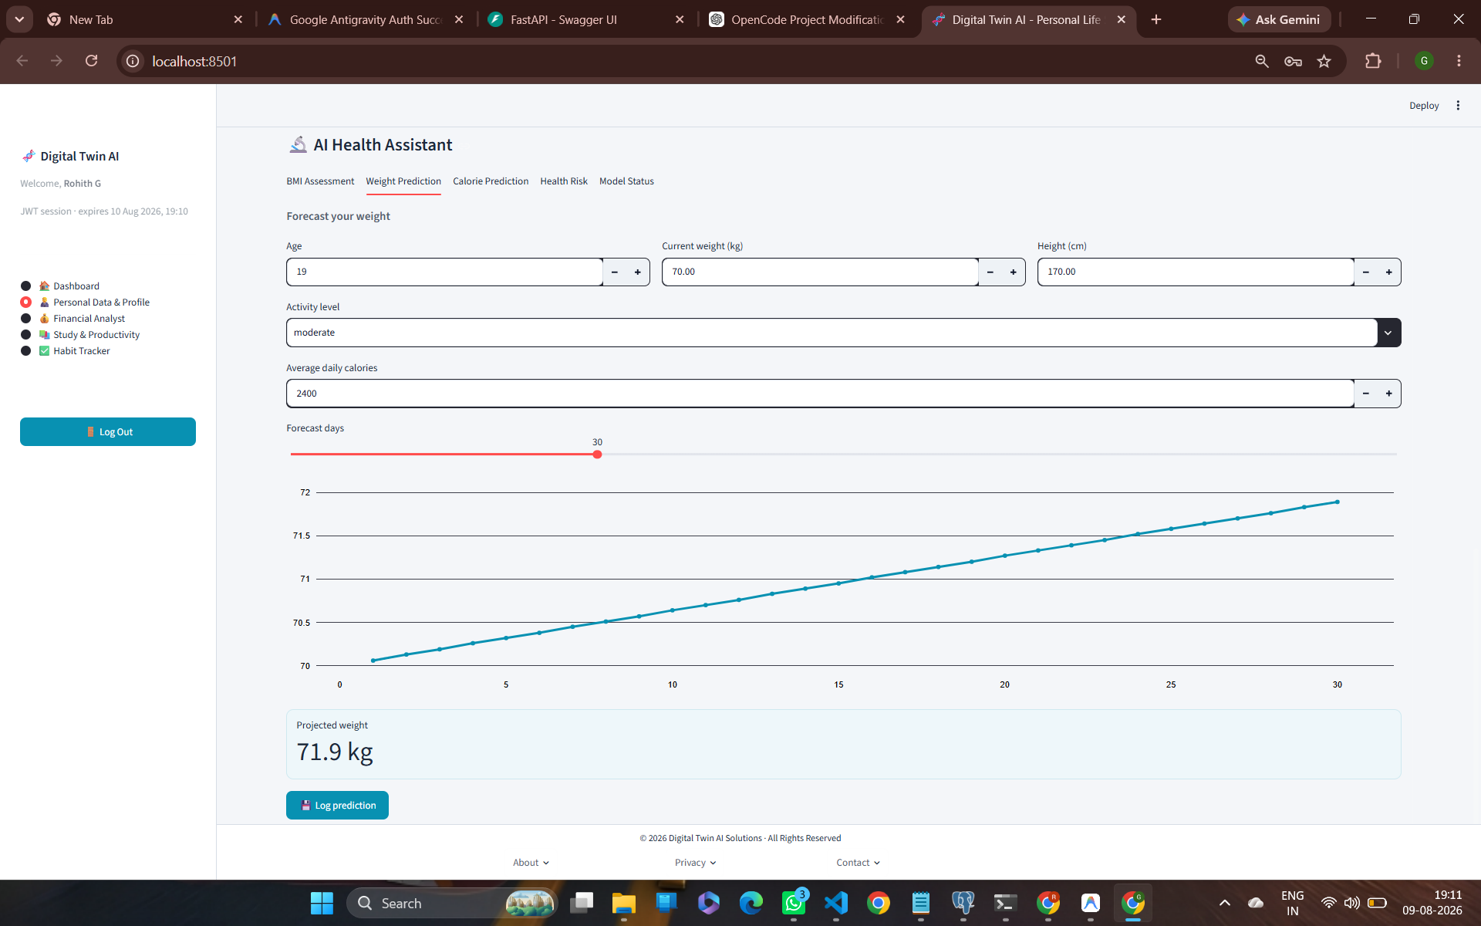
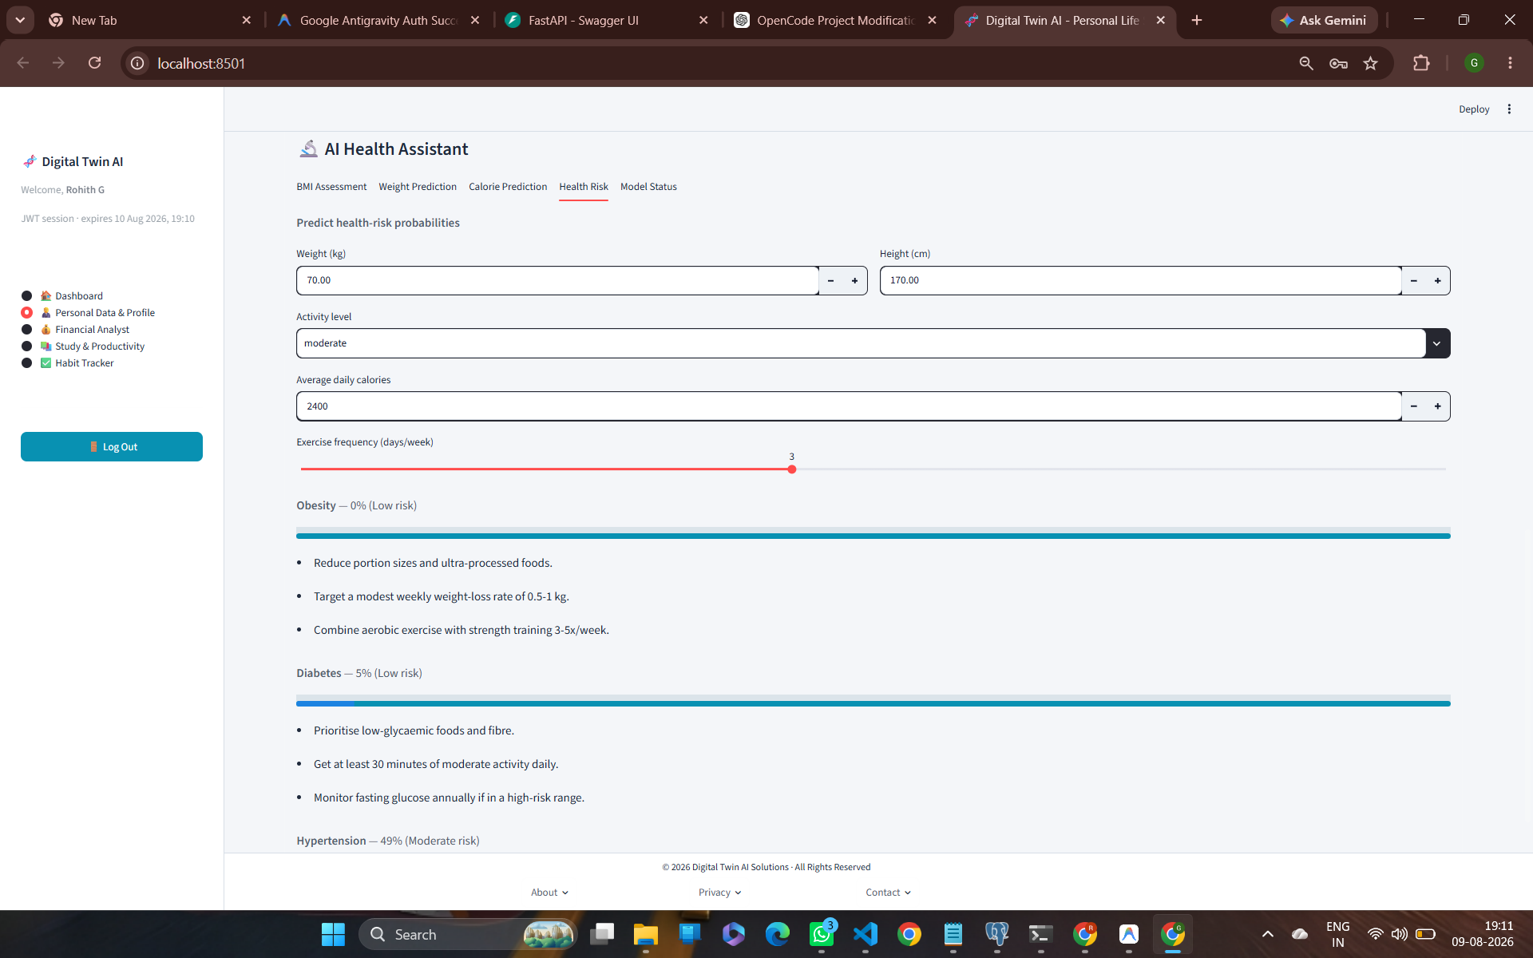
MILESTONE 2: AI DIGITAL TWIN
AI Health Assistant: Weight Trajectory & Health Risk
Predictive Weight & Disease Risk Models
• Weight Trajectory Forecasting: Scikit-Learn model projects 30-day weight trajectory (70.0 kg to 71.9 kg) based on caloric intake & activity.
• Obesity Risk Classifier: Trained on UCI Obesity dataset (2,110 rows, AUC 1.00, Acc 0.998) -> Evaluates user risk (0% Low Risk).
• Diabetes Risk Predictor: Trained on CDC BRFSS dataset (70,692 rows, AUC 0.760) -> Predicts diabetic risk (5% Low Risk).
• Hypertension Risk Classifier: Trained on ENSANUT dataset (3,352 rows, AUC 0.913, Acc 0.927) -> Identifies risk factors (49% Moderate Risk) with preventative tips.

Slide 7
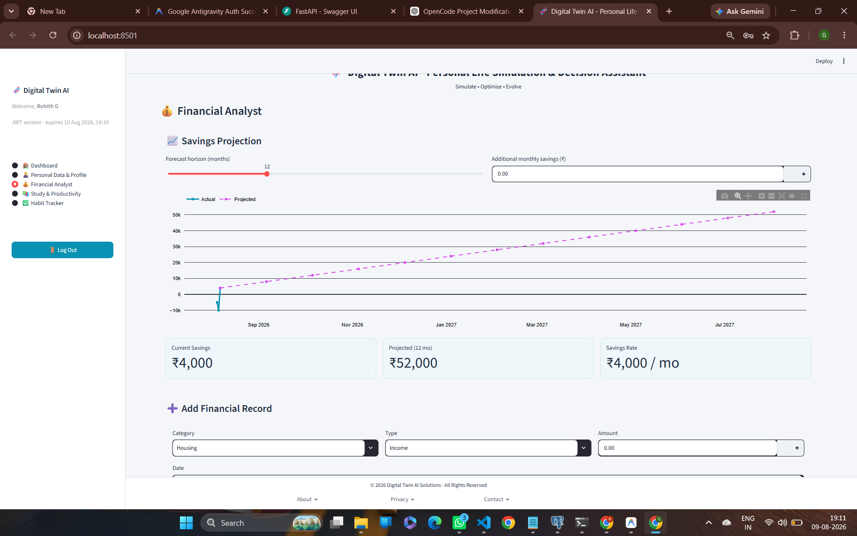
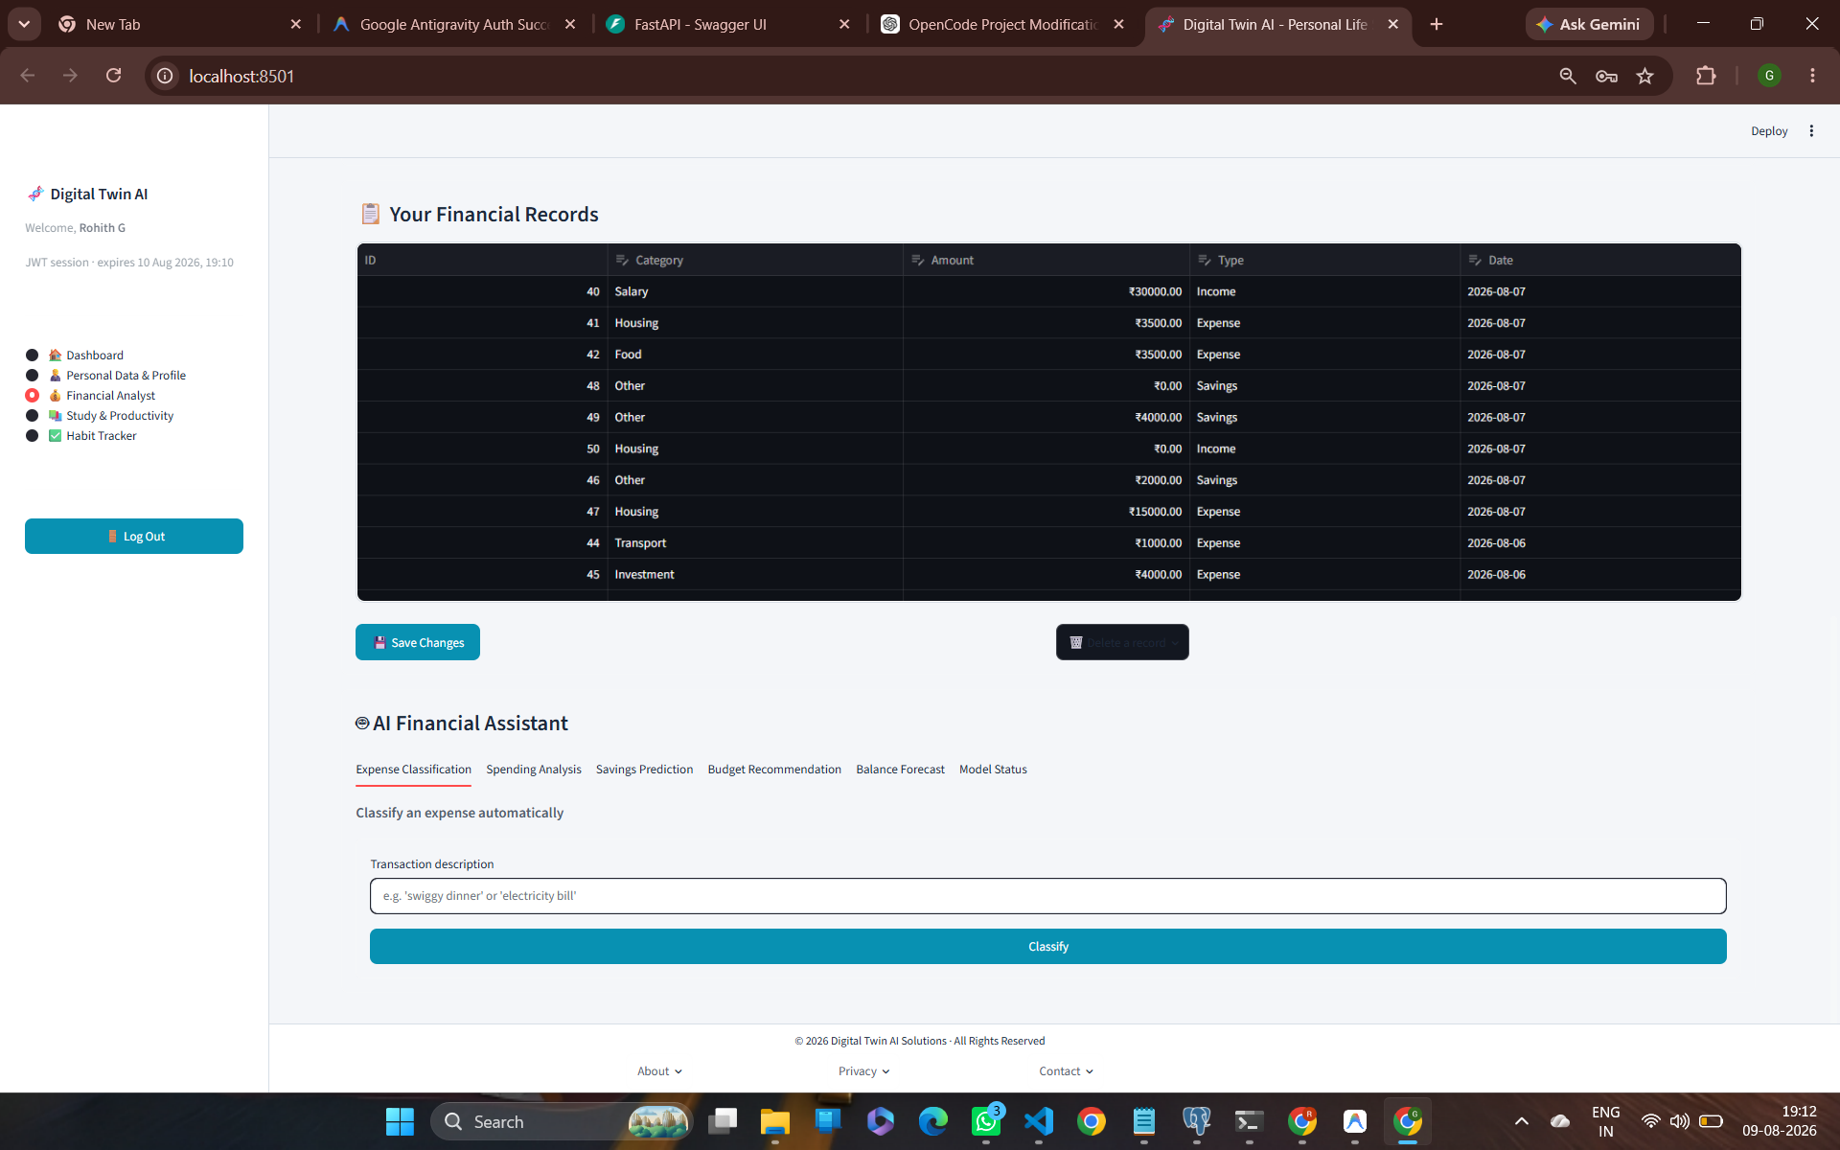
MILESTONE 2: AI DIGITAL TWIN
AI Financial Assistant: Savings & Expense Management
Financial Analytics & Savings Projections
• Financial Transaction Logging: Supports record creation across categories (Salary, Housing, Food, Transport, Investment, Savings).
• Automated Expense Classifier: ML model (`expense_classifier`) automatically categorizes plain-text descriptions into expense buckets.
• Savings Projection Engine: Forecasts cumulative savings growth over configurable horizons (12-month projection reaching ₹52,000 at ₹4,000/mo rate).
• Actual vs Projected Analytics: Compares logged actual savings against target trajectories for financial discipline.

Slide 8
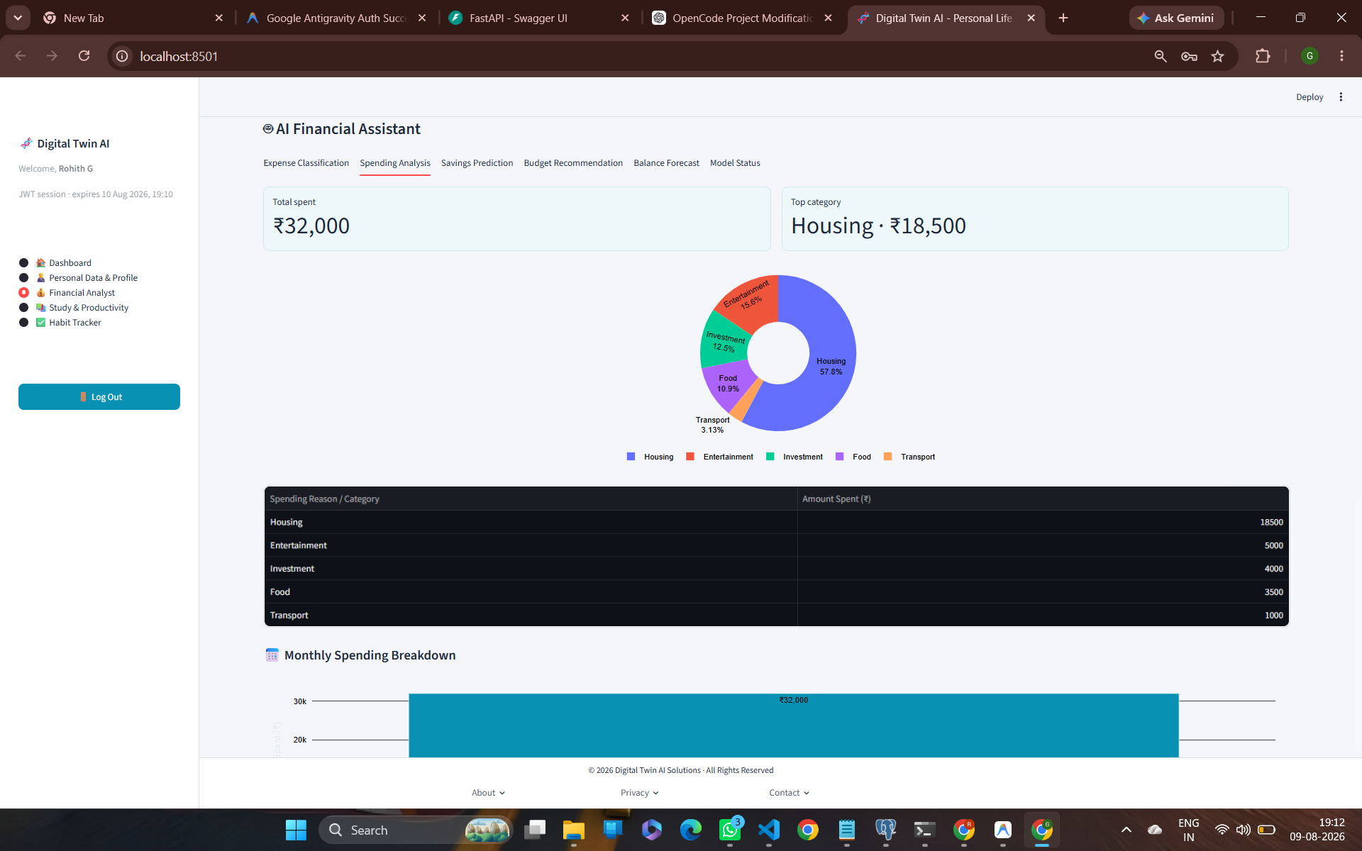
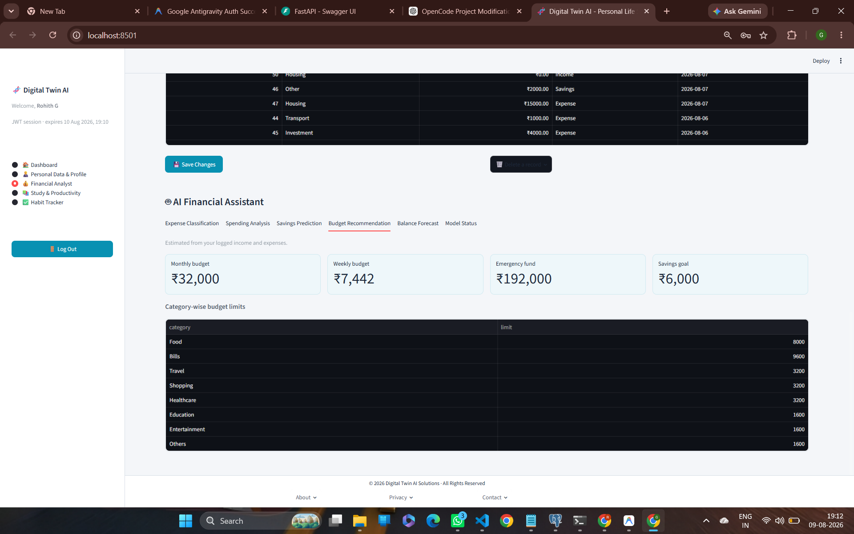
MILESTONE 2: AI DIGITAL TWIN
AI Financial Assistant: Spending Analysis & Budgeting
Spending Breakdown & Budget Allocation
• Categorical Spending Breakdown: Interactive pie chart visualizes expense shares (Total Spent ₹32,000; Top category Housing ₹18,500 / 57.8%).
• Algorithmic Budget Recommendations: Generates optimal budget limits: Monthly (₹32,000), Weekly (₹7,442), Emergency Fund Target (₹192,000), Savings Goal (₹6,000).
• Granular Limit Allocation: Establishes category-specific spending caps for Food (8k), Bills (9.6k), Shopping, and Healthcare.
• Balance Forecast Engine: Projects account balance trend over 90 days reaching ₹16,000.

Slide 9
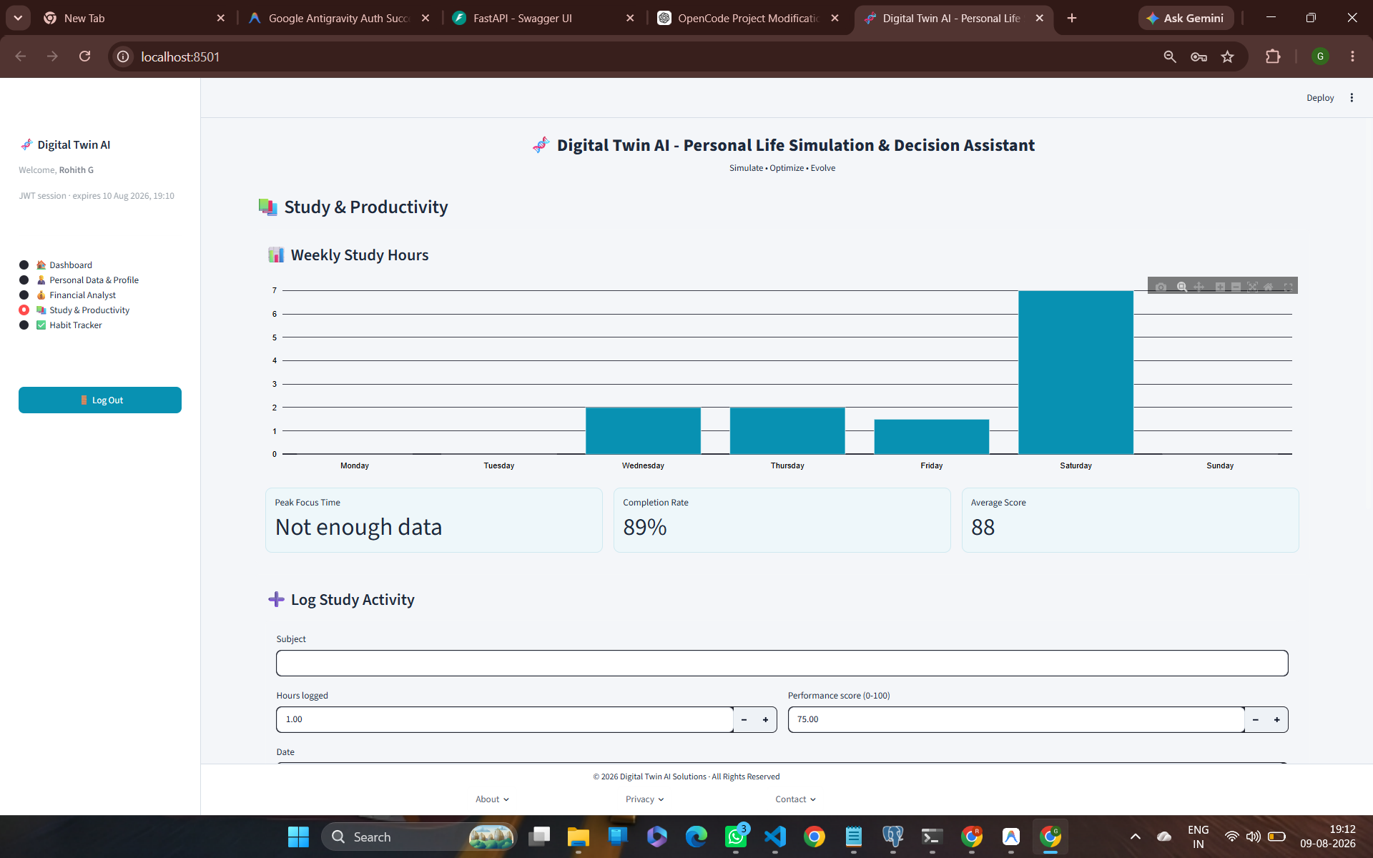
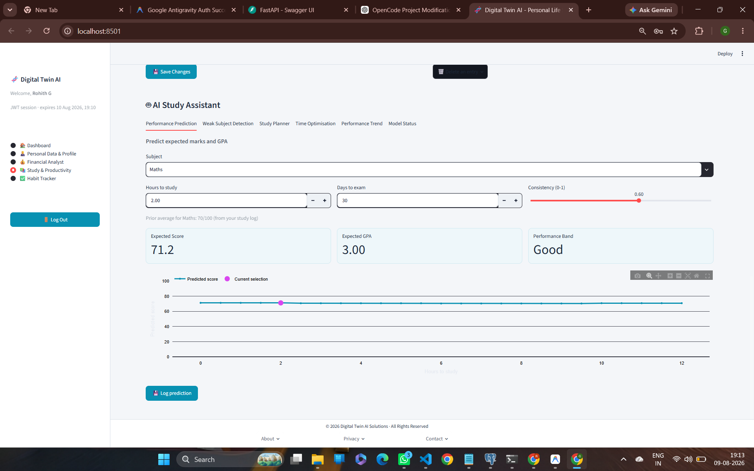
MILESTONE 2: AI DIGITAL TWIN
AI Study Assistant: Productivity & Marks Predictor
Productivity Tracking & Performance Model
• Weekly Study Logger: Tracks study hours per subject (Maths, C, English, Biology, CS) with completion rate (89%) and average score (88).
• Grade & GPA Prediction Model: Trained on UCI Student Performance dataset (1,044 records, R² 0.810, MAE 4.96).
• Predictive Inputs: Evaluates study hours, days remaining to exam, consistency score, and prior average score.
• Performance Band Output: Predicts expected marks (71.2/100), GPA (3.00), and performance tier ('Good') with curve visualization.

Slide 10
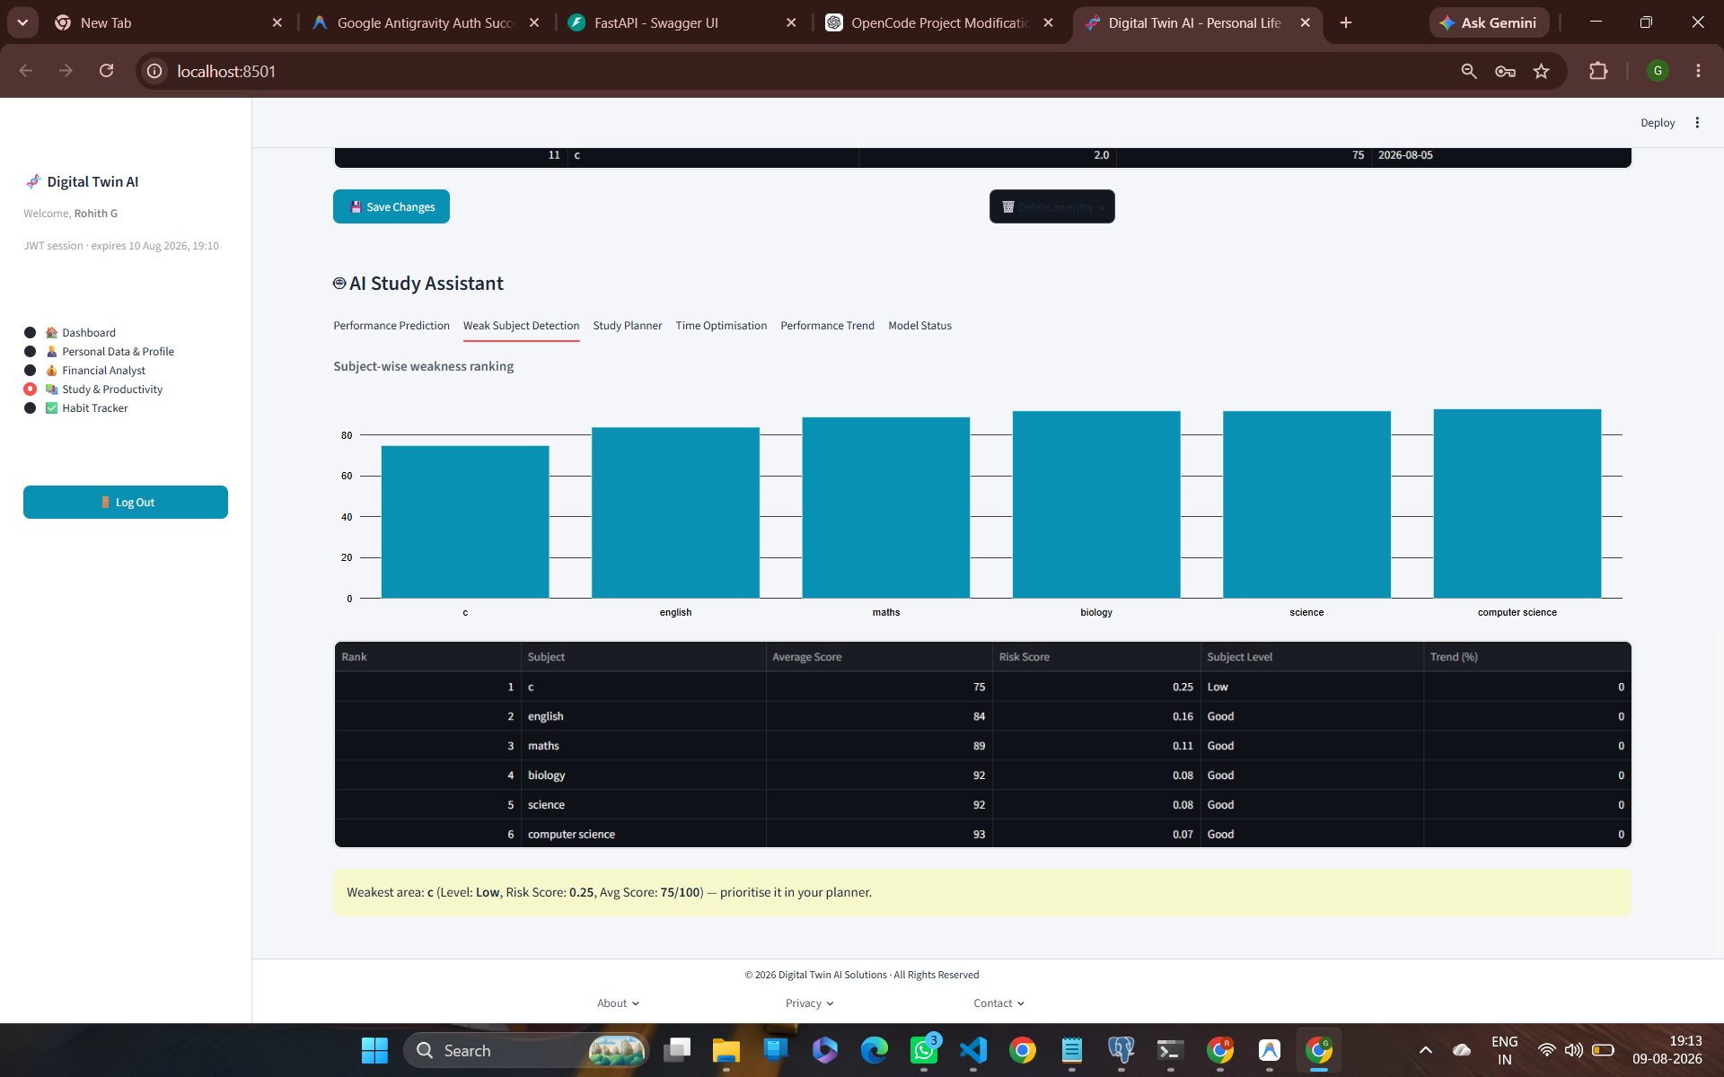
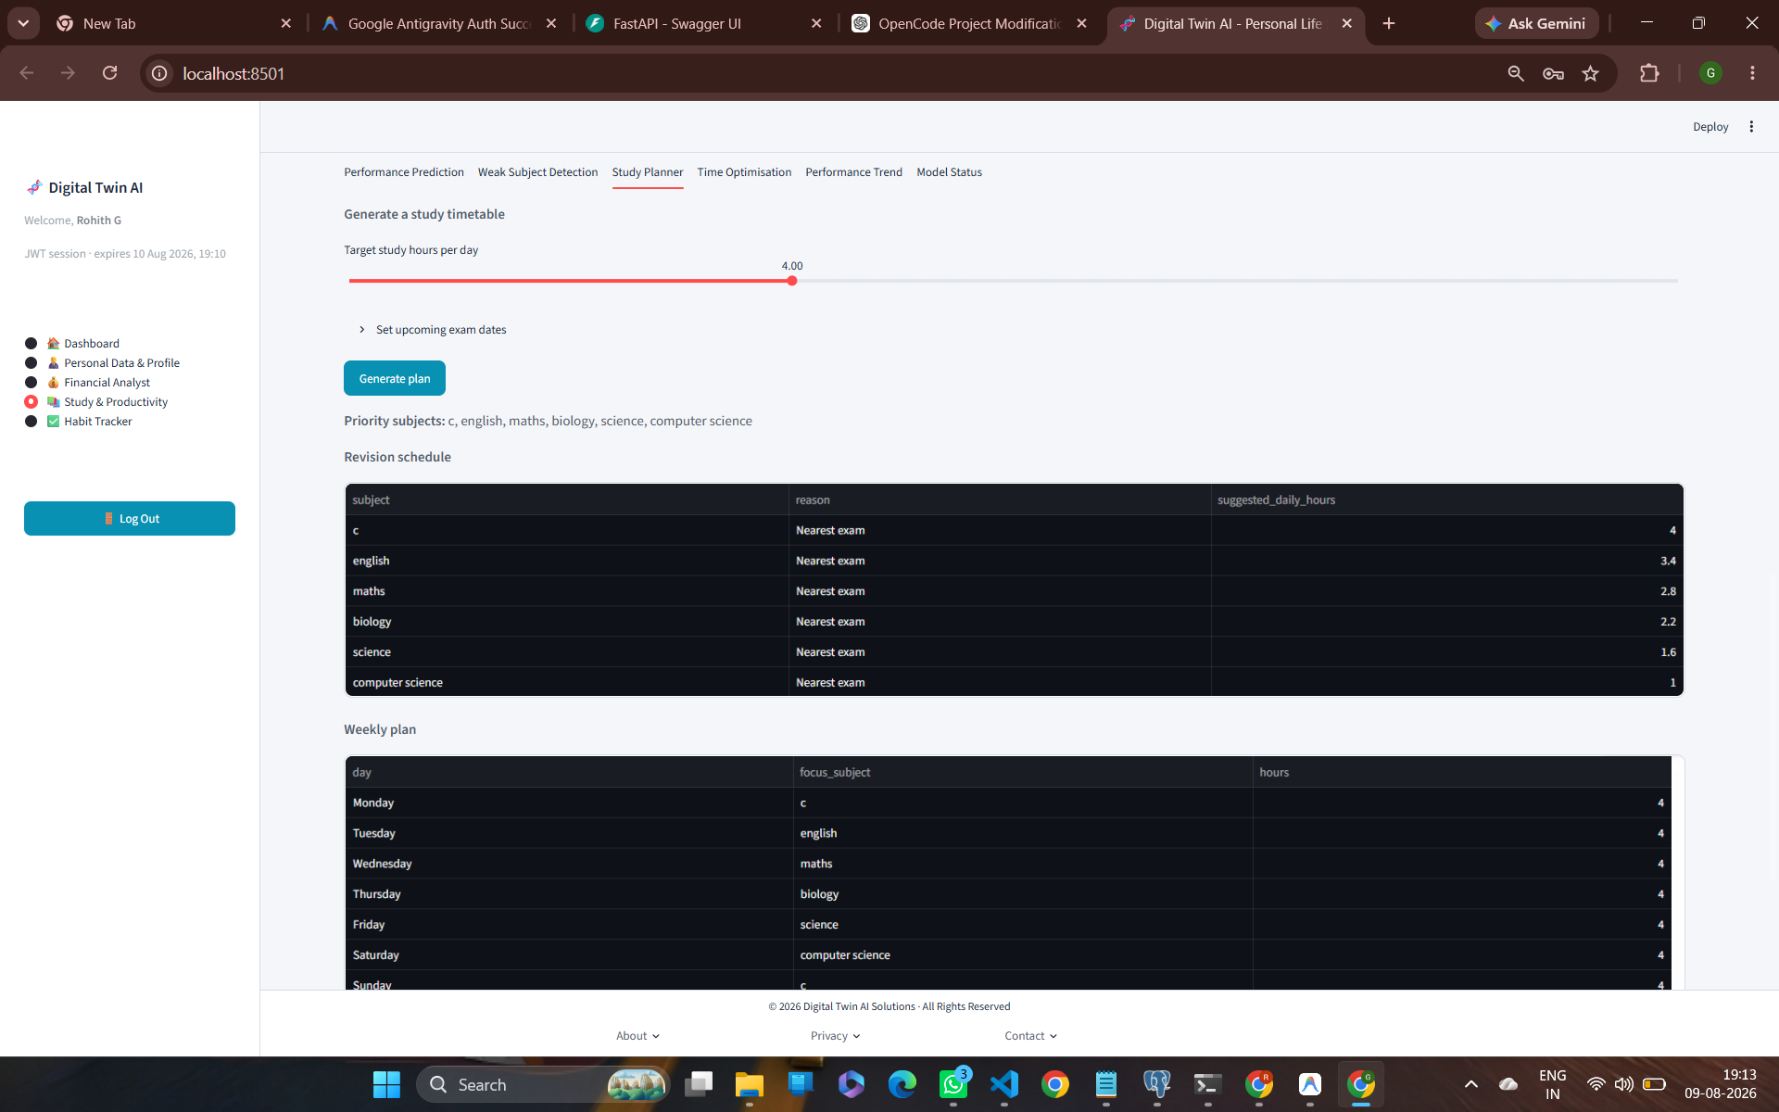
MILESTONE 2: AI DIGITAL TWIN
AI Study Assistant: Weak Subject Detection & Planner
Weakness Detection & Timetable Generator
• Weak Subject Risk Score Ranking: Ranks academic subjects by risk score (e.g. C Programming flagged as highest weakness with Risk Score 0.25, Avg 75/100).
• Automated Timetable Generator: Generates daily revision schedules balancing target hours (4.0 hrs/day) with upcoming exam dates.
• Time Optimisation Engine: Allocates weekly study hours proportionally to subject weakness rankings.
• Long-Term Performance Trend: Projects 180-day academic score (100) and GPA trajectory (4.0).

Slide 11
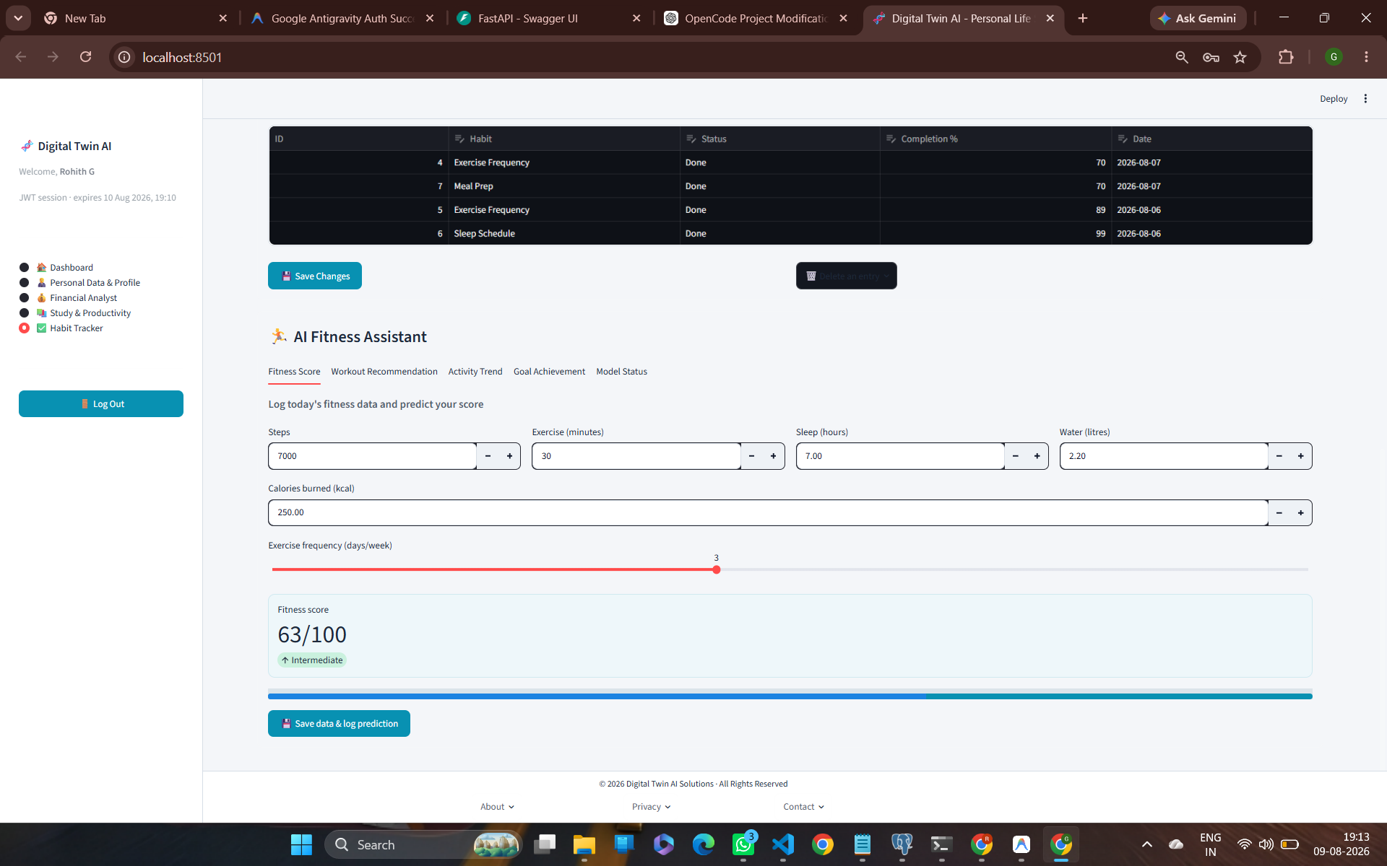
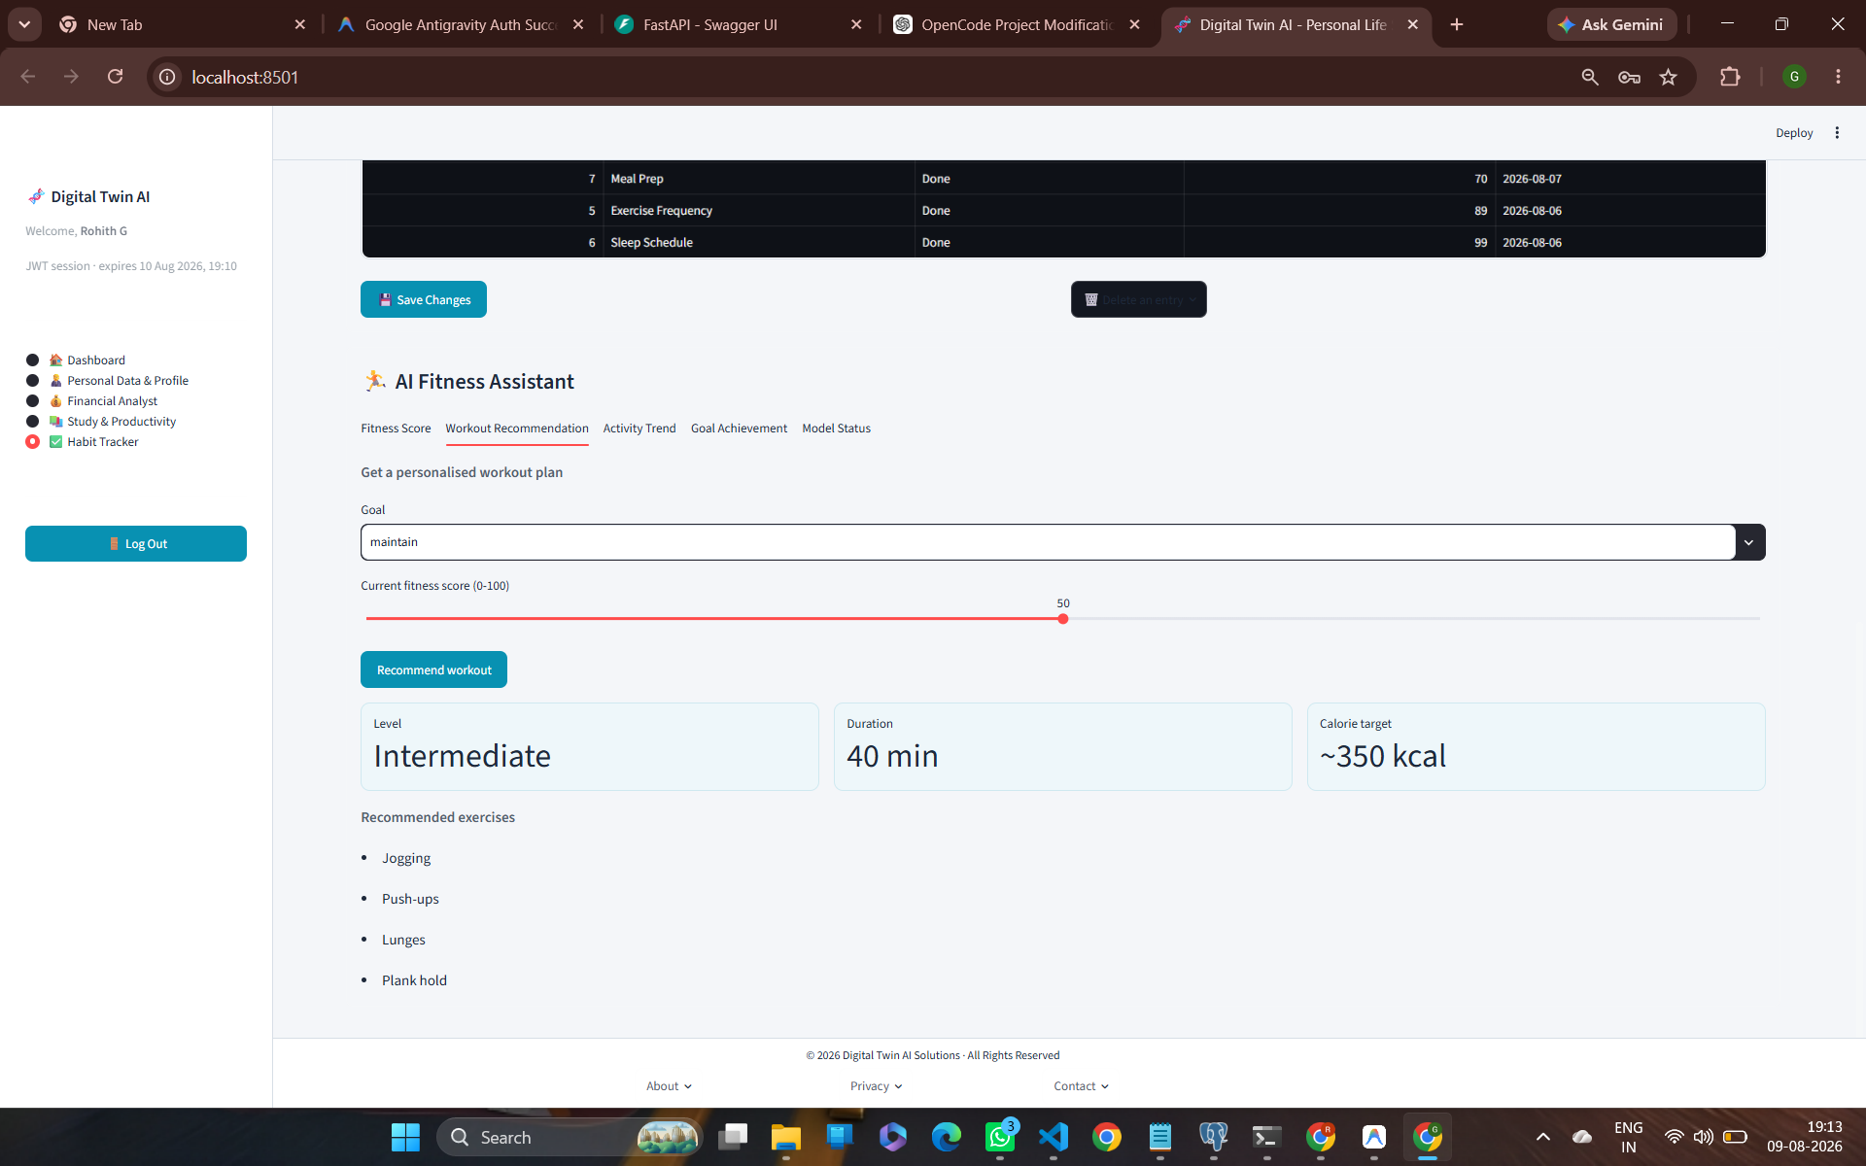
MILESTONE 2: AI DIGITAL TWIN
AI Fitness Assistant & Habit Tracker
Fitness Scoring & Goal Prediction
• Habit Consistency Tracking: Logs habit completion rates (Sleep Schedule 99%, Exercise Frequency 80%, Meal Prep 70%).
• Composite Fitness Score: Evaluates daily metrics (7,000 steps, 30m exercise, 7h sleep, 2.2L water) producing a composite score (63/100 Intermediate).
• Personalized Workout Generator: Recommends exercise plans tailored to goals (Intermediate level, 40 min duration, ~350 kcal target, exercises: Jogging, Push-ups, Lunges, Plank hold).
• Goal Achievement Classifier: Predicts probability of reaching long-term fitness goals (100% High probability to reach score 80 in 90 days).

Slide 12
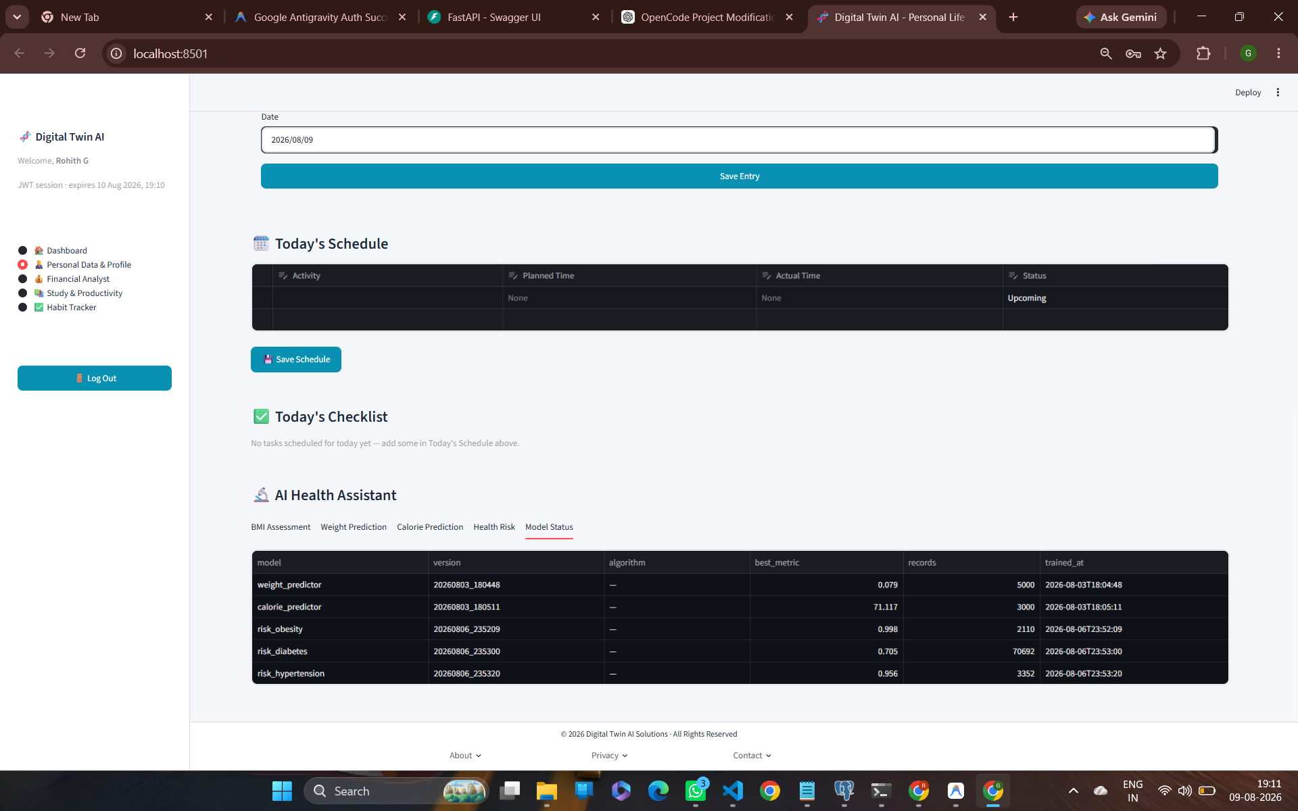
MILESTONE 2: AI DIGITAL TWIN
Machine Learning Models & Real-World Dataset Validation
Real Dataset Retraining & Hold-Out Validation
Model | Real Dataset Source | Sample Size | Hold-Out Metrics
risk_obesity | UCI Obesity (Palechor et al.) | 2,110 | AUC 1.00, Acc 0.998
risk_diabetes | CDC BRFSS 2015 Indicators | 70,692 | AUC 0.760, F1 0.705
risk_hypertension | ENSANUT 2021 Survey | 3,352 | AUC 0.913, Acc 0.927
performance_pred | UCI Student Performance | 1,044 | R² 0.810, MAE 4.96
workout_calorie | Hugging Face Calorie Dataset | 15,000 | R² 0.998, MAE 1.72 kcal

Slide 13
MILESTONE 2: AI DIGITAL TWIN
Technical Innovations & Engineering Highlights
Hybrid Training Architecture
Modular Domain Pipeline
• Retrained major models on downloaded public datasets (70k+ records).
• Maintains synthetic fallback generators (`ai_models/<domain>/synthetic.py`) for schema fields missing in public surveys.
• Ensures system reliability even when external datasets have missing features.
• Decoupled ML models into dedicated domains: health, fitness, finance, study.
• Joblib serialization for fast inference loading during web UI sessions.
• Independent evaluation scripts & automated pytest test suites.
Explainable AI & Recommendations
Interactive State & Session Management
• Converts raw probabilistic ML outputs into actionable clinical & financial tips.
• Integrates Mifflin-St Jeor biometric equations with ML calorie predictors.
• Provides clear disclaimer bounds (health estimates vs medical advice).
• Full JWT token validation ensuring secure multi-tenant data isolation.
• Reactive Streamlit state synchronization across forms, charts, and tables.
• Automated data caching under `data/real/` for fast retraining runs.

Slide 14
MILESTONE 2: AI DIGITAL TWIN
Conclusion & Milestone 3 Technical Roadmap
Milestone 2 Outcomes Delivered
Milestone 3 Planned Roadmap
✔ AI Core Fully Functioning: Successfully implemented and validated ML models for Health, Finance, Productivity, and Fitness.
✔ Real Data Integration: Trained models on real-world datasets achieving up to 1.00 AUC and 0.998 accuracy.
✔ Polished User Interface: Delivered an interactive web application with dashboards, forecasting charts, and log management.
✔ Reproducible Pipeline: Automated model retraining script (`ml/train_real.py`) and pytest suite.
➔ Real-World User Pilot: Collect consented real-user feedback to replace synthetic fallback models with empirical data.
➔ Advanced Deep Learning: Explore Neural Network architectures (PyTorch) for multi-variate time-series forecasting.
➔ Cloud Deployment: Deploy FastAPI backend & Streamlit web portal to cloud infrastructure (Hugging Face Spaces / AWS).
➔ Privacy & Security Audit: Enforce strict HIPAA-compliant data encryption and differential privacy mechanisms.

