Slide 1

INNOVATION AND DESIGN THINKING
AutoFace: A Modern Approach To Attendance
GUIDED BY :
PROJECT MEMBERS:
DR. SURESH KUMAR S
PRASANNA K 221801037
SANTHOSH V 221801047
NITHISH S 221801502

Slide 2

Problem Statement:
Manual attendance systems in educational institutions and workplaces are often time-consuming, prone to errors, and susceptible to proxy attendance. Traditional methods such as roll calls or ID card swiping are inefficient, especially in large classrooms or organizations. There is a growing need for an automated, secure, and reliable system that can streamline the attendance process. This project proposes an intelligent Attendance Management System using Face Recognition technology, which leverages computer vision and machine learning to accurately identify individuals and record their attendance in real time. The aim is to eliminate manual errors, prevent fraudulent attendance, and improve overall efficiency in attendance tracking.

Slide 3
Abstract:
The traditional methods of recording attendance in educational institutions and organizations are often inefficient, time-consuming, and vulnerable to manipulation such as proxy attendance. To address these limitations, this project presents an automated Attendance Management System using Face Recognition technology. The system captures real-time images of individuals through a camera, processes them using facial recognition algorithms, and automatically marks attendance by matching the detected face with the stored database. The project aims to enhance transparency, reduce human effort, and provide a seamless and reliable solution for attendance tracking in classrooms and corporate environments

Slide 4
Proposed System:
The proposed system is an automated Attendance Management System that uses Face Recognition technology to accurately record attendance. Instead of relying on manual roll calls or ID cards, this system captures facial images of students or employees through a camera. The system then processes these images using facial recognition algorithms to identify individuals and mark their attendance.
The system consists of three main components:
Face Detection – Captures and detects faces using OpenCV and a camera device.
Face Recognition – Matches the detected face with the trained database using machine learning models.
Attendance Marking – Updates the attendance record automatically in the backend (e.g., CSV or database) upon successful recognition.
This approach eliminates the chances of proxy attendance, reduces human errors, and saves time. It is user-friendly, secure, and scalable for both educational institutions and organizations.

Slide 5
Existng System:
In the current scenario, most educational institutions and organizations use manual or semi-automated methods for attendance management. These include:
Manual Roll Call – The teacher or supervisor calls out names, and students respond. This process is time-consuming and prone to human errors.
Paper-Based Registers – Attendance is marked on physical registers, which are hard to maintain and vulnerable to loss or damage.
ID Card Scanning / Biometric Devices – Some institutions use ID cards or fingerprint scanners. However, these methods require physical contact and can be misused or manipulated (e.g., buddy punching).
Excel Sheets / Google Forms – Teachers manually enter attendance data in spreadsheets or collect responses via forms, which still requires verification and post-processing.
These systems are inefficient, especially in large institutions, and cannot prevent proxy attendance or ensure real-time verification.

Slide 6
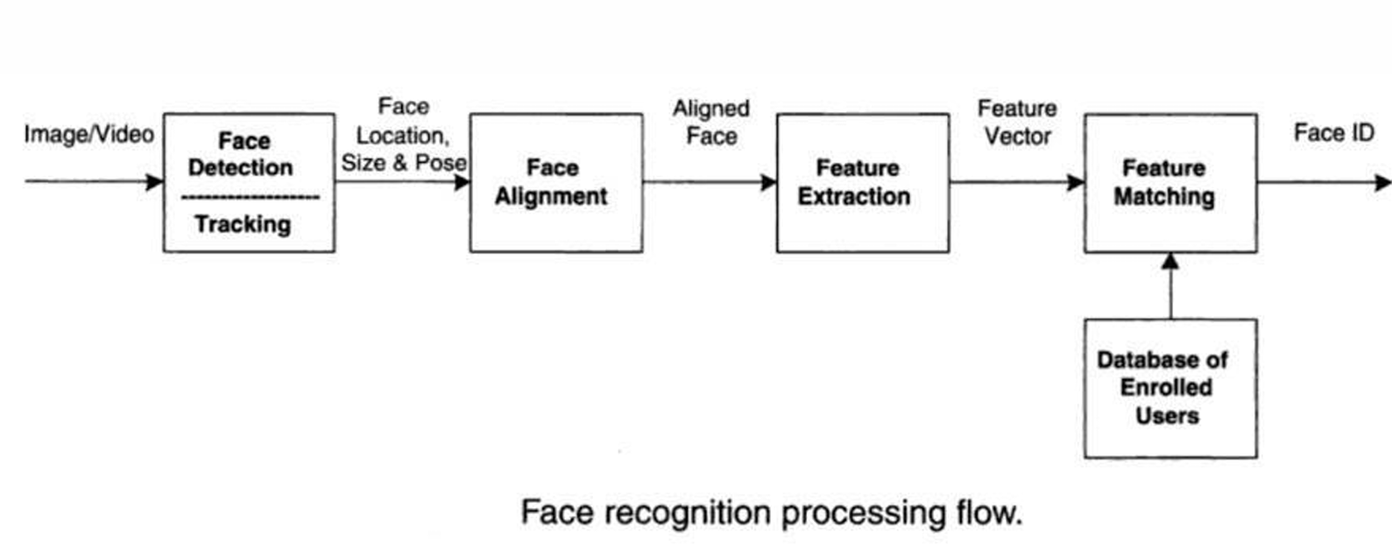
Flow Diagram:

Slide 7
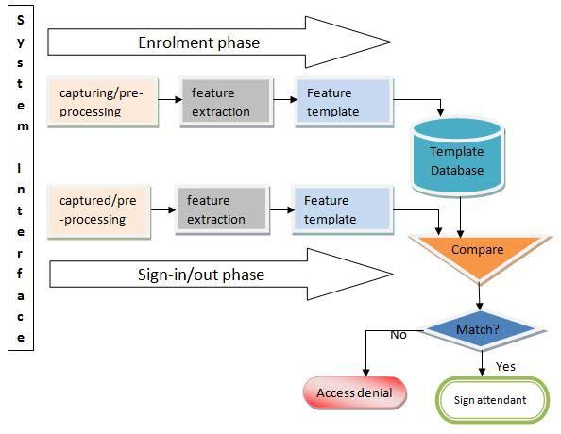
System Architecture:

Slide 8
Modules used:
User Registration Module
Allows admin to register new students/employees with their personal details and face data.
Captures and stores facial images for training the recognition model.
Face Detection Module
Detects faces in real-time using the webcam.
Uses OpenCV or similar libraries to locate and extract face features.
Face Recognition Module
Compares detected faces with the trained database.
Identifies individuals based on their facial features using ML algorithms.
Attendance Marking Module
Automatically marks attendance of recognized individuals.
Records date, time, and identity in a backend database or CSV file.
Admin Dashboard Module
Allows the admin to view, edit, or export attendance records.
Provides access to reports, statistics, and user management.

Slide 9
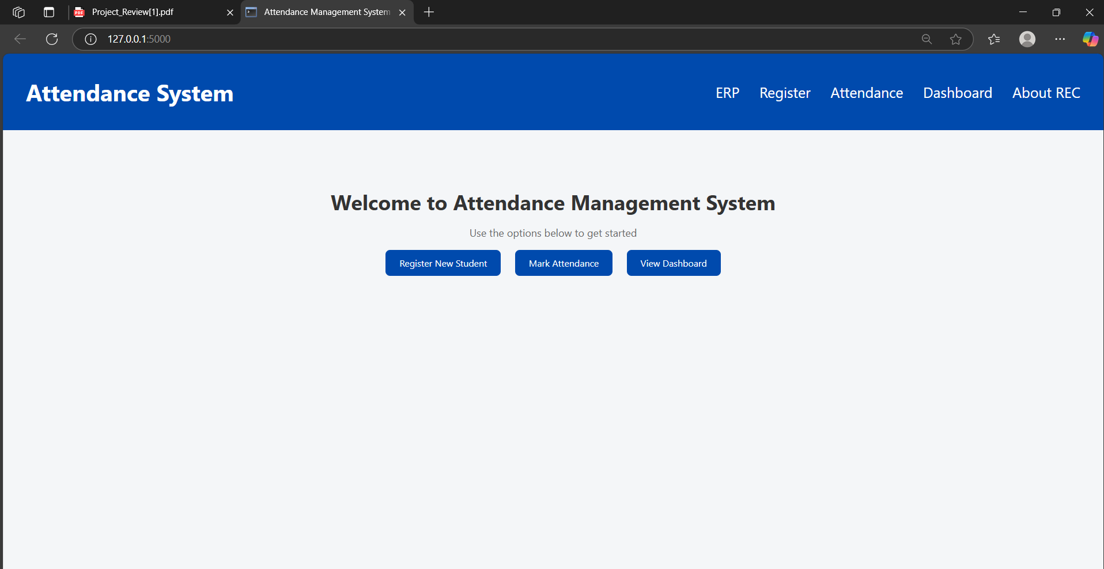
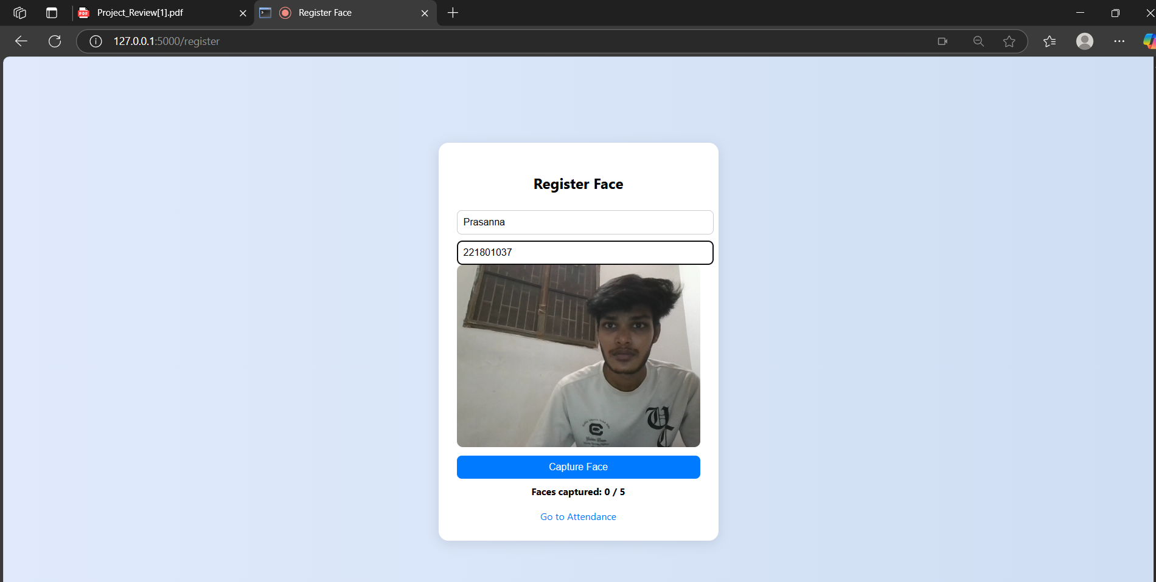
Output:

Slide 10
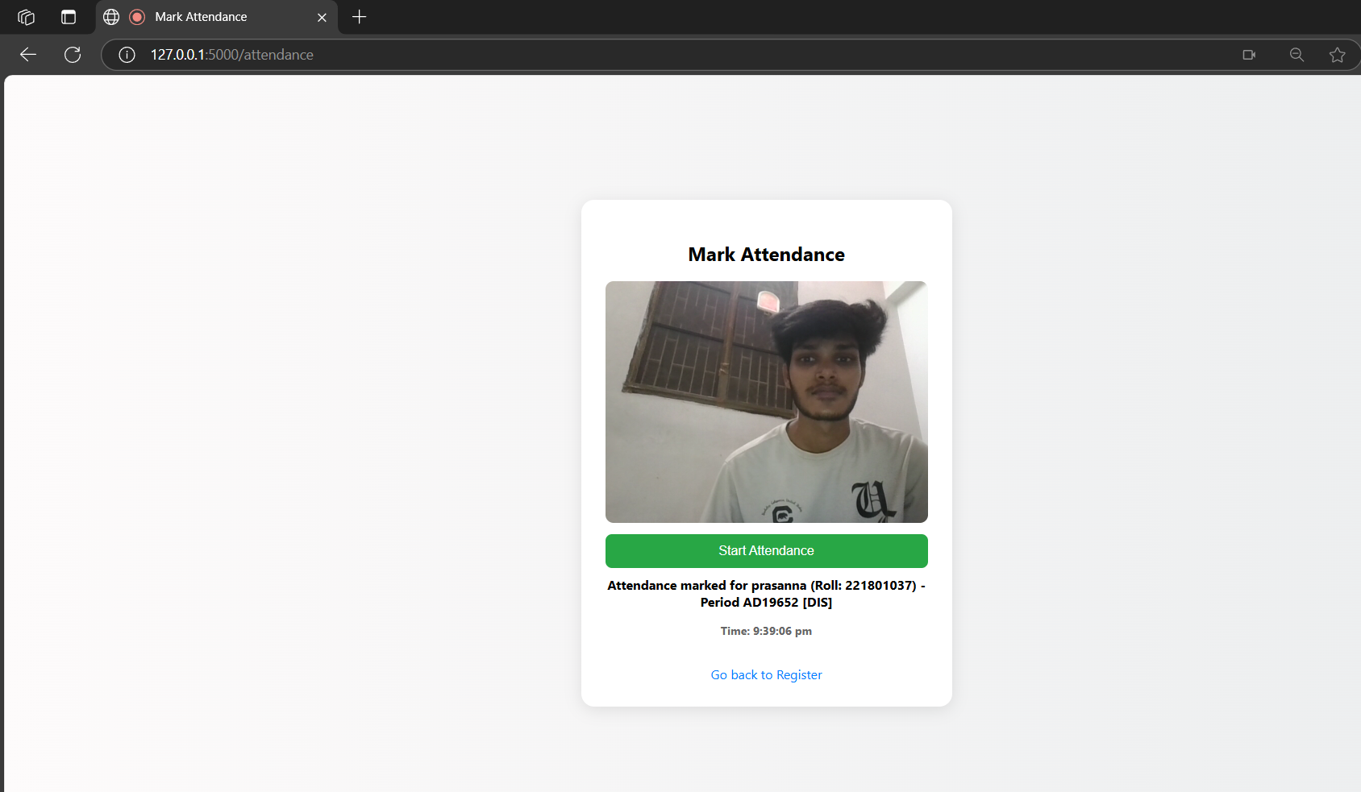
Output:

Slide 11
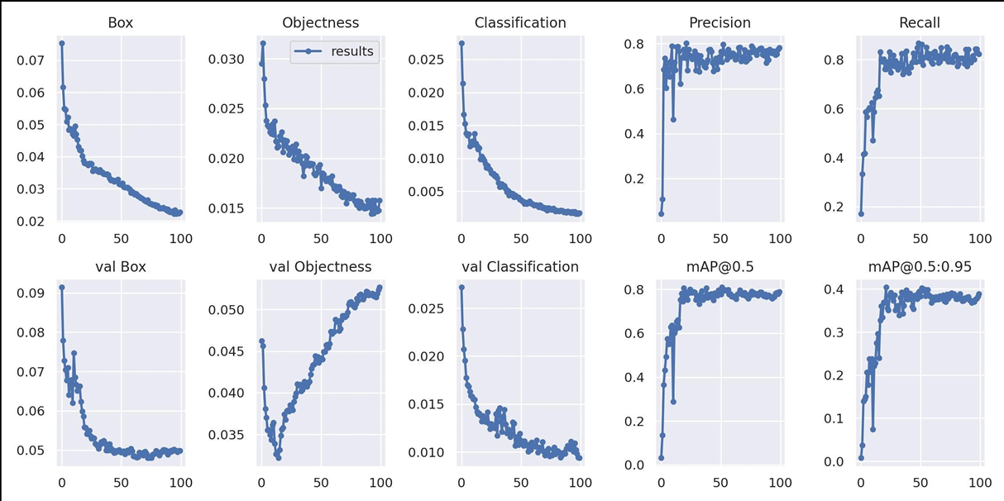
Output:

Slide 12
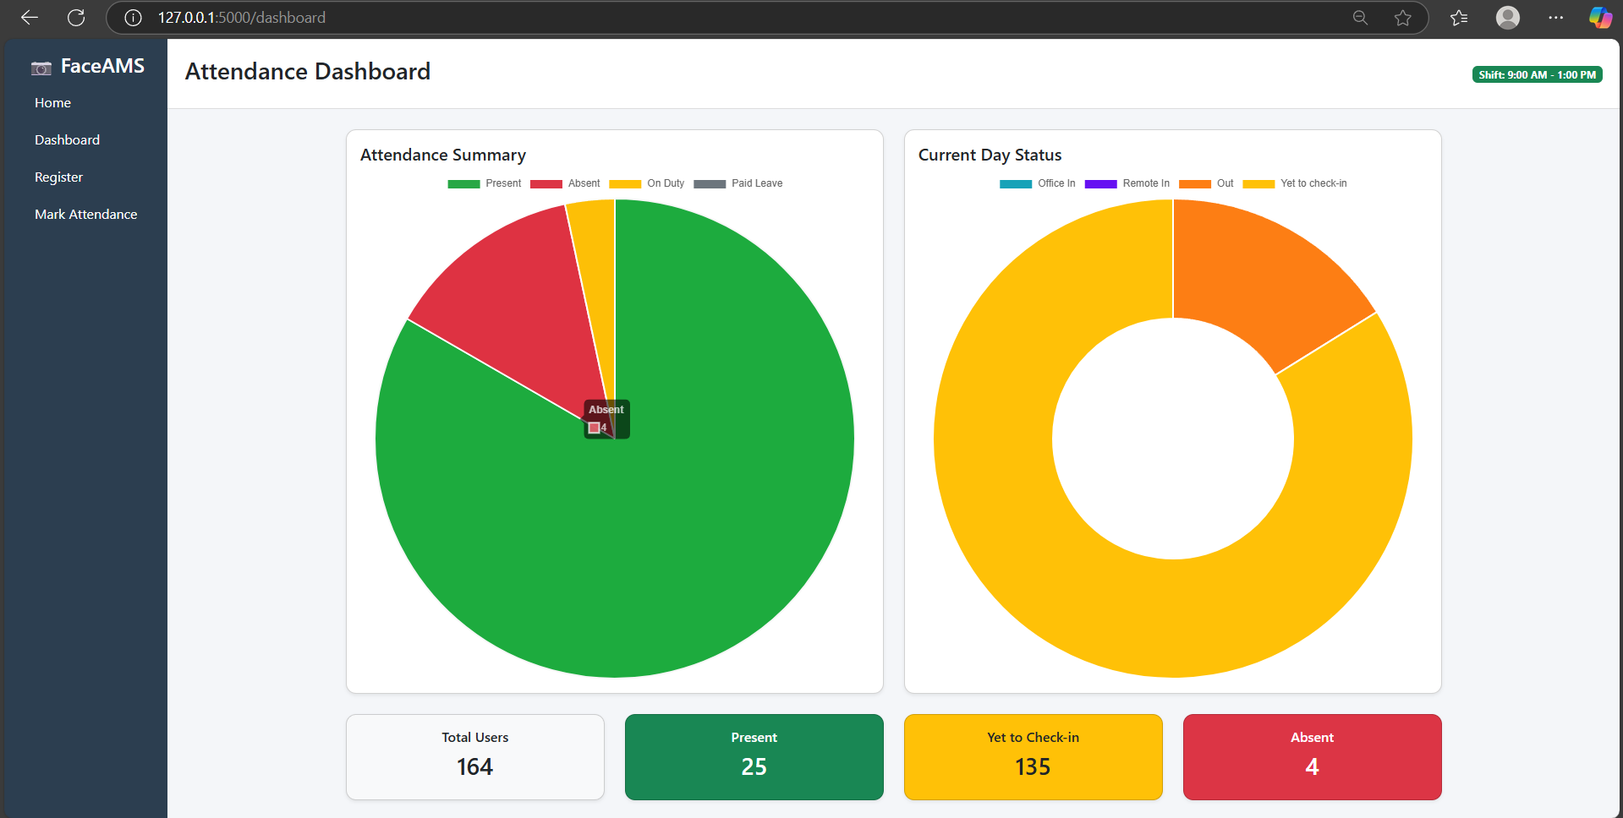
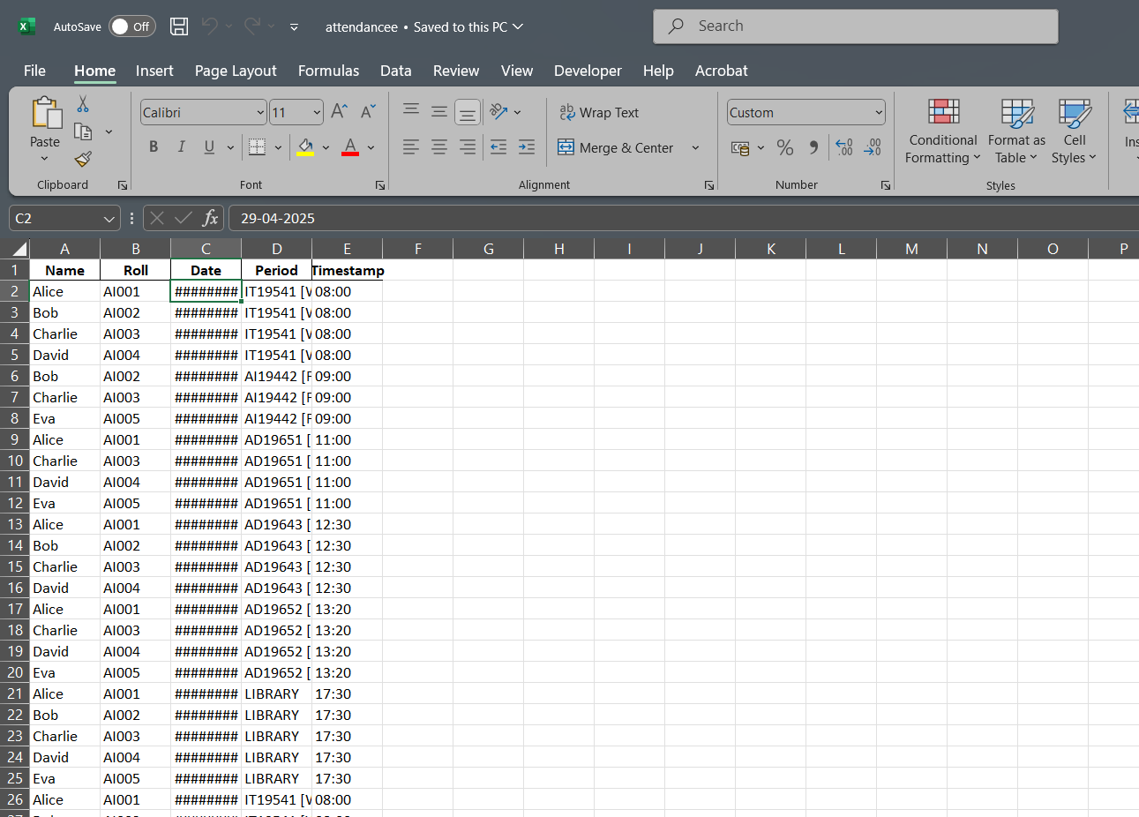
Output:

Slide 13
Future Enhancements:
Add support for recognizing faces with masks.
Detect and mark attendance for multiple faces at once.
Create a mobile app for easy access and attendance tracking.
Store attendance data in the cloud for better backup and access.
Show attendance reports and statistics in a simple dashboard.
Send SMS or email notifications for absentees.
Add login features for students, teachers, and admins.

Slide 14
Conclusion:
The Attendance Management System using Face Recognition offers a modern, efficient, and secure alternative to traditional attendance methods. By leveraging computer vision and machine learning, the system successfully automates the attendance process, reducing manual effort and minimizing errors such as proxy marking. The implementation demonstrates that facial recognition can be effectively used for identity verification and attendance tracking in real-time. This system not only enhances operational efficiency but also promotes transparency and accountability. In the future, the system can be improved with features like mask detection, multi-face recognition, and integration with cloud storage or mobile applications for broader accessibility.

Slide 15
Thank You

