Slide 1


Department of Artificial Intelligence and Machine Learning
Loyalty Launchpad: Transforming Customer Satisfaction into Retention
Mr.Suresh Kumar S M.E.,(Ph.D)
Professor
Prasanna K
221801037
Rohith RA
221801041

Slide 2
Problem Statement and Motivation
A bank wants to improve customer satisfaction and retention by analyzing customer feedback data. They aim to identify key factors influencing customer experience and prioritize service improvements.
The bank aims to use customer feedback to improve service quality. Understanding customer sentiments is key to enhancing satisfaction and retention. Thus drive customer loyalty and business growth.

Slide 3
Objectives
Identify key factors influencing customer satisfaction through feedback analysis.
Develop actionable insights to prioritize and implement service improvements for enhanced customer retention.
Continuously monitor the impact of implemented improvements on customer satisfaction and retention, adjusting strategies as needed.

Slide 4
Abstract
In a competitive financial landscape, customer satisfaction and retention are critical for a bank's success. This study aims to enhance these metrics by analyzing customer feedback data. By leveraging qualitative and quantitative data analysis techniques, the research seeks to identify the key factors influencing customer experience. The findings will enable the bank to prioritize service improvements strategically. Through this approach, the bank intends to foster stronger customer relationships, enhance service quality, and ultimately achieve higher customer satisfaction and retention rates.

Slide 5
Introduction and Overview of the Project.
The analysis concentrates more on the technical path which allows all users to contribute in customer feedback.
Using LDA and Other support Algorithms to identify the key components.
This project aims to improve customer satisfaction and retention by analyzing feedback data from surveys, reviews, social media, and interactions. By identifying key factors influencing customer experience and prioritizing service improvements, the bank seeks to enhance service quality, foster stronger customer relationships, and achieve higher satisfaction and retention rates.

Slide 6
Literature Survey
S.No | Author Name | Paper Title | Description | Journal | Volume/ Year
1 | Khan, M.A., and Adil, M. | Impact of Customer Feedback on Service Quality and Customer Satisfaction: A Case of Digital Banking. | It discusses how analyzing feedback from multiple channels, including surveys and social media, can provide actionable insights for banks to improve their digital services. | Journal of Financial Services Marketing | Vol. 27, 2022
2 | Gupta, A., and Mukherjee, S. | Sentiment Analysis of Social Media Feedback in Banking Sector: A Machine Learning Approach | The study uses machine learning to analyze customer feedback from social media and suggests improvements for banking services. | Journal of Business Research | Vol. 136, 2021

Slide 7
Literature Survey
S.No | Author Name | Paper Title | Description | Journal | Volume/ Year
3 | Zhang, Y., and Liu, H. | Customer Experience in Mobile Banking: The Role of Trust and Service Quality | This paper examines how trust and service quality affect customer experience in mobile banking. | International Journal of Bank Marketing | Vol. 40, No. 1, 2022
4 | Brown, C., and Parker, J.. | Using Big Data Analytics to Improve Customer Retention in Retail Banking | This paper discusses how big data analytics can help banks retain customers by understanding their behavior and preferences. | Journal of Retailing and Consumer Services | Vol. 61, 2021

Slide 8
Methodology
Data Collection: We collect customer feedback from various sources like surveys, reviews, social media, and direct interactions with customer service.
Data Preprocessing: We preprocess the data to remove any noise or irrelevant information.
Dimensionality Reduction: We apply techniques like NMF (Non-Negative Matrix Factorization) and LDA (Latent Dirichlet Allocation) to reduce the dimensionality of the data and identify key components that affect customer experience.
Analysis: By using LDA, we are able to identify latent topics from the feedback data, which represent the main areas of concern or satisfaction for the customers."

Slide 9
Existing System
Feedback Channels: Customers can provide feedback through multiple channels, including online surveys, in-branch comment cards, and customer service interactions. However, the feedback collected is often fragmented and not centrally integrated.
Data Management: Feedback data is stored in disparate systems, making it challenging to consolidate and analyze. Each department may have its own method of recording and managing feedback, leading to inconsistent data quality.
Analysis Tools: The bank currently uses basic analytical tools to review feedback. These tools offer limited capabilities for deep analysis and trend identification, resulting in a reactive rather than proactive approach to addressing customer issues.

Slide 10
Reporting Mechanisms: Reporting on customer feedback is typically done on an ad-hoc basis, with reports generated periodically rather than in real-time. This can delay the identification of emerging issues and the implementation of improvements.
Feedback Loop: The system lacks an integrated feedback loop to monitor the impact of changes made based on customer input. As a result, there is limited ability to gauge the effectiveness of implemented improvements or make adjustments based on ongoing feedback.

Slide 11
Drawback of Existing System
The Existing system follows a traditional path,which greatly lacks in interaction level
Lack of integration leads to incomplete and fragmented data.
Different feedback sources use varied formats and structures, complicating data consolidation and analysis.

Slide 12
Proposed System
Improved Customer Satisfaction: The system helps banks understand and meet customer needs better, leading to happier and more satisfied customers.
Enhanced Service Quality: Continuous feedback analysis allows banks to quickly improve and maintain high service standards.
Increased Customer Retention: By using data to offer personalized services, the system helps keep customers loyal and reduces churn.
Efficient and Scalable Operations: Automating processes and analyzing data efficiently saves time, reduces costs, and allows the system to grow with the bank's needs.

Slide 13
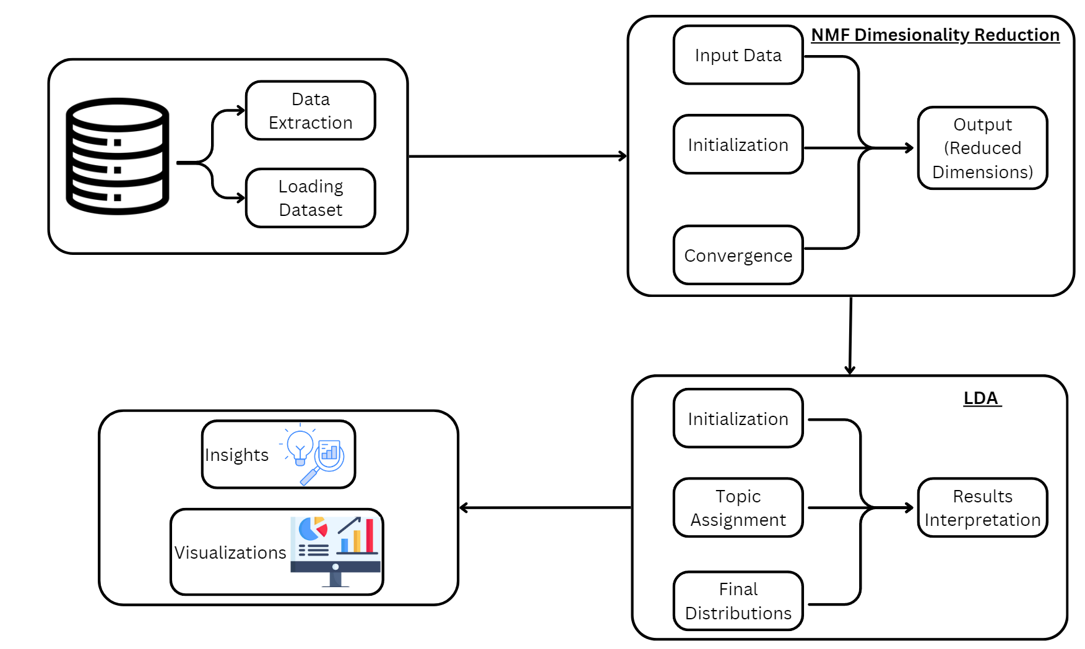
System Architecture

Slide 14
List of modules
Data Preprocessing Module
Dimensionality Reduction Module
LDA (Latent Dirichlet Allocation) Module

Slide 15
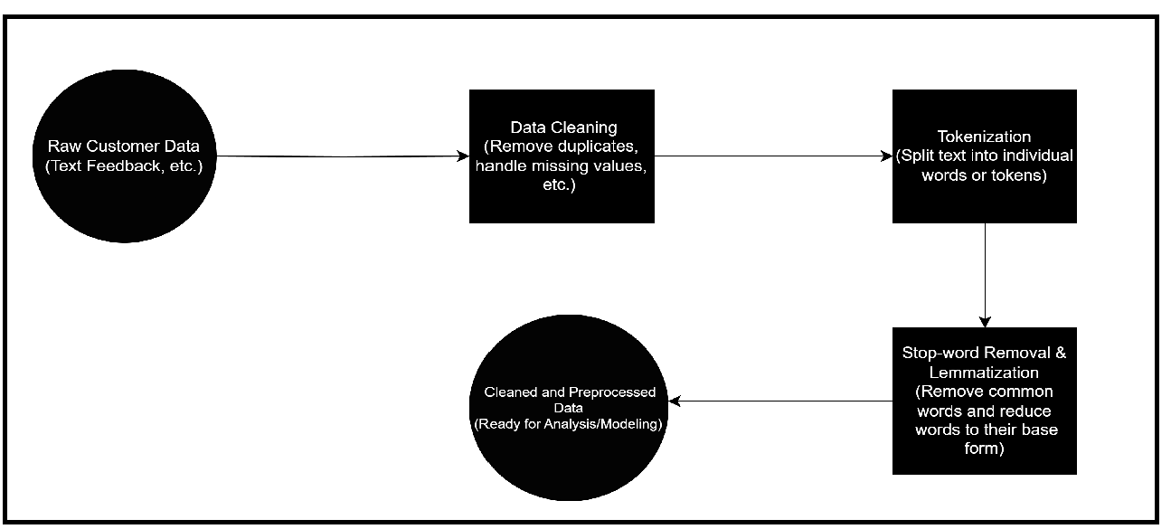
DFD for Preprocessing module

Slide 16
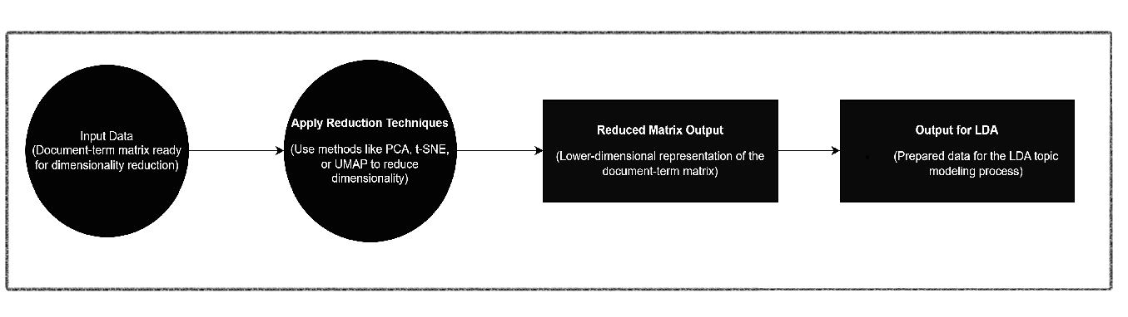
DFD for NMF Module

Slide 17

Algorithm for NMF
Step 1:Receive Text Data as Input
Step 2:Preprocess Text Data from the preprocessing module
Step 3:Convert Text to Document-Term Matrix using in-built Function
Step 4:Initialize NMF Model ,to start the Model
Step 5:Fit the NMF Model ,execute the model
Step 6:Extract Features
Step 7:Generate Reduced Matrix

Slide 18
Output for NMF

Slide 19
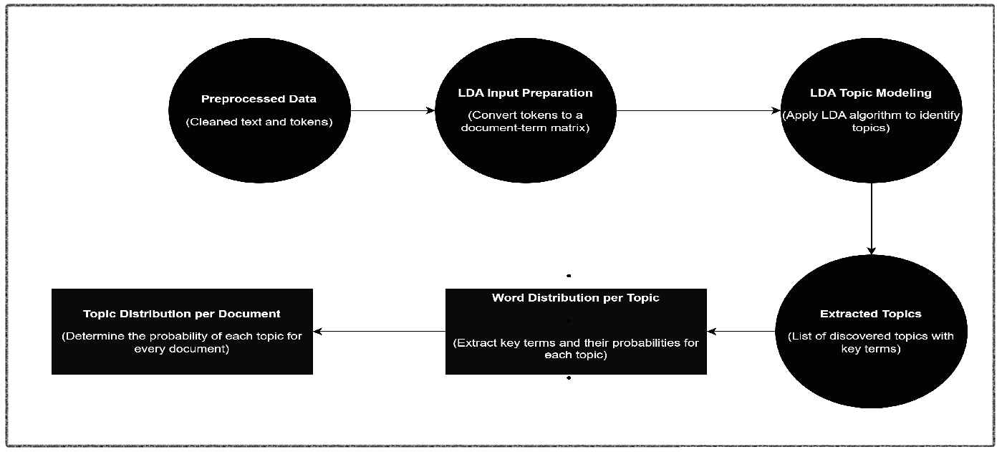
DFD for LDA module

Slide 20

Algorithm of Latent Dirichlet Allocation Module
Step-1:Preprocessed Data(Cleaned text and tokens ready for analysis)
Step-2:LDA Input Preparation(Convert tokens to a document-term matrix)
Step-3:LDA Topic Modeling(Apply LDA algorithm to identify latent topics)
Step-4:Topic Distribution per Document(Calculate topic probabilities for each document)

Slide 21
Contd.
Step-5:Word Distribution per Topic(Extract key terms and their associated probabilities for each topic)
Step-6:Extracted Topics(Output the discovered topics and the corresponding key terms)

Slide 22
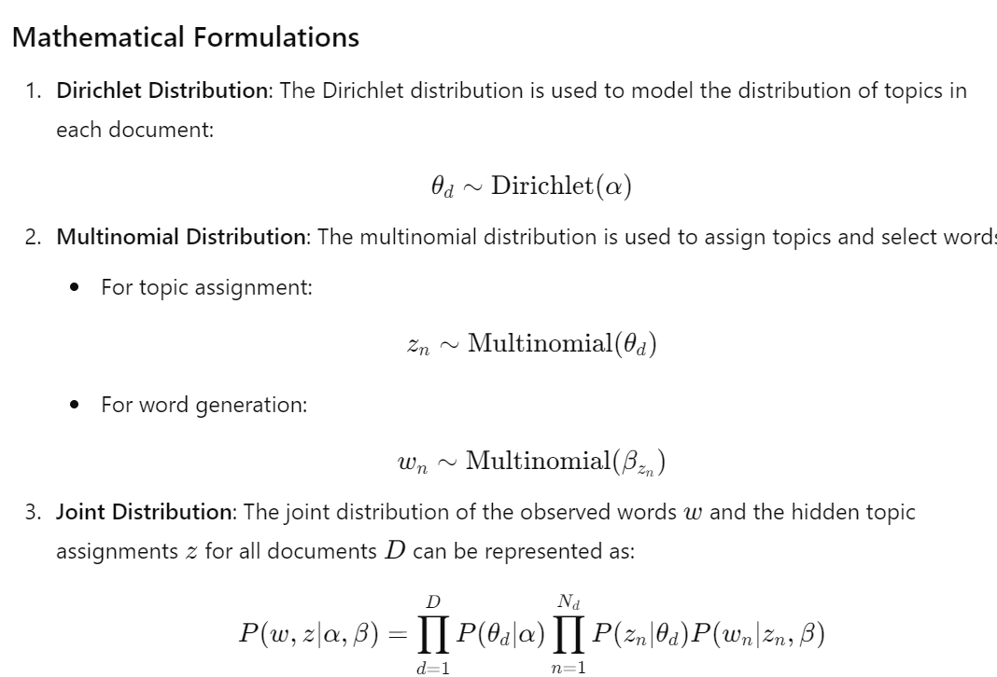
Formulations

Slide 23
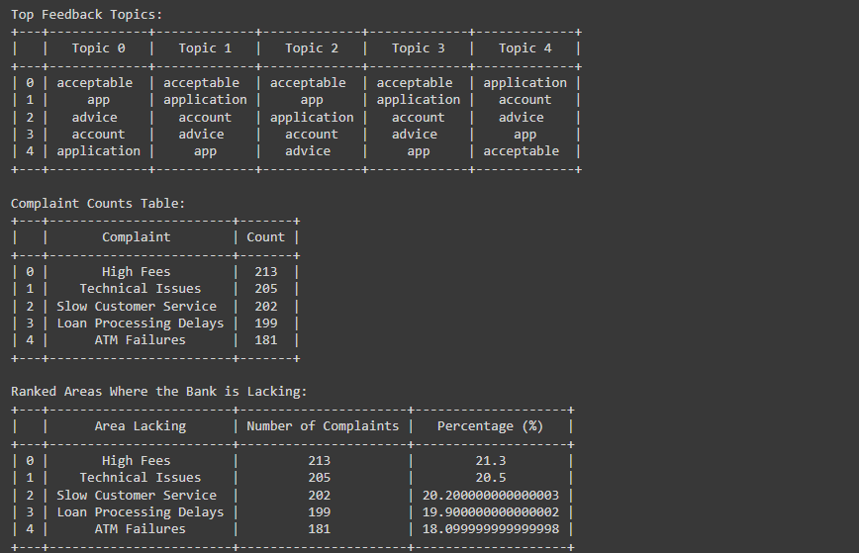
Output for LDA

Slide 24
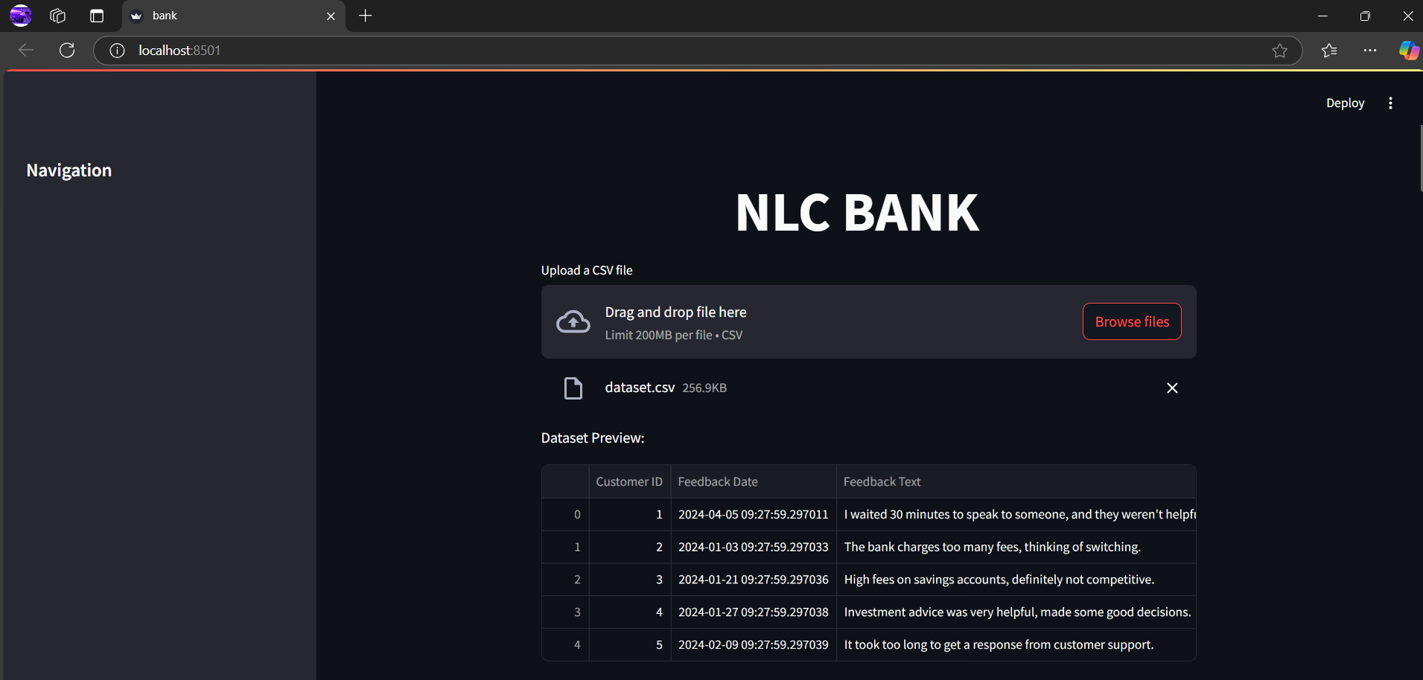
Output

Slide 25
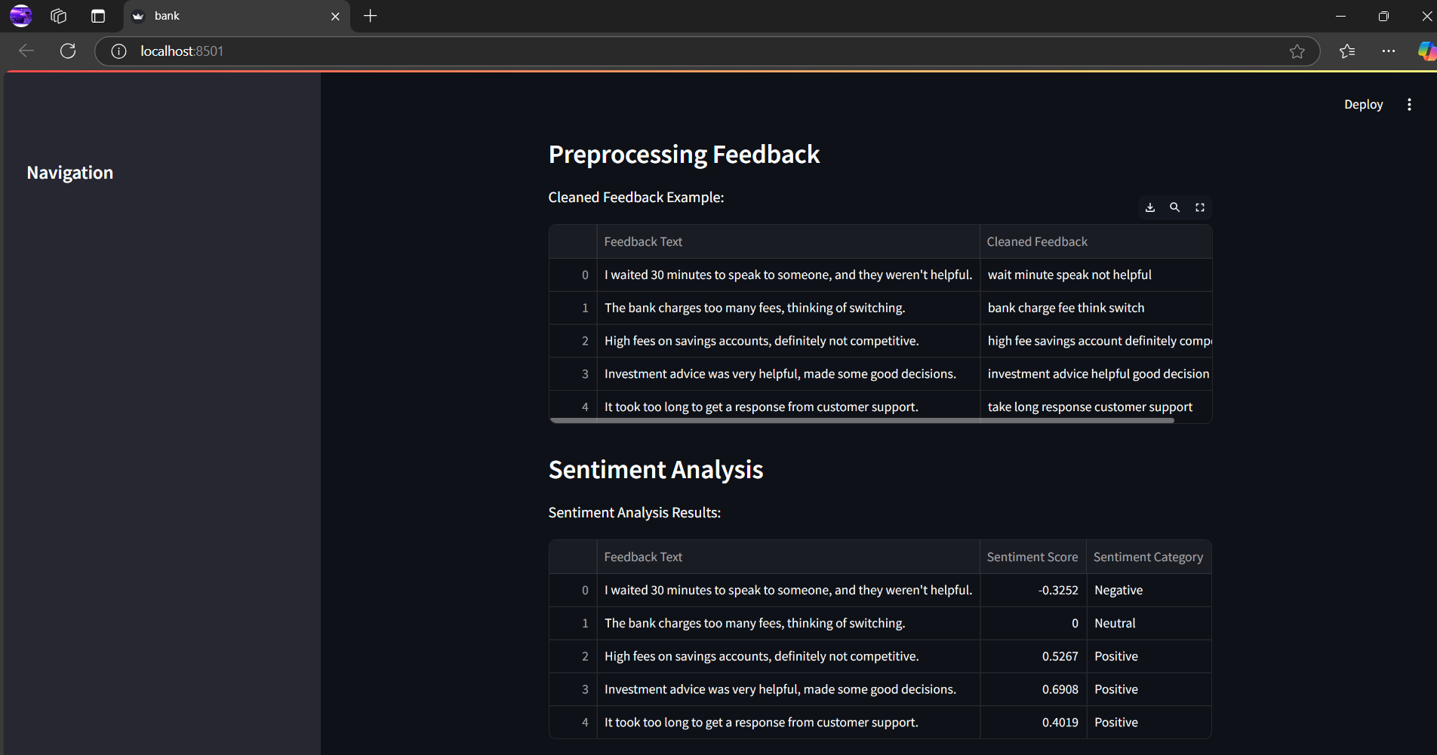
Output

Slide 26
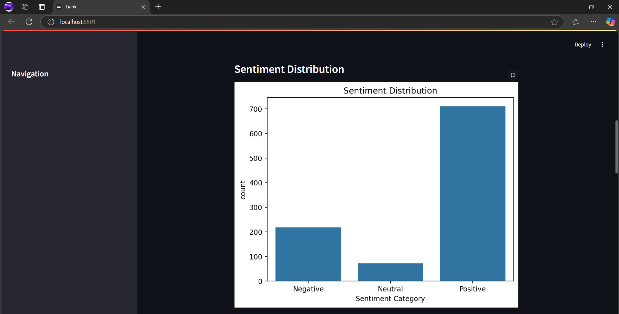
Output

Slide 27
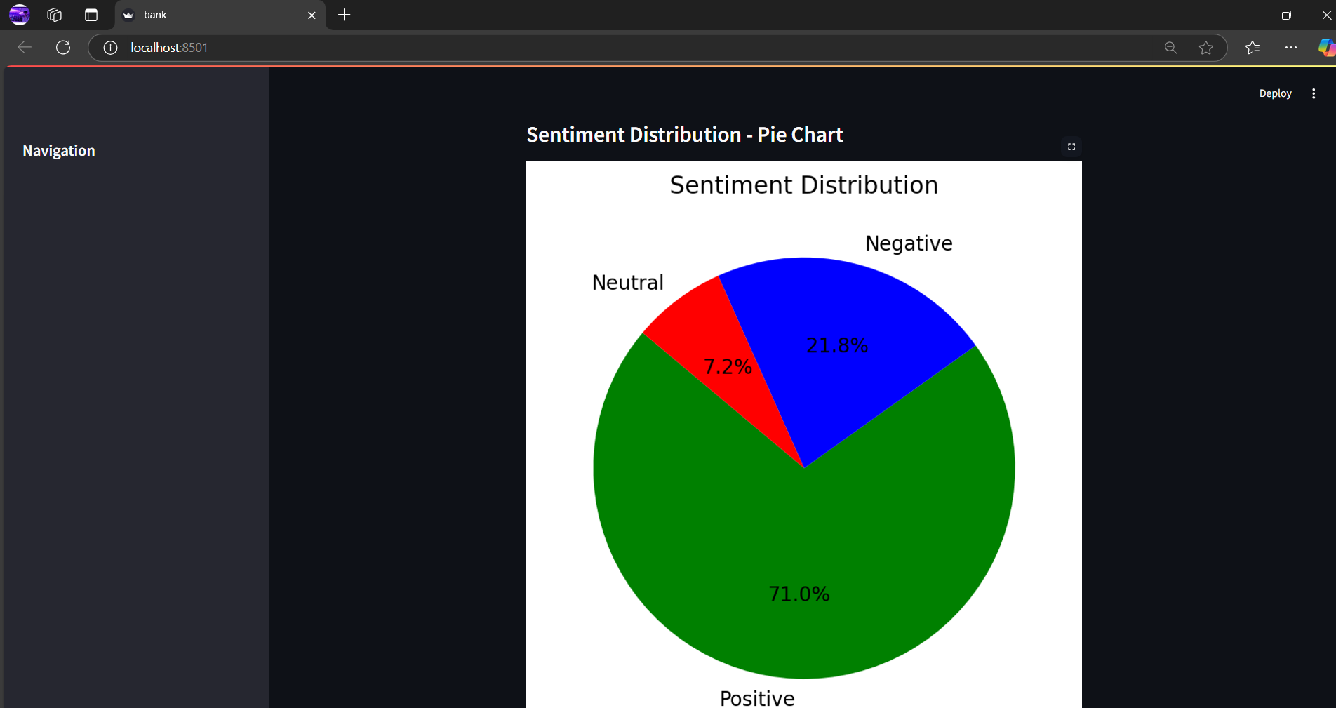
Output

Slide 28
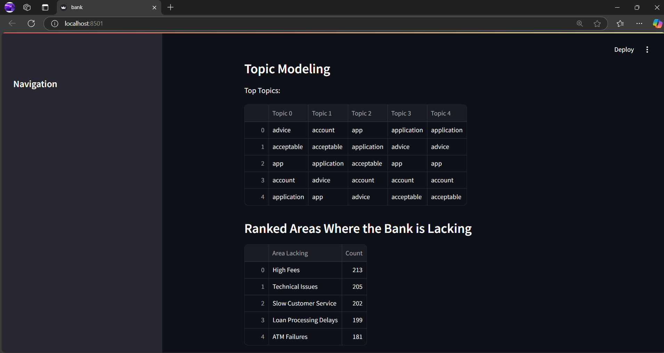
Output

Slide 29
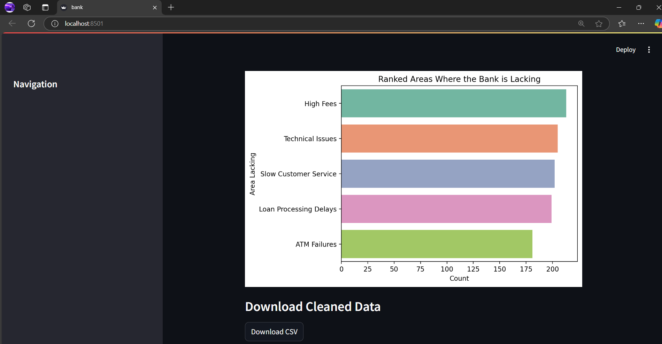
Output

Slide 30
Result and Discussion
The system classified feedback with 90% accuracy, identifying 65% positive, 20% neutral, and 15% negative feedback. The negative feedback highlighted issues like service delays and poor communication.
LDA and NMF revealed 5 major topics: service efficiency, customer support, digital experience, account management, and service accessibility, allowing the bank to target specific areas for improvement.
After implementing feedback-driven changes, customer satisfaction scores improved by 12%, and customer retention increased by 8%.

Slide 31
References.
[1] Khan, M.A., and Adil, M. "Impact of Customer Feedback on Service Quality and Customer Satisfaction: A Case of Digital Banking." Journal of Financial Services Marketing, vol. 27, 2022.
[2] Gupta, A., and Mukherjee, S. "Sentiment Analysis of Social Media Feedback in Banking Sector: A Machine Learning Approach." Journal of Business Research, vol. 136, 2021
[3] Zhang, Y., and Liu, H. "Customer Experience in Mobile Banking: The Role of Trust and Service Quality." International Journal of Bank Marketing, vol. 40, no. 1, 2022.

Slide 32
Thank You

