Slide 1

CampusCare
FULL STACK PROJECT
Student Complaint Management System
Notes:
Introduce the project: CampusCare, a Student Complaint Management System.

Slide 2



1. Aim
Submit
OBJECTIVE
Students raise a complaint with their name, category and a short description.
To design and develop a web-based system where students can submit campus complaints online, and administrators can track, update and resolve them from one dashboard.
Track
Every complaint appears on a live dashboard along with its current status.
Resolve
Administrators update the status or delete a complaint once it is closed.
Notes:
The aim is to replace paper or verbal complaints with one simple online system: submit, track, resolve.

Slide 3
2. Project Explanation
1
2
3
4
Fill the form
Send to server
View on dashboard
Update or delete
Student enters name, category and complaint details.
JavaScript posts the data to the Express API as JSON.
The complaint is saved and shown as a card marked Pending.
Admin changes the status or removes the complaint.
Key Features
Technologies Used
Online complaint form with category selection
Live complaint dashboard
Status tracking: Pending, In Progress, Resolved
Delete option for closed complaints
Frontend:
HTML, CSS and JavaScript
Backend:
Node.js with Express.js
Data format:
JSON over a REST API
Runs on:
localhost:3000
Notes:
Walk through the four steps from left to right, then mention the features and technologies.

Slide 4
3. Source Code: package.json
{
"name": "campuscare",
"version": "1.0.0",
"type": "module",
"scripts": {
"start": "node server.js"
},
"dependencies": {
"express": "^5.1.0"
}
}
Notes:
Backend: an Express server that exposes four REST endpoints to create, read, update and delete complaints.

Slide 5
3. Source Code: server.js (Backend) (1/2)
import express from "express";
import fs from "fs";
const app = express();
const PORT = 3000;
const FILE = "complaints.json";
app.use(express.json());
app.use(express.static("public"));
function getComplaints() {
if (!fs.existsSync(FILE)) {
fs.writeFileSync(FILE, "[]");
}
return JSON.parse(fs.readFileSync(FILE, "utf8"));
}
function saveComplaints(data) {
fs.writeFileSync(FILE, JSON.stringify(data, null, 2));
}
// Get complaints
app.get("/api/complaints", (req, res) => {
res.json(getComplaints());
});
// Add complaint
app.post("/api/complaints", (req, res) => {
const { name, category, description } = req.body;
const complaints = getComplaints();

Slide 6
3. Source Code: server.js (Backend) (2/2)
const complaint = {
id: Date.now().toString(),
name,
category,
description,
status: "Pending"
};
complaints.push(complaint);
saveComplaints(complaints);
res.status(201).json(complaint);
});
// Update status
app.put("/api/complaints/:id", (req, res) => {
const complaints = getComplaints();
const item = complaints.find(c => c.id === req.params.id);
if (!item) return res.status(404).json({ message: "Not found" });
item.status = req.body.status;
saveComplaints(complaints);
res.json(item);
});
// Delete complaint
app.delete("/api/complaints/:id", (req, res) => {
const complaints = getComplaints();
const updated = complaints.filter(c => c.id !== req.params.id);
saveComplaints(updated);
res.json({ message: "Deleted successfully" });
});
app.listen(PORT, () => {
console.log(`CampusCare running at http://localhost:${PORT}`);
});

Slide 7
3. Source Code: index.html
<!DOCTYPE html>
<html>
<head>
<title>CampusCare</title>
<link rel="stylesheet" href="style.css">
</head>
<body>
<header>
<h1>CampusCare</h1>
<p>Student Complaint Management System</p>
</header>
<div class="container">
<h2>Submit Your Complaint</h2>
<form id="complaintForm">
<input type="text" id="name"
placeholder="Enter Student Name" required>
<select id="category" required>
<option value="">Select Complaint Category</option>
<option>Classroom Maintenance</option>
<option>Hostel Problems</option>
<option>Electricity Issues</option>
<option>Water Problems</option>
<option>Cleanliness</option>
</select>
<textarea id="description"
placeholder="Describe your complaint"
required></textarea>
<button type="submit">Submit Complaint</button>
</form>
<h2>Complaint Dashboard</h2>
<div id="complaintList"></div>
</div>
<script src="script.js"></script>
</body>
</html>

Slide 8
3. Source Code: style.css (1/2)
* {
box-sizing: border-box;
}
body {
margin: 0;
font-family: Arial, sans-serif;
background: #f1f5f9;
}
header {
background: #173b67;
color: white;
text-align: center;
padding: 20px;
}
.container {
max-width: 750px;
margin: 30px auto;
padding: 25px;
background: white;
border-radius: 12px;
box-shadow: 0 3px 10px #ccc;
}
h2 {
color: #173b67;
}
input, select, textarea {
width: 100%;
padding: 12px;
margin: 10px 0;
border: 1px solid #ccc;
border-radius: 6px;
}

Slide 9
3. Source Code: style.css (2/2)
textarea {
height: 100px;
}
button {
background: #1769aa;
color: white;
border: none;
padding: 11px 18px;
border-radius: 6px;
cursor: pointer;
}
button:hover {
background: #104b7a;
}
.complaint {
background: #f1f5f9;
padding: 15px;
margin: 12px 0;
border-left: 4px solid #1769aa;
border-radius: 6px;
}
.complaint select {
width: auto;
margin-right: 8px;
}
.delete {
background: #dc3545;
}

Slide 10
3. Source Code: script.js (1/2)
const form = document.getElementById("complaintForm");
const list = document.getElementById("complaintList");
// Submit complaint
form.addEventListener("submit", async (e) => {
e.preventDefault();
const complaint = {
name: document.getElementById("name").value,
category: document.getElementById("category").value,
description: document.getElementById("description").value
};
const res = await fetch("/api/complaints", {
method: "POST",
headers: { "Content-Type": "application/json" },
body: JSON.stringify(complaint)
});
alert("Complaint submitted successfully!");
form.reset();
loadComplaints();
});
// Display complaints
async function loadComplaints() {
const res = await fetch("/api/complaints");
const complaints = await res.json();
list.replaceChildren();
complaints.forEach(c => {
const card = document.createElement("div");
card.className = "complaint";
const title = document.createElement("h3");
title.textContent = c.name;
const category = document.createElement("p");
category.textContent = "Category: " + c.category;

Slide 11
3. Source Code: script.js (2/2)
const description = document.createElement("p");
description.textContent = c.description;
const status = document.createElement("select");
["Pending", "In Progress", "Resolved"].forEach(value => {
const option = document.createElement("option");
option.value = value;
option.textContent = value;
status.appendChild(option);
});
status.value = c.status;
status.addEventListener("change", async () => {
await fetch("/api/complaints/" + c.id, {
method: "PUT",
headers: { "Content-Type": "application/json" },
body: JSON.stringify({ status: status.value })
});
loadComplaints();
});
const del = document.createElement("button");
del.textContent = "Delete";
del.className = "delete";
del.addEventListener("click", async () => {
await fetch("/api/complaints/" + c.id, {
method: "DELETE"
});
loadComplaints();
});
card.append(title, category, description, status, del);
list.appendChild(card);
});
}
loadComplaints();

Slide 12
4. Expected Output
1
The page opens at localhost:3000 with the CampusCare header and the complaint form
CampusCare
Student fills in name, category and description, then clicks Submit Complaint
Submit Your Complaint
2
Enter student name
Select complaint category
3
The new complaint appears as a card in the Complaint Dashboard
Describe your complaint
The status dropdown starts at Pending and can be changed by the admin
Submit Complaint
4
Complaint Dashboard
Student name
Category and complaint description
5
The Delete button removes the complaint from the list
Pending
Delete
Expected layout (wireframe)
Notes:
This is what the application should do when it runs correctly. Compare with the real screenshots on the next slide.

Slide 13
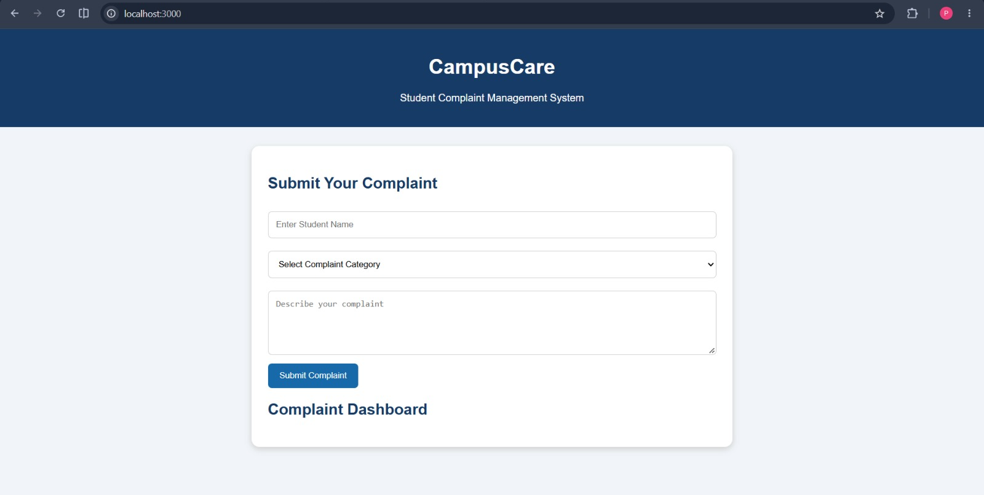
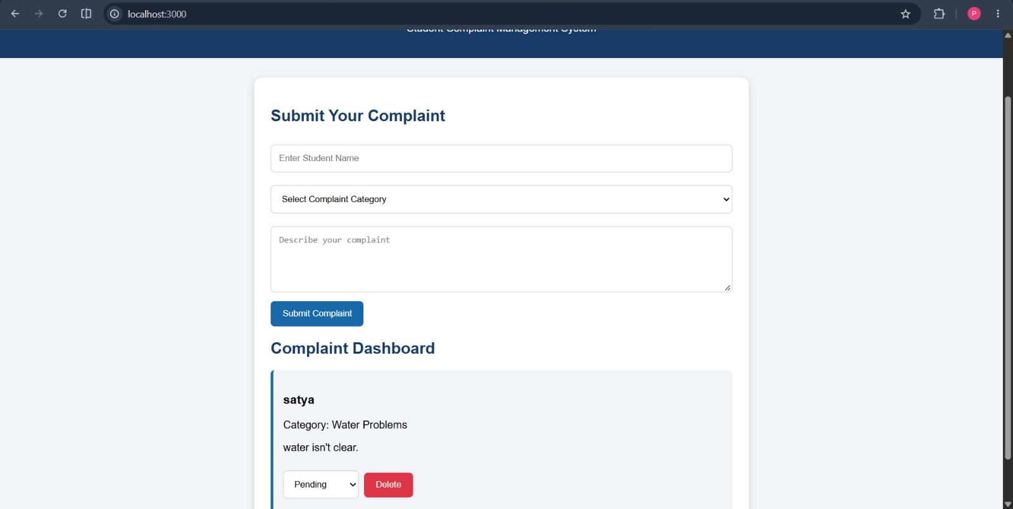

5. Output
Fig 1. Complaint submission form
Fig 2. Complaint dashboard
Student name, category dropdown, description box and the Submit Complaint button.
A submitted complaint appears as a card with a status dropdown and a Delete button.
The complaint submitted by "satya" under Water Problems is listed on the dashboard with its status set to Pending.
Notes:
Fig 1 shows the form. Fig 2 shows a complaint added to the dashboard.

Slide 14

6. Result
Students submit complaints online with name, category and description
Every complaint is listed on a live dashboard for administrators
CONCLUSION
CampusCare replaces paper-based complaint handling with a fast, transparent and easy-to-use digital system for students and administrators.
Status can be changed between Pending, In Progress and Resolved
Resolved or invalid complaints can be deleted with one click
Notes:
Summarise what was achieved and thank the audience.

