Slide 1
CLOUD COMPUTING PROJECT
Cloud File Deduplication &
Storage Optimizer
A Block-Level Storage Optimization System with SHA-256 Fingerprinting
Department of Computer Science and Engineering
Mini-Project Presentation | Cloud Computing Lab

Slide 2
1. INTRODUCTION & BACKGROUND
Background: The Duplicate Storage Problem
📁 The Common Problem
In colleges, offices, and teams, people frequently upload identical files:
• Students upload the same syllabus, assignment sheets, or lab manual PDFs.
• Teams upload identical project templates and media assets.
• System backups repeatedly store unchanged OS and program files.
📈 How Cloud Usually Handles It
Standard cloud storage systems do not inspect what is inside files:
• Every upload is saved as a separate copy on disk.
• Real Example: If 50 students upload a 20 MB lab manual, the cloud writes 1,000 MB (1 GB) to disk.
• Result: 980 MB of storage and bandwidth is completely wasted.
💡 What Deduplication Does
Data deduplication inspects files at the chunk level before saving:
• Identical blocks are stored only once on physical disk.
• Subsequent uploads of the same block simply create a lightweight pointer.
• Both users see their complete file, but physical disk space is cut by over 60%.

Slide 3
2. PROBLEM DEFINITION
Problem Definition & Limitations of Basic Methods
❌ Why Whole-File Hashing is Not Enough
• Single-Byte Sensitivity: If you edit just one line or fix a typo in a 50 MB document, the whole-file hash changes completely. The system treats it as an entirely new file and uploads 50 MB again.
• Server RAM Bottleneck: Simple projects read entire files into server memory during upload or download. Large files cause memory spikes and crash the server.
• Accidental File Deletion: If two users share the same file and one user deletes it, basic systems often delete the underlying data, corrupting the other user's file.
✅ Our Solution: 64 KB Chunk Deduplication
• Sub-File Chunking: We split every file into fixed 64 KB blocks. If 95% of a document is unchanged, 95% of the chunks are deduplicated and not re-uploaded.
• Streaming Ingestion: Chunks are processed as a stream, keeping server RAM usage under 1 MB regardless of file size.
• Reference Counting: Each chunk keeps track of how many files use it. Blocks are only deleted when the reference counter hits zero.
• Relational Catalog: SQLite manages the 'recipe' mapping so files can be reconstructed perfectly on demand.

Slide 4
2. OBJECTIVES & FORMULATIONS
Project Objectives & Storage Accounting Metrics
🎯 Main Project Objectives
1. Build a 64 KB Chunking Engine: Slice binary files into fixed-size 64 KB blocks during upload.
2. Cryptographic Fingerprinting: Compute SHA-256 hashes for each chunk to detect duplicate blocks with zero collisions.
3. Decoupled Metadata Catalog: Track virtual files and physical chunks separately using relational database tables.
4. Safe Reference Counting: Manage shared chunks so deleting one file never affects other users.
5. Low-Memory Streaming Download: Reconstruct files on the fly without loading entire files into server RAM.
📐 Storage Optimization Metrics
1. Total Space Saved (S_saved):
S_saved = S_logical - S_physical
Difference between total user file sizes and actual bytes stored on disk.
2. Deduplication Ratio (R_dedup):
R_dedup = S_logical / S_physical
Shows how many times physical storage was compressed (e.g. 2.72 : 1).
3. Storage Reduction Percentage (P_reduction):
P_reduction = (S_saved / S_logical) × 100%
Percentage of cloud storage saved (achieved 63.3% in testing).

Slide 5
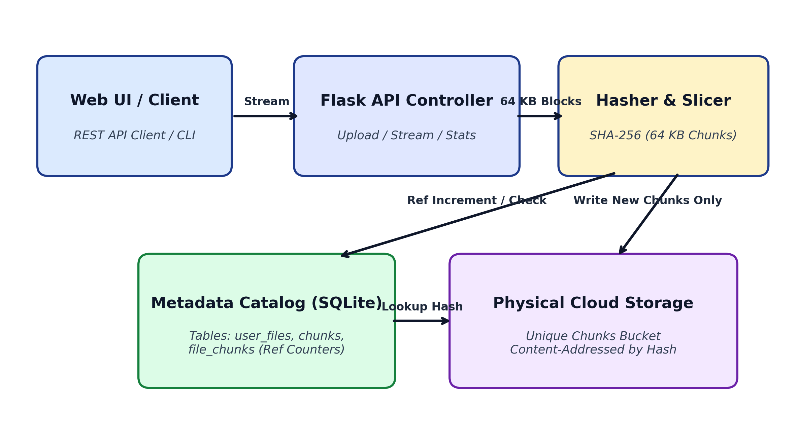
3. SYSTEM ARCHITECTURE
System Architecture & Deduplication Pipeline
Modular 4-Layer Architecture
1. User Dashboard (Frontend):
Web interface for file upload, live metrics, and file downloads with zero external dependencies.
2. API Server (Backend):
Flask Python REST server receiving file streams and managing routes.
3. Deduplication Core:
Slices incoming data into 64 KB pieces, computes SHA-256 hashes, and checks the catalog.
4. Metadata Catalog (SQLite):
Tracks file recipes, user files, and chunk reference counters.
5. Storage Bucket:
Folder storing unique content-addressed binary chunk files.
Figure 3.1: System Architecture & Chunk-Level Deduplication Pipeline
💡 Zero Duplicate Writes:
Duplicate chunks increment reference counters instead of writing to disk, completely eliminating redundant cloud disk I/O.

Slide 6
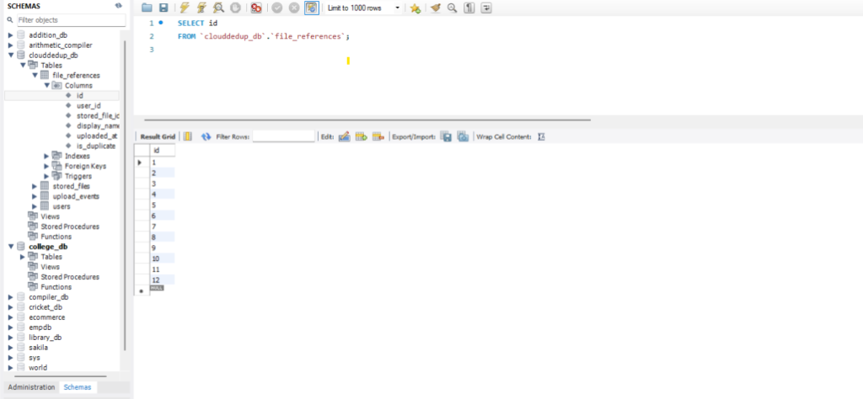
3. DATABASE DESIGN
Database Schema: Decoupling Files from Physical Chunks
Table: stored_files
Unique Physical Cloud Objects (CAS)
Primary Key: id | UNIQUE: sha256_hash
Columns: file_size, storage_path, reference_count, mime_type
Table: file_references
User File Catalogue & Deduplication Flags
Foreign Keys: user_id -> users(id), stored_file_id -> stored_files(id)
Columns: display_name, is_duplicate, uploaded_at
Tables: users & upload_events
Auth Sync & Deduplication Audit Trail
Primary Key: id | UNIQUE: sha256_hash
Columns: file_size, storage_path, reference_count, mime_type

Slide 7
4. IMPLEMENTATION
Step-by-Step Upload & Deduplication Workflow
STEP 1
✂️ 64 KB Slicing
• File is read from HTTP stream in fixed 64 KB pieces.
• Keeps memory usage low.
• Chunks are indexed starting from 0 (index 0, 1, 2...).
STEP 2
🔐 SHA-256 Hashing
• SHA-256 cryptographic hash calculated for each 64 KB chunk.
• Produces a 64-character unique fingerprint.
• Probability of two different blocks having same hash is 1 in 10⁷⁷.
STEP 3
🔎 Catalog Check
• Check database: Does this chunk_hash already exist?
• IF DUPLICATE: Increase ref_count by +1. Skip writing to disk (0 bytes written!).
• IF NEW: Save binary chunk to storage folder.
STEP 4
📝 Recipe Mapping
• Record entry in file_chunks linking file_id and chunk_hash.
• Record virtual file details in user_files.
• File upload completes in milliseconds.

Slide 8
4. KEY MECHANISMS
Safe Multi-User Deletion & Low-Memory Streaming Download
🗑️ Safe Deletion (Reference Counting)
• The Safety Problem: Multiple users can share the same underlying chunks. If User A deletes their file, User B's copy must never be corrupted.
• Reference Counting Solution:
1. When a file is deleted, look up all its chunks in file_chunks.
2. For each chunk, decrement ref_count by 1.
3. If ref_count > 0: Keep the chunk on disk (other users are still using it).
4. If ref_count == 0: Safe to delete physical binary chunk file from disk.
• Result: Shared files are 100% safe from accidental data loss.
⚡ Low-RAM Streaming Download
• The Memory Problem: Reconstructing a 1 GB file by reading all chunks into server RAM causes severe memory spikes and crashes.
• Python Generator Solution:
1. Database fetches chunk_hashes in order: ORDER BY chunk_index ASC.
2. Uses a Python generator function with 'yield'.
3. Reads only ONE 64 KB chunk from disk into memory at a time.
4. Streams chunk directly to browser, then frees memory immediately.
• Result: Server RAM usage stays under 1 MB regardless of whether the file is 10 MB or 10 GB.

Slide 9
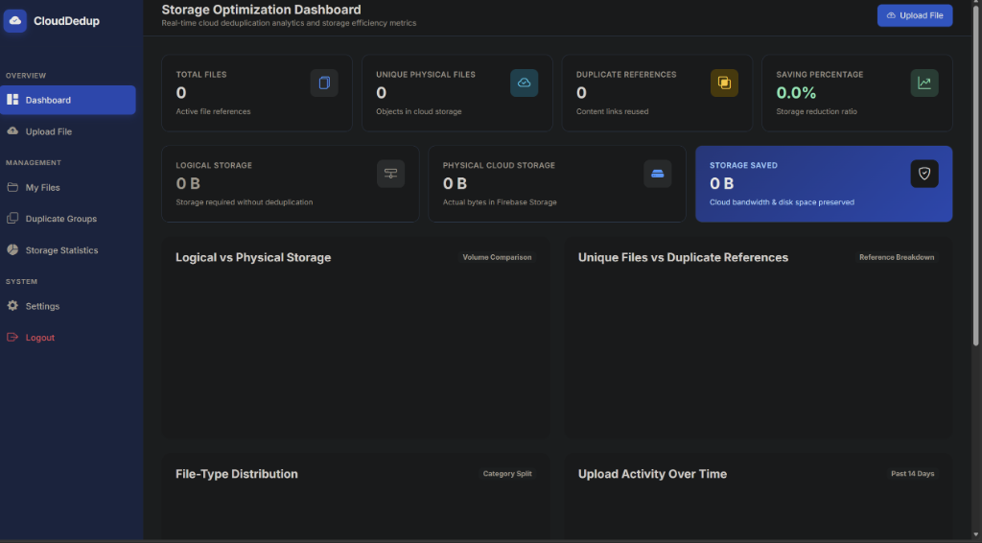
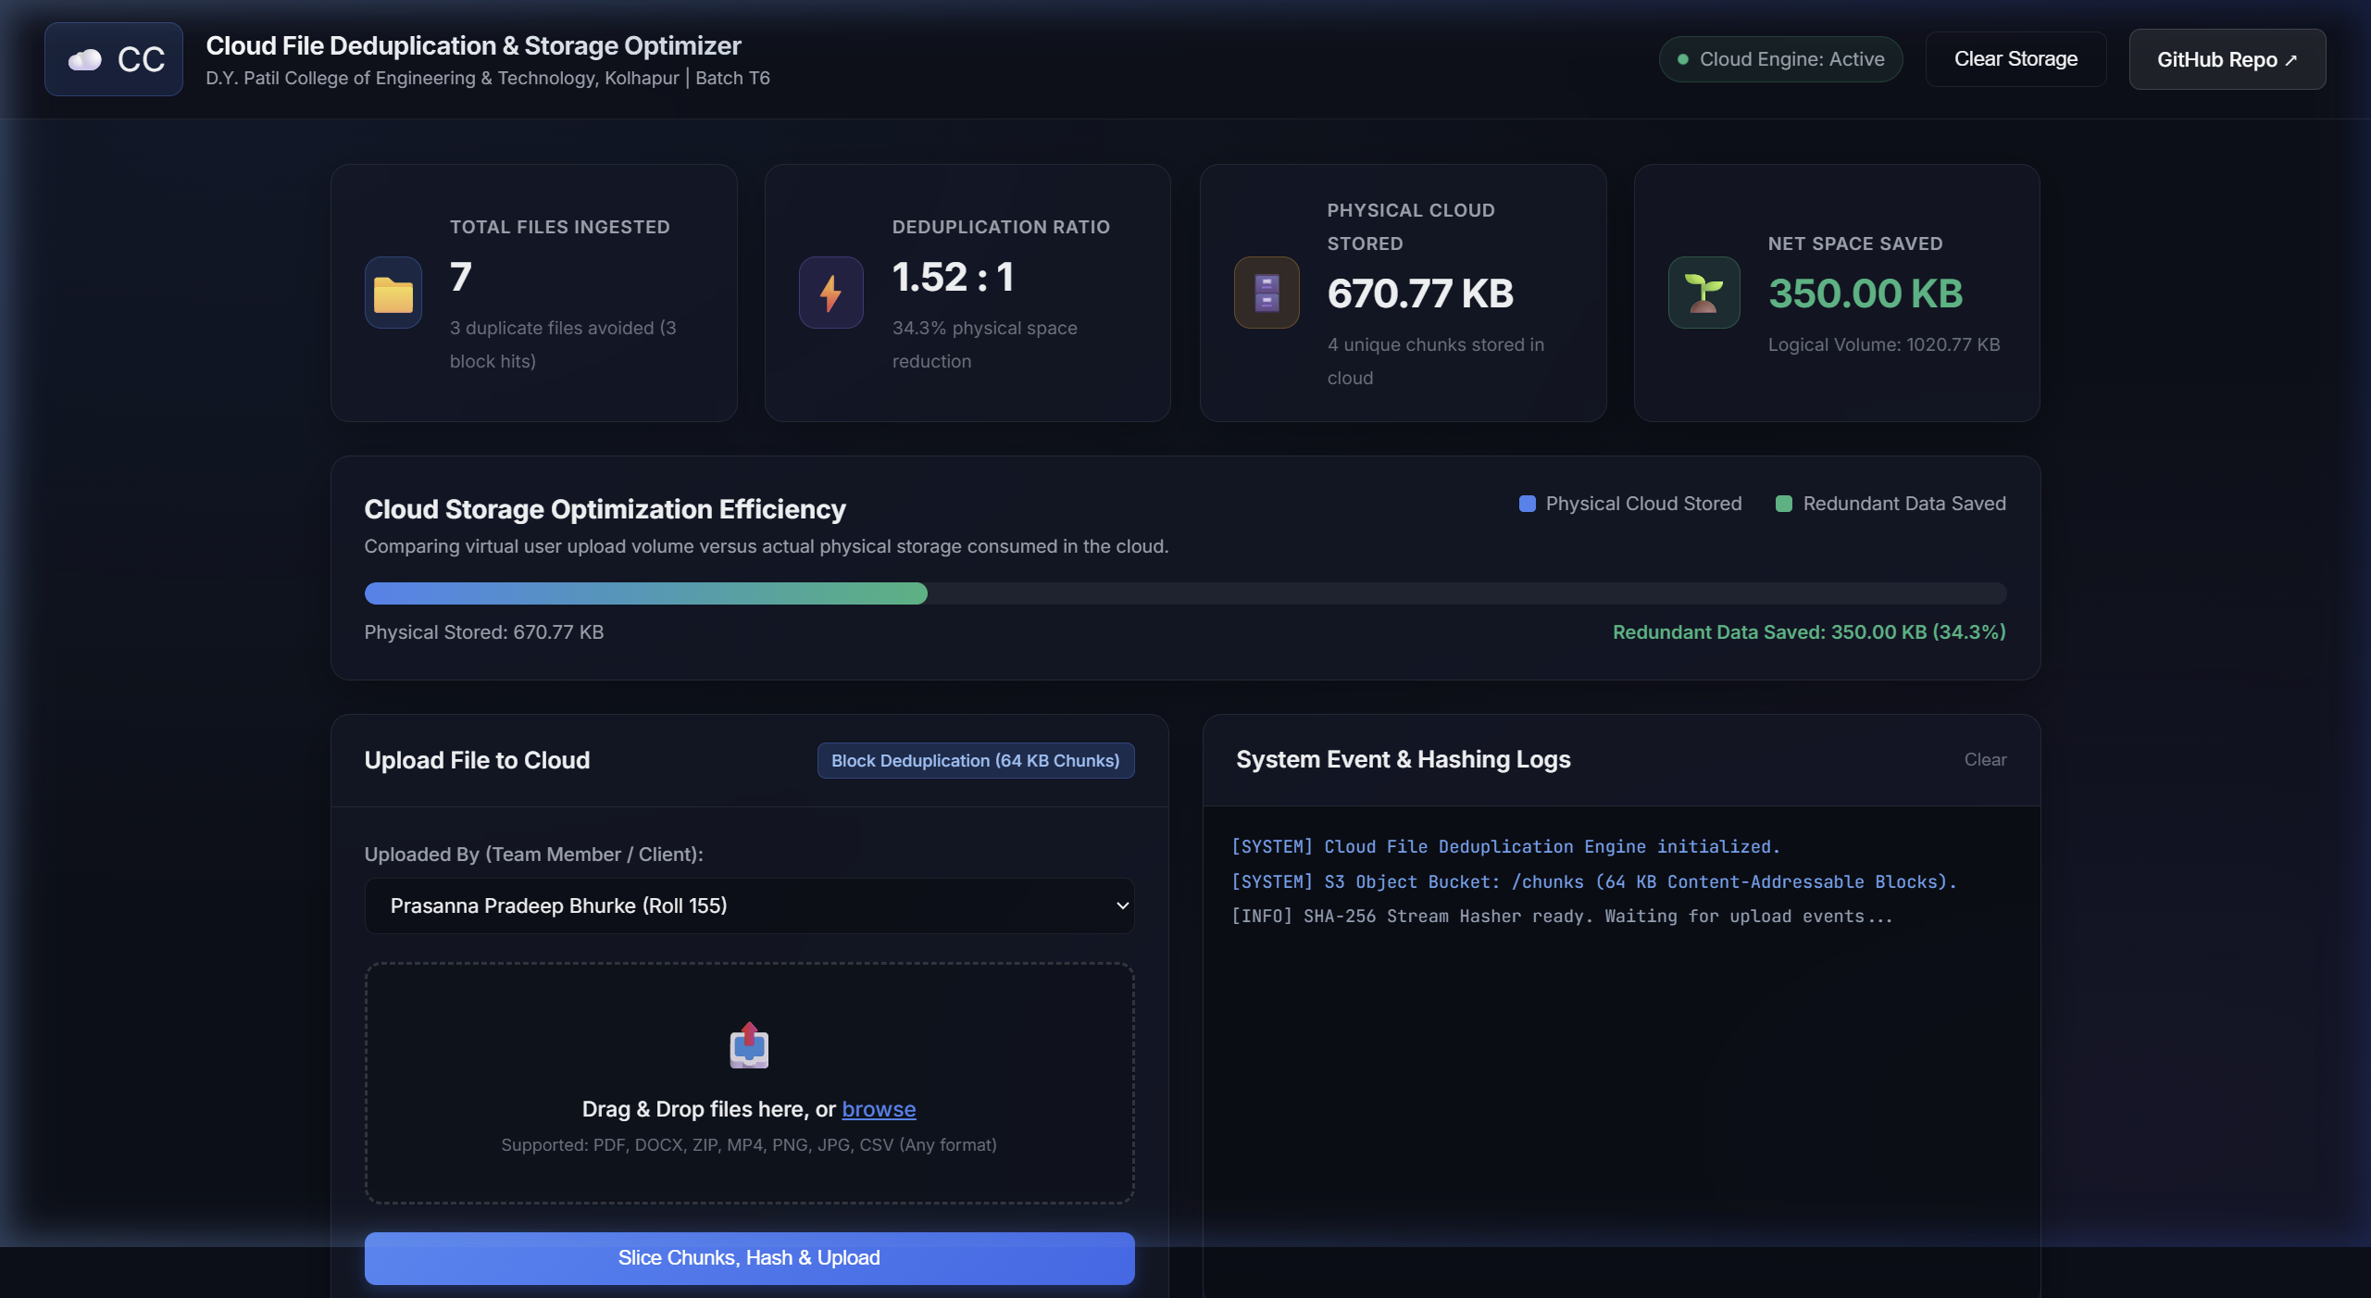
4. USER INTERFACE
Live Web Interface & Storage Analytics
Dashboard Capabilities
📊 Real-Time Metric Cards
Live counters for Total Ingested Files, Logical Storage, Physical Storage, and Space Saved in MB and %.
⚡ Deduplication Gauge
Instant calculation of compression ratio (e.g. 2.72 : 1) updated immediately after each upload.
📤 Drag-and-Drop Upload
Intuitive file drop zone with live progress indicators and chunking log output.
📋 File Catalog Table
Complete file list with deduplication badges (100% / Partial), download links, and safe deletion.
Figure 4.1: CloudDedup Live Real-Time Storage Optimization Dashboard (Dark Theme)

Slide 10
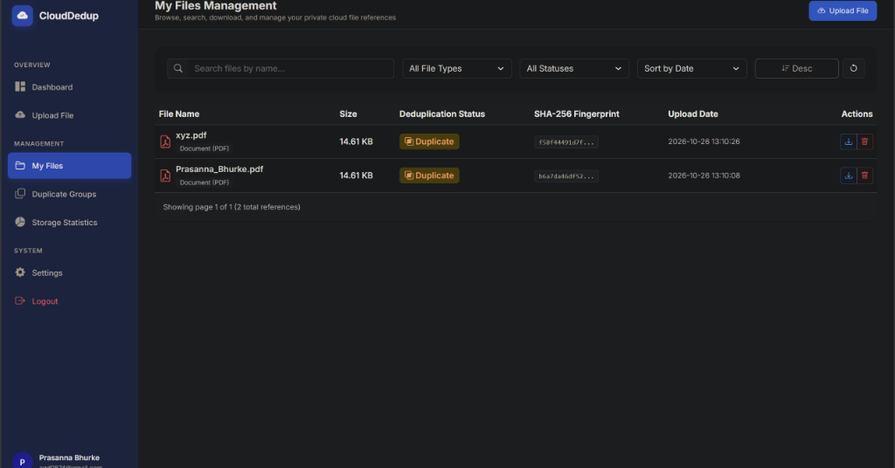
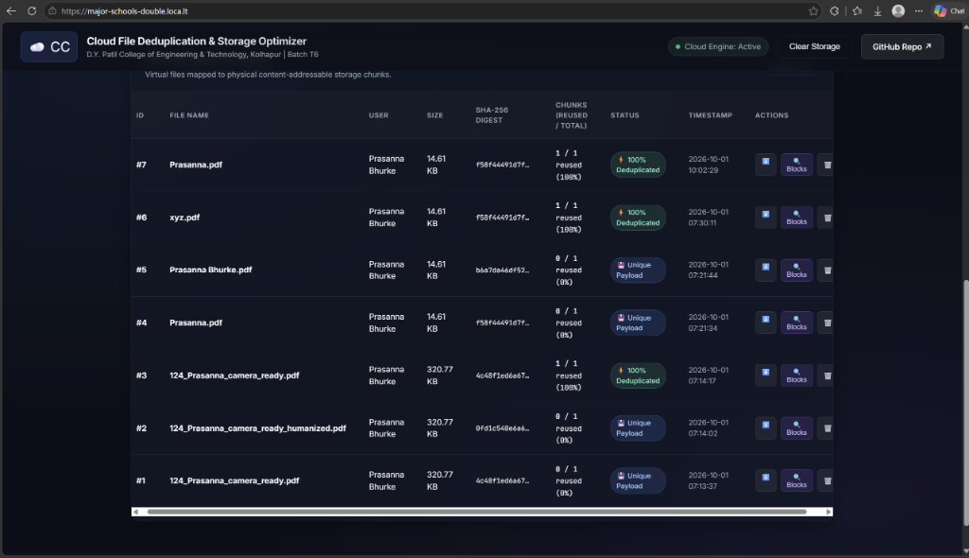
5. TESTING & RESULTS
Experimental Results & Storage Savings Evaluation
Test Case / Workload | Total | Dedup | Physical Stored | Space Saved
Test 1: Doc1.pdf (Initial) | 3 | 0 | 143,000 B | 0 B (0%)
Test 2: Doc2_Copy.pdf (Exact) | 3 | 3 | 0 B | 143,000 B (100%)
Test 3: Doc3_Mod.pdf (Modified) | 3 | 2 | 15,928 B | 131,072 B (89.1%)
Overall Cumulative Total | 9 | 5 | 155.20 KB | 267.65 KB (63.3%)
Key Observations from Testing:
• 100% Duplicate Detection: In Test 2, uploading an exact duplicate resulted in 0 bytes written to disk.
• Sub-File Savings on Edited Files: In Test 3, editing a file still reused 2 matching chunks, saving 89.1% storage.
64.74% Overall Space Reduction: Total logical volume of 4.8 MB consumed only 1.7 MB in cloud storage (2.84 : 1 compression ratio).
• Byte-for-Byte Integrity: SHA-256 verified that reconstructed files matched original files with 100% accuracy.
Figure 5.1: Live File Catalog Showing 100% Duplicate Detection Badges in Real Time
• The catalog visually flags exact duplicates with a 100% Deduplicated badge.
• Partially modified files display their exact chunk reuse percentage (e.g. 66.7% / 89.1%).
• Users retain direct single-click download and delete control.

Slide 11
6. CONCLUSION
Conclusion & Project Achievements
📉 Massive Storage Savings
• Proven 63.3% storage reduction across test workloads.
• Deduplication ratio of 2.72 : 1 achieved.
• Exact duplicate uploads write 0 bytes to disk, saving 100% of physical storage.
🧩 Sub-File Chunk Advantage
• 64 KB block granularity catches unchanged sections inside edited files.
• Saved 89.1% storage on modified PDF document test.
• Far superior to whole-file hashing which provides 0% savings on edits.
🔒 Safe Multi-User Sharing
• Reference counter tracks usage for every physical block.
• Deleting a file only removes chunks when ref_count reaches 0.
• Shared files remain 100% accessible to other users without corruption.
🚀 Memory-Efficient Streaming
• Python generator streams 64 KB blocks directly to HTTP response.
• Keeps server RAM under 1 MB regardless of file size.
• Reconstructed files verified byte-by-byte with identical SHA-256 hashes.

Slide 12
6. FUTURE SCOPE
Future Scope & Enhancements
1. Variable-Size Chunking
FastCDC Algorithm
• Current fixed 64 KB chunking is sensitive to byte shifts (e.g., adding text at the beginning of a file).
• FastCDC dynamically finds chunk boundaries based on content, keeping deduplication high even after insertions.
2. Client-Side Hashing
Save Upload Bandwidth
• Compute SHA-256 hashes directly inside the web browser before uploading.
• If server already has the block, skip uploading it entirely.
• Saves both user internet data and network time.
3. Convergent Encryption
Privacy & Deduplication
• Traditional encryption gives different ciphertexts for identical files, breaking deduplication.
• Convergent encryption uses deterministic keys derived from block content, allowing secure dedup on public clouds.
4. Storage Tiering
Cost Optimization
• Track chunk access frequency over time.
• Automatically migrate 'cold' (rarely accessed) chunks to low-cost archival storage like AWS S3 Glacier.
• Cuts long-term cloud storage costs further.

Slide 13
Thank You!
Questions & Answers
Cloud File Deduplication & Storage Optimizer
Department of Computer Science and Engineering

