Slide 1
Opcenter EXPR Tools
Tools for Migration and in-place upgrade
Prasanna Rajaram

Slide 2
Migration Tools

Slide 3
Why
XDiamondPM / XDBManager Pro migration to Opcenter EXPR requires configuration of equipment modules, equipment flow configuration, automation node instances among others.
The configuration of automation node instances is a time consuming and repetitive task – causing fatigue and chance for errors.
Do we really need a tool for this? or do we have alternatives?
Notes:
This tool addresses this issue to save time and enables ease of configuration for the engineer (allowing more time for important tasks)

Slide 4
Alternatives – Notepad++
Opcenter EXPR has the option to export the automation node instance configuration to a CSV file, which in turn can be edited by hand (over Notepad++ or any text editor).
Editing this configuration by (copy-paste and find-replace) manual operations is in-efficient as these are repetitive.
The repetitive operation can cause fatigue and a simple error like missing a quote (symbol) or comma can cause import errors.

Slide 5
Alternatives – MS Excel
Usually, CSV files are edited using MS Excel
The exported CSV file uses double quotes to encapsulate the data which is delimited by commas.
If the file is edited in MS Excel,
the double quotes are removed
If the last field is an empty field (like “”), then it is removed
Notes:
Among the two alternatives shown, using Notepad++ causes less problems than MS Excel.

Slide 6
Work process
Input (MS XL)
Phase Names extract from Simatic Manager
Tool
Process input and produces CSV
CSV file
Automation Node Instance
Automation Node Instance Parameter
Tag Management (Gen 2)
Six Bit Tasks
Automation Node Instance Report
Manual Prep
Exported

Slide 7
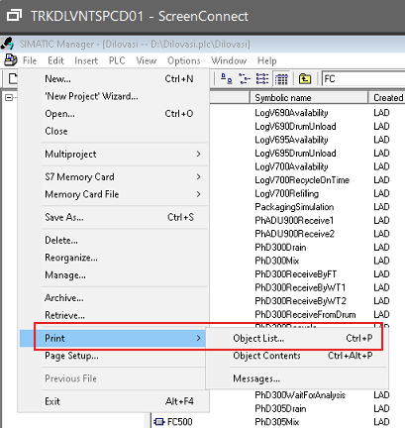
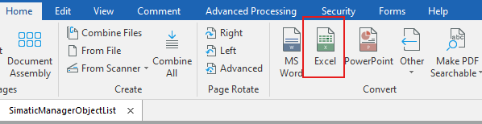
Extracting Phase names from Simatic Manager
Open Simatic Manager.
File > Print > Object List. This should allow to save the objects as PDF.
Copy the PDF file from the VM to your DWS
Open the file with Kofax Power PDF and select Excel under the Convert section
From the Excel, copy paste the phase name into a file called “ANIInputFile.xlsx”

Slide 8
Features
The tool will have the following features
Creating new automation node instances
Read input from excel file. The excel file is generated by exporting phase names from Simatic Manager.
Read tag management extract text file (Gen 2 feature)
Generate output CSV file (copy-paste to CSV in EXPR)
Update CSV file in EXPR (in-place – Gen 2 feature)
Updating existing automation node instances (Gen 2)
Read CSV from EXPR
Read tag management extract text file
Update CSV file in EXPR

