Slide 1

PROJECT-2
GLOBAL SUICIDE RATES ANALYSIS
-JU A HAN
-LAKSHMI
-SANA
-SOUJANYA

Slide 2
MOTIVATION
Suicide is a global phenomenon; in fact, 78% of suicides occurred in low- and middle-income countries in 2015.
Death by suicide is an extremely complex issue that causes pain to hundreds of thousands of people every year around the world.
According to estimates from the World Health Organization (WHO), Suicide is the second leading cause of death among 15-29 years old and over 800,000 people die because of it every year.
Such large numbers and the recent COVID situation in relation to mental health motivated us to work on this topic.

Slide 3
Components Used
Data Sources
Csv file: https://www.kaggle.com/russellyates88/suicide-rates-overview-1985-to-2016
API: https://raw.githubusercontent.com/datasets/geo-countries/master/data/countries.geojson
Database – Heroku PostgreSQL – Generated by Python Script, Table created from csv file
Flask – Python code, connects to PostgreSQL, retrieves the data from PostgreSQL, Serves data in JSON format via endpoints
Landing Page – index.html - custom CSS files
Data Visualization (Libraries used) – java script, D3.js, Plotly, JQuery with Ajax (new library)

Slide 4
DATA EXTRACTION
We used jupyter notebook and pandas to pull in the csv file and perform data transformation - dropped some columns and renamed some columns
We then created a connection string to PostgreSQL and stored our data in the database
We used Flask and python to create different API routes
We also used ----- API to get country coordinates
We used javascript libraries – D3, plotly and Jquery(Ajax) to plot and analyze our data

Slide 5
ANALYSIS – MAIN DASHBOARD
Our Interactive Dashboard shows the analysis of the suicide rates from countries all over the world and visualizes the patterns in choropleth map and charts. This allows users to navigate to specific charts by clicking on any of those graphs for an in depth analysis
Further, our graphs allow the user to select specific year / countries to include in the comparison.
We also created a choropleth map which visualizes the global suicide count among the countries.

Slide 6
Visualizations

Slide 7
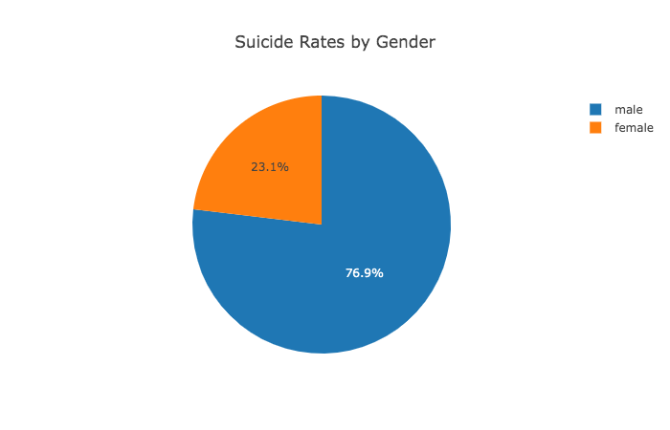
Suicide Rates by Gender
This Graph represents the number of suicides by Gender.
Suicide is more common in men than women. Men are three times more likely to die by suicide than women.
Suicides by men account for 76.9% of the total suicides.

Slide 8
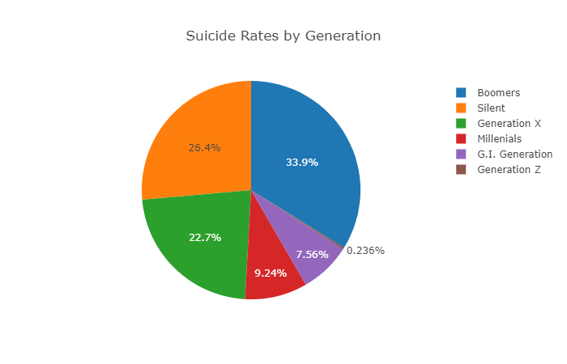
Suicides by Generation
The rate of suicides in the baby boomers generation is the highest
from 1997 to 2014 at 34% followed by the silent generation.
This page allows users to view suicides by generation by year by
clicking on the interactive drop down button
Baby Boomers: Baby boomers were born between 1944 and 1964
Gen X: Gen X was born between 1965 - 1980
Gen Y: Gen Y, or Millennials, were born between 1981 and 1996
Gen Z: Gen Z is the newest generation to be named and were born between 1995 and 2015
Silent: Silent generation were born between 1925 and 1945
After doing some research, it appears that the correlation between the high number of suicides and baby boomers is the economy

Slide 9
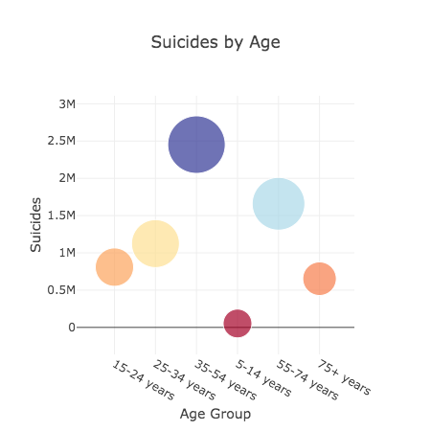
Suicides by Age
The bubble plot visualizes the different
age groups and their relationship to
suicide rates.
Age group 35-54 years
being an outlier with highest number
of suicide rates.
Allows users to select specific age groups
and countries for comparison.

Slide 10
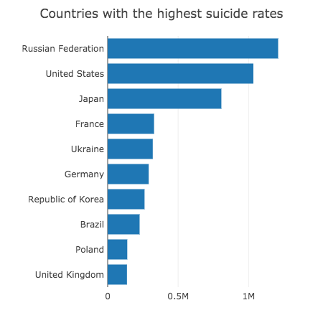
Suicides by Country
Visualizes the suicide rate among the
top 10 countries.
The Russian Federation has the highest suicide
rate, compared to the least amount of suicides
in the United Kingdom.
Allows user to select specific countries that they
wish to include in the comparison.

Slide 11
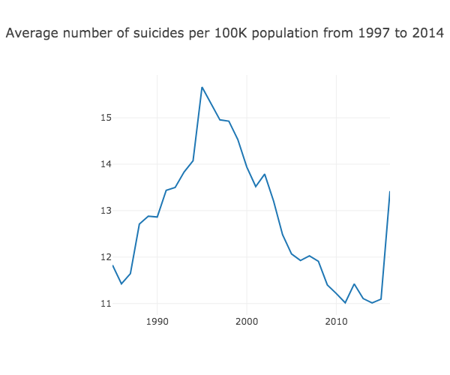
Suicides Per 100k Over the Years (1997-2014)
The Average number of suicides per 100,000 declined
in 1986 after which there was an upward trend and
a sharp peak in 1995.
The number then steadily declined until 2010
and then increased in 2012 and 2015

Slide 12
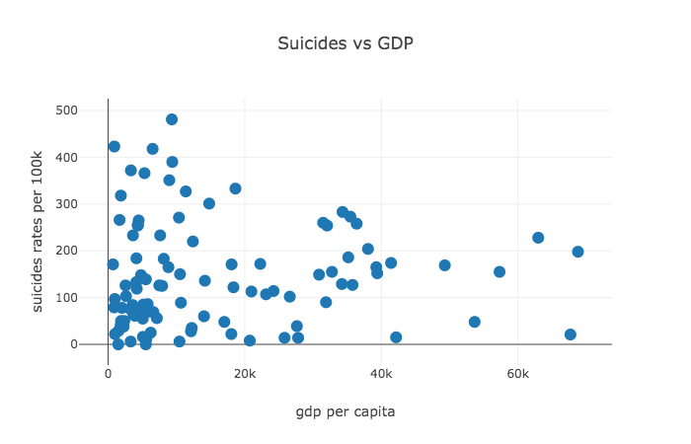
Suicide vs GDP
The scatter plot shows that there's no correlation between suicide rates and gdp per capita.
Although GDP could be one of the many reasons of suicide, it was not the main cause.

Slide 13
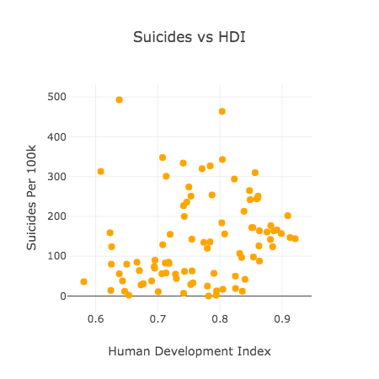
Suicide vs HDI
HDI (human development index) is determined by:
a long and healthy life
being knowledgeable
a decent standard of living.
The scatter chart shows that the suicide rates are higher in the countries where the hdi is high.

Slide 14
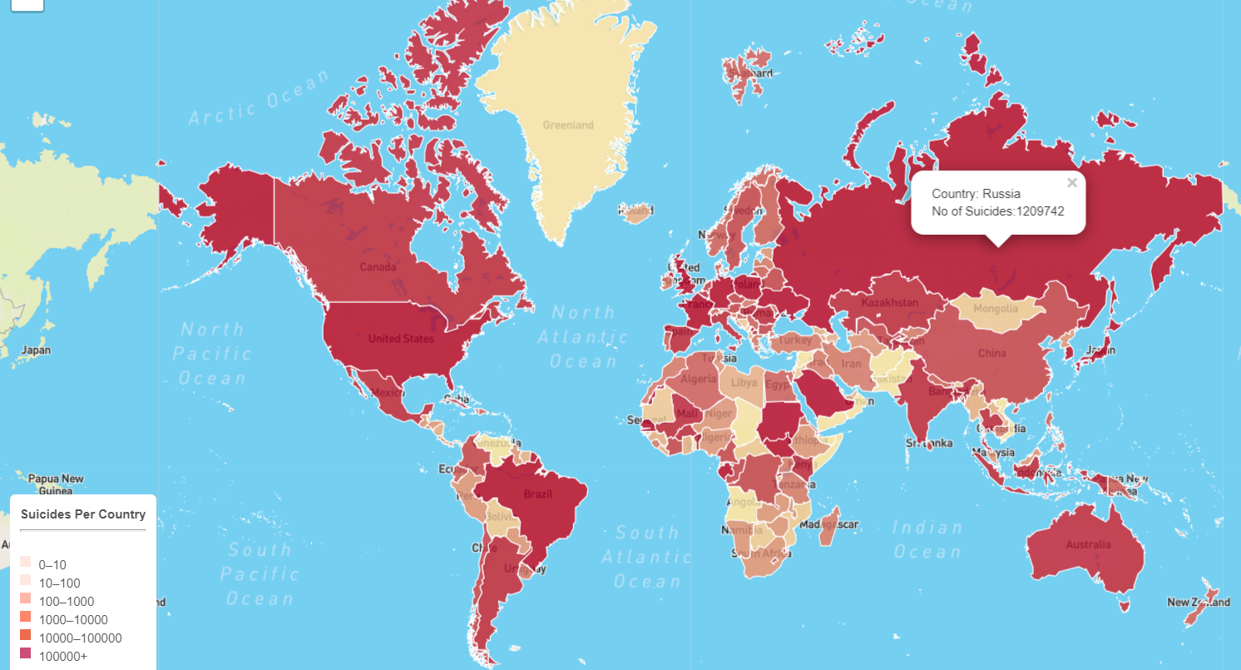
Suicide Rates based on Countries - (Choropleth Map)

Slide 15
Key Challenges
Creating and Designing Visualizations
Limited Access to Sensitive Suicide Data
API did not have all the country codes we wanted

Slide 16
CONCLUSION
Suicide is indeed one of the most talked about issue in these crisis times and this research helped us to check the influence of multiple factors such as poverty, mental health, unemployment and many more.
The purpose of this project is not to discuss the reason behind the suicide rates of a specific country but to try to understand the variation of suicide rate over the course of the years and to identify potential factors that may have contributed to the change.
However, the reason behind suicide can’t be easily identified. Each country has different socio economic and cultural backgrounds which also makes identifying underlying causes difficult.
Our goal with this project is to give users a clean platform to view and interact with the data so further research becomes easier.

