Slide 1

Medical Premium Insurance Cost Prediction
PrasannaKumar Reddy,
Akhil Muthyala,
Naga Sai Anudeep,
Manoj Vallabhaneni.

Slide 2
Introduction
Our project aims to develop a regression models to estimate future medical costs for individuals based on their demographic and lifestyle factors, we empowering them to make informed financial decisions regarding healthcare planning.
We leverage a diverse range of demographic and lifestyle data, including age, sex, BMI, number of children, smoker status, and regional categorization.
Our project addresses critical challenges in healthcare planning and financial management by providing personalized estimates of future medical costs.
We utilized machine learning models such as linear regression, decision trees, and random forests to develop a regression model for estimating future medical costs based on demographic and lifestyle factors.

Slide 3

Data Source
The dataset was obtained from Kaggle, a platform for data science competitions and datasets.
In dataset we have attributes like Age, BMI, Sex, Number of Children etc..,
The dataset comprises into 1330 records, providing a comprehensive sample for analysis and modeling.

Slide 4

Data Pre-Processing
The dataset contains a comprehensive set of columns, including many not required for the specific analysis.
Removing Unnecessary Columns, Excludes irrelevant data to focus analysis.
Convert categorical attributes (e.g., sex, smoker status) into numerical format using one-hot encoding.
Normalize numerical features (e.g., age, BMI) to a similar scale to improve algorithm performance.
Ensure all features contribute equally to predictions by scaling or normalizing numerical features.
Prepared a clean dataset for analysis and modeling.

Slide 5
Data Pre-Processing
The data preprocessing for machine learning, using scikit-learn libraries for essential tasks.
Numeric features undergo missing value imputation via the median and subsequent scaling using StandardScaler to normalize the data.
The ColumnTransformer consolidates these numeric and categorical preprocessing steps, facilitating a modular and organized approach.
The fit_transform method of the ColumnTransformer is employed to apply the preprocessing steps to the input dataset X.
The resulting preprocessed data is converted back to a DataFrame, ensuring transparency with reconstructed column names.
The dataset is split into training and testing sets using train_test_split from scikit-learn, with a test size of 20%.
The final datasets, namely X_train, X_test, y_train, and y_test, are ready for subsequent model training.
This structured data preprocessing pipeline, addressing both numeric and categorical features, to prepare the dataset for machine learning tasks.

Slide 6
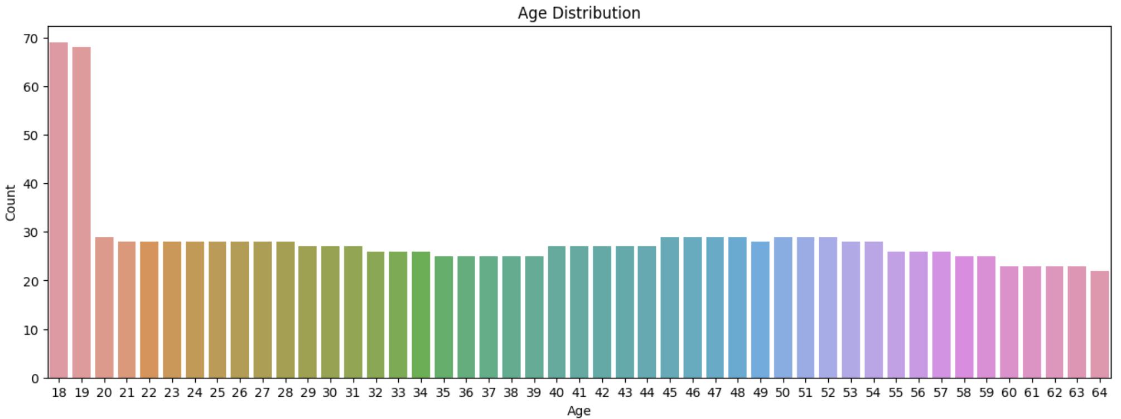
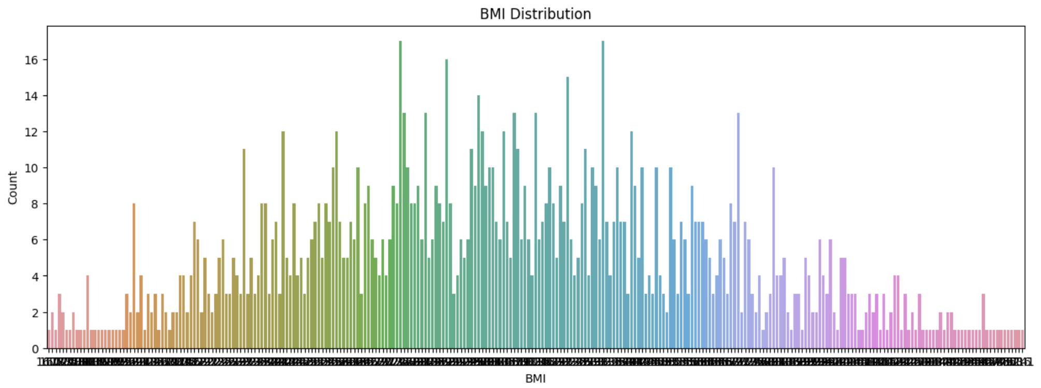
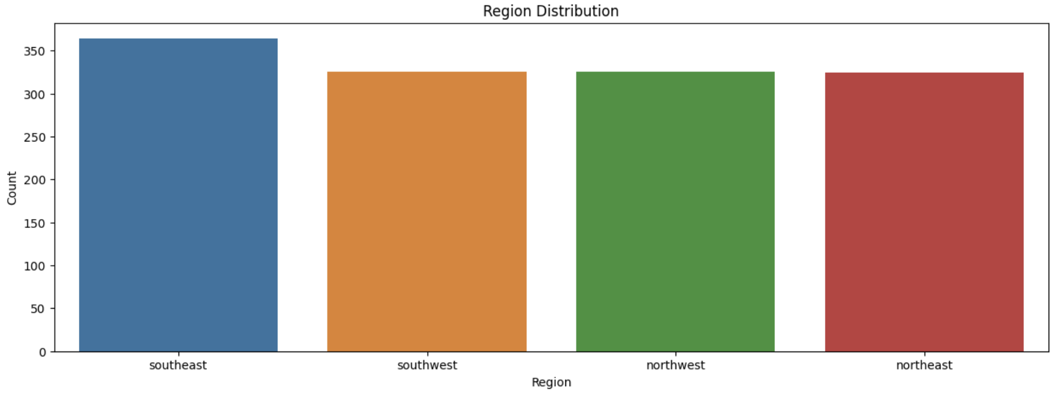
Data Visualization
Visualizing data for gaining insights and understanding patterns in the dataset.
Utilize visualizations to explore the distribution of various features in the dataset.
Use bar plots to visualize the distribution of categorical features such as age, sex, BMI, smoker status, etc.
Compare feature distributions between different genders, age groups, or regions to identify potential disparities.
Identify demographic or regional variations that may influence the target variable (e.g., medical expenses).

Slide 7
Model Selection
Polynomial Regression: polynomial Regression is a statistical model that estimates the probability of a binary outcome. It's selected for its simplicity and interpretability, making it suitable for predicting the likelihood of medical insurance claims or identifying individuals at risk of certain medical conditions based on their demographic and lifestyle factors.
Decision Tree: Decision Tree is a tree-like model used for classification and regression tasks. It's constructed by recursively splitting the dataset into subsets based on the most informative features (such as age, BMI, smoker status), creating a hierarchy of decisions.
Random Forest: Random Forest is an ensemble method that combines multiple Decision Trees. It's chosen for its ability to improve prediction accuracy and reduce overfitting, addressing the challenge of accurately estimating future medical costs for individuals with diverse demographic and lifestyle profiles.
KNN: K-Nearest Neighbors is a non-parametric algorithm used for both classification and regression tasks. It operates by assigning a data point to the majority class among its k nearest neighbors in the feature space. KNN is suitable for our project as it can capture local patterns and relationships in the data.

Slide 8
Polynomial Regression
we explore Polynomial Regression, a technique extending linear regression by introducing polynomial features. A results dictionary is initialized to store evaluation metrics for different polynomial degrees.
The build_and_evaluate_model function is defined to streamline the process of training polynomial regression models, making predictions, and computing key evaluation metrics such as R-squared, Mean Absolute Error (MAE), and Mean Squared Error (MSE). These metrics provide insights into the model's predictive performance.
The loop iterates over polynomial degrees from 1 to 4, creating polynomial regression models of varying complexities. Each model is then evaluated using the defined function, and the results are stored in the results dictionary for later analysis.
For each degree of polynomial regression, the evaluation metrics are printed, offering a clear understanding of how model performance evolves with increasing complexity. This step-by-step assessment aids in selecting an appropriate degree for the polynomial regression model.
The results dictionary is then outputted, summarizing the performance metrics for all polynomial regression models. This presentation style facilitates a concise overview of how different polynomial degrees impact the model's accuracy and reliability

Slide 9
Decision Tree
For Decision Tree model we explored how different settings for the maximum depth of a Decision Tree affect the accuracy of predictions. We keep track of these insights in a results dictionary.
For depths ranging from 1 to 9, we create separate Decision Tree models, each trained and tested on our datasets. The models are evaluated based on key metrics like R-squared, Mean Absolute Error (MAE), and Mean Squared Error (MSE).
The results are neatly organized in the dtree_results dictionary, allowing us to easily compare how changes in maximum depth impact the model's performance. This way, we can pinpoint the depth that gives us the best balance between model complexity and accurate predictions.
At the end of the loop, we present a straightforward summary for each depth, making it clear how the model performs under different settings. This helps in making an informed decision about choosing the right depth for our Decision Tree model during the presentation.

Slide 10
Random Forest
we explore Random Forest Regression, a robust machine learning technique. We create a Random Forest regressor with 100 trees, ensuring consistency by setting a fixed random state. The model is then trained on our data and used to make predictions on the test set.
To evaluate its performance, we calculate key metrics, including R-squared, Mean Absolute Error (MAE), and Mean Squared Error (MSE). These metrics provide a comprehensive view of how well the Random Forest model predicts outcomes.
The resulting metrics are stored in the rf_metrics dictionary and seamlessly integrated into our broader results collection, allowing for easy comparison with other regression models.
Our presentation of the results is straightforward and focused, emphasizing the essential metrics. By highlighting R-squared, MAE, and MSE, we convey a clear picture of the Random Forest Regression model's accuracy and precision.

Slide 11
K-Nearest Neighbors Regression
K-Nearest Neighbors (KNN) Regression as a predictive modeling technique. A KNN regressor is instantiated with a specified number of neighbors (in this case, 5) and trained on the provided training data (X_train and y_train). Predictions are then made on the test data (X_test), and key evaluation metrics are computed.
The evaluation metrics include R-squared, Mean Absolute Error (MAE), and Mean Squared Error (MSE). These metrics serve as crucial benchmarks for assessing the accuracy and performance of the KNN Regression model.
The calculated metrics are encapsulated in the knn_metrics dictionary, summarizing the model's effectiveness. This information is seamlessly integrated into the broader results dictionary, providing a consolidated record of various models' performance throughout the presentation.
The results are presented in a clear and concise manner for K-Nearest Neighbors Regression, emphasizing the predictive accuracy and overall effectiveness of the model. By specifically highlighting R-squared, MAE, and MSE, the audience gains insights into how well the model aligns with the actual values and the extent of prediction errors

Slide 12

Model Evaluation Metrics
R-squared (Coefficient of Determination): Measures the proportion of the variance in the dependent variable that is predictable from the independent variables. It indicates the goodness of fit of the model.
Mean Absolute Error (MAE): Measures the average absolute difference between the actual and predicted values. It provides a measure of the model's accuracy.
Mean Squared Error (MSE): Measures the average of the squares of the errors between the actual and predicted values. It penalizes larger errors more heavily than smaller ones.

Slide 13
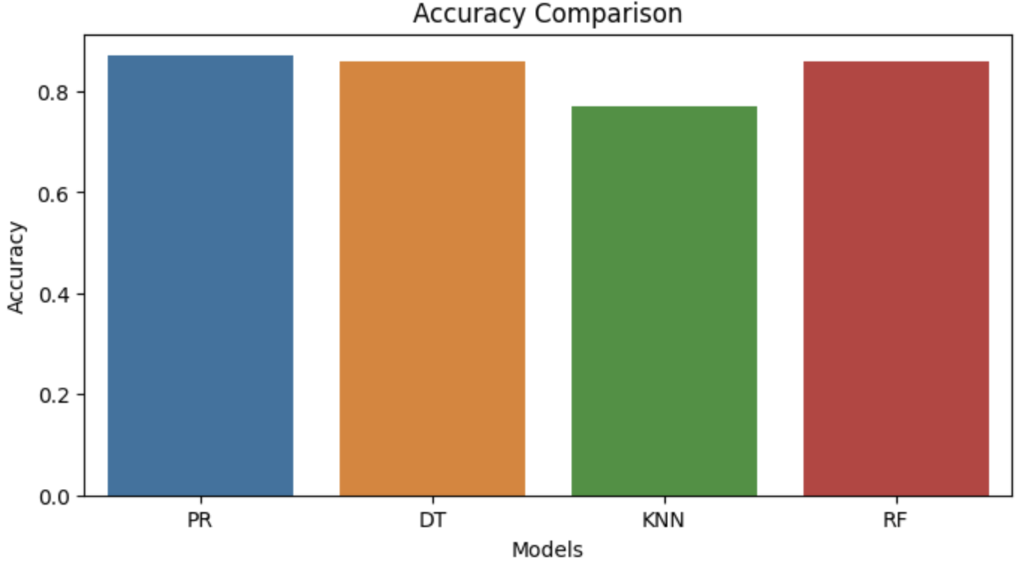
Model Comparision
Polynomial Regression: Achieved an R-squared value of 0.87, indicating a strong fit to the data.
Decision Tree: Attained an R-squared value of 0.86, indicating slightly lower performance compared to other models.
K-Nearest Neighbors: Achieved an R-squared value of 0.77, demonstrating competitive performance among the models.
Random Forest: Also achieved an R-squared value of 0.86, demonstrating comparable performance to Polynomial Regression.

Slide 14
Results
Polynomial Regression: Achieved an R-squared value of approximately 0.87. This model performed well in capturing the relationship between the predictor variables and the target variable. The polynomial features of degree 2 effectively captured the non-linear relationships present in the data, resulting in a high R-squared value.
Decision Tree Regression (Max Depth 4): Achieved an R-squared value of approximately 0.86.The decision tree model with a maximum depth of 4 demonstrated strong predictive performance. It effectively partitioned the feature space into segments based on the most informative features, resulting in accurate predictions.
K-Nearest Neighbors Regression: Achieved an R-squared value of approximately 0.77. While the KNN model performed reasonably well, it yielded a slightly lower R-squared value compared to the polynomial and decision tree models. This may indicate that the local patterns captured by KNN were not as predictive as the global patterns captured by other models.
Random Forest Regression: Achieved an R-squared value of approximately 0.86. The Random Forest model exhibited competitive performance, with a similar R-squared value to the polynomial regression and decision tree models. It leveraged the ensemble of decision trees to mitigate overfitting and improve prediction accuracy.

Slide 15

Conclusion
The project aimed to develop a regression model to estimate future medical costs for individuals based on their demographic and lifestyle factors.
Polynomial Regression (Degree 2) emerged as the top-performing model, achieving the highest R-squared value of approximately 0.87.
Further exploration could involve fine-tuning the models' hyperparameters to potentially enhance their performance.

Slide 16

THANK YOU

